Slide 1
16.317
Microprocessor Systems Design I
Instructor: Dr. Michael Geiger
Fall 2013
Lecture 25:
Exam 2 Review

Slide 2
Lecture outline
Announcements/reminders
  No class Monday 11/11
Today’s lecture: Exam 2 Review
  Exam stats
  Regrade requests: due in writing, 11/15
  Figuring out where you stand
  Exam solution
Microprocessors I: Exam 2 Review

Slide 3
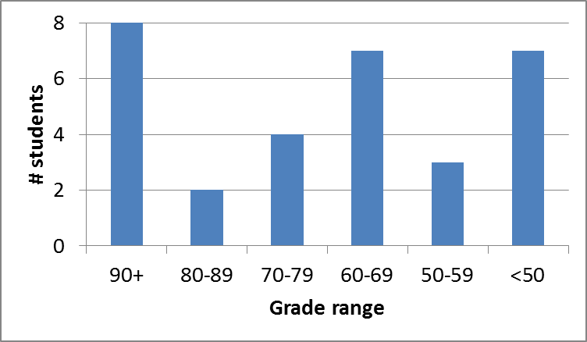
Exam stats & grade distribution
Question-by-question averages:
  Q1: 14.2 / 20 (71%)
  Q2: 25.4 / 40 (64%)
  Q3: 29.4 / 40 (73%)
Extra credit
  17 students
  7.8 / 10 average
Average: 69
Median: 68
Std. deviation: 20.1
Max: 99
Microprocessors I: Exam 2 Review

Slide 4
Figuring out where you stand
Homework: 55% (5/8 done; 4/8 graded)
Exams: 45% (15% + 15% + 15%)
~35% of your grade still to be determined
Estimating your grade
  Homework avg (HWA) =
  (total homework points) / 2
  Exam avg (EA) =
  ((Exam1) + (Exam2)) / 2
  Overall avg = HWA * 0.55 + EA * 0.45
Microprocessors I: Exam 2 Review

Slide 5
Figuring out where you stand
Estimated avg. = HWA * 0.55 + EA * 0.45
Current course averages
  Without extra credit: ~79%, SD ≈ 11.5
  With extra credit: ~80%, SD ≈ 12.4
Key points
  “Curve” would add at most ~1-2 points to those below mean
  Very possible there will be no grading curve
  Therefore, right now:
    Min grade for C-: 68
    Min grade for D: 56
    THESE NUMBERS WILL ALMOST CERTAINLY CHANGE BEFORE SEMESTER’S END—THESE FIGURES ARE JUST ROUGH ESTIMATES!!!!!
Microprocessors I: Exam 2 Review

Slide 6
Final notes
Next time:
  PIC introduction (on Wednesday, 11/13)
Reminders:
  No class Monday, 11/11
Microprocessors I: Exam 2 Review

