Slide 1
16.317
Microprocessor Systems Design I
Instructor: Dr. Michael Geiger
Fall 2013
Lecture 4:
x86 memory

Slide 2
Lecture outline
Announcements/reminders
  HW 1 due 9/16
  Sign up for the course discussion group on Piazza!
Review
  Memory issues: alignment and endianness
  Addressing modes
  x86 introduction
Today’s lecture: x86 memory
  Memory spaces
  Memory organization
  Memory addressing
Moment of silence at 8:45 AM to mark 12th anniversary of Sept. 11, 2001 attacks
Microprocessors I: Lecture 4

Slide 3
Review
Memory issues
  Aligned data: address divisible by number of bytes
  Endianness: 80x86 data is little endian
Addressing modes
  Register addressing → data in register
  Immediate addressing → data in instruction
  Memory addressing → data in memory
    Need effective address
    EA calculation
      Direct addressing → EA = constant
      Register indirect → EA = register value
      Base + displacement addressing → EA = constant + reg(s)
x86 overview
  Briefly discussed general purpose registers
  Memory organization
Microprocessors I: Lecture 4

Slide 4
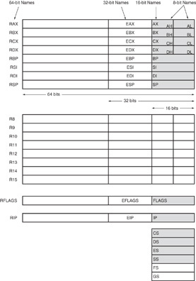
Review: x86 registers
Nine 32-bit registers
  (4) Data registers- EAX, EBX, ECX, EDX, can be used as 32, 16 or 8bit
  (2) Pointer registers- EBP, ESP
  (2) Index registers- ESI, EDI
  (1) Instruction pointer- EIP
Six 16-bit registers
  (6) Segment registers- CS, DS, SS, ES, FS, GS
Flags (status) register-EFLAGS
Microprocessors I: Lecture 4
Notes:
Chapter 2

Slide 5
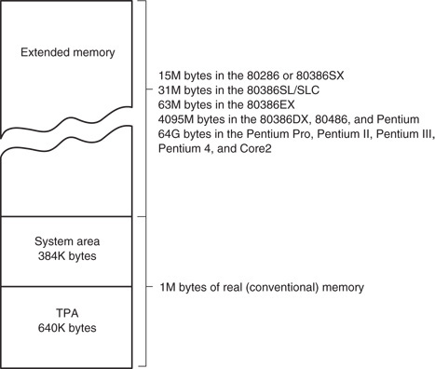
x86 memory spaces
x86 architecture implements independent memory and input/output (not shown) address spaces
Memory address space
  1 MB “real” memory
    System + transient program area (TPA)
  Extended memory size dependent on processor
Input/output address space- 65,536 bytes long (64KB)
Microprocessors I: Lecture 4
Notes:
Chapter 2

Slide 6
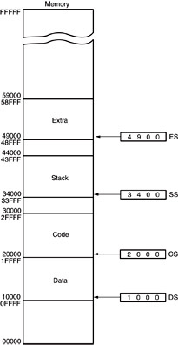
Memory segmentation
Only subset of address space is active (accessible)
Memory split into segments
  Active sections of memory
  Segments may overlap
  Segment size can be fixed (as in x86 real mode) or variable (as in protected mode)
Architecture requires register(s) to store start of active segment(s)
Microprocessors I: Lecture 4
Notes:
Chapter 2

Slide 7
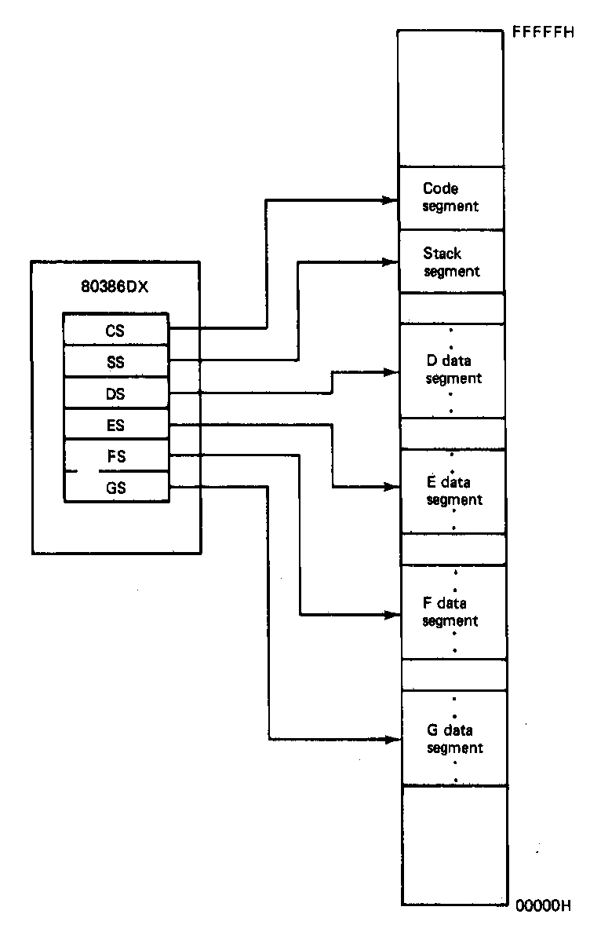
Segmentation in x86
Each real mode segment 64KB
Six programmer-controlled segment registers indicate start of each segment
Each segment must start on 16-byte boundary
  Valid starting addresses: 00000H, 00010H, 00020H, etc.
Total active memory: 384 KB
  64 KB code segment (CS)
  64 KB stack segment (SS)
  256 KB over 4 data segments (DS, ES, FS, GS)
Microprocessors I: Lecture 4
Notes:
Chapter 2

Slide 8
x86 memory addressing
Two pieces to address in segmented memory
  Starting address of segment
  Offset within segment
x86 real mode specifics
  All addresses are 20 bits
  Segment registers hold upper 16 bits of segment base address
    Where are the lower 4 bits of the base address?
      Always 0, since starting address must be divisible by 16
  Calculated effective address used as 16-bit offset
    Why is offset 16 bits?
      64KB = 2¹⁶ → 16 bit address needed to choose location within segment
Microprocessors I: Lecture 4

Slide 9
x86 memory addressing
Within instruction, address is combination of segment register/effective address
  Address of form SBA:EA
    SBA = segment base address
    EA = effective address
  EA based on addressing mode
  Address examples
    CS:IP → address of current instruction
    SS:SP → address of top of stack
    DS:0100H → address within current data segment with offset 0100H
Use this information to find linear address
  Program-generated location in memory space
Microprocessors I: Lecture 4

Slide 10
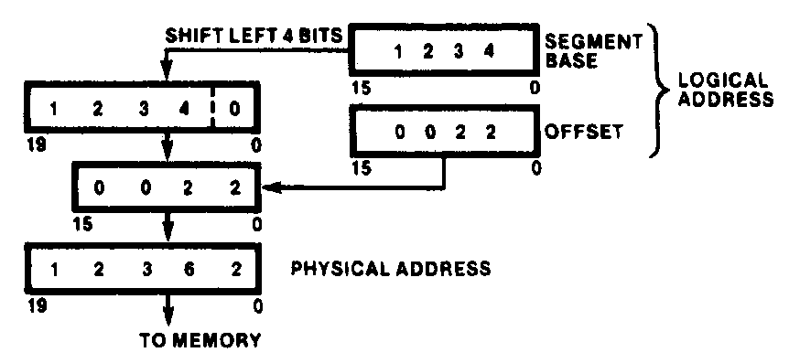
Generating Real-Mode Memory Address
  Segment base address = 1234H
  Offset = 0022H
  1234H = 0001001000110100₂
  0022H = 0000000000100010₂
  Shifting base address,
  00010010001101000000₂ = 12340H
  Adding binary segment address and offset
00010010001101000000₂ + 0000000000100010₂
= 00010010001101100010₂
    = 12362H
  In hex:
  12340H + 0022H = 12362H
Microprocessors I: Lecture 4
Notes:
Chapter 2

Slide 11
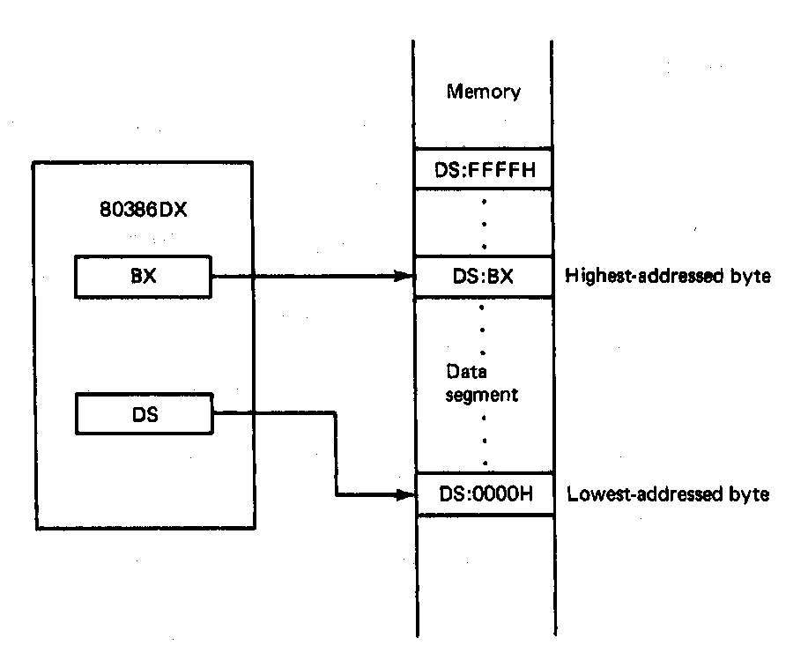
Boundaries of a Segment
Six active segments: CS, DS, ES. GS, FS, SS
  Each 64K-bytes in size → maximum of 384K-bytes of active memory
    64K-bytes for code
    64K-bytes for stack
    256K-bytes for data
Starting address of a data segment
DS:0H → lowest addressed byte
Ending address of a data segment
DS:FFFFH → highest addressed byte
Address of an element of data in a data segment
  DS:BX → address of a byte, word, or
  double word element of data in the
  data segment
Microprocessors I: Lecture 4
Notes:
Chapter 2

Slide 12
Address generation examples
Given the following register values:
  CS = 0x1000
  SS = 0x2000
  DS = 0x3000
  ES = 0x4000
  EIP = 0x00000100
  ESP = 0x0002FF00
  EBP = 0x0000F000
  ESI = 0x0001000E
  EBX = 0xABCD1234
What linear addresses correspond to the following logical addresses?
  CS:IP
  SS:SP
  SS:BP
  DS:SI
  ES:BX
Microprocessors I: Lecture 4

Slide 13
Example solutions
CS:IP
  CS << 4 = 0x10000
  Address = 0x10000 + 0x0100 = 0x10100
SS:SP
  SS << 4 = 0x20000
  SP = lower 16 bits of ESP = 0xFF00
  Address = 0x20000 + 0xFF00 = 0x2FF00
SS:BP
  SS << 4 = 0x20000
  BP = lower 16 bits of EBP = 0xF000
  Address = 0x20000 + 0xF000 = 0x2F000
Microprocessors I: Lecture 4

Slide 14
Example solutions (cont.)
DS:SI
  DS << 4 = 0x30000
  SI = lower 16 bits of ESI = 0x000E
  Address = 0x30000 + 0x000E = 0x3000E
ES:BX
  ES << 4 = 0x40000
  BX = lower 16 bits of EBX = 0x1234
  Address = 0x40000 + 0x1234 = 0x41234
Microprocessors I: Lecture 4

Slide 15
x86 memory operands
Addresses in x86 instructions enclosed by brackets
Most instructions don’t explicitly specify segment register
  DS is usually default
  Some instructions use SS, CS as default
Examples (using basic MOV instruction)
  MOV AX, [0100H] → move data from DS:100H to AX
  MOV AX, DS:[0100H] → same as above
  MOV AX, ES:[0100H] → move data from ES:100H to AX
In all examples above
  0100H is effective address
  Segment register is either DS or ES
Microprocessors I: Lecture 4

Slide 16
x86 addressing modes
All examples of general addressing modes discussed earlier
Direct addressing
  EA = constant value
  Example: MOV AX, [0100H]
Register indirect addressing
  EA = value stored in register
  SS default segment if BP, SP used; DS otherwise
  Example: MOV [DI], AX
Base-plus-index addressing
  EA = base register (BX/BP) + index register (SI/DI)
  Example: MOV AX, [BX+SI]
Microprocessors I: Lecture 4

Slide 17
x86 addressing modes (cont.)
Register relative addressing
  EA = register + constant
  Examples:
    MOV CL, [BX+4]
    MOV AX, ARRAY[BX] ARRAY is constant memory location
Base relative-plus-index addressing
  EA = base register + index register + constant
  Example: MOV AX, 10H[SI][BX] -or-
  MOV AX, [10H+SI+BX]
Scaled-index addressing
  EA = register + (scaling factor * second register)
  Often useful for array accesses
    Scaling factor = element size (2, 4, 8 bytes)
  Example: MOV EDX, [EAX + 4*EBX]
Microprocessors I: Lecture 4

Slide 18
Final notes
Next time:
  More on x86 memory
Reminders:
  HW 1 posted; due 9/16
  Sign up for the discussion group on Piazza
Microprocessors I: Lecture 4

