Slide 1
16.317
Microprocessor Systems Design I
Instructor: Dr. Michael Geiger
Fall 2014
Lecture 10:
Jump and loop instructions

Slide 2
Lecture outline
Announcements/reminders
  HW 2 due today
  Exam 1: Wednesday, October 1
    Allowed calculator, 1 double-sided 8.5” x 11” note sheet
    Instruction list to be provided
  No lecture Friday (in-class office hours)
Review
  Compare instructions
  CMOV
  Set on condition
Today’s lecture
  Jump instructions
  Loop instructions
Microprocessors I: Lecture 10

Slide 3
Review: compare
CMP D, S
  Flags show result of (D) – (S)
    Assumes signed computation
  ZF = 1 → D == S
  ZF = 0, (SF XOR OF) = 1 → D < S
  ZF = 0, (SF XOR OF) = 0 → D > S
Condition codes: mnemonics implying certain flag conditions
Microprocessors I: Lecture 10

Slide 4
Review: conditional instructions
Conditional move
  Move performed only if condition is true
SETcc D
  Sets single byte destination to 1 (01H) if condition true; all 0s (00H) if condition false
  Can be used to build up complex conditions
Microprocessors I: Lecture 10

Slide 5
Jump instructions
Used to change flow of program
  Next instruction specified by operand
Two general types
  Unconditional: JMP <target>
    Always goes to address indicated by <target>
  Conditional: Jcc <target>
    Jump only occurs if condition true
    cc replaced by valid condition code
      Most codes discussed in previous lecture
      Additional codes: CXZ/ECXZ
      → CX/ECX register is zero
Microprocessors I: Lecture 10

Slide 6
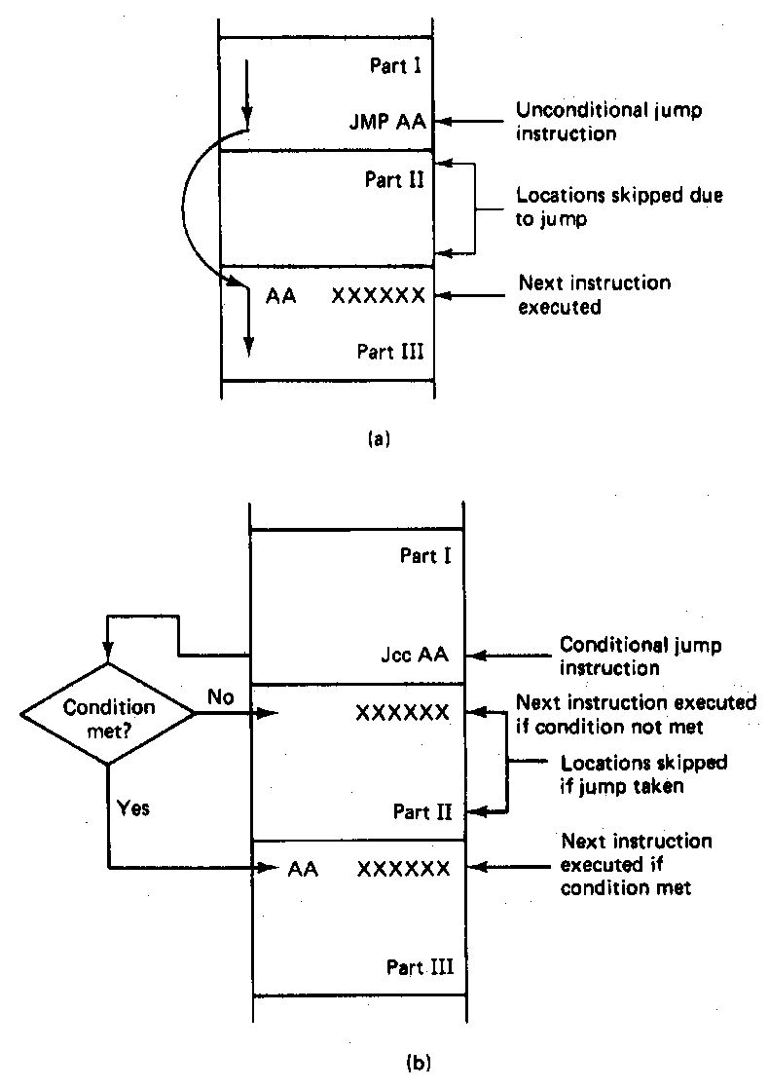
Jump Instructions
Microprocessors I: Lecture 10
Notes:
Chapter 6 part 1

Slide 7
Example: program structure 1
Given the instructions below, what are the resulting register values if:
  AX = 0010H, BX = 0010H
  AX = 1234H, BX = 4321H
What type of high-level program structure does this sequence demonstrate?
Instructions
  CMP AX, BX
  JE L1
  ADD AX, 1
  JMP L2
  L1: SUB AX, 1
  L2: MOV [100H], AX
Microprocessors I: Lecture 10

Slide 8
Example solution
First case: AX = BX = 0010H
  CMP AX, BX → Shows AX == BX
  JE L1 → Cond. true—jump to L1
  ADD AX, 1
  JMP L2
  L1: SUB AX, 1 → AX = AX – 1 = 000F
  L2: MOV [100H], AX → Store 000F at DS:100H
Microprocessors I: Lecture 10

Slide 9
Example solution (cont.)
Second case: AX = 1234H, BX = 4321H
  CMP AX, BX → Shows AX < BX
  JE L1 → Cond. false—no jump
  ADD AX, 1 → AX = AX + 1 = 1235H
  JMP L2
  L1: SUB AX, 1 → AX = AX – 1 = 000F
  L2: MOV [100H], AX → Store 000F at DS:100H
Microprocessors I: Lecture 10

Slide 10
Example solution (cont.)
High-level program structure: if/else statement
  If part: compare + jump (if (AX == BX))
  Else part: what follows if condition false
  Unconditional jump used to skip “if” part
  Both parts have same exit (L2)
Microprocessors I: Lecture 10

Slide 11
Example: program structure 2
Given the instructions below, what are the resulting register values if, initially, AX = 0001H?
What type of high-level program structure does this sequence demonstrate?
Instructions
  MOV CL, 5
  L: SHL AX, 1
  DEC CL
  JNZ L
Microprocessors I: Lecture 10

Slide 12
Example: program structure 3
Given the instructions below, what are the resulting register values if, initially, AX = 0001H?
What type of high-level program structure does this sequence demonstrate?
Instructions
  MOV CL, 5
  L: JCXZ END
  ADD AX, AX
  DEC CL
  JMP L
  END: MOV [10H], AX
Microprocessors I: Lecture 10

Slide 13
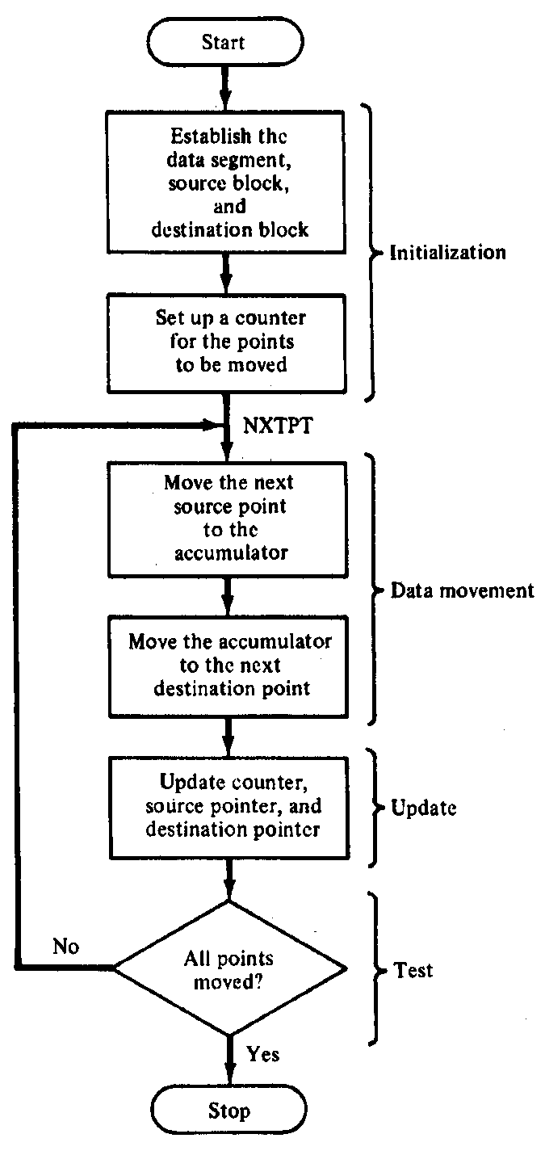
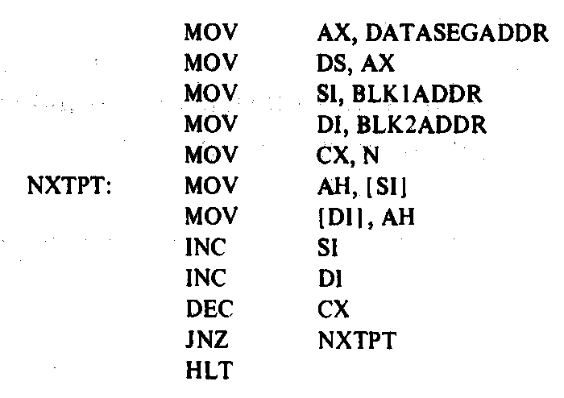
Block Move Program
Microprocessors I: Lecture 10
Notes:
Chapter 6 part 1

Slide 14
Loop instructions
Common operations in basic loops
  Compare
  Conditional jump
  Decrement loop counter (CX)
Loop instructions combine all into one op
  All decrement CX by 1, then check if CX == 0
  <target> must be short-label (8-bit immediate)
  LOOP <target>: Return to <target> if CX != 0
  LOOPE/LOOPZ <target>: Return to <target> if (CX != 0) && (ZF == 1)
  LOOPNE/LOOPNZ <target>: Return to <target> if (CX != 0) && (ZF != 1)
Microprocessors I: Lecture 10

Slide 15
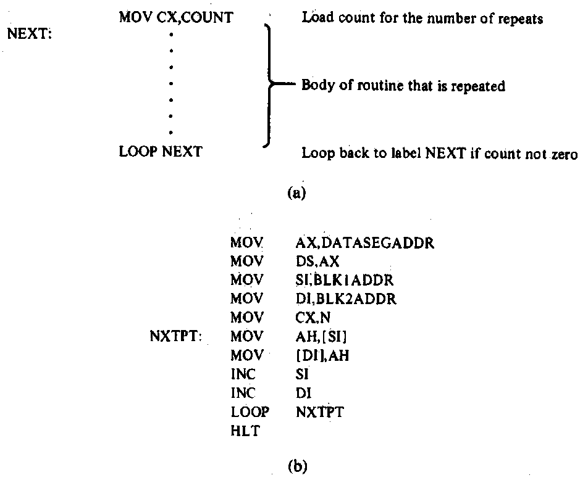
Loop Program Structure
Structure of a loop
  CX = initial count
  Loop body: code to be repeated
  Loop instruction– determines if loop is complete or if the body is to repeat
Example: block move
Microprocessors I: Lecture 10
Notes:
Chapter 6 part 2

Slide 16
Loop example 1
Rewrite the post-tested loop seen earlier using a loop instruction:
  MOV CL, 5
  L: SHL AX, 1
  DEC CL
  JNZ L
Solution:
  MOV CL, 5
  L: SHL AX, 1
  LOOP L
Microprocessors I: Lecture 10

Slide 17
Loop example 2
Describe the operation of the following program (Example 6.15-6.16).
What is the final value of ESI if the 15 bytes between 0A001 and 0A00F have the following values?
  00 01 02 03 04 05 06 07 08 09 0A 0B 0C 0D 0E
MOV DL, 05
MOV EAX, 0000A000h
MOV ESI, 00000000h
MOV CX, 000F
AGAIN:INC SI
CMP [EAX + ESI], DL
LOOPNE AGAIN
Microprocessors I: Lecture 10

Slide 18
Final notes
Next time:
  No lecture Friday (in-class office hours)
  Exam 1 Preview on Monday
Reminders:
  HW 2 due today
  Exam 1: Wednesday, October 1
    Allowed calculator, 1 double-sided 8.5” x 11” note sheet
    Instruction list to be provided
Microprocessors I: Lecture 10

