Slide 1
16.317
Microprocessor Systems Design I
Instructor: Dr. Michael Geiger
Fall 2014
Lecture 2:
Data storage and addressing

Slide 2
Lecture outline
Announcements/reminders
  Sign up for the course discussion group on Piazza
Today’s lecture
  Review: instruction set architecture
  Data types
  Data storage
  Addressing modes
Microprocessors I: Lecture 2

Slide 3
Review: instruction set architecture
Defines how programmer interfaces with hardware
Operations generally fall into one of four groups
  Data transfer: move data across storage locations
  Arithmetic: add, subtract, etc.
  Logical: AND, OR, shifts, etc.
  Program control: jumps/branches/calls
Operands: the data being operated on
  How are the bits interpreted? (int, FP, signed/unsigned)
  What size are they? (byte, word, etc.)
  How do we reference operands?
Instruction formats: how instructions are encoded
Microprocessors I: Lecture 2

Slide 4
Data types
Also seen in high-level languages
  Think about C types: int, double, char, etc.
  What does a data type specify?
    How big is each piece of data?
    How do we interpret the bits representing those data?
Data sizes
  Smallest addressable unit: byte (8 bits)
  Can also deal with multi-byte data: 16, 32, 64 bits
  Often deal with words of data
    Word size processor-dependent (16 bits on x86, 32 bits on MIPS)
    Can have double words, quad words, half words …
Interpreting bits
  Numbers: Integers, floating-point; signed vs. unsigned
  May treat as characters, other special formats
Microprocessors I: Lecture 2

Slide 5
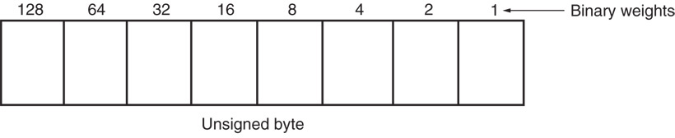
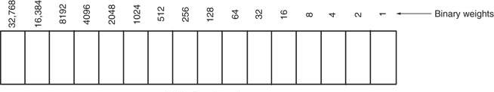
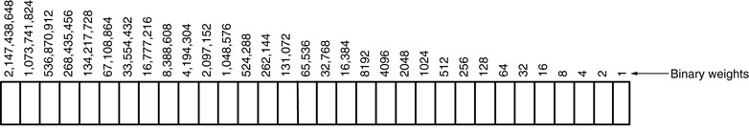
Unsigned Integers
Types:
Sizes Range
8-bit 0H → 255₁₀
16-bit 0H → 65,535₁₀
32-bit 0H → 4,294,967,295₁₀
Microprocessors I: Lecture 2
Notes:
Chapter 2

Slide 6
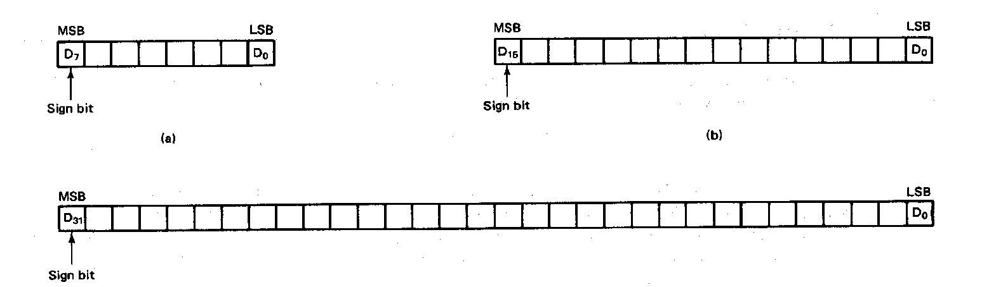
Signed Integers
MSB is sign bit ( 0/1 -> +/-)
Remaining bits represent value
Negative numbers expressed in 2’s complement notation
Types:
Sizes Range
8-bit -128 → +127
16-bit -32,768 → +32,767
32-bit -2,147,483,648 → +2,147,483,647
Microprocessors I: Lecture 2
Notes:
Chapter 2

Slide 7
Integer Examples
Given the 8-bit value: 1001 1111₂
Calculate the decimal value of this integer as
  An unsigned integer
  A signed integer
Microprocessors I: Lecture 2
Notes:
Chapter 2

Slide 8
Integer example solution
Given the 8-bit value: 1001 1111₂
Calculate the decimal value of this integer as
  An unsigned integer
  Solution:
    (1 x 2⁷) + (1 x 2⁴) + (1 x 2³) + (1 x 2²) + (1 x 2¹) + (1 x 2⁰)
    = 128 + 16 + 8 + 4 + 2 + 1 = 159
  A signed integer
  Solution:
    MSB = 1 → negative value
    To get magnitude, take 2’s complement:
    0110 0001₂ = (1 x 2⁶) + (1 x 2⁵) + (1 x 2⁰)
    = 64 + 32 + 1 = 97
    → Result = -97
Microprocessors I: Lecture 2

Slide 9
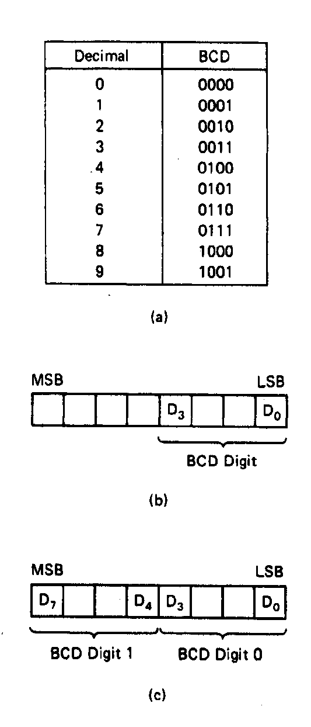
BCD Numbers
Direct coding of numbers as binary coded decimal (BCD) numbers supported
Unpacked BCD [Fig.2.10(b)]
  Lower four bits contain a digit of a BCD number
  Upper four bits filled with zeros (zero filled)
Packed BCD [Fig. 2.10(c)]
  Lower significant BCD digit held in lower 4 bits of byte
  More significant BCD digit held in upper 4 bits of byte
Example: Packed BCD byte at address 01000H is 10010001₂, what is the decimal number?
Organizing as BCD digits gives,
1001_{BCD} 0001_{BCD} = 91₁₀
Microprocessors I: Lecture 2
Notes:
Chapter 2

Slide 10
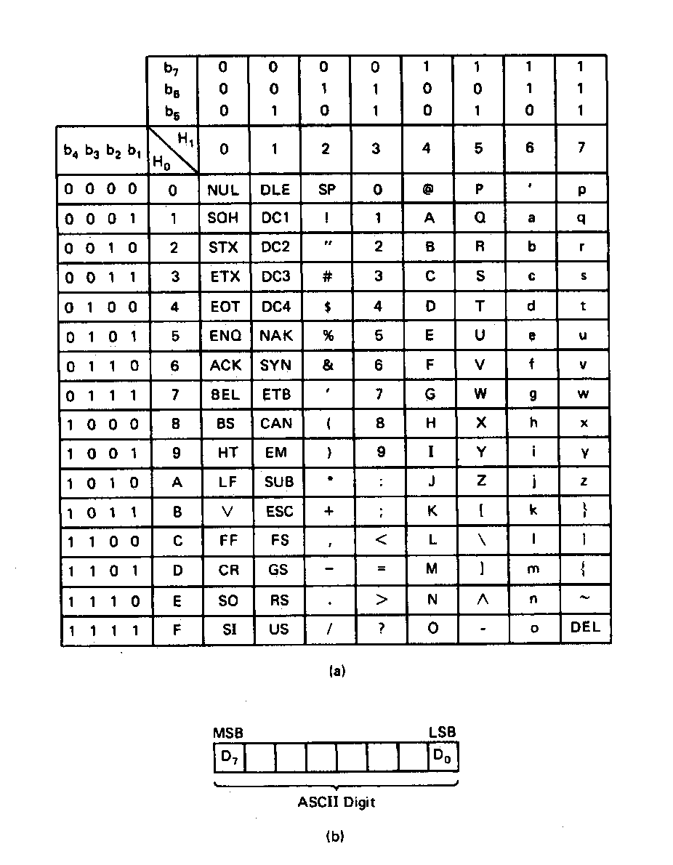
ASCII Data
American Code for Information Interchange (ASCII) code
ASCII information storage in memory
  Coded one character per byte
  7 LS-bits = b₇b₆b₅b₄b₃b₂b₁
  MS-bit filled with 0
Example: Addresses 01100H-01104H contain ASCII coded data 01000001, 01010011, 01000011, 01001001, and 01001001, respectively. What does the data stand for?
0 100 0001_{ASCII} = A
0 101 0011_{ASCI} = S
0 100 0011_{ASCII} = C
0 100 1001_{ASCII} = I
0 100 1001_{ASCII} = I
Microprocessors I: Lecture 2
Notes:
Chapter 2

Slide 11
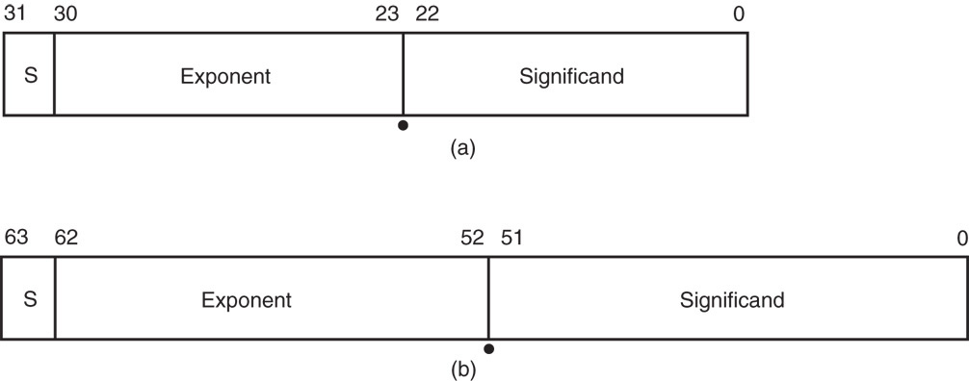
Real Numbers
Floating-point data stored in two parts
  Significand (fraction)
  Exponent
Single-precision (32 bits) or double-precision (64 bits)
Microprocessors I: Lecture 2

Slide 12
Data storage
What characteristics do we want storage media to have?
Two primary answers
  Speed
  Capacity
  Very difficult to get both in single storage unit
Processors use two different types of storage
  Registers
  Memory
Microprocessors I: Lecture 2

Slide 13
Registers
Small, fast set of storage locations close to processor
Primarily used for computation, short-term storage
  Speed → ideal for individual operations
  Lack of capacity → will frequently overwrite
Reference registers by name
  Example: ADD EAX, EBX → EAX = EAX + EBX
  EAX, EBX are registers in x86 architecture
Microprocessors I: Lecture 2

Slide 14
Memory
Provides enough capacity for all code, data (possibly I/O as well)
Typically organized as hierarchy
Used primarily for long-term storage
  Lacks speed of registers
  Provides capacity to ensure data not overwritten
Reference memory by address
  Example: MOV EAX, DS:[100H]
  → EAX = memory at address DS:[100H]
Microprocessors I: Lecture 2

Slide 15
Memory (continued)
Accessing single byte is easy
Considerations with multi-byte data
  Are the data aligned?
    Easier/faster to access aligned data
  How are the data organized in memory (“endianness”)?
    Given 32-bit number: DEADBEEFH or 0xDEADBEEF
    Which byte—MSB (0xDE) or LSB (0xEF) gets stored in memory first?
Microprocessors I: Lecture 2

Slide 16
Aligned Words, Double words
Aligned word
Aligned data: address is divisible by # of bytes
  2 bytes → address must be even
  4 bytes → address must be multiple of 4
x86 architecture doesn’t require aligned data access
  Performance impact for accessing unaligned data in memory (32-bit data bus)
Byte address
0
4
8
12
16
20
Aligned double word
Unaligned
word
Unaligned
double
word
Microprocessors I: Lecture 2
Notes:
Chapter 2

Slide 17
Byte order (“endianness”)
In a multi-byte operand, how are the bytes ordered in memory?
Assume the double word value 1,000,000 (0x000F4240) is stored at address 80
  In a little-endian ISA (like x86), the least significant byte (the “little” end) is at address 80
  In a big-endian ISA (like MIPS), it’s the other way around
 |  | 40 | 42 | 0F | 00
… | 79 | 80 | 81 | 82 | 83 | 84 | …
 |  | 00 | 0F | 42 | 40
… | 79 | 80 | 81 | 82 | 83 | 84 | …
Computer Architecture Lecture 1

Slide 18
Examples
Given the following memory contents:
  Starting address of each line shown on left
  Leftmost byte has lowest address
    First line: addresses 0x200C, 0x200D, 0x200E, 0x200F
What is the value of:
  The word starting at address 0x200D?
  The double word starting at address 0x2012?
Are these data aligned?
 | Lo |  |  | Hi
0x200C | 40 | 96 | 2C | 00
0x2010 | 55 | 12 | CD | AB
0x2014 | 01 | 23 | 88 | 99
Microprocessors I: Lecture 2

Slide 19
Solution
 | Lo |  |  | Hi
0x200C | 40 | 96 | 2C | 00
0x2010 | 55 | 12 | CD | AB
0x2014 | 01 | 23 | 88 | 99
Word at 0x200D = 0x2C96
  Address is not divisible by 2 → unaligned
Double word at 0x2012 = 0x0123ABCD
  Address is not divisible by 4 → unaligned
    Remember, hexadecimal is base 16—0x12 = 18₁₀
Microprocessors I: Lecture 2

Slide 20
Final notes
Next time:
  x86 introduction
Reminders:
  Sign up for the discussion group on Piazza
Microprocessors I: Lecture 2

