Slide 1
16.317
Microprocessor Systems Design I
Instructor: Dr. Michael Geiger
Spring 2014
Lecture 9:
Conditional execution

Slide 2
Lecture outline
Announcements/reminders
  HW 2 due 9/24
Review
  Rotate instructions
  Bit test instructions
  Bit scan instructions
Today’s lecture
  Conditional execution
Microprocessors I: Lecture 9

Slide 3
Review: rotate instructions
Rotate instructions: bits that are shifted out one side are shifted back in other side
  ROL <src>, <amt> or ROR <src>, <amt>
  CF = last bit rotated
Rotate through carry instructions
  CF acts as “extra” bit that is part of value being rotated
  RCL <src>, <amt> or RCR <src>, <amt>
Microprocessors I: Lecture 9

Slide 4
Review: bit test/scan
Bit test instructions
  Check state of bit and store in CF
  Basic test (BT) leaves bit unchanged
  Can also set (BTS), clear (BTR), or complement bit (BTC)
Bit scan instructions
  Find first non-zero bit and store index in dest.
  Set ZF = 1 if source non-zero; ZF = 0 if source == 0
  BSF: scan right to left (LSB to MSB)
  BSR: scan left to right (MSB to LSB)
Microprocessors I: Lecture 9

Slide 5
Compare Instructions
Compare 2 values; store result in ZF/SF
General format: CMP D,S
  Works by performing subtraction (D) – (S)
    D, S unchanged
  ZF/SF/OF indicate result (signed values)
    ZF = 1 → D == S
    ZF = 0, (SF XOR OF) = 1 → D < S
    ZF = 0, (SF XOR OF) = 0 → D > S
Microprocessors I: Lecture 9
Notes:
Chapter 6 part 1
(D) (S) result CF SF AF
AX BX
2345>1234 0 0 0
1234<2345 1 1 1
1234>ABCD 1 0 1
ABCD<1234 0 1 0
ABCD>A000 0 0 0
A000<ABCD 1 1 1
7FFF 8000 overflow

Slide 6
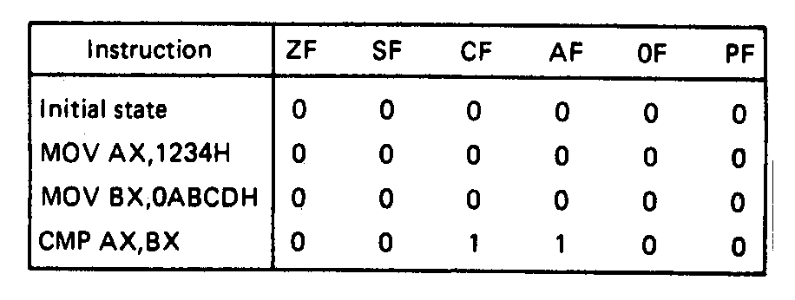
Compare Instructions- Example
Example—Initialization of internal registers with immediate data and compare. Example:
    MOV AX,1234H ;Initialize AX
    MOV BX,ABCDH ;Initialize BX
    CMP AX,BX ;Compare AX-BX
  Data registers AX and BX initialized from immediate data
  IMM16 → (AX) = 1234H → + integer
  IMM16 → (BX) = ABCDH → - integer
  Compare computation performed as:
  (AX) = 0001001000110100₂ (BX) = 1010101111001101₂
(AX) – (BX) = 0001001000110100₂ - 1010101111001101₂
  ZF = 0 = NZ
  SF = 0 = PL ;treats as signed numbers
  CF = 1 = CY
  AF = 1 = AC
  OF = 0 = NV
  PF = 0 = PO
Microprocessors I: Lecture 9
Notes:
Chapter 6 part 1

Slide 7
Condition codes
Conditional execution: result depends on value of flag bit(s)
Intel instructions specify condition codes
  Condition code implies certain flag values
  Opcodes written with cc as part of name
  cc can be replaced by any valid code
  Examples: CMOVcc, SETcc, Jcc
    Specific examples: CMOVE, SETL, SETZ, JNE, JG
Microprocessors I: Lecture 9

Slide 8
Condition codes (cont.)
Testing overflow
  O (OF = 1), NO (OF =0)
Testing carry flag
  C (CF = 1)
  NC (CF = 0)
Testing sign flag
  S (SF = 1), NS (SF = 0)
Testing parity flag
  P or PE (PF = 1)
  NP or PO (PF = 0)
Microprocessors I: Lecture 9

Slide 9
Condition codes (cont.)
Testing equality/zero result
  E or Z (ZF = 1)
  NE or NZ (ZF = 0)
Signed comparison
  L or NGE (SF XOR OF = 1)
  NL or GE (SF XOR OF = 0)
  LE or NG ((SF XOR OF) OR ZF = 1)
  NLE or G ((SF XOR OF) OR ZF = 0)
Unsigned comparison
  “Below” → less than, “above” → greater than
  B, NAE (CF = 1)
  NB, AE (CF = 0)
  BE or NA (CF OR ZF = 1)
  NBE or A (CF OR ZF = 0)
Microprocessors I: Lecture 9

Slide 10
Conditional move (CMOV)
Only in Pentium Pro & later
Perform move only if condition is true
Examples:
  CMOVZ AX, [SI] → move if ZF == 1
  CMOVG EBX, EAX → move if greater than
Microprocessors I: Lecture 9

Slide 11
Byte Set on Condition Instruction
Byte set on condition instruction
  Used to set byte based on condition code
  Can be used for boolean results—complex conditions
  General format:
    SETcc D
    cc = one of the supported conditional relationships
  Result
    D = 01h if condition true
    D = 00h if condition false
Microprocessors I: Lecture 9
Notes:
Chapter 6 part 1

Slide 12
Byte Set on Condition Instruction
Operation: Flags tested for conditions defined by “cc” and the destination in a register or memory updated as follows
If cc test True:
  00000001₂ = 01H → D
  If cc test False:
  00000000₂ = 00H → D
Examples of conditional tests:
SETE = set byte if equal → ZF = 1
SETC = set byte if carry → CF =1
SETBE = set byte if below or equal → CF = 1 +(or) ZF = 1
Example: SETA AL = set byte if above
  if CF = 0 • (and) ZF = 0
  (AL) = 01H
  Otherwise,
  (AL) =00H
Microprocessors I: Lecture 9
Notes:
Chapter 6 part 1

Slide 13
Example
Show the results of the following instructions, assuming that
  “A” = (100H) = 0001H
  “B” = (102H) = 0003H
  “C” = (104H) = 1011H
  “D” = (106H) = 1011H
  “E” = (108H) = ABCDH
  “F” = (10AH) = DCBAH
What complex condition does this sequence test?
MOV AX, [100H]
CMP AX, [102H]
SETLE BL
MOV AX, [104H]
CMP AX, [106H]
SETE BH
AND BL, BH
MOV AX, [108H]
CMP AX, [10AH]
SETNE BH
OR BL, BH
Microprocessors I: Lecture 9

Slide 14
Example solution
Condition being tested:
  To simplify, treat each word as a variable named “A” through “F”
  ((A <= B) && (C == D)) || (E != F)
Source: http://www.arl.wustl.edu/~lockwood/class/cs306/books/artofasm/Chapter_6/CH06-4.html
Microprocessors I: Lecture 9

Slide 15
Final notes
Next time:
  Continue with conditional execution
Reminders:
  HW 2 due 9/24
Microprocessors I: Lecture 9

