Slide 1
16.317: Microprocessor System Design I
Instructor: Dr. Michael Geiger
Spring 2012
Lecture 13: Exam 1 Preview
Notes:
Chapter 2

Slide 2
Lecture outline
Announcements/reminders
  HW 2 solution to be posted later today
  Lab 1 report due 2/29
    Must have work checked off
    Amanda’s OH: M/W 2:30-5, Tuesday 5-7 in Ball 407
  Exam 1: Friday, 2/24
Today: Exam 1 Preview
  General exam info
  Topics covered
    Basic processor architecture/software model
    Data organization/alignment
    Data types
    Memory accesses
    Stack, I/O
    Assembly language
Microprocessors I: Exam 1 Preview

Slide 3
Exam 1 notes
Allowed
  One 8.5” x 11” double-sided sheet of notes
  Calculator
No other notes or electronic devices (phone, laptop, etc.)
Exam will last 50 minutes
Covers all lectures through last Friday
  You will not be tested on lecture 1
  (basic intro)
  Material starts with processor architecture
Microprocessors I: Exam 1 Preview

Slide 4
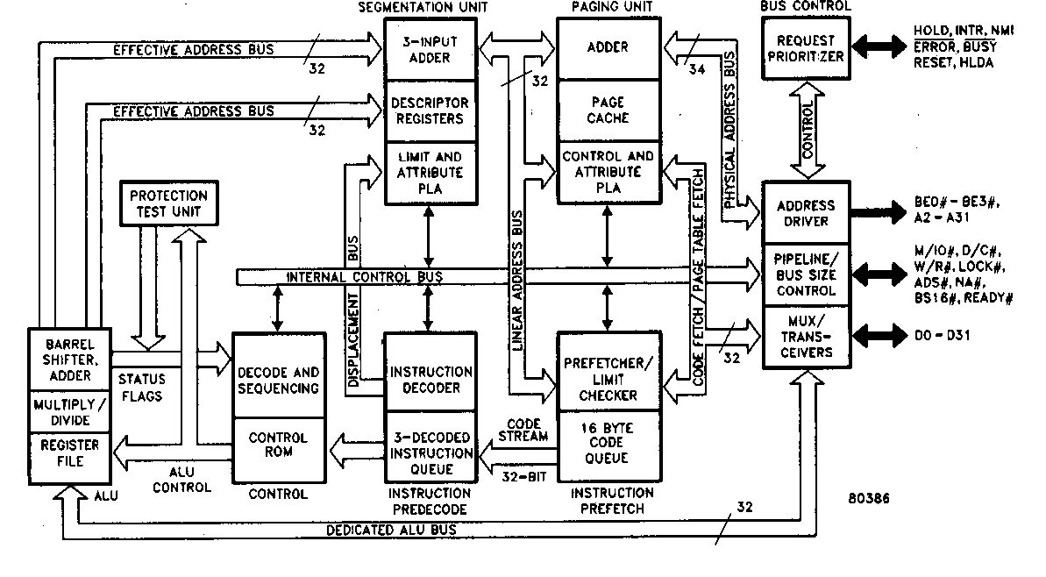
Review: Processor architecture
High level hardware view
80386: six functional units:
  Bus units
  Execution unit
  Segment unit
  Page unit
  Prefetch unit
  Decode unit
Microprocessors I: Exam 1 Preview
Notes:
Chapter 2

Slide 5
Review: Software Model
Programmer’s understanding the operation of the microcomputer from a software point of view
Elements of the software model
  How much data is available?
    # registers; size of address space
  Where is data stored?
    Registers
    Memory
    I/O address space
  How is data used?
    Data vs. addresses vs. flags
    Different data sizes, formats
  What operations can be performed?
Microprocessors I: Exam 1 Preview
Notes:
Chapter 2

Slide 6
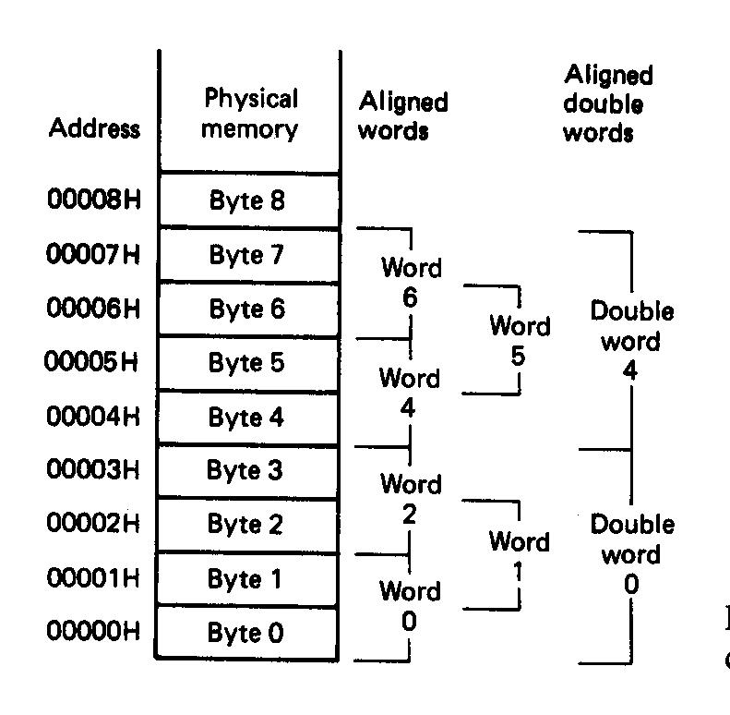
Review: Data in memory
Aligned data
  Words (16 bits) must start at even address
  Double words (32 bits) must start at address divisible by 4
  Performance penalty for accessing unaligned data
Multi-byte data stored using little endian format
  LSB has lowest address
  MSB has highest address
Microprocessors I: Exam 1 Preview
Notes:
Chapter 2

Slide 7
Review: data types, segmentation, registers
Data types
  Byte/word/double word
  Signed/unsigned integers
  BCD
  ASCII characters
Memory segmentation
  Segment registers (CS, SS, DS, ES, FS, GS) indicate start of 64KB segment
  Can change registers to switch segments
Registers
  General purpose data: A, B, C, D
    Access as byte (AH/AL), word (AX), double word (EAX)
  Pointer: SP (ESP), BP (EBP)
  Index: SI (ESI), DI (EDI)
  Flags register: status flags, control flags
Microprocessors I: Exam 1 Preview

Slide 8
Review: address calculations
Logical vs. physical addresses (in 386)
  Logical address: base/offset register pair
    i.e. CS:IP, DS:SI, SS:SP
  Physical address: actual address in memory
    In 386, calculate by shifting base left by 4 bits, adding offset
    Example: CS = 0x1000 and IP = 0x1234
    → Physical addr. = 0x10000 + 0x1234 = 0x11234
  Can have multiple logical addresses mapping to same physical address: aliases
Microprocessors I: Exam 1 Preview

Slide 9
Review: stack, I/O
Stack
  Stores data related to function calls
    Saved processor state
    Return address
    Function variables
  Grows from high to low addresses
  Stack accesses
    Push → add data to stack, decrement SP
    Pop → remove data from stack, increment SP
I/O address space
  Dedicated I/O in 386
  Can access byte, word, or double word ports
Microprocessors I: Exam 1 Preview

Slide 10
Review: Addressing modes
Addressing modes: how data is specified
  Register: MOV AX, BX
  Immediate: MOV AX, 1234H
  Memory
    Direct: MOV AX, [1010H]
      EA = 1010H
    Register indirect: MOV AX, [SI]
      EA = contents of SI
    Based: MOV AX, [BX + 1234H]
      EA = (contents of BX) + 1234H
    Indexed: MOV AX, [SI + 1234H]
      EA = (contents of SI) + 1234H
    Based-indexed: MOV AX, [BX + SI + 1234H]
      EA = (contents of BX) + (contents of SI) + 1234H
Microprocessors I: Exam 1 Preview

Slide 11
Review: instruction classes
Assembly/machine code: several different instruction classes
  Data Transfer instructions
  Input/output instructions
  Arithmetic instructions
  Logic instructions
  String Instructions
  Control transfer instructions
  Processor control
Microprocessors I: Exam 1 Preview

Slide 12
Review: Data transfer instructions
MOV: basic data transfer
  Can use registers, memory, immediates
  If segment reg. is destination, source must be register
MOVSX/MOVZX
  Sign-extend or zero-extend register/memory value
  Moving byte from memory: BYTE POINTER
XCHG
  Exchange contents of source, dest
LEA: load effective address
  Calculate EA/store in register
Load full pointer (LDS/LES/LFS/LGS/LSS)
  Load dest & segment register from memory
Microprocessors I: Exam 1 Preview

Slide 13
Review: Flags
Arithmetic instructions set flags
  Carry flag (CF): carry out of MSB
  Auxiliary carry flag (AF): carry out from lowest nibble (4 bit quantity) to next-lowest nibble
    Used with BCD, ASCII math—we won’t cover
  Sign flag (SF): matches sign bit (MSB) of result
  Zero flag (ZF): flag is 1 if result is 0
  Parity flag (PF): flag is 1 if result has even parity
  Overflow flag (OF): flag is 1 if result out of range
Microprocessors I: Exam 1 Preview

Slide 14
Review: add/subtract
Addition instructions
  ADD AX,BX → AX = AX + BX
  ADC AX,BX → AX = AX + BX + CF
  INC AX → AX = AX + 1
Subtraction instructions
  SUB AX,BX → AX = AX – BX
  SBB AX,BX → AX = AX – BX – CF
  DEC AX → AX = AX – 1
  NEG AX → AX = -AX = 0 - AX
Microprocessors I: Exam 1 Preview

Slide 15
Review: multiply/divide/logical
Multiplication instructions
  MUL (unsigned), IMUL (signed)
  Result uses 2x bits of source
  Source usually implied (AL/AX/EAX)
Division instructions
  DIV (unsigned), IDIV (signed)
  Implied source (AX, (DX,AX), (EDX,EAX)) 2x bits of specified source
  Quotient/remainder split across result
Convert instructions (CBW, CWD, CWDE, CDQ)
Logical instructions (AND/OR/XOR/NOT)
Microprocessors I: Exam 1 Preview

Slide 16
Review: shift instructions
Basic shift instructions
  Move value by <amt> bits; add 0s to left or right
  CF = last bit shifted out
  SHL <src>, <amt>: Move <src> to left
    SAL exactly the same
  SHR <src>, <amt>: Move <src> to right
Arithmetic right shift
  Move value right by <amt> bits
  Copy sign bit to fill remaining bits
  CF = last bit shifted out
  SAR <src>, <amt>
Microprocessors I: Exam 1 Preview

Slide 17
Review: rotate instructions
Rotate instructions: bits that are shifted out one side are shifted back in other side
  ROL <src>, <amt> or ROR <src>, <amt>
  CF = last bit rotated
Rotate through carry instructions
  CF acts as “extra” bit that is part of value being rotated
  RCL <src>, <amt>
Microprocessors I: Exam 1 Preview

Slide 18
Next time
Exam 1
  Remember, only 1 note sheet, calculator (no cell phones as calculators)
  Please be on time!
Microprocessors I: Exam 1 Preview

