Slide 1
16.317: Microprocessor System Design I
Instructor: Dr. Michael Geiger
Spring 2012
Lecture 15: Bit test/scan, flag control instructions
Notes:
Chapter 2

Slide 2
Lecture outline
Announcements/reminders
  Lab 1 report due today
  Amanda’s OH: M/W 2:30-5, Tuesday 5-7 in Ball 407
  Exam 1 regrades due Monday, 3/5
    In writing; must show understanding of problem
Lecture outline
  Today
    Bit test and scan instructions
    Flag control instructions
  Early feedback form
Microprocessors I: Lecture 15

Slide 3
Bit Test Instructions
BT → Bit test
BTR → Bit test and reset
BTS → Bit test and set
BTC → Bit test and complement
Format of bit test instruction: BT(x) D,S
  (S) → index that selects the position of the bit tested
  (D) → Holds value tested
Operation:
  Enables programmer to test bit in a value in register or memory
  All → Save the value of the selected bit in the CF
  BT → Leaves selected bit unchanged
  BTR → Clears the bit (bit = 0)
  BTS → Sets the bit (bit = 1)
  BTC → Complements the bit (bit = ~bit)
Microprocessors I: Lecture 15
Notes:
Chapter 5 part 2

Slide 4
Bit Test Instructions
Example:
  BTC BX,7
Before execution
  (BX) = 03F0H = 0000 0011 1111 0000₂
  IMM8 = 7
After Execution
  (CF) = 1
  (BX) = 0370H = 0000 0011 0111 0000₂
Microprocessors I: Lecture 15
Notes:
Chapter 5 part 2

Slide 5
Bit Scan Instructions
BSF → Bit scan forward
BSR → Bit scan reverse
Format of bit scan instructions: BS(x) D,S
  (S) → Holds value for which bits are tested to be 0
  (D) → Index of first bit that tests as non-zero
Operation:
  Enable the programmer to test a value in a register or memory location to determine if all of its bits are 0
  BSF → Scans bits starting from bit 0
    Set ZF = 0 if all bits are found to be zero
    Sets ZF = 1 when first 1 bit detected and places index of that bit into destination
  BSR → Scans bits starting from MSB
    Set ZF = 0 if all bits are found to be zero
    Sets ZF = 1 when first 1 bit detected and places index of that bit into destination
Example:
  BSF ESI,EDX → 32-bits of EDX scanned starting from B₀
  If EDX = 00000000 → ZF = 0 (all bits zero)
  If EDX = 00000001 → ESI = 00000000, ZF = 1 (bit 0 is 1)
  If EDX = 00003000 → ESI = 0000000C, ZF = 1 (bit 12 is first bit set to 1)
Microprocessors I: Lecture 15
Notes:
Chapter 5 part 2

Slide 6
Example
Given initial state shown in handout
List all changed registers/memory locations and their values, as well as CF
Instructions
  BT WORD PTR [02H], 4
  BTC WORD PTR [10H], 1
  BTS WORD PTR [04H], 1
  BSF CX, [0EH]
  BSR DX, [09H]
Microprocessors I: Lecture 15

Slide 7
Example solution
BT WORD PTR [02H], 4
  Address = DS:02H = 21102H
  Word at 21102 = 1010H = 0001 0000 0001 0000
  CF = bit 4 = 1
BTC WORD PTR [10H], 1
  Address = DS:10H = 21110H
  Word at 21110 = 001EH = 0000 0000 0001 1110
  CF = bit 1 = 1
  Complement bit 1
    Word at 21110 = 0000 0000 0001 1100 = 001CH
Microprocessors I: Lecture 15

Slide 8
Example solution (cont.)
BTS WORD PTR [04H], 1
  Address = DS:04H = 21104H
  Word at 21104 = 0189H = 0000 0001 1000 1001
  CF = bit 1 = 0
  Set bit 1
    Word at 21110 = 0000 0001 1000 1011 = 018BH
BSF CX, [0EH]
  Address = DS:0EH = 2110EH
  Word at 2110E = 00FFH = 0000 0000 1111 1111
  Word is not zero → ZF = 1
  First non-zero bit (starting from bit 0) is bit 0 → CX = 0000H
BSR DX, [09H]
  Address = DS:09H = 21109H
  Word at 2110E = 0000H = 0000 0000 0000 0000
  Word is zero → ZF = 0
  DX unchanged
Microprocessors I: Lecture 15

Slide 9
Flag Control Instructions
Modifying the carry flag
  Used to initialize the carry flag
  Clear carry flag (CLC): CF = 0
  Set carry flag (STC): CF = 1
  Complement carry flag (CMC): CF = ~CF
Modifying the interrupt flag
  Used to turn off/on external hardware interrupts
  Clear interrupt flag (CLI): IF = 0
  Set interrupt flag (STI): IF = 1
Microprocessors I: Lecture 15
Notes:
Chapter 6 part 1

Slide 10
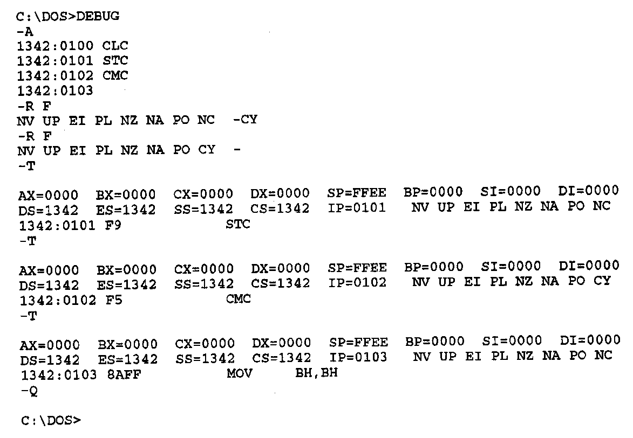
Flag Control Instructions- Example
Debug flag notation
  CF → CY = 1, NC = 0
Example—Execution of carry flag modification instructions
  CY=1
  CLC ;Clear carry flag
    STC ;Set carry flag
    CMC ;Complement carry flag
Microprocessors I: Lecture 15
Notes:
Chapter 6 part 1

Slide 11
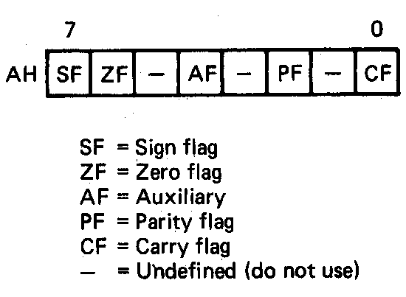
Loading and Saving the Flag Register
All loads and stores of flags take place through the AH register
  Format of the flags in the AH register
    B₀ = CF
    B₂ = PF
    B₄ = AF
    B₆ = ZF
    B₇ = SF
Load AH with content of flags registers (LAHF)
  AH = (Flags)
  Flags unchanged
Store content of AH in flags register (SAHF)
  (Flags) = AH
  SF,ZF,AF,PF,CF → updated
Microprocessors I: Lecture 15
Notes:
Chapter 6 part 1

Slide 12
Loading and Saving the Flag Register
Application—saving a copy of the flags and initializing with new values
LAHF ;Load of flags into AH
MOV [MEM1],AH ;Save old flags at address MEM1
MOV AH,[MEM2] ;Read new flags from MEM2 into AH
SAHF ;Store new flags in flags register
Microprocessors I: Lecture 15
Notes:
Chapter 6 part 1

Slide 13
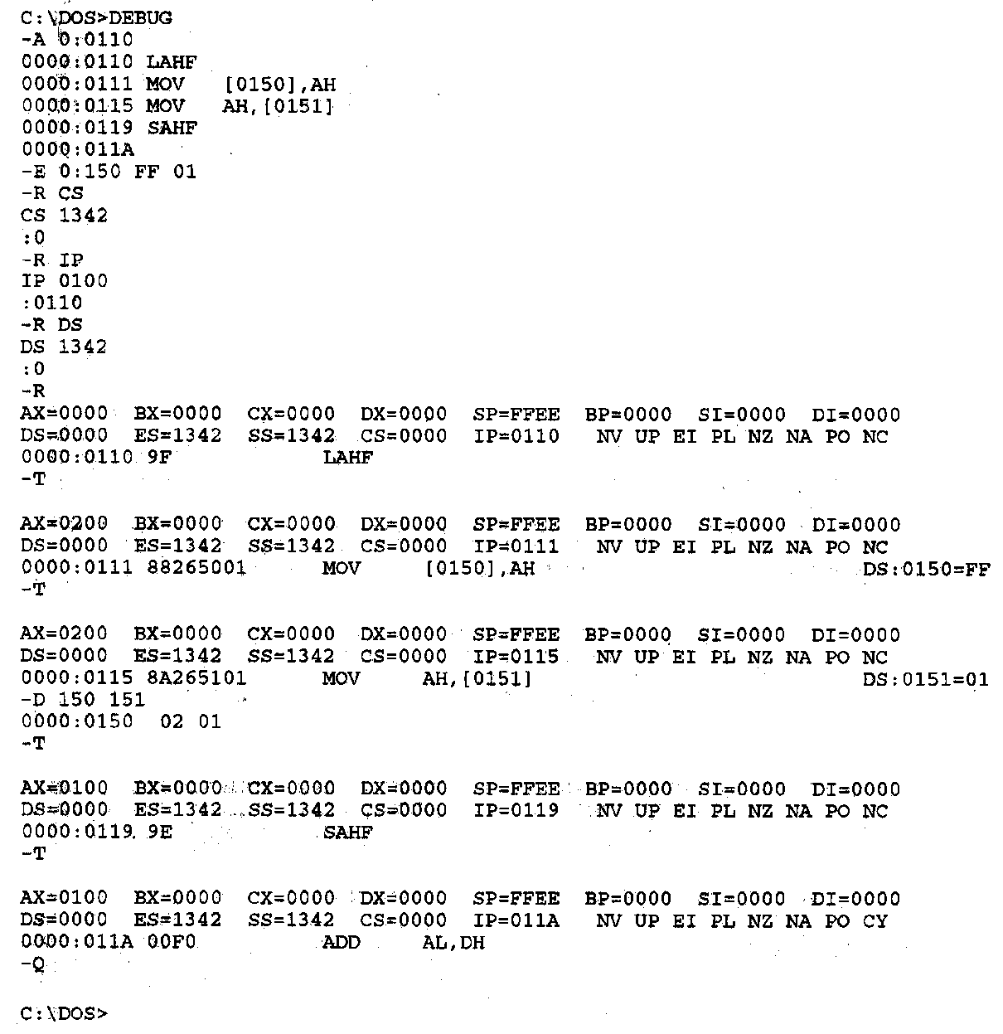
Flag Control Instructions- Example
Example—Execution of the flags save and initialization sequence
Other flag notation:
  Flag = 1/0
  SF = NG/PL
  ZF = ZR/NZ
  AF = AC/NA
  PF = PE/PO
Microprocessors I: Lecture 15
Notes:
Chapter 6 part 1

Slide 14
Example
Given initial state shown in handout
  Typo: Starting address should be 10110H, not 10010H
List all changed registers/memory locations and their values, as well as CF
Instructions
  LAHF
  MOV [20H], AH
  MOV AH, [30H]
  SAHF
  MOV AX, [26H]
  CMC
  RCL AX, CL
Microprocessors I: Lecture 15

Slide 15
Example solution
LAHF
  AH = Flags register = 00H
MOV [20H], AH
  Address = DS:20H = 10110H
  Byte at 10110H = 00H
MOV AH, [30H]
  Address = DS:30H = 10120H
  AH = byte at 10120 = 1EH
SAHF
  Flags register = AH = 1EH
  SF = Bit 7 = 0
  ZF = Bit 6 = 0
  AF = Bit 4 = 1
  PF = Bit 2 = 1
  CF = Bit 0 = 0
Microprocessors I: Lecture 15

Slide 16
Example solution (cont.)
MOV AX, [26H]
  Address = DS:26H = 10116H
  AX = word at 10116 = 4020H
CMC
  Complement CF
  CF = ~CF = ~0 = 1
RCL AX, CL
  Rotate AX left through carry by CL places
  (CF,AX) = 1 0100 0000 0010 0000₂ rotated left by 5
  AX = 0000 0100 0001 0100₂ = 0414H, CF = 0
Microprocessors I: Lecture 15

Slide 17
Next time
Compare instructions
Jump instructions
Subroutine instructions
Microprocessors I: Lecture 15

