Slide 1
16.317: Microprocessor System Design I
Instructor: Dr. Michael Geiger
Spring 2012
Lecture 16: Compare instructions
Notes:
Chapter 2

Slide 2
Lecture outline
Announcements/reminders
  Exam 1 regrades due Monday, 3/5
    In writing; must show understanding of problem
  Lab 2, HW 3 coming next week
Lecture outline
  Review
    Bit test and scan instructions
    Flag control instructions
  Compare instructions
  Set on condition instructions
Microprocessors I: Lecture 16

Slide 3
Review
Bit test instructions
  Check state of bit and store in CF
  Basic test (BT) leaves bit unchanged
  Can also set (BTS), clear (BTR), or complement bit (BTC)
Bit scan instructions
  Find first non-zero bit and store index in dest.
  Set ZF = 1 if source non-zero; ZF = 0 if source == 0
  BSF: scan right to left (LSB to MSB)
  BSR: scan left to right (MSB to LSB)
Flag control instructions
  Initialize carry flag to 0 (CLC), 1 (STC), or ~CF (CMC)
  Set (STI) or clear (CLI) interrupt flag
  Transfer flags to (LAHF) or from (SAHF) register AH
Microprocessors I: Lecture 16

Slide 4
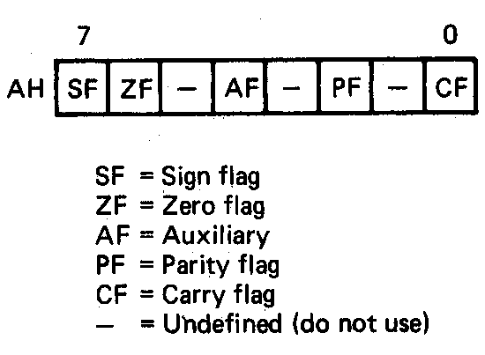
Loading and Saving the Flag Register
Application—saving a copy of the flags and initializing with new values
LAHF ;Load of flags into AH
MOV [MEM1],AH ;Save old flags at address MEM1
MOV AH,[MEM2] ;Read new flags from MEM2 into AH
SAHF ;Store new flags in flags register
Microprocessors I: Lecture 16
Notes:
Chapter 6 part 1

Slide 5
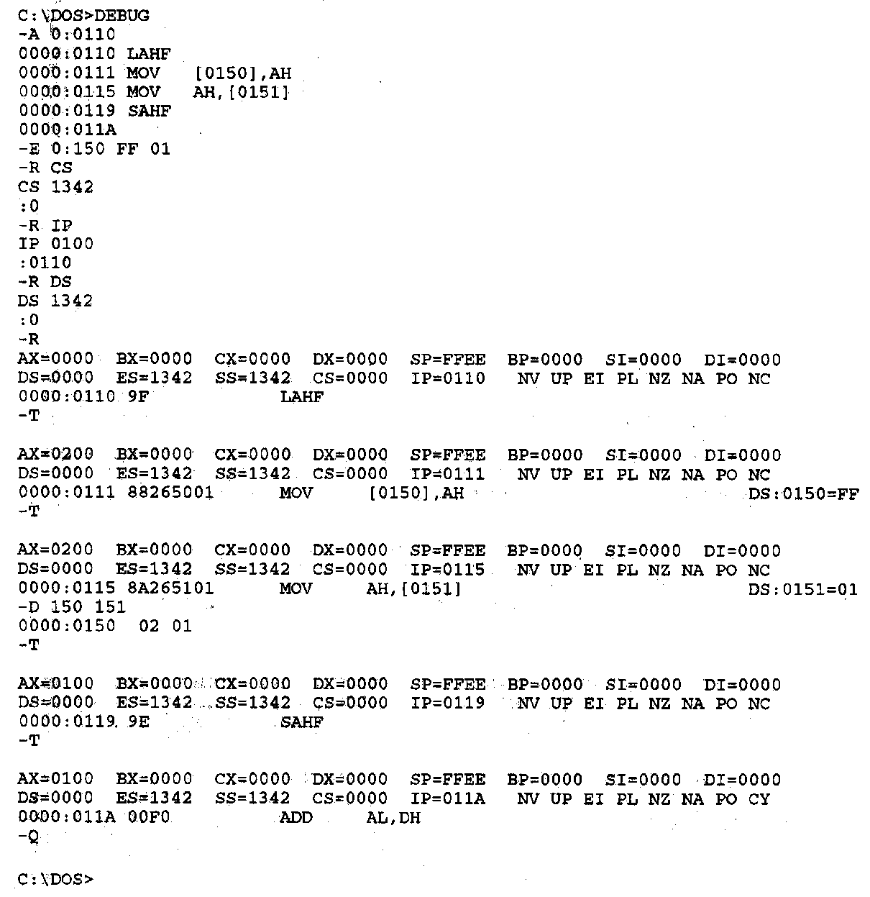
Flag Control Instructions- Example
Example—Execution of the flags save and initialization sequence
Other flag notation:
  Flag = 1/0
  SF = NG/PL
  ZF = ZR/NZ
  AF = AC/NA
  PF = PE/PO
  OF = OV/NV
Microprocessors I: Lecture 16
Notes:
Chapter 6 part 1

Slide 6
Example
Given initial state shown in handout
List all changed registers/memory locations and their values, as well as CF
Instructions
  LAHF
  MOV [20H], AH
  MOV AH, [30H]
  SAHF
  MOV AX, [26H]
  CMC
  RCL AX, CL
Microprocessors I: Lecture 16

Slide 7
Example solution
LAHF
  AH = Flags register = 00H
MOV [20H], AH
  Address = DS:20H = 10110H
  Byte at 10110H = 00H
MOV AH, [30H]
  Address = DS:30H = 10120H
  AH = byte at 10120 = 1EH
SAHF
  Flags register = AH = 1EH
  SF = Bit 7 = 0
  ZF = Bit 6 = 0
  AF = Bit 4 = 1
  PF = Bit 2 = 1
  CF = Bit 0 = 0
Microprocessors I: Lecture 16

Slide 8
Example solution (cont.)
MOV AX, [26H]
  Address = DS:26H = 10116H
  AX = word at 10116 = 4020H
CMC
  Complement CF
  CF = ~CF = ~0 = 1
RCL AX, CL
  Rotate AX left through carry by CL places
  (CF,AX) = 1 0100 0000 0010 0000₂ rotated left by 5
  AX = 0000 0100 0001 0100₂ = 0414H, CF = 0
Microprocessors I: Lecture 16

Slide 9
Compare Instructions
Compare 2 values; store result in ZF/SF
General format: CMP D,S
  Works by performing subtraction (D) – (S)
    D, S unchanged
  ZF/SF/OF indicate result (signed values)
    ZF = 1 → D == S
    ZF = 0, (SF XOR OF) = 1 → D < S
    ZF = 0, (SF XOR OF) = 0 → D > S
Microprocessors I: Lecture 16
Notes:
Chapter 6 part 1
(D) (S) result CF SF AF
AX BX
2345>1234 0 0 0
1234<2345 1 1 1
1234>ABCD 1 0 1
ABCD<1234 0 1 0
ABCD>A000 0 0 0
A000<ABCD 1 1 1
7FFF 8000 overflow

Slide 10
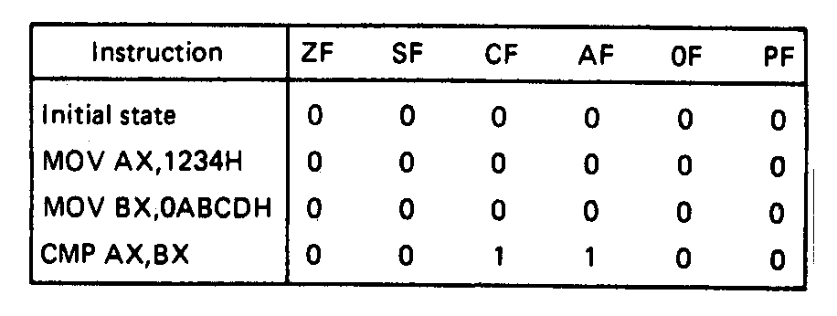
Compare Instructions- Example
Example—Initialization of internal registers with immediate data and compare. Example:
    MOV AX,1234H ;Initialize AX
    MOV BX,ABCDH ;Initialize BX
    CMP AX,BX ;Compare AX-BX
  Data registers AX and BX initialized from immediate data
  IMM16 → (AX) = 1234H → + integer
  IMM16 → (BX) = ABCDH → - integer
  Compare computation performed as:
  (AX) = 0001001000110100₂ (BX) = 1010101111001101₂
(AX) – (BX) = 0001001000110100₂ - 1010101111001101₂
  ZF = 0 = NZ
  SF = 0 = PL ;treats as signed numbers
  CF = 1 = CY
  AF = 1 = AC
  OF = 0 = NV
  PF = 0 = PO
Microprocessors I: Lecture 16
Notes:
Chapter 6 part 1

Slide 11
Condition codes
Conditional execution: result depends on value of flag bit(s)
Intel instructions specify condition codes
  Condition code implies certain flag values
  Opcodes written with cc as part of name
  cc can be replaced by any valid code
  Examples: SETcc, Jcc
    Specific examples: SETL, SETZ, JNE JG
Microprocessors I: Lecture 16

Slide 12
Condition codes (cont.)
Testing overflow alone
  O (OF = 1), NO (OF =0)
Testing carry flag alone
  “Below” or “above” describes carry flag
  Used with unsigned comparisons
  B, NAE, or C (CF = 1)
  NB, AE, or NC (CF = 0)
Testing sign flag alone
  S (SF = 1), NS (SF = 0)
Testing parity flag alone
  P or PE (PF = 1)
  NP or PO (PF = 0)
Microprocessors I: Lecture 16

Slide 13
Condition codes (cont.)
Testing equality/zero result
  E or Z (ZF = 1)
  NE or NZ (ZF = 0)
Codes that combine multiple flags
  Testing “above”/”below” and equality
    BE or NA (CF OR ZF = 1)
    NBE or A (CF OR ZF = 0)
  Testing less than/greater than
    L or NGE (SF XOR OF = 1)
    NL or GE (SF XOR OF = 0)
    LE or NG ((SF XOR OF) OR ZF = 1)
    NLE or G ((SF XOR OF) OR ZF = 0)
Microprocessors I: Lecture 16

Slide 14
Byte Set on Condition Instruction
Byte set on condition instruction
  Used to set byte based on condition code
  Can be used for boolean results—complex conditions
  General format:
    SETcc D
    cc = one of the supported conditional relationships
Microprocessors I: Lecture 16
Notes:
Chapter 6 part 1

Slide 15
Byte Set on Condition Instruction
Operation: Flags tested for conditions defined by “cc” and the destination in a register or memory updated as follows
If cc test True:
  11111111₂ = FFH → D
  If cc test False:
  00000000₂ = 00H → D
Examples of conditional tests:
SETE = set byte if equal → ZF = 1
SETC = set byte if carry → CF =1
SETBE = set byte if below or equal → CF = 1 +(or) ZF = 1
Example: SETA AL = set byte if above
  if CF = 0 • (and) ZF = 0
  (AL) = FFH
  Otherwise,
  (AL) =00H
Microprocessors I: Lecture 16
Notes:
Chapter 6 part 1

Slide 16
Example
Show the results of the following instructions, assuming that
  DS:100H = 0001H
  DS:102H = 0003H
  DS:104H = 1011H
  DS:106H = 1011H
  DS:108H = ABCDH
  DS:10AH = DCBAH
What complex condition does this sequence test?
MOV AX, [100H]
CMP AX, [102H]
SETLE BL
MOV AX, [104H]
CMP AX, [106H]
SETE BH
AND BL, BH
MOV AX, [108H]
CMP AX, [10AH]
SETNE BH
OR BL, BH
Microprocessors I: Lecture 16

Slide 17
Example solution
Condition being tested:
  To simplify, treat each word as a variable named “A” through “F”
  ((A <= B) && (C == D)) || (E != F)
Source: http://www.arl.wustl.edu/~lockwood/class/cs306/books/artofasm/Chapter_6/CH06-4.html
Microprocessors I: Lecture 16

Slide 18
Next time
Jump instructions
Subroutine instructions
Microprocessors I: Lecture 16

