Slide 1
16.317: Microprocessor System Design I
Instructor: Dr. Michael Geiger
Spring 2012
Lecture 19: Subroutine instructions
Notes:
Chapter 2

Slide 2
Lecture outline
Announcements/reminders
  Lab 2 due 3/28
  HW 3 to be posted during/after break, likely due 3/26
Lecture outline
  Review: loop instructions
  Subroutine instructions
Microprocessors I: Lecture 19

Slide 3
Review
Jump applications
  Conditional statements (if/else)
  Loops (pre-/post-tested)
Loop instructions
  Combines CX decrement with JNZ test
  May add additional required condition
    LOOPE/LOOPZ: loop if ((CX != 0) && (ZF == 1))
    LOOPNE/LOOPNEZ: loop if (CX != 0) && (ZF == 0))
Microprocessors I: Lecture 19

Slide 4
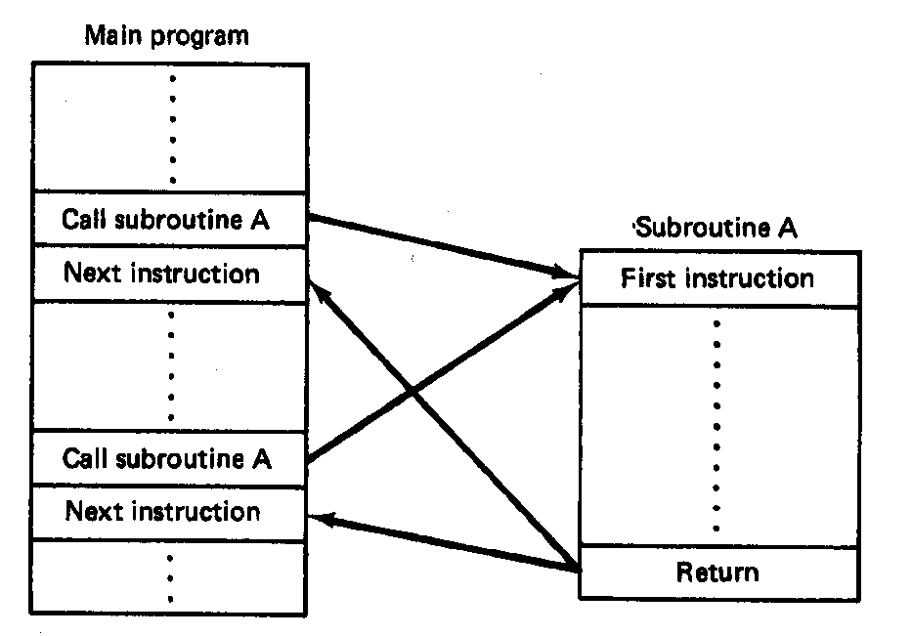
Subroutines
Subroutine: special program segment that can be “called” from any point in program
  Implements HLL functions/procedures
  Written to perform operation that must be repeated in program
  Actual subroutine code only written once
Microprocessors I: Lecture 19
Notes:
Chapter 6 part 2

Slide 5
Subroutine operation
When called, address of next instruction saved
  State may need to be saved before call
  Parameters can be passed
Control of program transferred to subroutine
After subroutine finished, return instruction goes back to saved address
Microprocessors I: Lecture 19
Notes:
Chapter 6 part 2

Slide 6
80386 subroutines
Specify starting point with pseudo-op
  <name> PROC NEAR → same segment
  <name> PROC FAR → different segment
May save state/allocate variables at start
  If so, will restore at end of subroutine
Last instruction returns to saved address
  Always RET
Pseudo-op after RET indicates routine end
  <name> ENDP
Microprocessors I: Lecture 19

Slide 7
Subroutine example
SQUARE PROC NEAR
PUSH AX ; Save AX to stack
MOV AL, BL ; Copy BL to AL
IMUL BL ; AL = BL * AL
; = original BL squared
MOV BX, AX ; Copy result to BX
POP AX ; Restore AX
RET
SQUARE ENDP
Microprocessors I: Lecture 19

Slide 8
Call/return
Calling subroutine: CALL <proc>
  Address of next instruction saved on stack
    Either IP (near) or CS, IP (far)
  <proc> can be 16- or 32-bit label/immediate, register, memory operand
    16-bit immediate added to IP
    16-bit register/memory replaces IP
    32-bit values replace CS/IP
Ending subroutine: RET
  Saved address restored to IP (& CS if needed)
Microprocessors I: Lecture 19

Slide 9
Example
Assuming AX = 2 and BX = 4, show the results of the following sequence (Ex. 6.11):
  Assume the addresses of the first three instructions are CS:0005, CS:0008, and CS:0009, respectively
    Typo in handout—segment register should be CS, not DS
  CALL SUM
  RET ; End main function
  SUM PROC NEAR
  MOV DX, AX
  ADD DX, BX
  RET
  SUM ENDP
Microprocessors I: Lecture 19

Slide 10
Saving state
May need to save state before routine starts
  Overwritten registers (that aren’t return values)
  Flags
Placing data on stack: PUSH
  Store data “above” current TOS; decrement SP
    Stack grows toward lower addresses
    New SP points to start of data just stored
  Basic PUSH stores word or double word
  Directly storing flags: PUSHF
  Storing all 16-/32-bit general purpose registers: PUSHA/PUSHAD
Microprocessors I: Lecture 19

Slide 11
Restoring state
Removing data from TOS: POP
  Data removed from TOS; SP incremented
  Basic POP removes word/double word
  Directly removing flags: POPF
  Removing all 16-/32-bit general purpose registers: POPA/POPAD
POP instructions generally executed in reverse order of corresponding PUSH instructions
Microprocessors I: Lecture 19

Slide 12
Revisiting subroutine example
SQUARE PROC NEAR
PUSH AX ; Save AX to stack
MOV AL, BL ; Copy BL to AL
IMUL BL ; AL = BL * AL
; = original BL squared
MOV BX, AX ; Copy result to BX
POP AX ; Restore AX
RET
SQUARE ENDP
Microprocessors I: Lecture 19

Slide 13
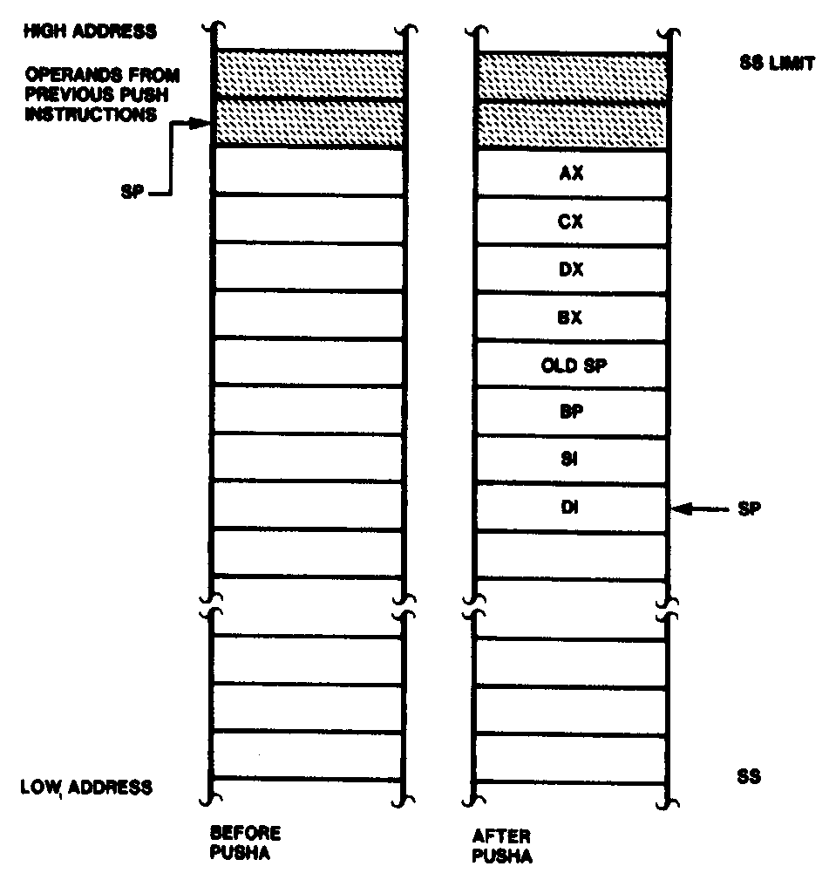
Push All and Pop All Operations
Microprocessors I: Lecture 19
Notes:
Chapter 6 part 2

Slide 14
Stack examples
Assume initial state shown in handout
What is the resulting stack state of each of the following sequences?
  PUSH BX
  PUSH AX
  PUSH EBX
  PUSH EAX
  PUSHA
Microprocessors I: Lecture 19

Slide 15
Next time
Enjoy your break!
Microprocessors I: Lecture 19

