Slide 1
16.317
Microprocessor Systems Design I
Instructor: Dr. Michael Geiger
Spring 2012
Lecture 1: Course Overview and Introduction

Slide 2
Lecture outline
Course overview
  Instructor information
  Course materials
  Course policies
  Resources
  Course outline
General overview of course material
Microprocessors I: Lecture 1

Slide 3
Course staff & meeting times
Lectures:
  Section 201: MWF 8-8:50, Ball Hall 314
  Section 202: MWF 9-9:50, Ball Hall 206
Labs:
  Open lab hours in Ball Hall 407
  Will get card access after add/drop deadline
Instructor: Dr. Michael Geiger
  E-mail: Michael_Geiger@uml.edu
  Phone: 978-934-3618 (x3618 on campus)
  Office: Engineering 118A
  Office hours: M 1-3, W 1-3, Th 1-3
Teaching Assistant: Amanda Thomas
  Office hours: TBD
Microprocessors I: Lecture 1

Slide 4
Course materials
Textbook: Walter Triebel, The 80386, 80486, and Pentium Processors: Hardware, Software, and Interfacing, 1998, Prentice Hall.
  ISBN: 0-13-533225-7
Course website: http://mgeiger.eng.uml.edu/16317/sp12/index.htm
  Will contain lecture slides, handouts, assignments
Discussion group through piazza.com
  Allow common questions to be answered for everyone
  All course announcements will be posted here
  Will use as class mailing list—you must enroll by the end of the week
Microprocessors I: Lecture 1

Slide 5
Course policies
Prerequisites: 16.265 (Logic Design), 16.365 (Electronics I)
Labs
  Can work in groups of 1 or 2 students
    No group changes without Dr. Geiger’s permission
  All labs must be checked off by instructor
  Each student must complete individual lab report
    Group members may share data generated in lab (screenshots, etc.) but must write own description
    Report format to be specified in separate document
  Typed reports due in class on due date
    Late reports penalized 20% per weekday
Microprocessors I: Lecture 1

Slide 6
Course policies (cont.)
Academic honesty
  All assignments are to be done individually unless explicitly specified otherwise by the instructor
  Any copied solutions, whether from another student or an outside source, are subject to penalty
  You may discuss general topics or help one another with specific errors, but not share assignment solutions
    Must acknowledge assistance from classmate in submission
Microprocessors I: Lecture 1

Slide 7
Course policies (cont.)
Grading breakdown
  Labs: 35%
  Homework: 10%
  Exam 1: 15%
  Exam 2: 20%
  Final: 20%
Exam dates
  Exam 1: Friday, February 24
  Exam 2: Wednesday, April 4
  Final: TBD (common final for both sections)
Microprocessors I: Lecture 1

Slide 8
What you should learn in this class
Basics of microcomputers vs. microprocessors
  AMD, Apple, Dell, IBM, Intel: what do they make?
  Can you run x86 PC software on IBM Cell processor? Why?
  Why larger memory brings better performance?
Two major aspects:
  How to program
    Focus on assembly language
  How a microprocessor works with other components
    Focus on interfacing circuits and control schemes
Will work with two processors:
  Intel 80386DX
  PIC microcontroller
Microprocessors I: Lecture 1
· To understand the interconnection of the CPU, memory, and I/O

Slide 9
Tentative course outline
Internal processor architecture
Assembly language programming
  Start with 80386DX; PIC microcontroller at end
  Areas will include
    Addressing modes
    Instruction types
    Programming modes
Memory management
  Segmentation
  Virtual memory
External interfacing
  Processor signals used in interfacing
  Interface circuitry
  External memory
Microcontroller-based systems
Microprocessors I: Lecture 1

Slide 10
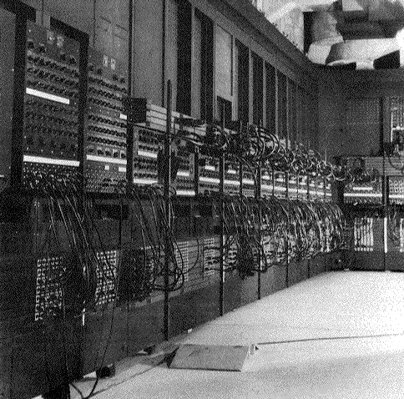
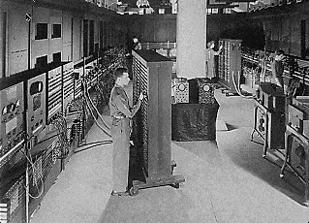
The History
Thirty tons
Forced air cooling
200KW
19,000 vacuum tubes
Punch card
Manual wiring
Numerical computation
The first electronic digital computer – ENIAC, built in UPenn in 1946
Source: http://ei.cs.vt.edu/~history/ENIAC.Richey.HTML
Notes:
Chapter 1

Slide 11
The Evolution
IBM’s PCs replaced mainframes and minicomputers
  VLSI, computation power is cheaper
  Software
  Open system
Processor: 8088-> 80286-> 80386-> Pentium …
Frequency: 8MHz -> 16MHz -> 100MHz -> …
Internal Bus: 8-bit I/O channel -> 16-bit ISA -> 32,64-bit PCI
Devices: speaker, joystick -> graphics cards -> wireless …
Storage: floppy -> 20M HD -> … -> 200GB HD, DVD
Notes:
Chapter 1

Slide 12
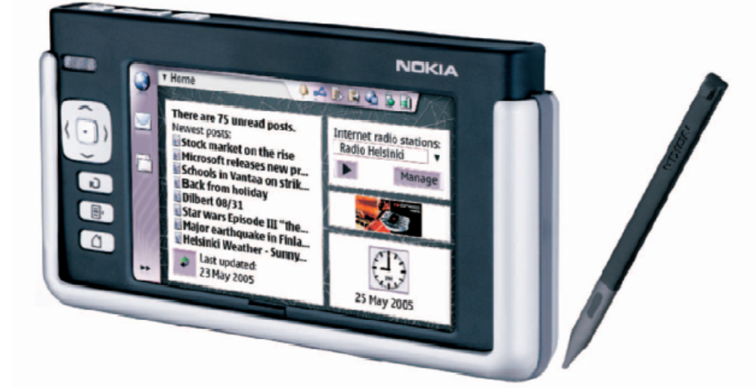
Yesterday
230g
141x79x19 mm
ARM microprocessor
4” 65K color touch screen
802.11b/g, bluetooth
Voice over IP, Email, Web
browser, Instant messanger
…
Nokia 770 Internet Tablet (available in Q3 2005)
Source: IEEE Pervasive Computing, July – Sept 2005
Notes:
Chapter 1

Slide 13
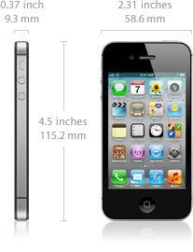
Today
iPhone 4S Technical Specifications
Screen size 3.5 inches
Screen resolution 960 by 640 at 326 ppi
Input method Multi-touch
Operating system iOS 5.0
Storage 16 / 32 / 64 GB
Cellular network UMTS/GSM/CDMA
Wireless data Wi-Fi (802.11b/g/n) + EDGE + Bluetooth 4.0
Camera 8.0 megapixels
Battery Up to 6 hrs Internet, 8 hrs talk,
10 hrs video, 40 hrs audio,
200 hrs standby
Dimensions 4.5 x 2.3 x 0.37 inches
Weight 4.9 ounces
Notes:
Chapter 1

Slide 14
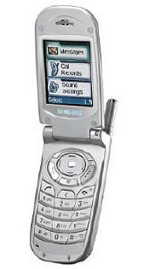
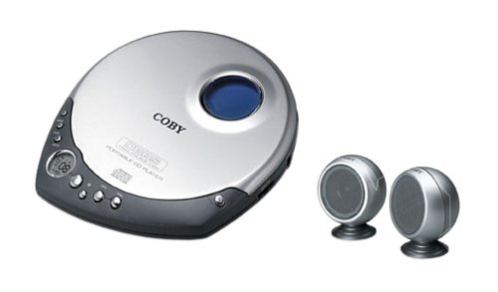
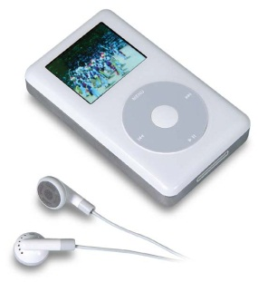
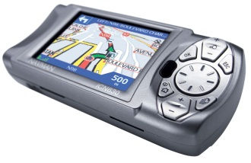
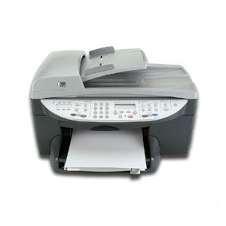
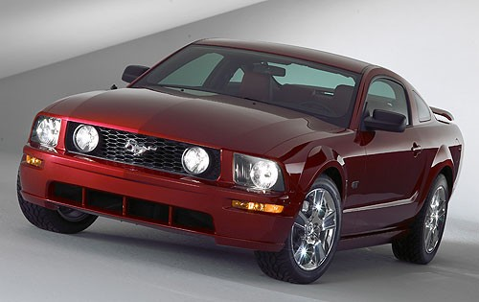
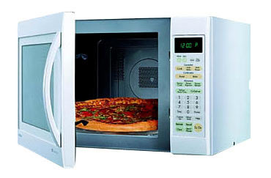
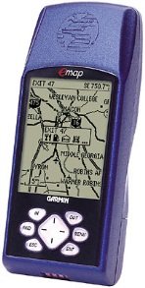
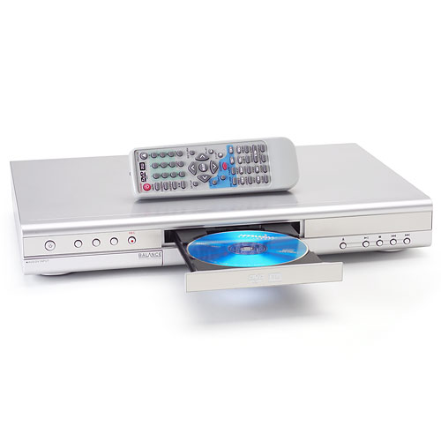
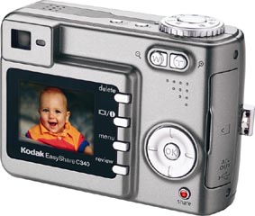
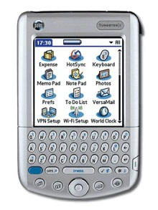
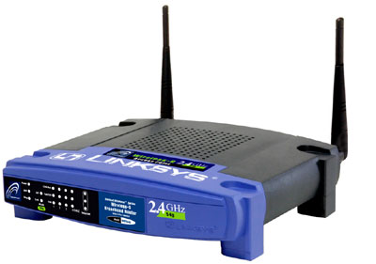
Embedded (Computer) Systems Are Everywhere
Notes:
Chapter 1

Slide 15
Microcomputer
Computer systems with changeable functionalities
  Not like microwave oven, remote controller
  Develop, buy/download, install software
  Can also be dedicated (file server, web server, gaming sever)
Systems dependent on microprocessor
Notes:
Chapter 1

Slide 16
Microcomputer Architecture
MPU
Input
Output
Storage
  primary
  secondary
Notes:
Chapter 1

Slide 17
Evolution of Intel Microprocessors
Intel Microprocessors:
  8086, 8088
  80386
  Pentium
  Xeon
  Itanium, Dual Core, Quad Core
  What is next?
Performance Evaluation - benchmarking
  MIPS
  iCOMP
Notes:
Chapter 1

Slide 18
Final notes
Next time: 80386DX intro
  Internal architecture
  Data organization
Remember:
  Check the course web page
  Join the course discussion group on piazza.com
    Will likely post a survey re: TA office hour times
Acknowledgements: Thanks to Prof. Yan Luo for providing material from previous semesters, which was used in this lecture
Microprocessors I: Lecture 1

