Slide 1
16.317
Microprocessor Systems Design I
Instructor: Dr. Michael Geiger
Spring 2012
Lecture 2: 80386DX Internal Architecture
& Data Organization

Slide 2
Lecture outline
Announcements/reminders
  Register for the discussion group on piazza.com
    Search by course # “16.317”
Lecture outline
  Processor architecture
    General discussion
    80386DX specifics
  Software model
    General discussion
    80386DX specifics
      Registers
      Address space
      Data types
Microprocessors I: Lecture 2

Slide 3
Processor architecture
“Architecture” can refer to
  High-level description of hardware; could be
    Overall system
    Microprocessor
    Subsystem within processor
  Operations available to programmer
    Instruction set architecture
  Other applications to computing (e.g., “software architecture”) we won’t discuss
Commonly used to discuss functional units and how they work together
Microprocessors I: Lecture 2

Slide 4
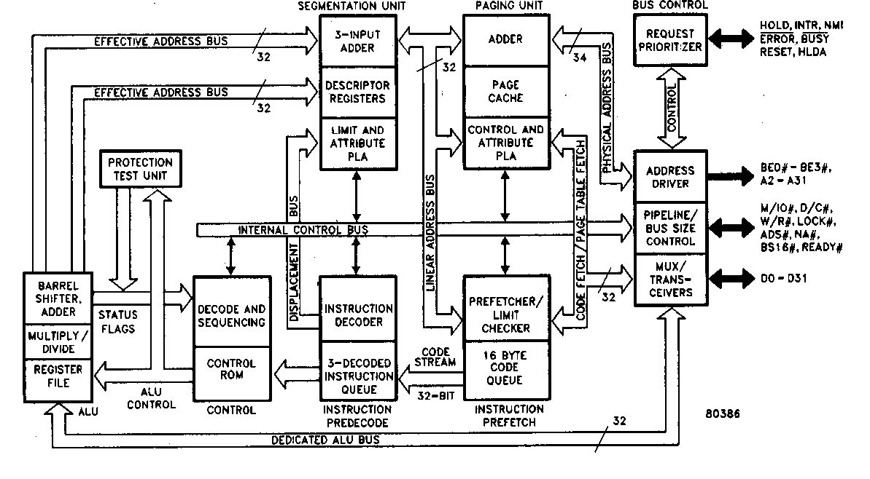
Internal Architecture of the 80386DX Microprocessor
Parallel processing -> high performance
Six functional units:
  Bus units
  Execution unit
  Segment unit
  Page unit
  Prefetch unit
  Decode unit
Microprocessors I: Lecture 2
Notes:
Chapter 2

Slide 5
Bus Interface Unit
Interface to the outside world
Responsible for
  Fetching instruction
    Operation to be executed
  Reading and writing of data for memory
  Input/output of data for input/output peripherals
Information transfers over the bus
  De-multiplexed bus
  386DX
    32-bit data bus
    Real-mode: 20-bit address, 1M-byte physical address space
    Protected-mode: 32-bit address bus, 4G-byte physical address space
Microprocessors I: Lecture 2
Notes:
Chapter 2

Slide 6
Prefetch Unit
Instructions stored in FIFO queue
  Holds code until ready for decoding
Whenever the queue is not full, prefetch the next sequential instructions
  Time to fetch many of the instructions in a microcomputer program is “hidden”.
Microprocessors I: Lecture 2
Notes:
Chapter 2

Slide 7
Decode Unit
Offloads the responsibility of instruction decoding from the execution unit
  Decodes instructions into the microcode instruction format used by the execution unit
Contains another instruction queue that holds 3 fully decoded instructions
  Decoded instructions are held until requested by the execution unit
Microprocessors I: Lecture 2
Notes:
Chapter 2

Slide 8
Execution Unit
Responsible for executing instructions
Element of the EU
  Arithmetic/logic unit (ALU)
    Performs the operation identified by the instruction: ADD, SUB, AND, etc.
  Flags register
    Holds status and control information
  General-purpose registers
    Holds address or data information
  Control ROM
    Contains microcode sequences that define operations performed by machine instructions
  Special multiply, shift, and barrel shift hardware
    Accelerate multiply, divide, and rotate operations
Microprocessors I: Lecture 2
Notes:
Chapter 2

Slide 9
Operations of the Execution Unit
Reads instructions from the instruction queue
Accesses data
  General purpose registers if necessary
  Generates memory address of data storage locations in memory if necessary
  Passes memory addresses to the segmentation and paging units and requests the bus unit to perform read or write bus cycles to access data operands in memory
Performs the operation defined by the instruction on the selected data
Tests the state of flags if necessary
  Updates flag state based on instruction result
Microprocessors I: Lecture 2
Notes:
Chapter 2

Slide 10
Segmentation and Paging Unit
Off-load memory-management and protection services from the bus unit
Segmentation unit
  Implements real-mode and protected-mode segmentation model
  Contains general registers, segment registers, and instruction pointer
  Holds address and data operand information
Segmentation unit address generation logic
  Real-mode address generation
    CS:IP → code
    DS:SI → data
  Protected-mode address translation
    Translates logical address to linear address
  Protection checking
Microprocessors I: Lecture 2
Notes:
Chapter 2

Slide 11
Segmentation and Paging Unit
Paging unit
  Implements protected-mode paging model
  Contains translation look-aside buffer
    Acts as a cache for recently used page directory entries and page table entries
  Translates linear address output of segmentation unit to a physical page address
  Not used in real mode
Microprocessors I: Lecture 2
Notes:
Chapter 2

Slide 12
The Software Model
Programmer’s understanding the operation of the microcomputer from a software point of view
Elements of the software model
  Register set
  Memory address space
  Input/output address space
  Could also consider operations processor can perform
What the programmer must know about the microprocessor
  Registers available within the device
    Purpose, operating capabilities of each
  Size, organization of memory and I/O address spaces
  Types of data
Microprocessors I: Lecture 2
Notes:
Chapter 2

Slide 13
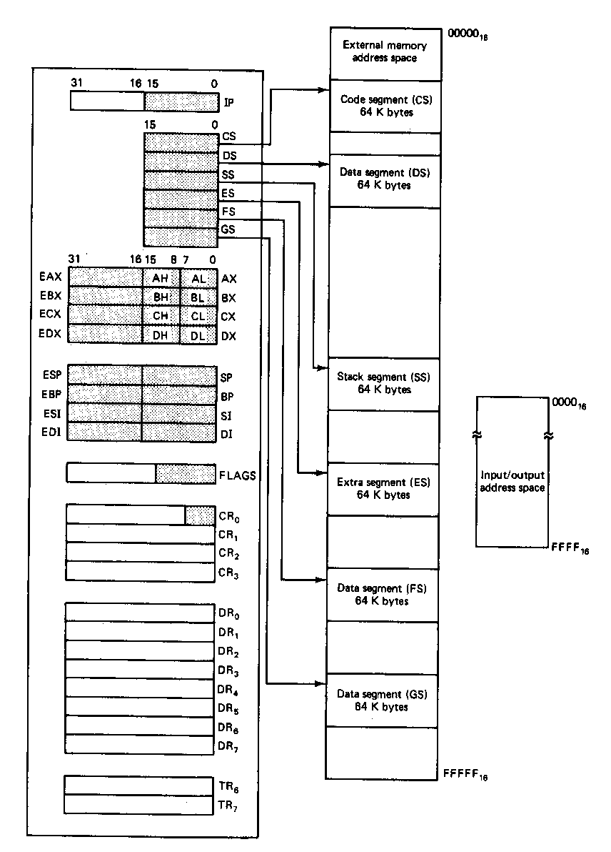
Register Set
Eight 32-bit registers
  (4) Data registers- EAX, EBX, ECX, EDX, can be used as 32, 16 or 8bit
  (2) Pointer registers- EBP, ESP
  (2) Index registers- ESI, EDI
Seven 16-bit registers
  (1) Instruction pointer- IP
  (6) Segment registers- CS, DS, SS, ES, FS, GS
Flags (status) register-EFLAGS
Control register- CR0
Microprocessors I: Lecture 2
Notes:
Chapter 2

Slide 14
Memory and Input/Output
Architecture implements independent memory and input/output address spaces
  Why?
Memory address space- 1,048,576 bytes long (1MB)
Input/output address space- 65,536 bytes long (64KB)
Microprocessors I: Lecture 2
Notes:
Chapter 2

Slide 15
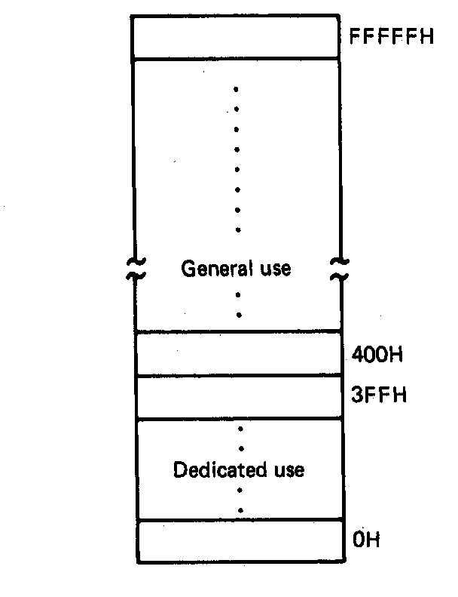
Address Space
Memory organized as individual bytes
Memory address space corresponds to the 1M addresses in the range 00000H to FFFFFH
00000H= 00000000000000000000₂
FFFFFH= 11111111111111111111₂
2²⁰= 1,048,576 = 1M unique addresses
Data organization:
  Byte: content of any individual byte address
  Word: contents of two contiguous byte addresses
  Double-word: contents of 4 contiguous byte addresses
Microprocessors I: Lecture 2
Notes:
Chapter 2

Slide 16
Dedicated and General Use of Memory
Memory address space is partitioned into general use and dedicated use areas
Dedicated (0H – 3FFH):
  Interrupt vector table
  1st 1024 bytes
    Addresses 0H → 3FFH
  256 4-byte pointers
    16-bit segment base address
    16-bit offset
General use:
  400H → FFFFFH
  Used for stack, code, and data
Microprocessors I: Lecture 2
Notes:
Chapter 2

Slide 17
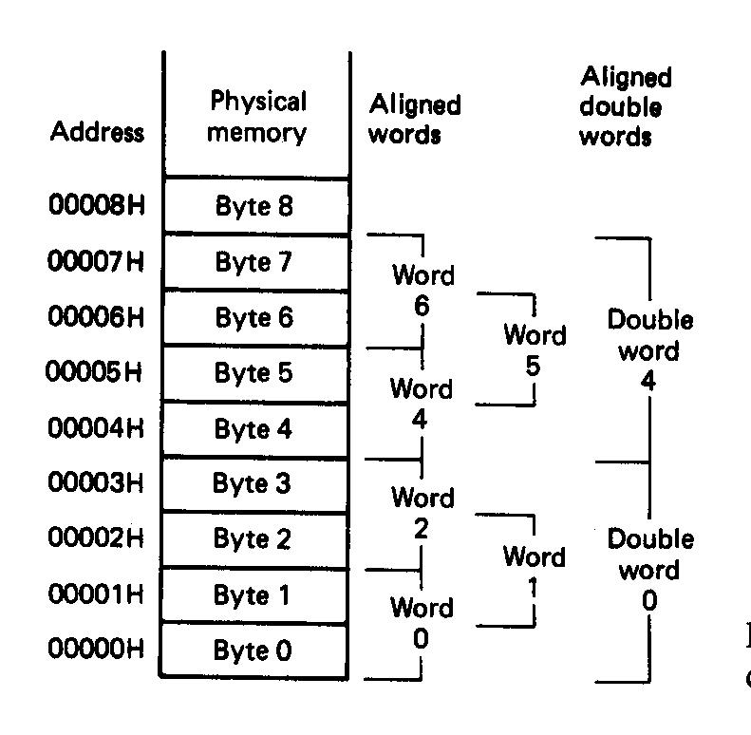
Aligned Words, Double words
Words and double words of data can be stored in memory at an even or odd address boundary
  Examples of even address boundaries:
  00000₁₆, 00002₁₆, 00004₁₆
  Examples of odd address boundaries:
  00001₁₆, 00003₁₆, 00005₁₆
Aligned double-words are stored at even addresses that are a multiple of 4
  Examples: double words 0 and 4
Microprocessors I: Lecture 2
Notes:
Chapter 2

Slide 18
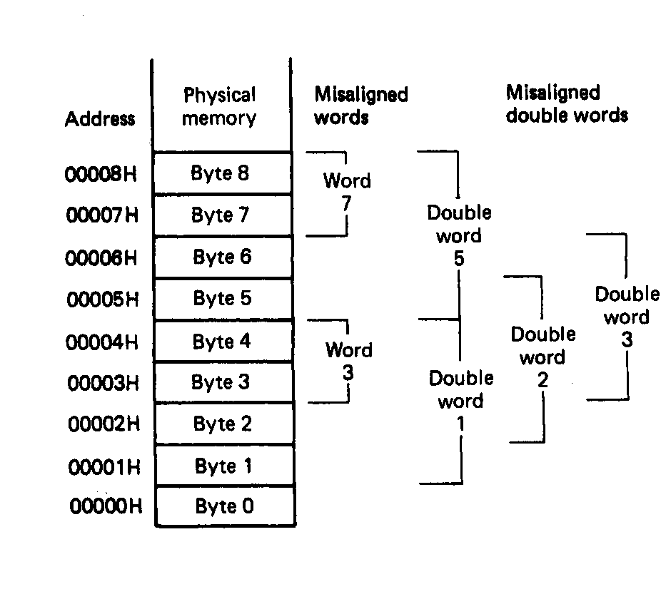
Misaligned Words
80x86 architecture supports access or aligned or misaligned data
Words stored across a double-word boundary are said to be “misaligned or unaligned words ”
  Examples: words 3 and 7
Misaligned double-words are stored at addresses that are not a multiple of 4
  Examples: double words 1, 2 and 3
There is a performance impact for accessing unaligned data in memory (32-bit data bus)
Microprocessors I: Lecture 2
Notes:
Chapter 2

Slide 19
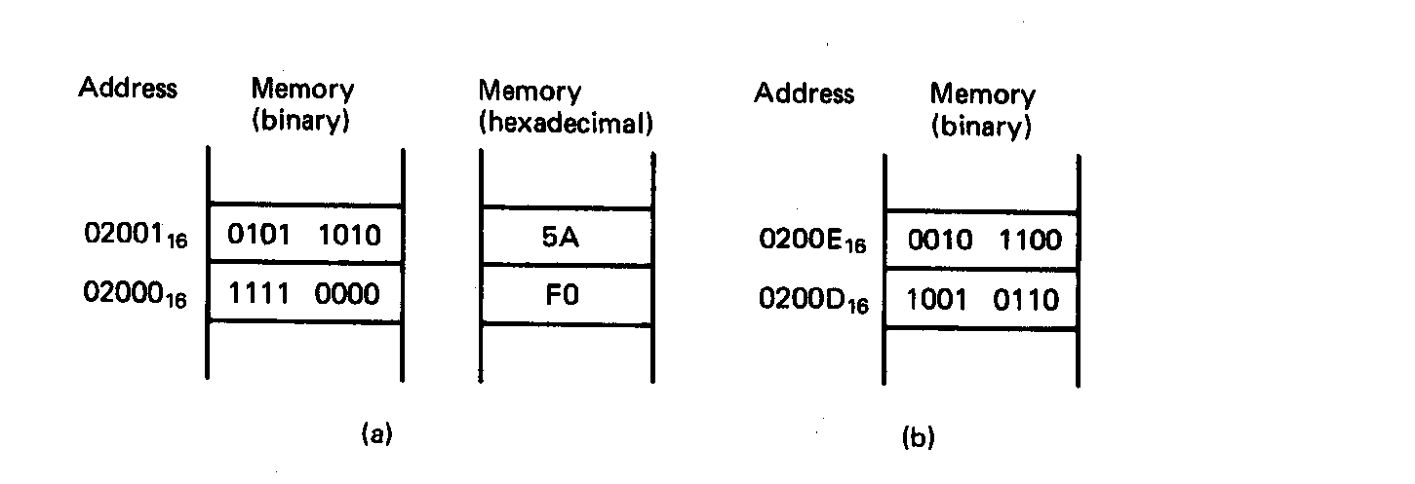
Examples of Words of Data
“Little endian” organization
Most significant byte at high address
Least significant byte at low address
Example [Fig. 2.5 (a)]
(02001₁₆) = 0101 1010₂=5AH= MS-byte
(02000₁₆) = 1111 0000₂=F0H= LS-byte
as a word they give
01011010 11110000₂=5AF0H
Microprocessors I: Lecture 2
Notes:
Chapter 2

Slide 20
Examples of Words of Data
What is the data word shown in this figure?
  Express your result in hexadecimal
Is the word aligned?
Answer:
  MSB = 00101100₂ = 2C₁₆
  LSB = 10010110₂ = 96₁₆
  → Full word = 2C96₁₆
  Starting address = 0200D₁₆
  → Address not divisible by 2
  → Word is not aligned
Microprocessors I: Lecture 2
Notes:
Chapter 2

Slide 21
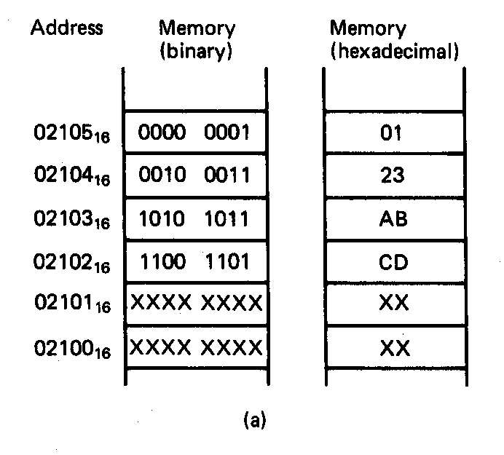
Example of Double Word
What is the double word shown in this figure?
Is it aligned?
Answer:
  LSB = CD₁₆
  MSB = 01₁₆
  → Arranging as 32-bit data:
  0123ABCD₁₆
  Starting address = 02102₁₆
  → Not divisible by 4
  → Double word is unaligned
Microprocessors I: Lecture 2
Notes:
Chapter 2

Slide 22
Final notes
Next time: Continue with the 80386DX
  Data types
  Registers
  Memory segmentation
Acknowledgements
  Thanks to Prof. Yan Luo for providing material used in this lecture
  Figures in these slides come from Triebel’s text The 80386, 80486, and Pentium Processor: Hardware, Software, and Interfacing
Microprocessors I: Lecture 2

