Slide 1
16.317: Microprocessor System Design I
Instructor: Dr. Michael Geiger
Spring 2012
Lecture 4: Real mode address generation, stack, I/O address space
Notes:
Chapter 2

Slide 2
Lecture outline
Announcements/reminders
  Register for the discussion group on piazza.com
    Search by course # “16.317”, semester Spring 2012
  Course handouts on:
  http://mgeiger.eng.uml.edu/16317/sp12
  HW/lab assignments coming soon
Lecture outline
  Review
    Data types
    Registers
    Memory segmentation
  Today: More on 80386 software model
    Real mode address generation
    Stack
Microprocessors I: Lecture 4

Slide 3
Review
Data types
  Byte/word/double word
  Signed/unsigned integers
  BCD
  ASCII characters
Memory segmentation
  Segment registers (CS, SS, DS, ES, FS, GS) indicate start of 64KB segment
  Can change registers to switch segments
Registers
  General purpose data: A, B, C, D
    Access as byte (AH/AL), word (AX), double word (EAX)
  Pointer: SP (ESP), BP (EBP)
  Index: SI (ESI), DI (EDI)
  Flags register: status flags, control flags
Microprocessors I: Lecture 4

Slide 4
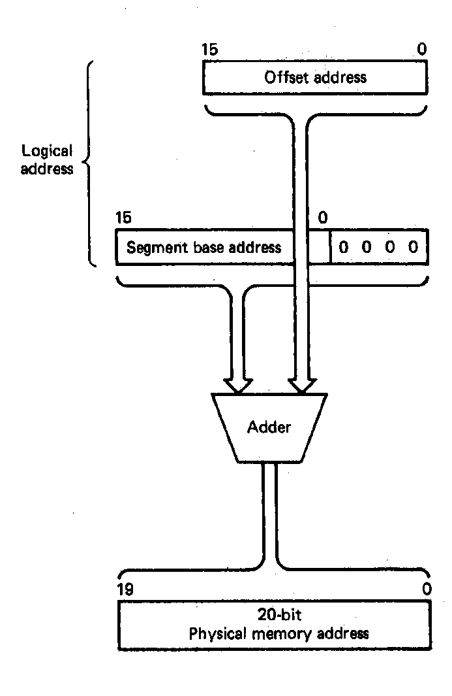
Logical and Physical Addresses
Logical address: real-mode architecture described by a segment base address and an offset
  Segment base address (CS,DS, ES, SS, etc.) are 16 bit quantities
  Offsets (IP, SI, DI, BX, DX, SP, BP, etc.) are 16bit
  Examples:
    CS:IP 100H:100H Code access
    DS:SI 2000H:1EFH Data access
    SS:SP F000H:FFH Stack access
Physical Address: actual address used for accessing memory
  20-bits in length
  Formed by:
    Shifting the value of the 16-bit segment base address left 4 bit positions
    Filling the vacated four LSBs with 0s
    Adding the 16-bit offset
Microprocessors I: Lecture 4
Notes:
Chapter 2

Slide 5
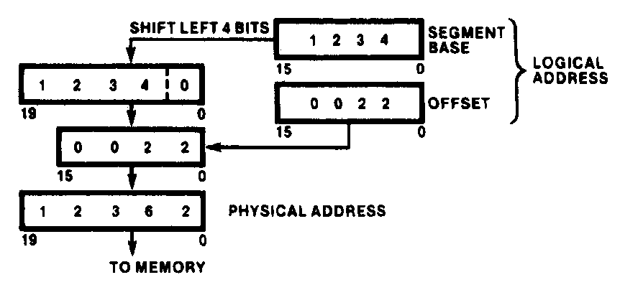
Generating a Real-Mode Memory Address
  Segment base address = 1234H
  Offset = 0022H
  1234H = 0001001000110100₂
  0022H = 0000000000100010₂
  Shifting base address,
  00010010001101000000₂ = 12340H
  Adding binary segment address and offset
00010010001101000000₂ + 0000000000100010₂
= 00010010001101100010₂
    = 12362H
  In hex:
  12340H + 0022H = 12362H
Microprocessors I: Lecture 4
Notes:
Chapter 2

Slide 6
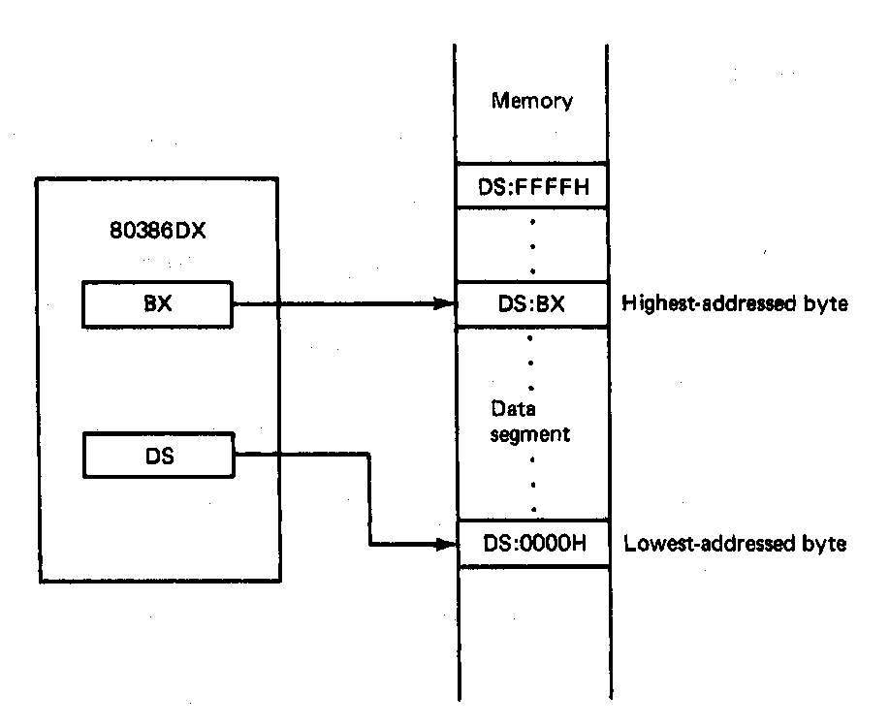
Boundaries of a Segment
Six active segments: CS, DS, ES. GS, FS, SS
  Each 64K-bytes in size → maximum of 384K-bytes of active memory
    64K-bytes for code
    64K-bytes for stack
    256K-bytes for data
Starting address of a data segment
DS:0H → lowest addressed byte
Ending address of a data segment
DS:FFFFH → highest addressed byte
Address of an element of data in a data segment
  DS:BX → address of a byte, word, or
  double word element of data in the
  data segment
Microprocessors I: Lecture 4
Notes:
Chapter 2

Slide 7
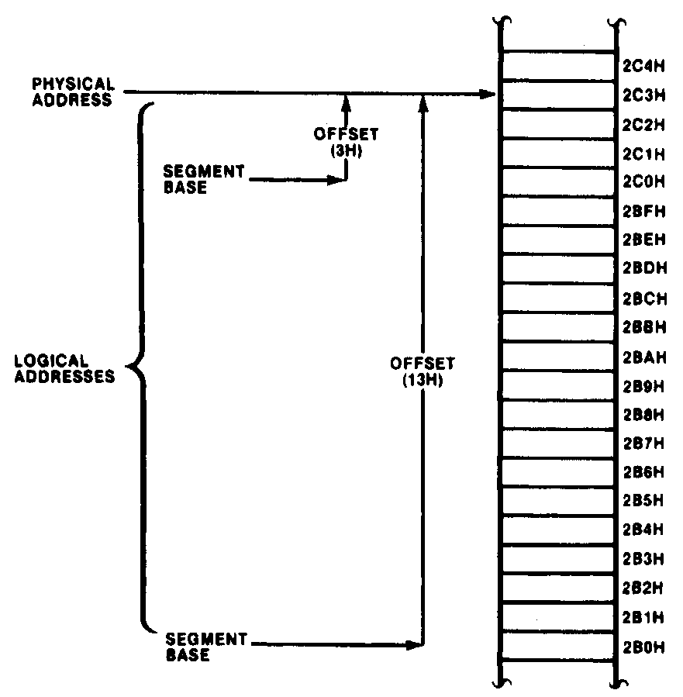
Relationship between Logical and Physical Addresses
Many different logical address can map to the same physical address
  Examples:
  2BH:13H = 002B0H+0013H = 002C3H
  2CH:3H = 002C0H + 0003H = 002C3H
  Said to be “aliases”
Microprocessors I: Lecture 4
Notes:
Chapter 2

Slide 8
Address generation examples
Given the following register values:
  CS = 0x1000
  SS = 0x2000
  DS = 0x3000
  ES = 0x4000
  IP = 0x0100
  ESP = 0x0002FF00
  EBP = 0x0000F000
  ESI = 0x0001000E
  EBX = 0xABCD1234
What physical addresses correspond to the following logical addresses?
  CS:IP
  SS:SP
  SS:BP
  DS:SI
  ES:BX
Microprocessors I: Lecture 4

Slide 9
Example solutions
CS:IP
  CS << 4 = 0x10000
  Address = 0x10000 + 0x0100 = 0x10100
SS:SP
  SS << 4 = 0x20000
  SP = lower 16 bits of ESP = 0xFF00
  Address = 0x20000 + 0xFF00 = 0x2FF00
SS:BP
  SS << 4 = 0x20000
  BP = lower 16 bits of EBP = 0xF000
  Address = 0x20000 + 0xF000 = 0x2F000
Microprocessors I: Lecture 4

Slide 10
Example solutions (cont.)
DS:SI
  DS << 4 = 0x30000
  SI = lower 16 bits of ESI = 0x000E
  Address = 0x30000 + 0x000E = 0x3000E
ES:BX
  ES << 4 = 0x40000
  BX = lower 16 bits of EBX = 0x1234
  Address = 0x40000 + 0x1234 = 0x41234
Microprocessors I: Lecture 4

Slide 11
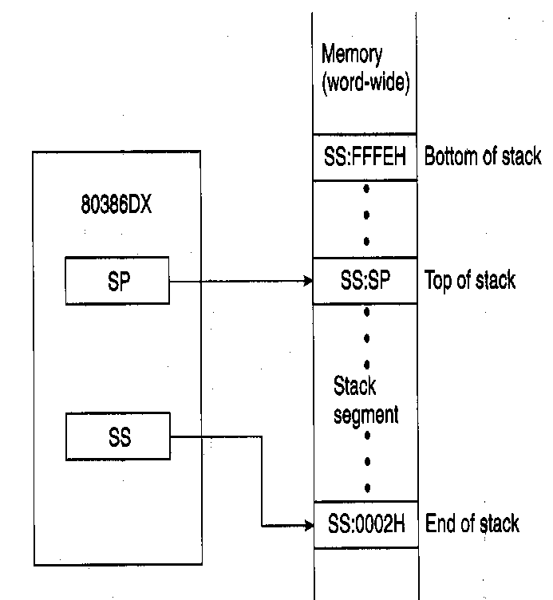
The Stack
Stack—temporary storage area in stack segment of memory
  Real mode—64K bytes long
  Organized as 32K words
  Information saved as words or double words, not bytes
Organization of stack
  SS:0002H→ end of stack (lowest addressed word)
  SS:FFFEH→ bottom of stack (highest addressed word)
  SS:SP→ top of stack (last stack location where data was pushed)
  Stack grows down from higher to lower address
Used by call, push, pop, and return operations
    PUSH ESI → causes the current content of the ESI register to be pushed onto the stack
    POP ESI → causes the value at the top of the stack to be popped back into the ESI register
Microprocessors I: Lecture 4
Notes:
Chapter 2

Slide 12
Next time
Continue with stack
I/O address space
Assembly programming intro
Microprocessors I: Lecture 4

