Slide 1
16.317: Microprocessor System Design I
Instructor: Dr. Michael Geiger
Spring 2012
Lecture 5: Stack, I/O address space, assembly programming intro
Notes:
Chapter 2

Slide 2
Lecture outline
Announcements/reminders
  Register for the discussion group on piazza.com
    Search by course # “16.317”, semester Spring 2012
  Course handouts on:
  http://mgeiger.eng.uml.edu/16317/sp12
    HW1 posted; due 2/10
    Lab 1 to be posted shortly
Lecture outline
  Review
    Real mode address generation
  Today
    Stack
    I/O address space
    Assembly programming overview
Microprocessors I: Lecture 5

Slide 3
Review
Logical vs. physical addresses (in 386)
  Logical address: base/offset register pair
    i.e. CS:IP, DS:SI, SS:SP
  Physical address: actual address in memory
    In 386, calculate by shifting base left by 4 bits, adding offset
    Example: CS = 0x1000 and IP = 0x1234
    → Physical addr. = 0x10000 + 0x1234 = 0x11234
  Can have multiple logical addresses mapping to same physical address: aliases
Microprocessors I: Lecture 5

Slide 4
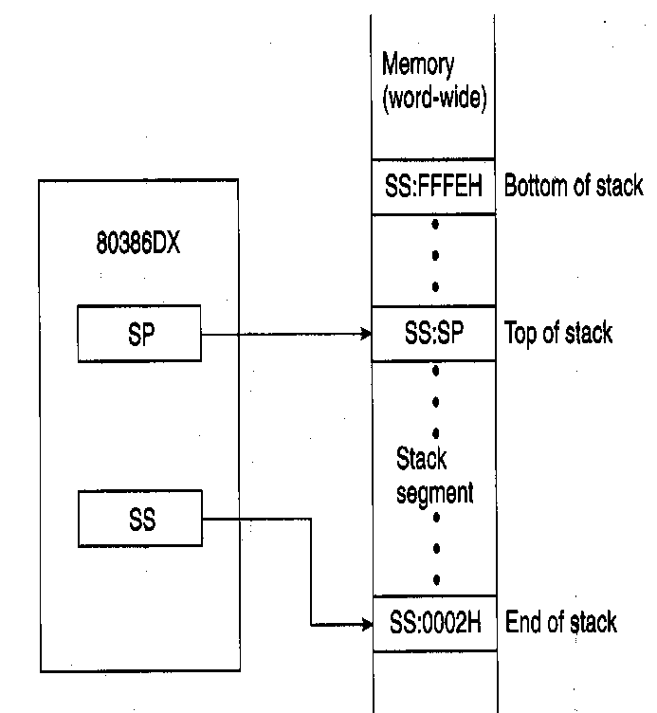
The Stack
Stack—temporary storage area in stack segment of memory
  Real mode—64K bytes long
  Organized as 32K words
  Information saved as words or double words, not bytes
Organization of stack
  SS:0002H→ end of stack (lowest addressed word)
  SS:FFFEH→ bottom of stack (highest addressed word)
  SS:SP→ top of stack (last stack location where data was pushed)
  Stack grows down from higher to lower address
Used by call, push, pop, and return operations
    PUSH ESI → causes the current content of the ESI register to be pushed onto the stack
    POP ESI → causes the value at the top of the stack to be popped back into the ESI register
Microprocessors I: Lecture 5
Notes:
Chapter 2

Slide 5
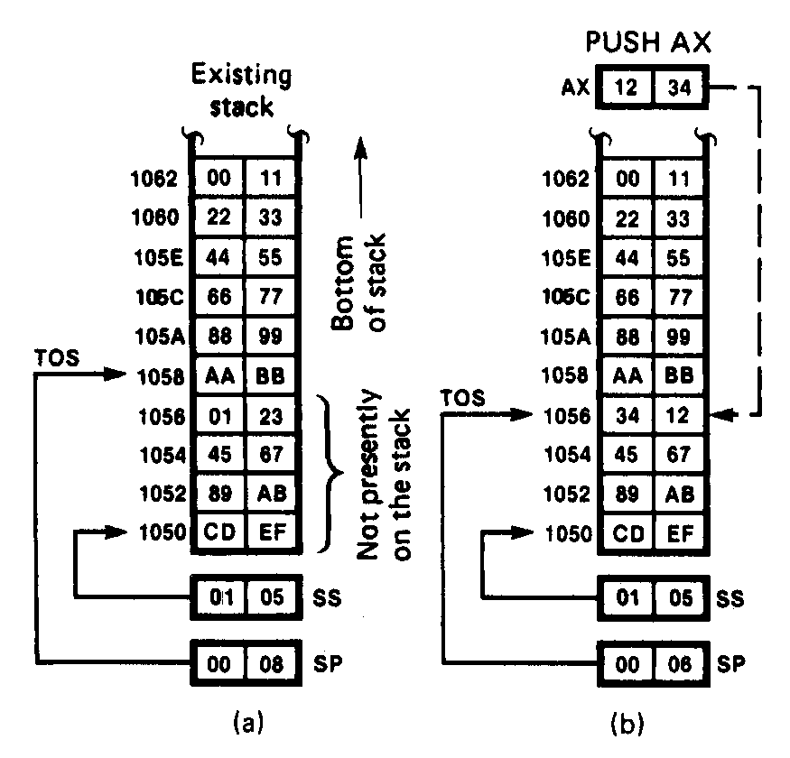
The Stack - Push Stack Operation
Status of the stack prior to execution of the instruction PUSH AX
AX = 1234H
    SS = 0105H
  A_{EOS} = SS:02 → 01052H = end of stack
  SP = 0008H
  A_{TOS} = SS:SP → 01058H = current top of stack
  A_{BOS} = SS:FFFE → 1104EH
  BBAAH = Last value pushed to stack
  Addresses < 01058H = invalid stack data
  Addresses >= 01058H = valid stack data
In response to the execution of PUSH AX instruction
    1. SP→ 0006 decremented by 2
    A_{TOP} → 01056H
2. Memory write to stack segment
AL = 34H → 01056H
AH = 12H → 01057H
Microprocessors I: Lecture 5
Notes:
Chapter 2

Slide 6
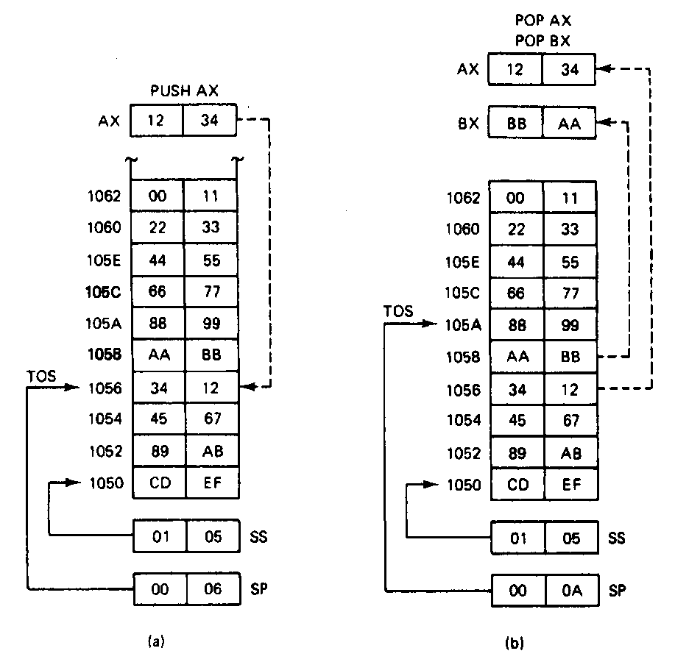
The Stack- Pop Stack Operation
Status of the stack prior to execution of the instruction POP AX
AX = XXXXH
    SS = 0105H
  SP = 0006H
  A_{TOS} = SS:SP → 01056H = current top of stack
  1234H = Last value pushed to stack
  Addresses < 01056H = invalid stack data
  Addresses >= 01056H = valid stack data
1
2
execution of POP AX instruction
1. Memory read to AX
01056H = 34H → AL
01057H = 12H → AH
2. SP→ 0008H incremented by 2
    A_{TOP} → 01058H
execution of POP BX instruction
1. Memory read to BX
01058H = AAH → BL
01059H = BBH → BH
2. SP→ 000AH incremented by 2
    A_{TOP} → 0105AH
Microprocessors I: Lecture 5
Notes:
Chapter 2

Slide 7
Stack examples
Given the following register values:
  SS = 0x3170
  SP = 0xFFFE
    Stack is initially empty
  EAX = 0x12345678
  EBX = 0xDEADBEEF
  ECX = 0x0000FFFF
  EDX = 0x11223344
What is the state of the stack and the registers after the following sequence?
  PUSH AX
  PUSH BX
  PUSH CX
  POP DX
  PUSH AX
  POP BX
  POP AX
  PUSH DX
Microprocessors I: Lecture 5

Slide 8
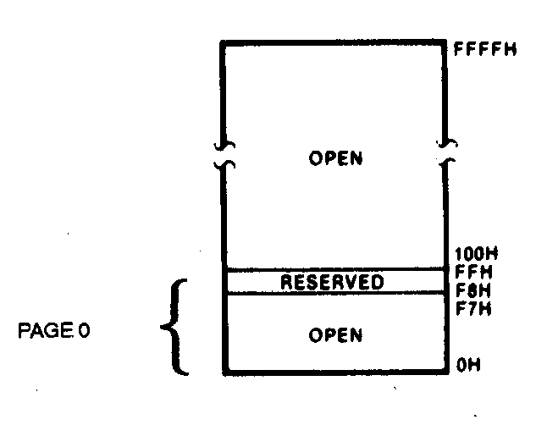
I/O Address Space
Input/output address space
  Place where I/O devices are normally implemented
  I/O addresses are only 16-bits in length
  Independent 64K-byte address space
  Address range 0000H through FFFFH
Page 0
  First 256 byte addresses→ 0000H - 00FFH
  Can be accessed with direct or variable I/O instructions
  Ports F8H through FF reserved
Microprocessors I: Lecture 5
Notes:
Chapter 2

Slide 9
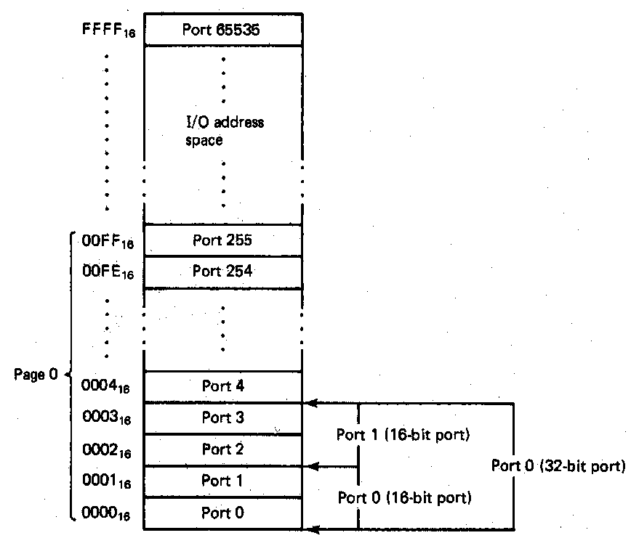
Organization of the I/O Data
Input/output data organization
  Supports byte, word, and double-word I/O ports
    64K independent byte-wide I/O ports
    32K independent word-wide I/O ports
    16K independent double-word-wide I/O ports
Examples (aligned I/O ports):
  Byte ports 0,1,2 → addresses 0000H, 0001H, and 0002H
  Word ports 0,1,2 → addresses 0000H, 0002H, 0004H
  Double-word ports 0,1,2 → addresses 0000H, 0004H, 0008H
Advantages of Isolated I/O
  Complete memory address space available for use by memory
  I/O instructions tailored to maximize performance
Disadvantage of Isolated I/O
  All inputs/outputs must take place between I/O port and accumulator register
Microprocessors I: Lecture 5
Notes:
Chapter 2

Slide 10
Software
Instruction -> Program -> Software
Machine language -> Assembly Language -> High Level Language (C/C++, Java)
Source code -> Object code -> Executable
Assembly language
  Instruction: Label: Instruction ; comment
  Example: START: MOV EAX, EBX; COPY EBX INTO EAX
  List file: line number, offset, machine language (code), instruction, comments
Microprocessors I: Lecture 5

Slide 11
Assembly Language Program Development
Assemble the program
Describe the problem
Yes
Syntax error
Plan steps of solution
No
Object module
flowchat
LINK the program
Implement flowchat using
Assembly language
Execute and debug
Handwritten
source program
Enter/edit source program
Yes
logic error
No
done
Assembler
source program
Microprocessors I: Lecture 5

Slide 12
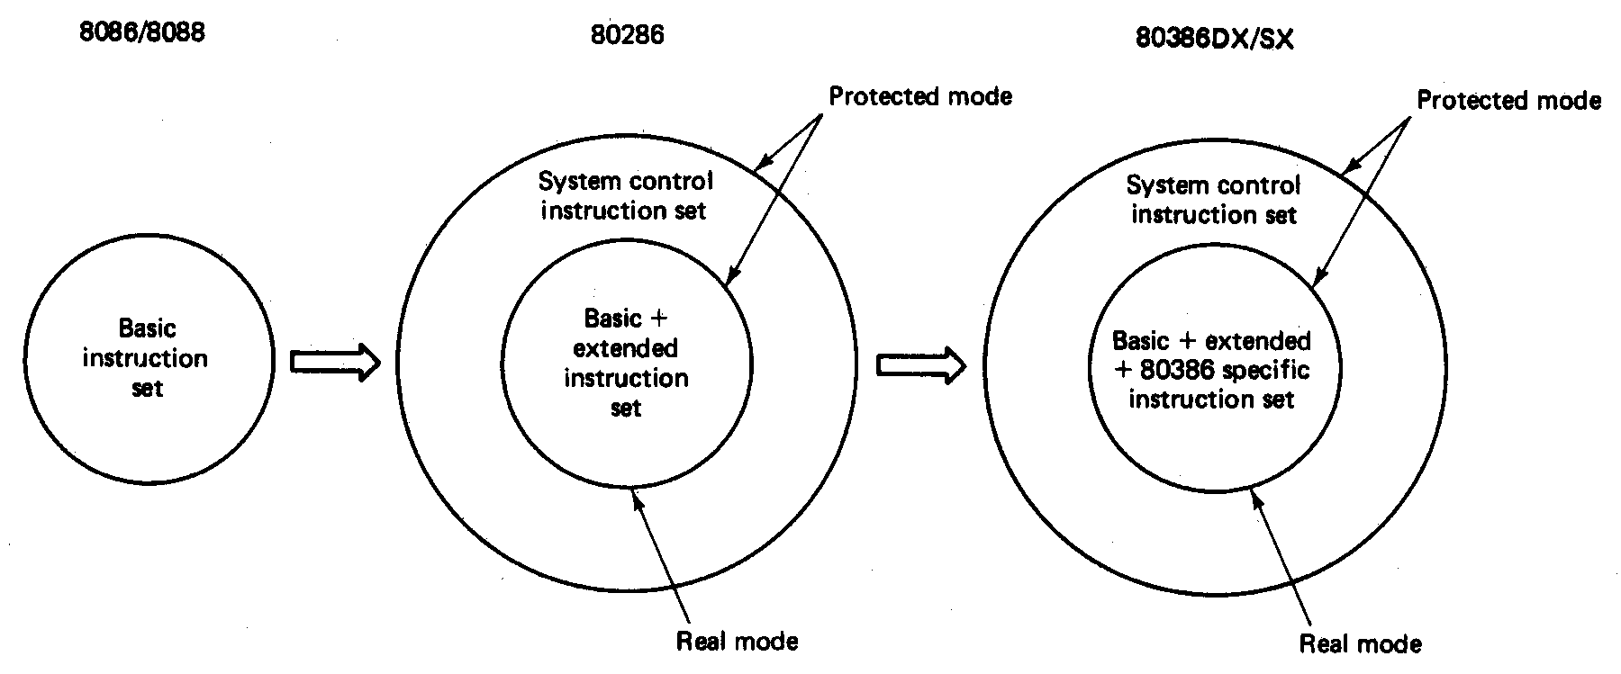
The 80386DX Base Instruction Set
Instruction set
  Defines the basic operations a programmer can make the microprocessor perform
  8088/8086 instruction set contains 117 basic instructions
Microprocessors I: Lecture 5
Notes:
Chapter 3

Slide 13
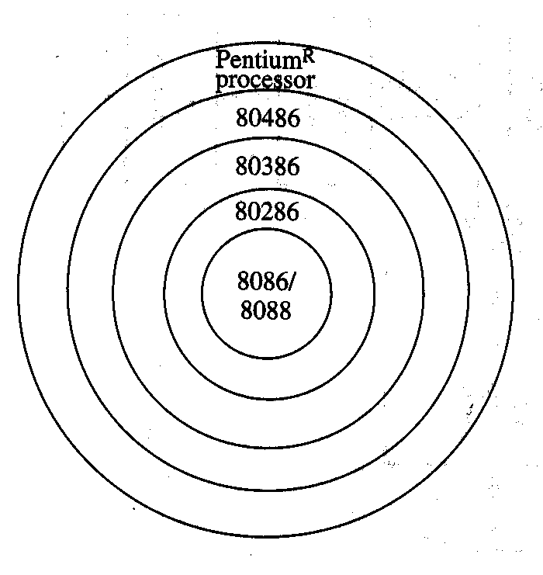
Instruction Set Compatibility
The 80x86 instruction set has evolved in an upward compatible manner
  Base instruction set → 8088/8086 processor
  Extended instruction set → 80286 processor
  System control instruction set → 80286 processor
  80386 specific instruction set → 80386DX/SX
  80486 specific instruction set → 80486DX/SX
  Pentium specific instruction set → Original Pentium processor
Microprocessors I: Lecture 5

Slide 14
Instruction Groups
Instruction groups
  Instructions are organized into groups of functionally related instructions
    Data Transfer instructions
    Input/output instructions
    Arithmetic instructions
    Logic instructions
    String Instructions
    Control transfer instructions
    Processor control
Microprocessors I: Lecture 5
Notes:
Chapter 3

Slide 15
Instruction Assembly Notation
  Each instruction is represented by a mnemonic that describes its operation—called its operation code (opcode)
    MOV = move → data transfer
    ADD = add → arithmetic
    AND = logical AND → logic
    JMP = unconditional jump → control transfer
  Operands are the other parts of an assembly language Instructions
    Identify whether the elements of data to be processed are in registers or memory
      Source operand– location of one operand to be process
      Destination operand—location of the other operand to be processed and the location of the result
Microprocessors I: Lecture 5

Slide 16
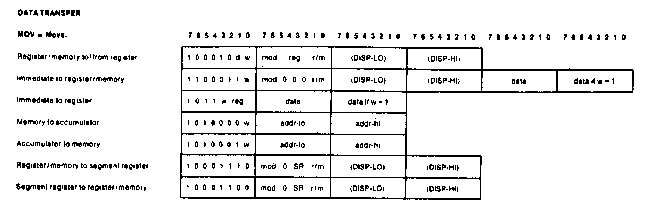
Machine Language
Native language of the 8088/8086 (PC) is machine language (code)
  One to one correspondence to assembly language statements
  Instructions encoded with 0’s and 1’s
  Machine instructions can take up from 1 to 6 bytes
  Example: Move=MOV
    The wide choice of register operands, memory operands, and addressing mode available to access operands in memory expands the move instruction to 28 different forms
    Ranges in size from 2 to 6 bytes
Microprocessors I: Lecture 5
Notes:
Chapter 3

Slide 17
Structure of an Assembly Language Statement
General structure of an assembly language statement
LABEL: INSTRUCTION ;COMMENT
  Label—address identifier for the statement
  Instruction—the operation to be performed
  Comment—documents the purpose of the statement
  Example:
START: MOV AX, BX ; Copy BX into AX
Other examples:
  INC SI ;Update pointer
ADD AX, BX
  Few instructions have a label—usually marks a jump to point
  Not all instructions need a comment
Microprocessors I: Lecture 5
Notes:
Chapter 3

Slide 18
Next time
Basic assembly program structure
Addressing modes (intro)
Microprocessors I: Lecture 5

