Slide 1
16.317: Microprocessor System Design I
Instructor: Dr. Michael Geiger
Spring 2012
Lecture 6: Assembly intro, addressing modes
Notes:
Chapter 2

Slide 2
Lecture outline
Announcements/reminders
  Register for the discussion group on piazza.com
    Search by course # “16.317”, semester Spring 2012
  Course handouts on:
  http://mgeiger.eng.uml.edu/16317/sp12
    HW1 posted; due 2/10
    Lab 1 to be posted next week
Lecture outline
  Review
    Stack
    I/O address space
  Today
    Assembly programming intro
    Addressing modes
Microprocessors I: Lecture 6

Slide 3
Review
Stack
  Stores data related to function calls
    Saved processor state
    Return address
    Function variables
  Grows from high to low addresses
  Stack accesses
    Push → add data to stack, decrement SP
    Pop → remove data from stack, increment SP
I/O address space
  Dedicated I/O in 386
  Can access byte, word, or double word ports
Microprocessors I: Lecture 6

Slide 4
Software
Instruction -> Program -> Software
Machine language -> Assembly Language -> High Level Language (C/C++, Java)
Source code -> Object code -> Executable
Assembly language
  Instruction: Label: Instruction ; comment
  Example: START: MOV EAX, EBX; COPY EBX INTO EAX
  List file: line number, offset, machine language (code), instruction, comments
Microprocessors I: Lecture 6

Slide 5
Assembly Language Program Development
Assemble the program
Describe the problem
Yes
Syntax error
Plan steps of solution
No
Object module
flowchart
LINK the program
Implement flowchart using
Assembly language
Execute and debug
Handwritten
source program
Enter/edit source program
Yes
logic error
No
done
Assembler
source program
Microprocessors I: Lecture 6

Slide 6
Instruction Groups
Instruction groups
  Instructions are organized into groups of functionally related instructions
    Data Transfer instructions
    Input/output instructions
    Arithmetic instructions
    Logic instructions
    String Instructions
    Control transfer instructions
    Processor control
Microprocessors I: Lecture 6
Notes:
Chapter 3

Slide 7
Instruction Assembly Notation
  Each instruction is represented by a mnemonic that describes its operation—called its operation code (opcode)
    MOV = move → data transfer
    ADD = add → arithmetic
    AND = logical AND → logic
    JMP = unconditional jump → control transfer
  Operands are the other parts of an assembly language Instructions
    Identify whether the elements of data to be processed are in registers or memory
      Source operand– location of one operand to be process
      Destination operand—location of the other operand to be processed and the location of the result
Microprocessors I: Lecture 6

Slide 8
Structure of an Assembly Language Statement
General structure of an assembly language statement
LABEL: INSTRUCTION ;COMMENT
  Label—address identifier for the statement
  Instruction—the operation to be performed
  Comment—documents the purpose of the statement
  Example:
START: MOV AX, BX ; Copy BX into AX
Other examples:
  INC SI ;Update pointer
ADD AX, BX
  Few instructions have a label—usually marks a jump to point
  Not all instructions need a comment
Microprocessors I: Lecture 6
Notes:
Chapter 3

Slide 9
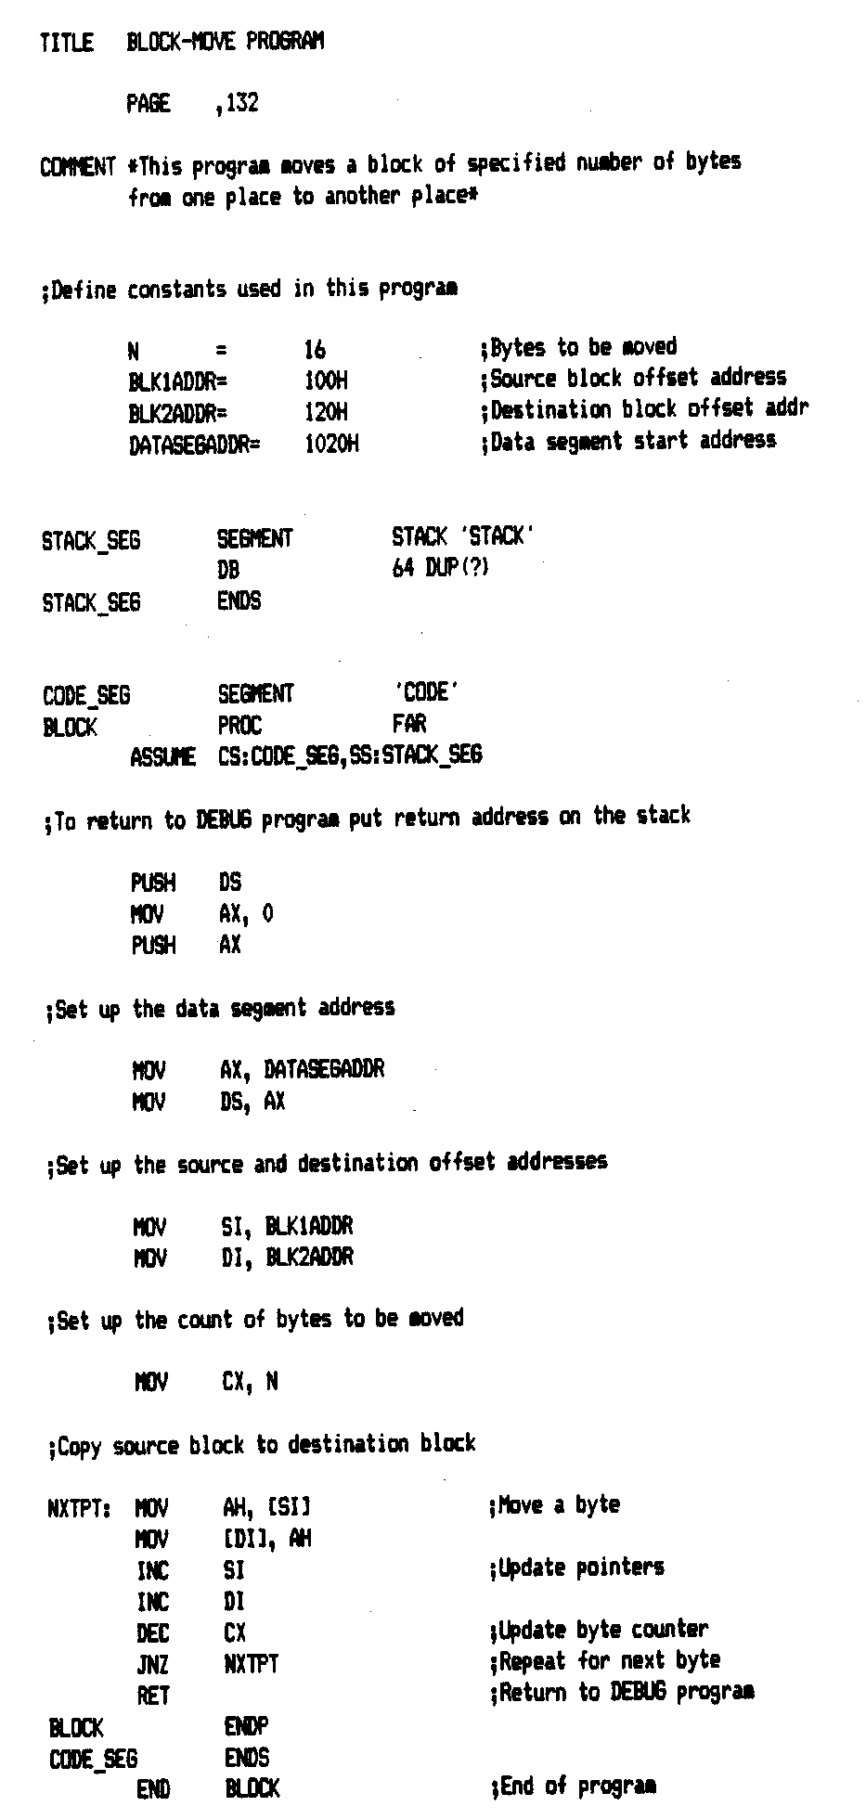
Source Program
Microprocessors I: Lecture 6
Notes:
Chapter 3

Slide 10
Assembler and the source program
Assembly language program
  Assembly language program (.asm) file—known as source code
  Converted to machine code by a process called assembling
  Assembling performed by a software program—an 80x86 assembler
  Machine (object ) code that can be run is output in the executable (.exe) file
  Source listing output in (.lst) file—printed and used during execution and debugging of program
DEBUG—part of disk operating system (DOS) of the PC
  Permits programs to be assembled and disassembled
  Line-by-line assembler
  Also permits program to be run and tested
Microprocessors I: Lecture 6

Slide 11
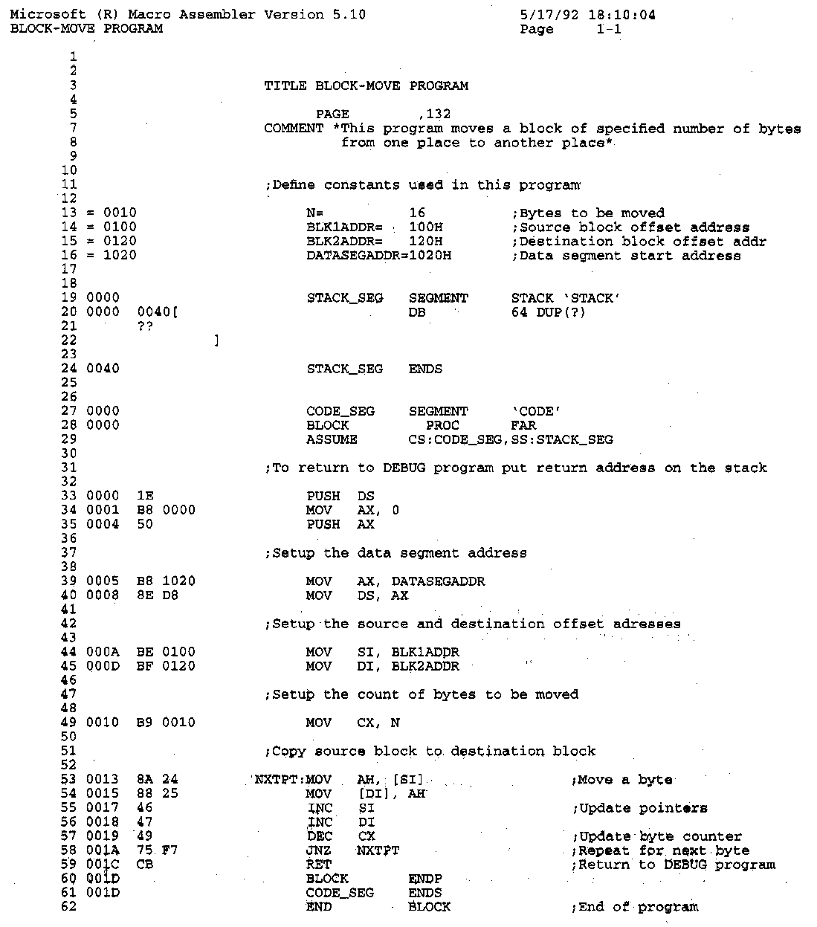
The Listing File
Microprocessors I: Lecture 6
Notes:
Chapter 3

Slide 12
The Listing File
Instruction statements—operations to be performed by the program
  Example—line 53
0013 8A 24 NXTPT: MOV AH, [SI] ;Move a byte
Where:
0013 = offset address of first byte of code in the current CS
8A24 = machine code of the instruction
NXTPT: = Label
MOV = instruction mnemonic
AH = destination operand—a register
[SI] = source operand—in memory
;Move xxxxx = comment
Directives—provides directions to the assembler program
  Example—line 20
  0000 0040 DB 64 DUP(?)
Defines and leaves un-initialized a block of 64 bytes in memory for the stack
Microprocessors I: Lecture 6

Slide 13
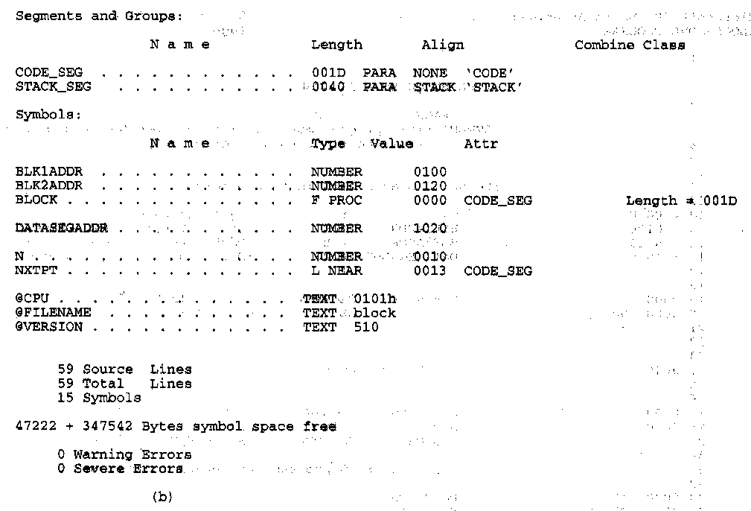
More Information in the Listing
Other information provided in the listing
  Size of code segment and stack
  Names, types, and values of constants and variables
  # lines and symbols used in the program
  # errors that occurred during assembly
Microprocessors I: Lecture 6
Notes:
Chapter 3

Slide 14
Addressing Modes
Instructions perform the operation they specify on elements of data that are called its operand
Types of operands
  Source operand
  Destination operand
  Content of source operand combined with content of destination operand → Result saved in destination operand location
Operands may be
  Part of the instruction—source operand only
  Held in one of the internal registers—both source and destination operands
  Stored at an address in memory—either the source or destination operand
  Held in an input/output port—either the source or destination operand
Microprocessors I: Lecture 6
Notes:
Chapter 3

Slide 15
Addressing Modes
Types of addressing modes
  Register addressing modes
  Immediate operand addressing
  Memory operand addressing
Each operand can use a different addressing mode
Microprocessors I: Lecture 6

Slide 16
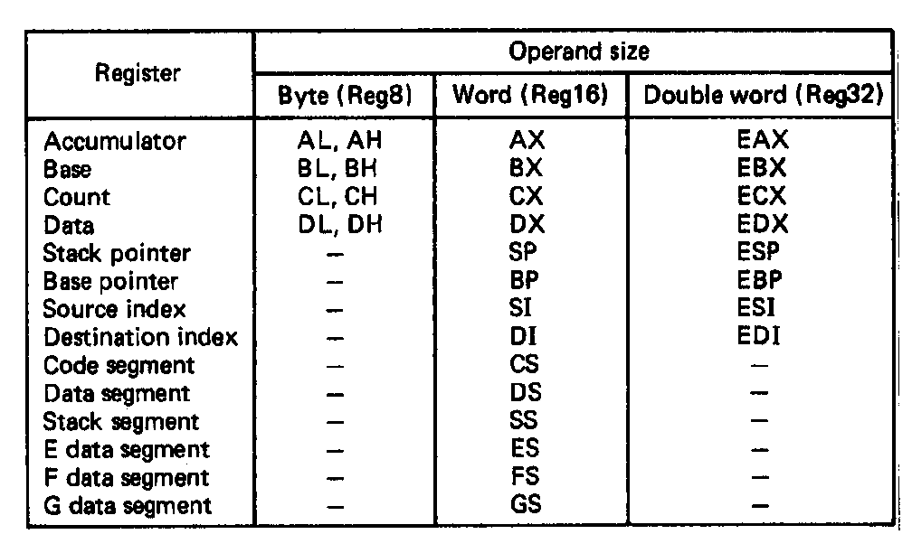
Register Operand Addressing Mode
Register addressing mode operands
  Source operand and destination operands are both held in internal registers of the 80386DX/SX
  Only the data registers can be accessed as bytes, words, or double words
    Ex. AL,AH → bytes
    AX → word
    EAX → double word
  Index and pointer registers as words or double words
  Ex. SI → word pointer
  ESI → double word pointer
  Segment registers only as words
    Ex. DS → word pointer
Microprocessors I: Lecture 6
Notes:
Chapter 3

Slide 17
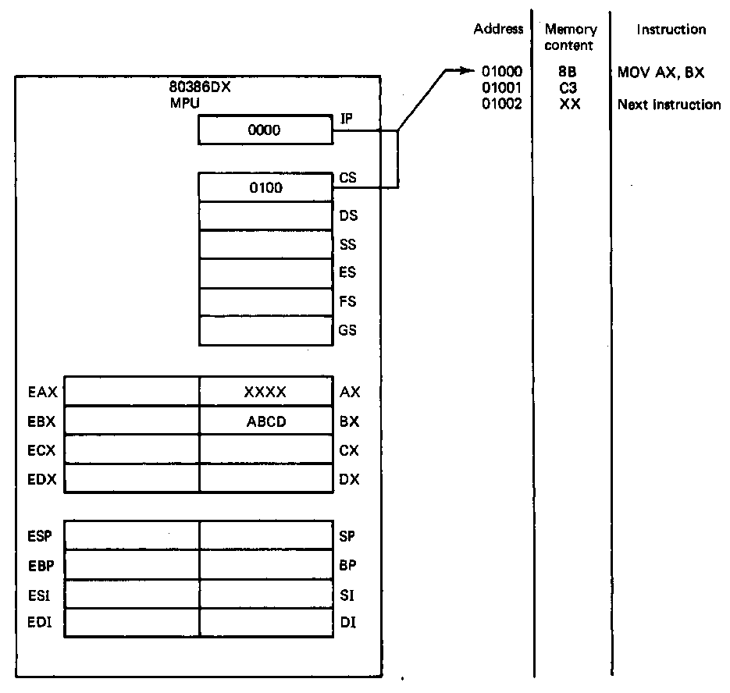
Register Operand Addressing Mode
Example
  MOV AX,BX
  Source = BX → word data
  Destination = AX → word data
  Operation: (BX) → (AX)
State before fetch and execution
  CS:IP = 0100:0000 = 01000H
  Move instruction code = 8BC3H
  (01000H) = 8BH
  (01001H) = C3H
  (BX) = ABCDH
  (AX) = XXXX → don’t care state
Microprocessors I: Lecture 6
Notes:
Chapter 3

Slide 18
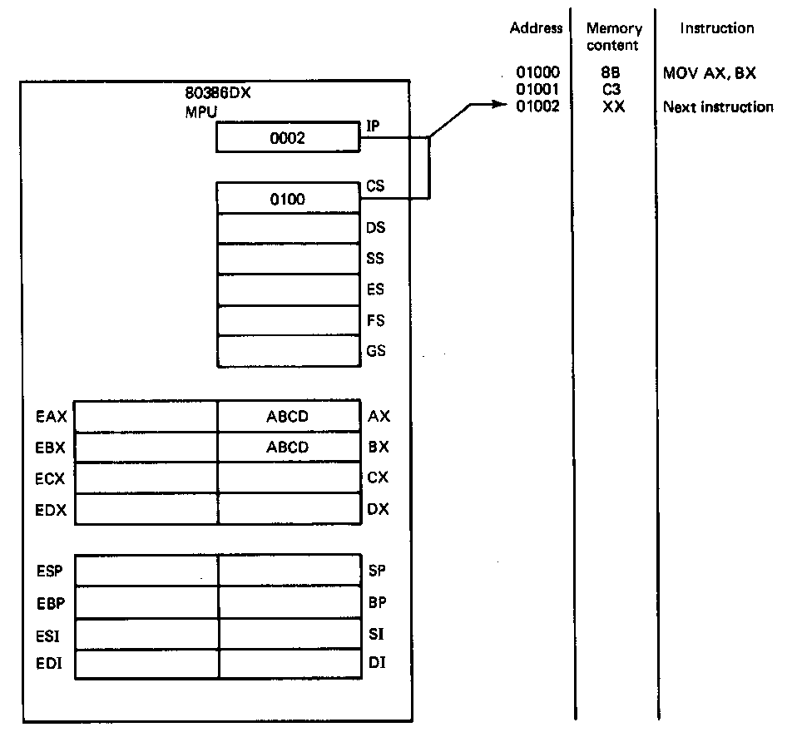
Register Operand Addressing Mode
Example (continued)
State after execution
  CS:IP = 0100:0002 = 01002H
  01002H → points to next sequential instruction
  (BX) = ABCDH
  (AX) = ABCDH → Value in BX copied
  into AX
  Rest of the bits in EAX unaffected
Microprocessors I: Lecture 6
Notes:
Chapter 3

Slide 19
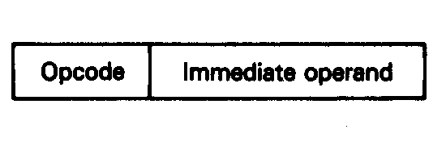
Immediate Operand Addressing Mode
Immediate operand
  Operand is coded as part of the instruction
  Applies only to the source operand
  Destination operand uses register addressing mode or a memory addressing mode
Types
  Imm8 = 8-bit immediate operand
  Imm16 = 16-bit immediate operand
  Imm32 = 32-bit immediate operand
General instruction structure and operation
  MOV Rx,ImmX
  ImmX → (Rx)
Microprocessors I: Lecture 6
Notes:
Chapter 3

Slide 20
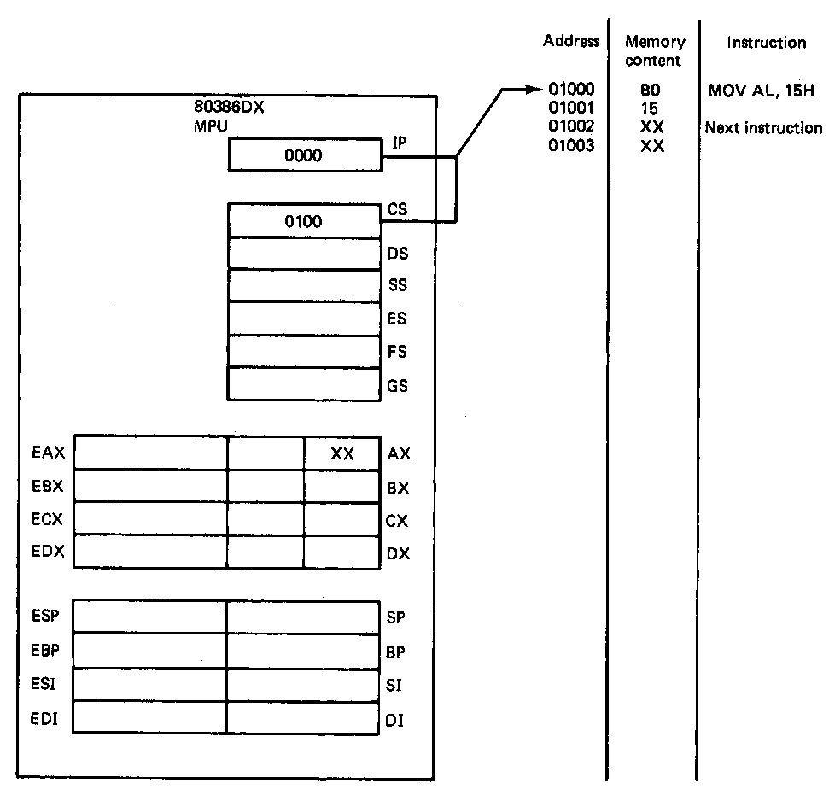
Immediate Operand Addressing Mode
Example
  MOV AL,15H
  Source = Imm8 → immediate byte data
  Destination = AL → Byte of data
  Operation: (Imm8) → (AL)
State before fetch and execution
  CS:IP = 0100:0000 = 01000H
  Move instruction code = B015H
  (01000H) = B0H
  (01001H) = 15H → Immediate data
  (AL) = XX → don’t care state
Microprocessors I: Lecture 6
Notes:
Chapter 3

Slide 21
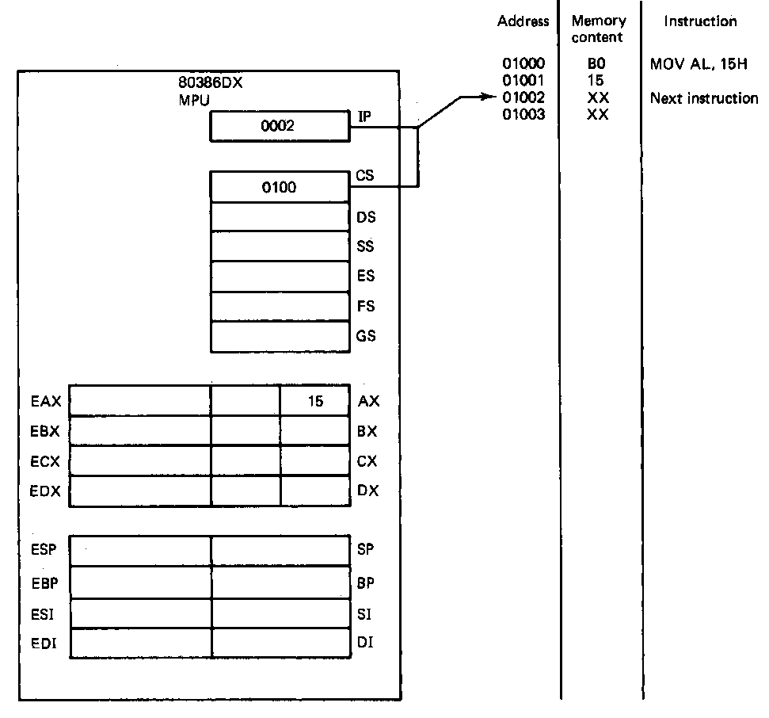
Immediate Operand Addressing Mode
Example (continued)
State after execution
  CS:IP = 0100:0002 = 01002H
  01002H → points to next sequential instruction
  (AL) = 15H → Immediate value in
  copied into AX
    Rest of bits in EAX unaffected
Microprocessors I: Lecture 6
Notes:
Chapter 3

Slide 22
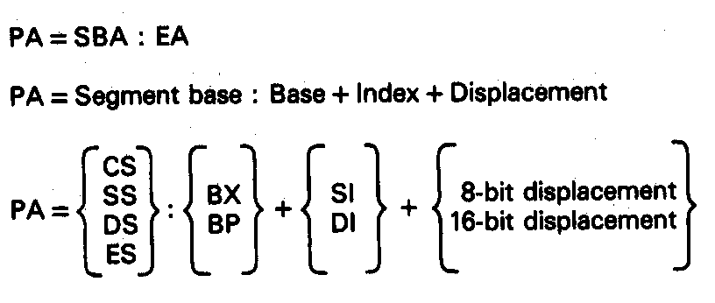
16-bit Memory Operand Addressing Modes
Accessing operands in memory
  Only one operand can reside in memory—either the source or destination
  Calculate the 20-bit physical address (PA) at which the operand in stored in memory
  Perform a read or write to this memory location
  16-bit memory addressing modes produce 8088/8086/80286 compatible code
Microprocessors I: Lecture 6
Notes:
Chapter 3

Slide 23
16-bit Memory Operand Addressing Modes
Physical address computation
  Given in general as
    PA = SBA:EA
    SBA = Segment base address
    EA = Effective address
  Components of a effective address
    Base → base registers BX or BP
    Index → index register SI or DI
    Displacement → 8 or 16-bit displacement
    Not all elements are used in all computations—results in a variety of addressing modes
Microprocessors I: Lecture 6

Slide 24
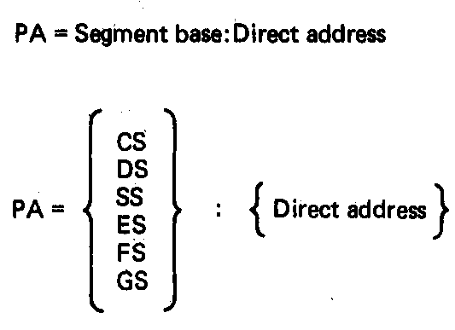
Direct Addressing Mode
Direct addressing mode
  Similar to immediate addressing in that information coded directly into the instruction
  Immediate information is the effective address—called the direct address
Physical address computation
  PA = SBA:EA → 20-bit address
    PA = SBA:[DA] → immediate 8-bit or 16 bit displacement
  Segment base address is DS by default
    PA = DS:[DA]
  Segment override prefix (SEG) is required to enable use of another segment register
  PA = ES:[DA]
Microprocessors I: Lecture 6
Notes:
Chapter 3

Slide 25
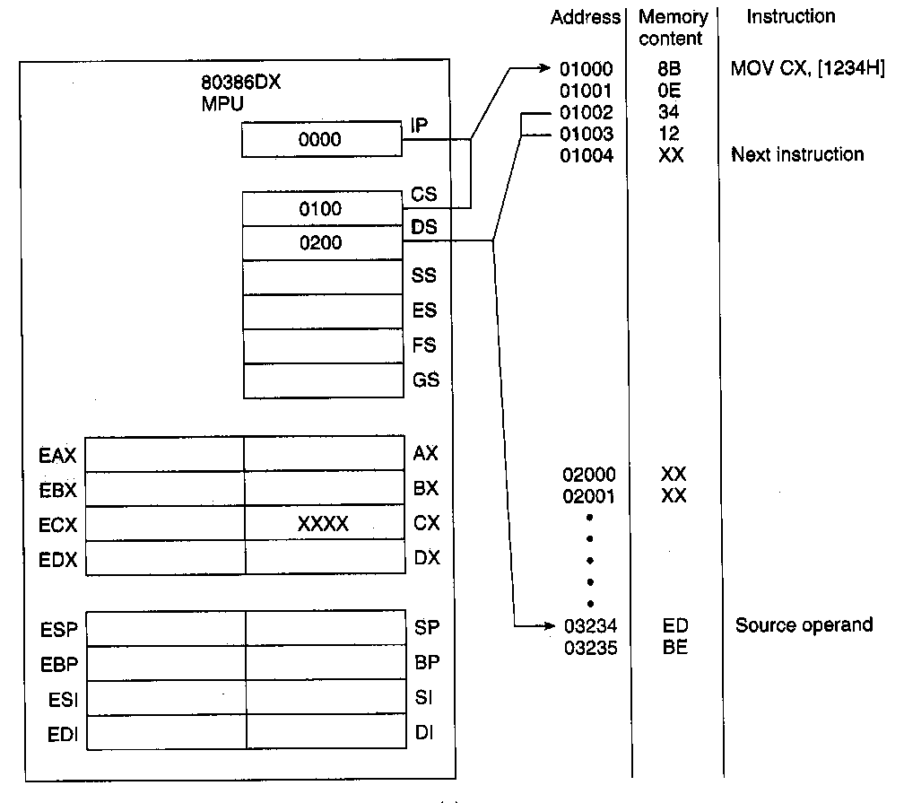
Direct Addressing Mode (Example: MOV CX, [1234H] )
State before fetch and execution
  Instruction
  CS = 0100H
  IP = 0000H
  CS:IP = 0100:0000H = 01000H
  (01000H,01001H) = Opcode = 8B0E
  (01003H,01002) = DA = 1234H
  Source operand—direct address
  DS = 0200H
  DA = 1234H
  PA = DS:DA = 0200H:1234H
  = 02000H + 1234H
  = 03234H
  (03235H,03234H) = BEEDH
  Destination operand—register operand addressing
  (CX) = XXXX → don’t care state
Microprocessors I: Lecture 6
Notes:
Chapter 3

Slide 26
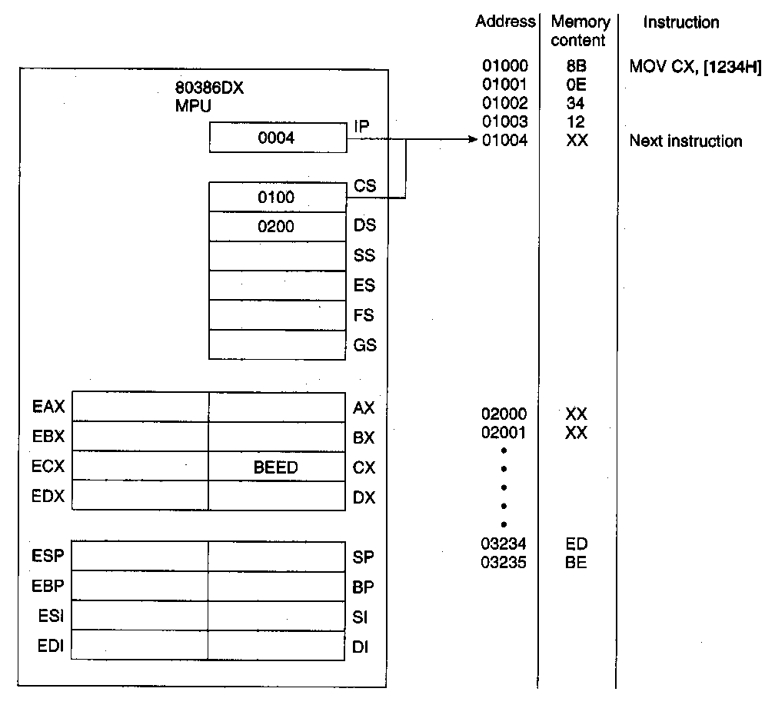
Direct Addressing Mode (Example: MOV CX, [1234H] )
Example (continued)
State after execution
  Instruction
  CS:IP = 0100:0004 = 01004H
  01004H → points to next sequential instruction
  Source operand
  (03235H,03234H) = BEEDH → unchanged
  Destination operand
  (CX) = BEED
  Rest of bits in ECX unaffected
Microprocessors I: Lecture 6
Notes:
Chapter 3

Slide 27
Next time
Continue with addressing modes
Brief discussion of machine code
Microprocessors I: Lecture 6

