Slide 1
16.317: Microprocessor System Design I
Instructor: Dr. Michael Geiger
Spring 2012
Lecture 8: Data Transfer Instructions
Notes:
Chapter 2

Slide 2
Lecture outline
Announcements/reminders
  HW 1 due Friday, 2/10
  Lab 1 to be posted; due date TBD
Lecture outline
  Review: memory addressing modes
  Today: data transfer instructions
Microprocessors I: Lecture 8

Slide 3
Review: Addressing modes
Addressing modes: how data is specified
  Memory operands: Address of form SBA:EA
    Direct: MOV AX, [1010H]
      EA = 1010H
    Register indirect: MOV AX, [SI]
      EA = contents of SI
    Based: MOV AX, [BX + 1234H]
      EA = (contents of BX) + 1234H
    Indexed: MOV AX, [SI + 1234H]
      EA = (contents of SI) + 1234H
    Based-indexed: MOV AX, [BX + SI + 1234H]
      EA = (contents of BX) + (contents of SI) + 1234H
Microprocessors I: Lecture 8

Slide 4
Instruction types
80386DX instruction types
  Data Transfer instructions
  Input/output instructions
  Arithmetic instructions
  Logic instructions
  String Instructions
  Control transfer instructions
  Processor control
Microprocessors I: Lecture 8

Slide 5
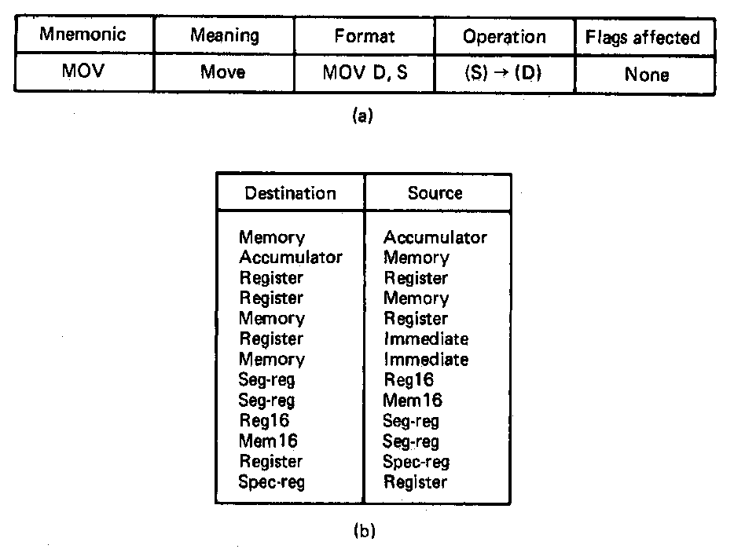
Move Instruction
Used to move (copy) data between:
  Registers
  Register and memory
  Immediate operand to a register or memory
General format: MOV D,S
Operation: Copies the content of the source to the destination
  (S) → (D)
  Source contents unchanged
  Flags unaffected
Allowed operands
  Register
  Memory
  Accumulator (AH,AL,AX,EAX)
  Immediate operand (S only)
  Segment register (Seg-reg)
Example:
  MOV [SUM],AX
  (AL) → (address SUM)
  (AH) → (address SUM+1)
  What is the addressing mode of the destination?
Microprocessors I: Lecture 8
Notes:
Chapter 5 (I)

Slide 6
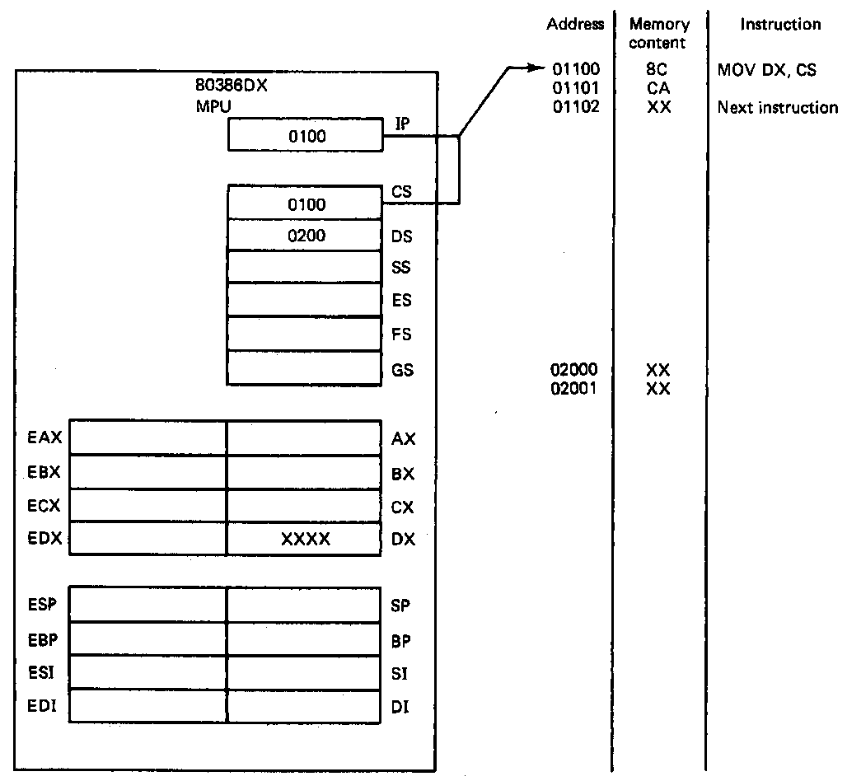
Example of Move Instruction
Example
  MOV DX,CS
  Source = CS → word data
  Destination = DX → word data
  Operation: (CS) → (DX)
State before fetch and execution
  CS:IP = 0100:0100 = 01100H
  Move instruction code = 8CCAH
  (01100H) = 8CH
  (01101H) = CAH
  (CS) = 0100H
  (DX) = XXXX → don’t care state
Microprocessors I: Lecture 8
Notes:
Chapter 5 (I)

Slide 7
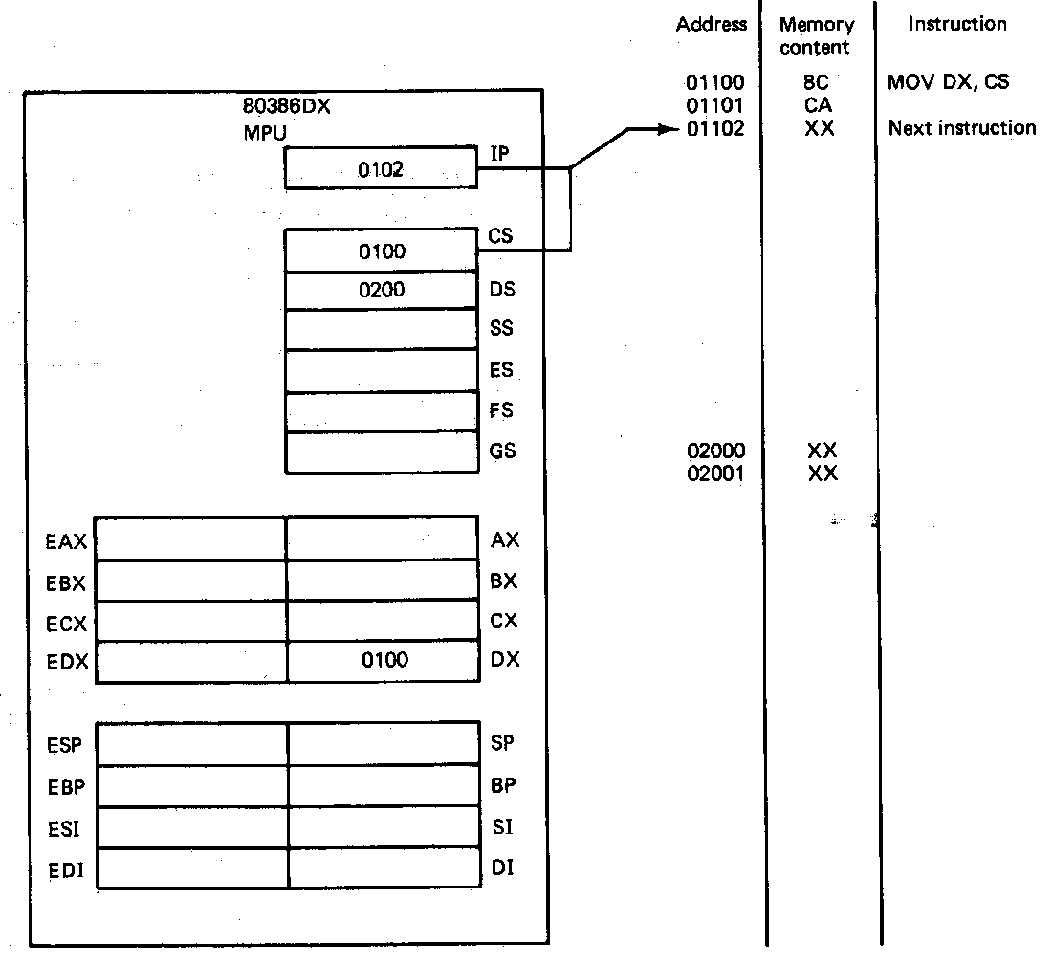
Example of Move Instruction
Example (continued)
State after execution
  CS:IP = 0100:0102 = 01102H
  01002H → points to next
  sequential instruction
  (CS) = 0100H
  (DX) = 0100H → Value in CS
  copied into DX
  - Rest of the bits in EDX
  unaffected
  - Value in CS unchanged
  How are the flags affected?
Microprocessors I: Lecture 8
Notes:
Chapter 5 (I)

Slide 8
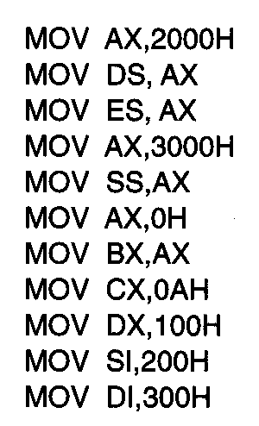
Usage of Move Instruction
Example—Initialization of internal registers with immediate data and address information
  What is the final state of all affected registers?
  Why is AX used to initialize segment registers?
Microprocessors I: Lecture 8
Notes:
Chapter 5 (I)

Slide 9
Usage of Move Instruction
Example—Initialization of internal registers with immediate data and address information
  DS, ES, and SS registers initialized from immediate data via AX
  IMM16 → (AX)
  (AX) → (DS) & (ES) = 2000H
  IMM16 → (AX)
  (AX) → (SS) = 3000H
  Data registers initialized
  IMM16 → (AX) =0000H
  (AX) → (BX) =0000H
  IMM16 → (CX) = 000AH and (DX) = 0100H
  Index register initialized from immediate operands
  IMM16 → (SI) = 0200H and (DI) = 0300H
Microprocessors I: Lecture 8
Notes:
Chapter 5 (I)

Slide 10
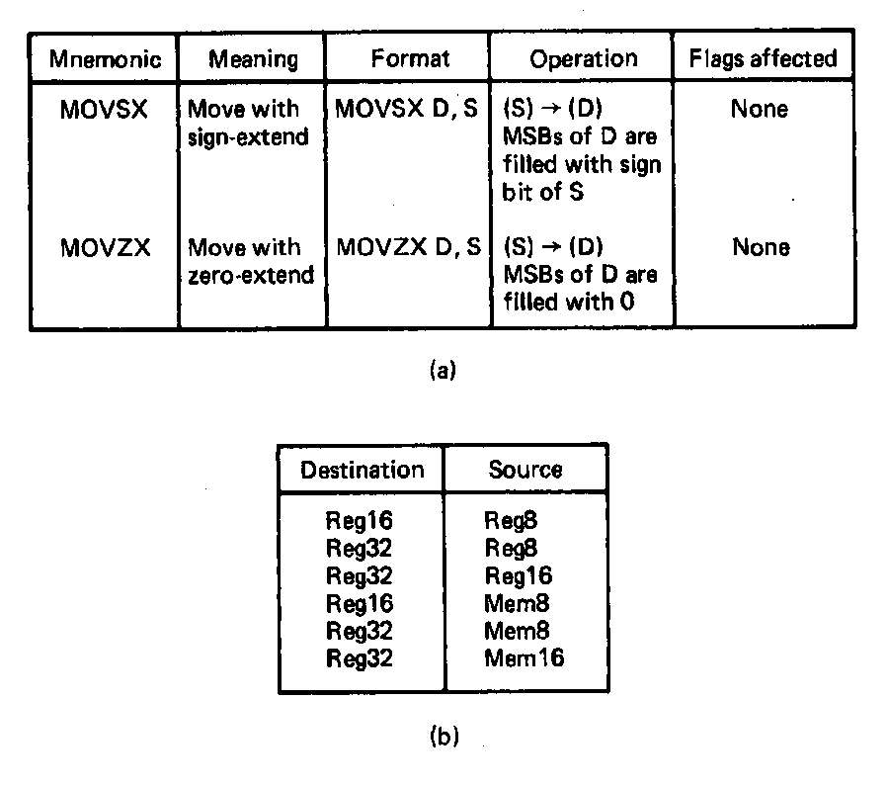
Sign-Extend and Zero-Extend Move Instruction
Sign-Extend Move instruction
  Used to move (copy) data between two registers or memory and a register and extend the value with the value of the sign bit
  General format:
    MOVSX D,S
  Operation: Copies the content of the source to the destination
    (S) → (D); source contents unchanged
    Sign bit → extended through bit 16 or 32
    Flags unaffected
  Examples: MOVSX EBX,AX
    Where: (AX) = FFFFH
    S = Reg16
    D = Reg32
    Sign bit (AX) = 1
    FFFFFFFFH → (EBX)
Zero-Extend Move instruction—MOVZX
  Operates the same as MOVSX except extends with zeros
  Example:MOVZX CX, Byte Pointer [DATA_BYTE]
  Where: (DATA_BYTE) = FFH,S = Mem8,D = Reg16
    00FFH → (CX)
Where might one use these instructions?
Why both sign extend and zero extend?
Microprocessors I: Lecture 8
Notes:
Chapter 5 (I)

Slide 11
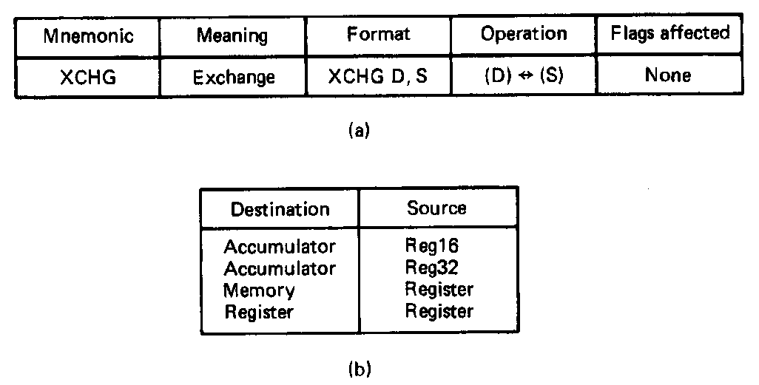
Exchange Instruction
  Used to exchange the data between two data registers or a data register and memory
  General format:
    XCHG D,S
  Operation: Swaps the content of the source and destination
    Both source and destination change
    (S) → (D)
    (D) → (S)
    Flags unaffected
  Special accumulator destination version executes faster
  Examples: XCHG AX,DX
    (Original value in AX) → (DX)
    (Original value in DX) → (AX)
Microprocessors I: Lecture 8
Notes:
Chapter 5 (I)

Slide 12
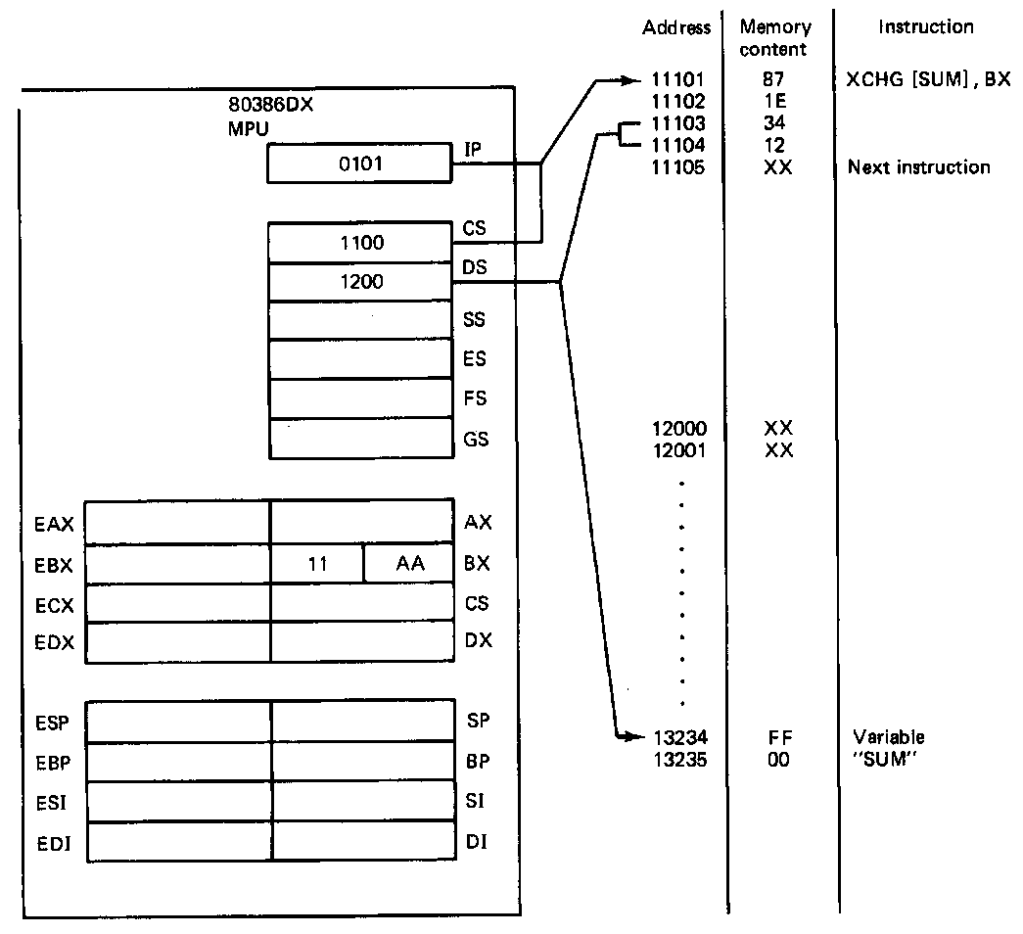
Example of Exchange Instruction
Example
  XCHG [SUM],BX
  Source = BX → word data
  Destination = memory address
  SUM → word data
  Operation:
  (SUM) → (BX)
  (BX) → (SUM)
State before fetch and execution
  CS:IP = 1100:0101 = 11101H
  XCHG instruction code = 871E3412H
  (01104H,01103H) = 1234H = SUM
  (DS) = 1200H
  (BX) = 11AA
  (DS:SUM) = (1200:1234) = 00FFH
Microprocessors I: Lecture 8
Notes:
Chapter 5 (I)

Slide 13
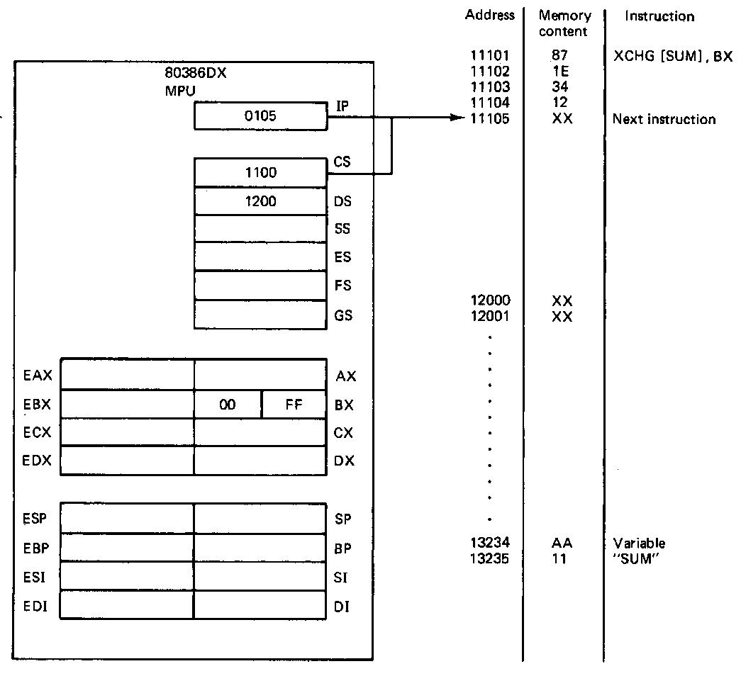
Example of Exchange Instruction
Example (continued)
State after execution
  CS:IP = 1100:0105 = 11105H
  11105H → points to next
  sequential instruction
  (BX) = 00FFH
  - Rest of the bits in EBX
  unaffected
  - Memory updated
  (1200:1234) = AAH
  (1200:1235) = 11H
Microprocessors I: Lecture 8
Notes:
Chapter 5 (I)

Slide 14
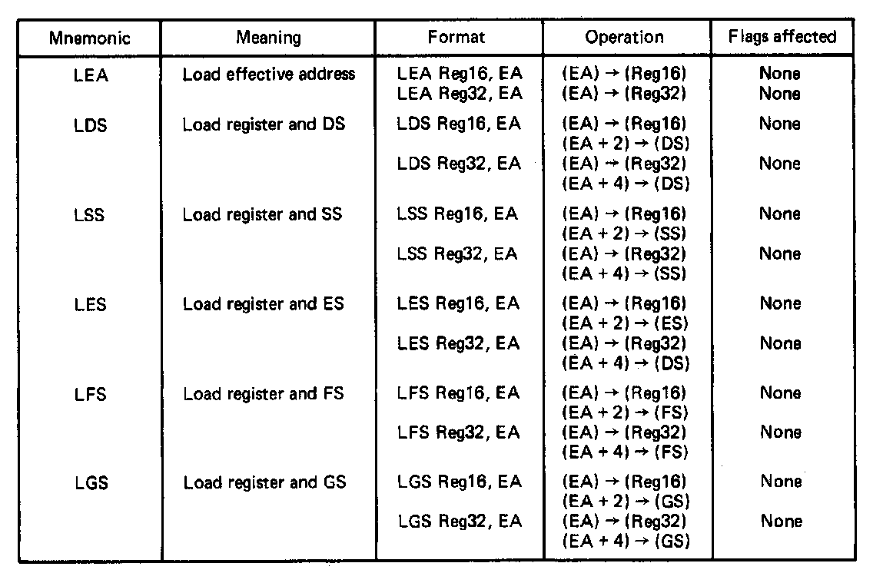
Load Effective Address
Load effective address instruction
  Used to load the effective address of memory operand into a register
  General format:
    LEA Reg16/32,EA
  Operation:
    EA → (Reg16/32)
    Source unaffected:
    Flags unaffected
Microprocessors I: Lecture 8
Notes:
Chapter 5 (I)

Slide 15
Load Full Pointer Instructions
  Used to load a full address pointer from memory into a segment register and register
  General formats and operation for LDS and LSS
  LDS Reg16/32,EA
  (EA) → (Reg16/32)
    (EA+2/4) →(DS)
  LSS Reg16/32,EA
  (EA) → (Reg16/32)
  (EA+2/4) → (SS)
  LES, LFS, and LGS operate the same
LES Reg16/32,EA (EA) → (Reg16/32),(ES)
LFS Reg16/32,EA (EA) → (Reg16/32),(FS)
LGS Reg16/32,EA (EA) → (Reg16/32),(GS)
Microprocessors I: Lecture 8
Notes:
Chapter 5 (I)

Slide 16
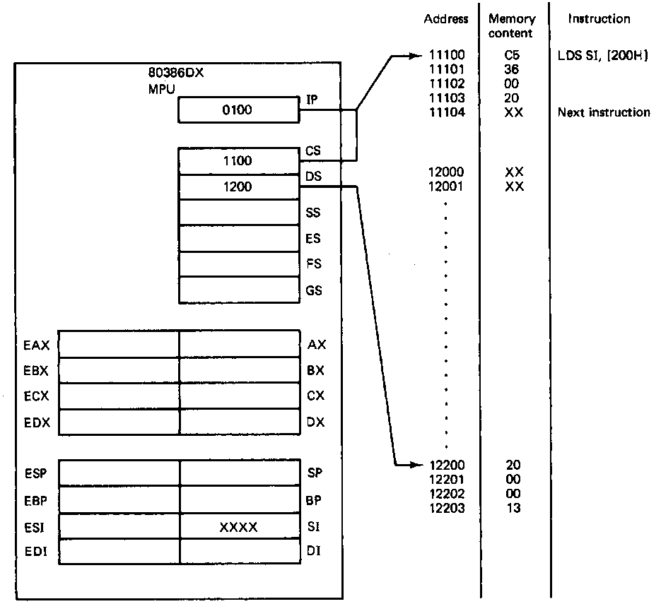
Load Full Pointer Instructions (example)
Error 02 not 20
Example
  LDS SI,[200H]
  Source = pointer at DS:200H→ 32 bits
  Destination = SI → offset of pointer
  DS → sba of pointer
  Operation: (DS:200H) → (SI)
  (DS:202H) → (DS)
State before fetch and execution
  CS:IP = 1100:0100 = 11100H
  LDS instruction code = C5360002H
  (11102H,11103H) = (EA) = 2000H
  (DS) = 1200H
  (SI) = XXXX → don’t care state
  (DS:EA) = 12200H = 0020H
  (DS:EA+2) = 12202H = 1300
Microprocessors I: Lecture 8
Notes:
Chapter 5 (I)

Slide 17
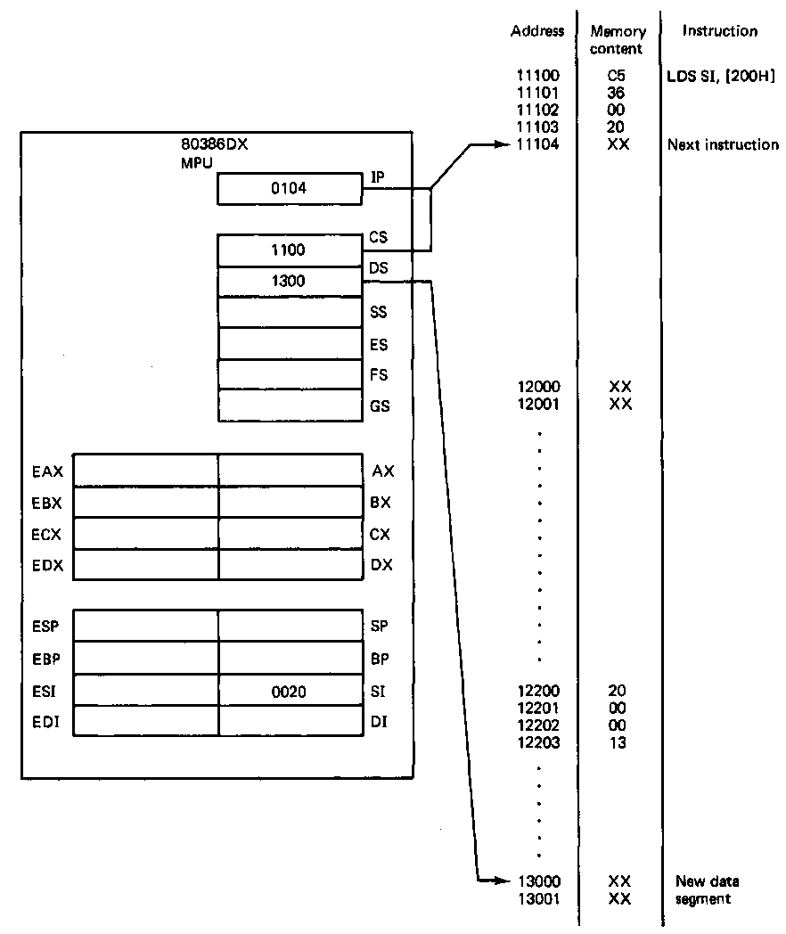
Load Full Pointer Instructions (example)
Example (continued)
State after execution
  CS:IP = 1100:0104 = 11104H
  01004H → points to next
  sequential instruction
  (DS) = 1300H → defines new data segment
  (SI) = 0020H
  - Rest of the bits in ESI unaffected
Microprocessors I: Lecture 8
Notes:
Chapter 5 (I)

Slide 18
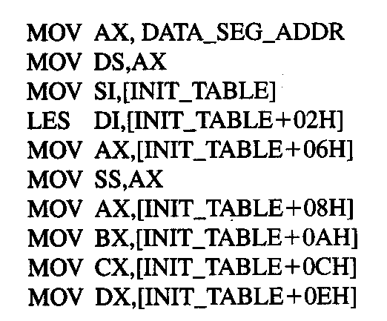
Example
DATA_SEG_ADDR:0000
DATA_SEG_ADDR:INIT_TABLE | 11 | 22
 | 33 | 44
 | 55 | 66
 | 77 | 88
 | 99 | AA
 | BB | CC
 | DD | EE
 | FF | 16
 | 03 | 17
Show the results of running the following program if DATA_SEG_ADDR = 1200H:
Microprocessors I: Lecture 8

Slide 19
Example solution
DATA_SEG_ADDR:0000
DATA_SEG_ADDR:INIT_TABLE | 11 | 22
 | 33 | 44
 | 55 | 66
 | 77 | 88
 | 99 | AA
 | BB | CC
 | DD | EE
 | FF | 16
 | 03 | 17
MOV AX,DATA_SEG_ADDR
  AX = DATA_SEG_ADDR
  = 1200H
MOV DS, AX
  DS = AX = 1200H
MOV SI, [INIT_TABLE]
  SI = memory @ DS:INIT_TABLE
  = 2211H
LES DI,[INIT_TABLE+02H]
  DI = memory @ DS:INIT_TABLE+02H
  = 4433H
  ES = memory @ DS:INIT_TABLE+04H
  = 6655H
Microprocessors I: Lecture 8

Slide 20
Example solution (cont.)
DATA_SEG_ADDR:0000
DATA_SEG_ADDR:INIT_TABLE | 11 | 22
 | 33 | 44
 | 55 | 66
 | 77 | 88
 | 99 | AA
 | BB | CC
 | DD | EE
 | FF | 16
 | 03 | 17
MOV AX,[INIT_TABLE+06H]
  AX = memory @ DS:INIT_TABLE+06H
  = 8877H
MOV SS, AX
  SS = AX = 8877H
MOV AX,[INIT_TABLE+08H]
  AX = memory @ DS:INIT_TABLE+08H
  = AA99H
MOV BX,[INIT_TABLE+0AH]
  BX = memory @ DS:INIT_TABLE+0AH
  = CCBBH
Microprocessors I: Lecture 8

Slide 21
Example solution (cont.)
DATA_SEG_ADDR:0000
DATA_SEG_ADDR:INIT_TABLE | 11 | 22
 | 33 | 44
 | 55 | 66
 | 77 | 88
 | 99 | AA
 | BB | CC
 | DD | EE
 | FF | 16
 | 03 | 17
MOV CX,[INIT_TABLE+0CH]
  CX = memory @ DS:INIT_TABLE+0CH
  = EEDDH
MOV DX,[INIT_TABLE+0EH]
  DX = memory @ DS:INIT_TABLE+0EH
  = 16FFH
Microprocessors I: Lecture 8

Slide 22
Next time
Arithmetic instructions
Microprocessors I: Lecture 8

