Slide 1
16.317: Microprocessor System Design I
Instructor: Dr. Michael Geiger
Spring 2012
Lecture 9: Arithmetic Instructions
Notes:
Chapter 2

Slide 2
Lecture outline
Announcements/reminders
  HW 1 due today
  HW 2 due next Friday, 2/17
  Lab 1 posted; due 2/29
    Amanda’s OH: M/W 2:30-5, T 5-7
    Lab: Ball 407
Lecture outline
  Review: data transfer instructions
  Today
    Finish data transfer (LEA, Load full pointer)
    Arithmetic instructions
Microprocessors I: Lecture 9

Slide 3
Review: Data transfer instructions
MOV: basic data transfer
  Can use registers, memory, immediates
  If segment reg. is destination, source must be register
MOVSX/MOVZX
  Sign-extend or zero-extend register/memory value
  Moving byte from memory: BYTE POINTER
XCHG
  Exchange contents of source, dest
Microprocessors I: Lecture 9

Slide 4
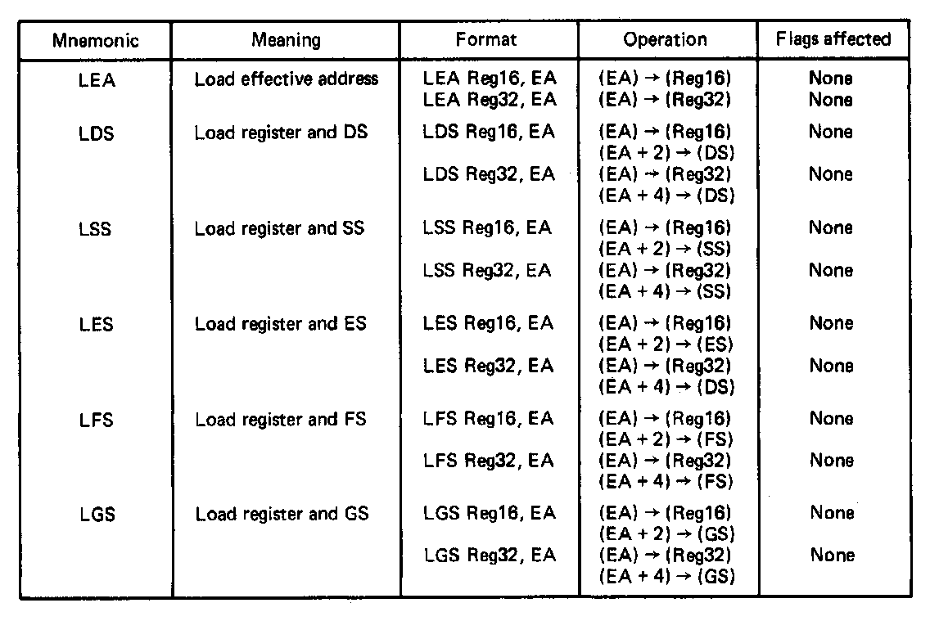
Load Effective Address
Load effective address instruction
  Used to load the effective address of memory operand into a register
  General format:
    LEA Reg16/32,EA
  Operation:
    EA → (Reg16/32)
    Source unaffected:
    Flags unaffected
Microprocessors I: Lecture 9
Notes:
Chapter 5 (I)

Slide 5
Load Full Pointer Instructions
  Used to load a full address pointer from memory into a segment register and register
  General formats and operation for LDS and LSS
  LDS Reg16/32,EA
  (EA) → (Reg16/32)
    (EA+2/4) →(DS)
  LSS Reg16/32,EA
  (EA) → (Reg16/32)
  (EA+2/4) → (SS)
  LES, LFS, and LGS operate the same
LES Reg16/32,EA (EA) → (Reg16/32),(ES)
LFS Reg16/32,EA (EA) → (Reg16/32),(FS)
LGS Reg16/32,EA (EA) → (Reg16/32),(GS)
Microprocessors I: Lecture 9
Notes:
Chapter 5 (I)

Slide 6
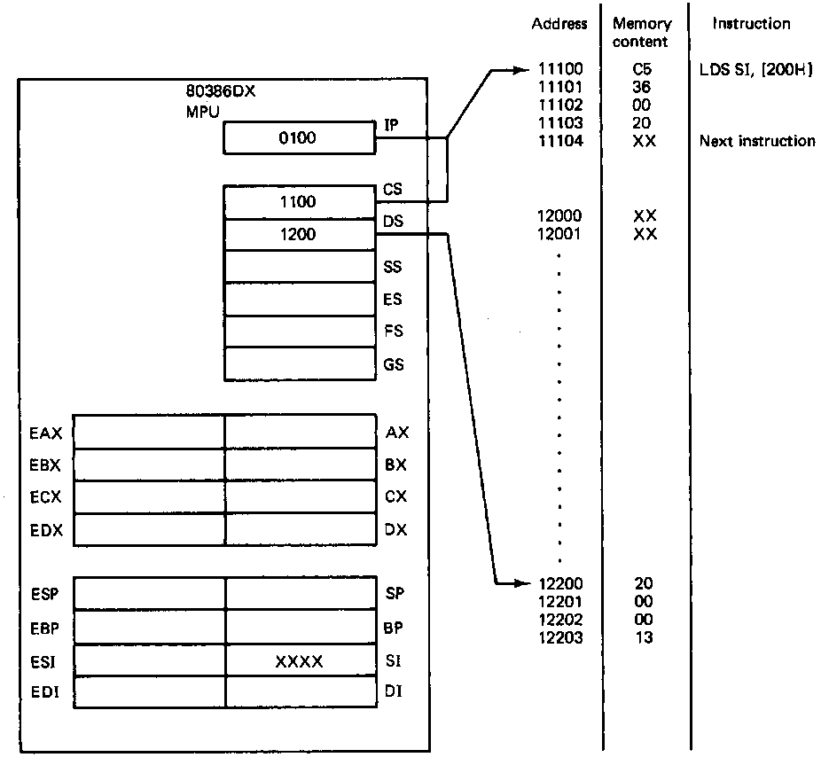
Load Full Pointer Instructions (example)
Error 02 not 20
Example
  LDS SI,[200H]
  Source = pointer at DS:200H→ 32 bits
  Destination = SI → offset of pointer
  DS → sba of pointer
  Operation: (DS:200H) → (SI)
  (DS:202H) → (DS)
State before fetch and execution
  CS:IP = 1100:0100 = 11100H
  LDS instruction code = C5360002H
  (11102H,11103H) = (EA) = 2000H
  (DS) = 1200H
  (SI) = XXXX → don’t care state
  (DS:EA) = 12200H = 0020H
  (DS:EA+2) = 12202H = 1300
Microprocessors I: Lecture 9
Notes:
Chapter 5 (I)

Slide 7
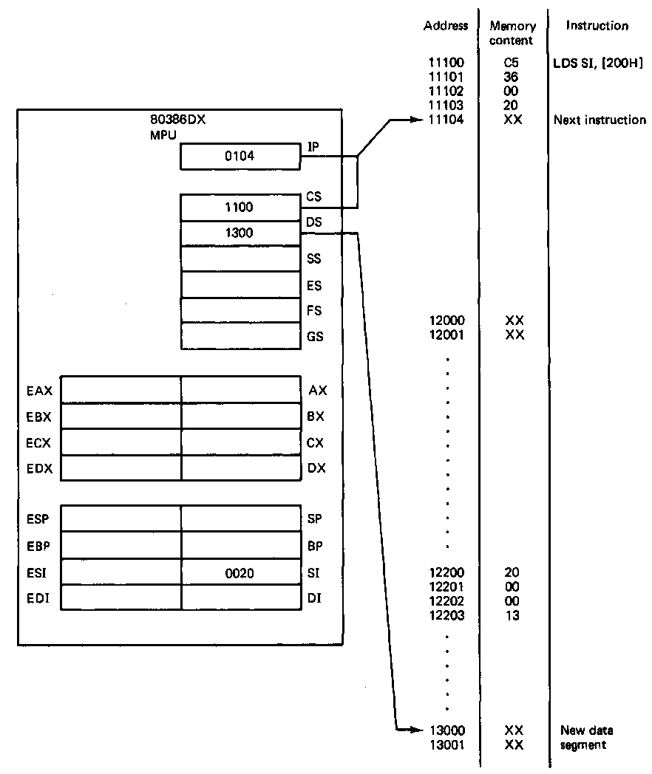
Load Full Pointer Instructions (example)
Example (continued)
State after execution
  CS:IP = 1100:0104 = 11104H
  01004H → points to next
  sequential instruction
  (DS) = 1300H → defines new data segment
  (SI) = 0020H
  - Rest of the bits in ESI unaffected
Microprocessors I: Lecture 9
Notes:
Chapter 5 (I)

Slide 8
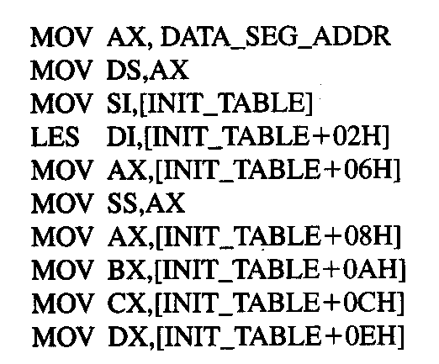
Example
DATA_SEG_ADDR:0000
DATA_SEG_ADDR:INIT_TABLE | 11 | 22
 | 33 | 44
 | 55 | 66
 | 77 | 88
 | 99 | AA
 | BB | CC
 | DD | EE
 | FF | 16
 | 03 | 17
Show the results of running the following program if DATA_SEG_ADDR = 1200H:
Microprocessors I: Lecture 9

Slide 9
Example solution
DATA_SEG_ADDR:0000
DATA_SEG_ADDR:INIT_TABLE | 11 | 22
 | 33 | 44
 | 55 | 66
 | 77 | 88
 | 99 | AA
 | BB | CC
 | DD | EE
 | FF | 16
 | 03 | 17
MOV AX,DATA_SEG_ADDR
  AX = DATA_SEG_ADDR
  = 1200H
MOV DS, AX
  DS = AX = 1200H
MOV SI, [INIT_TABLE]
  SI = memory @ DS:INIT_TABLE
  = 2211H
LES DI,[INIT_TABLE+02H]
  DI = memory @ DS:INIT_TABLE+02H
  = 4433H
  ES = memory @ DS:INIT_TABLE+04H
  = 6655H
Microprocessors I: Lecture 9

Slide 10
Example solution (cont.)
DATA_SEG_ADDR:0000
DATA_SEG_ADDR:INIT_TABLE | 11 | 22
 | 33 | 44
 | 55 | 66
 | 77 | 88
 | 99 | AA
 | BB | CC
 | DD | EE
 | FF | 16
 | 03 | 17
MOV AX,[INIT_TABLE+06H]
  AX = memory @ DS:INIT_TABLE+06H
  = 8877H
MOV SS, AX
  SS = AX = 8877H
MOV AX,[INIT_TABLE+08H]
  AX = memory @ DS:INIT_TABLE+08H
  = AA99H
MOV BX,[INIT_TABLE+0AH]
  BX = memory @ DS:INIT_TABLE+0AH
  = CCBBH
Microprocessors I: Lecture 9

Slide 11
Example solution (cont.)
DATA_SEG_ADDR:0000
DATA_SEG_ADDR:INIT_TABLE | 11 | 22
 | 33 | 44
 | 55 | 66
 | 77 | 88
 | 99 | AA
 | BB | CC
 | DD | EE
 | FF | 16
 | 03 | 17
MOV CX,[INIT_TABLE+0CH]
  CX = memory @ DS:INIT_TABLE+0CH
  = EEDDH
MOV DX,[INIT_TABLE+0EH]
  DX = memory @ DS:INIT_TABLE+0EH
  = 16FFH
Microprocessors I: Lecture 9

Slide 12
Instruction types
80386DX instruction types
  Data Transfer instructions
  Input/output instructions
  Arithmetic instructions
  Logic instructions
  String Instructions
  Control transfer instructions
  Processor control
Microprocessors I: Lecture 9

Slide 13
Flags
Arithmetic instructions set flags
  Carry flag (CF): carry out of MSB
  Auxiliary carry flag (AF): carry out from lowest nibble (4 bit quantity) to next-lowest nibble
    Used with BCD, ASCII math—we won’t cover
  Sign flag (SF): matches sign bit (MSB) of result
  Zero flag (ZF): flag is 1 if result is 0
  Parity flag (PF): flag is 1 if result has even parity
  Overflow flag (OF): flag is 1 if result out of range
Microprocessors I: Lecture 9

Slide 14
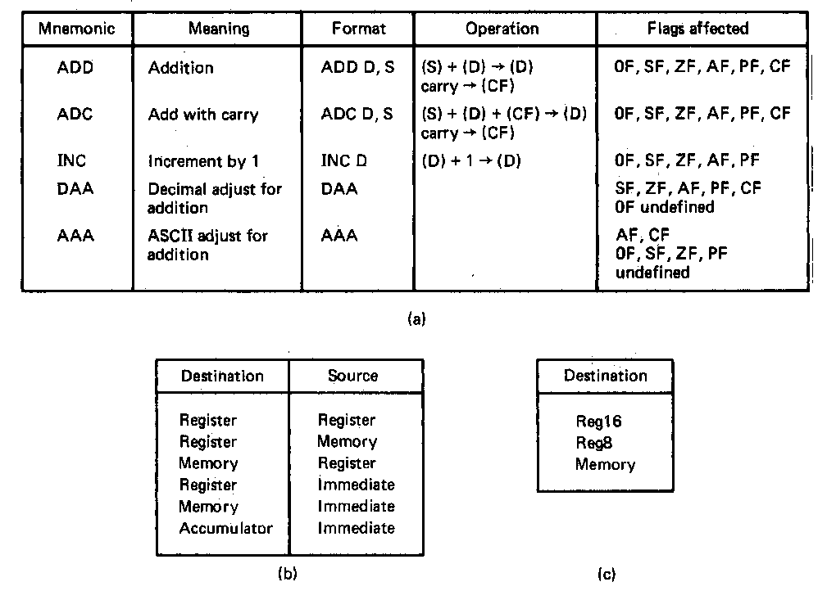
Addition Instructions
Variety of arithmetic instruction provided to support integer addition—core instructions are
  ADD → Addition
  ADC → Add with carry
  INC → Increment
Addition Instruction—ADD
  ADD format and operation:
    ADD D,S
    (S) +(D) → (D)
    Add values in two registers
    ADD AX,BX
    (AX) + (BX) → (AX) & CF
    Add a value in memory and a value in a register
    ADD [DI],AX
    (DS:DI) + (AX) → (DS:DI)
    Add an immediate operand to a value in a register or memory
    ADD AX,100H
    (AX) + IMM16 → (AX)
Flags updated based on result
  CF, OF, SF, ZF, AF, PF
Microprocessors I: Lecture 9
Notes:
Chapter 5 (I)

Slide 15
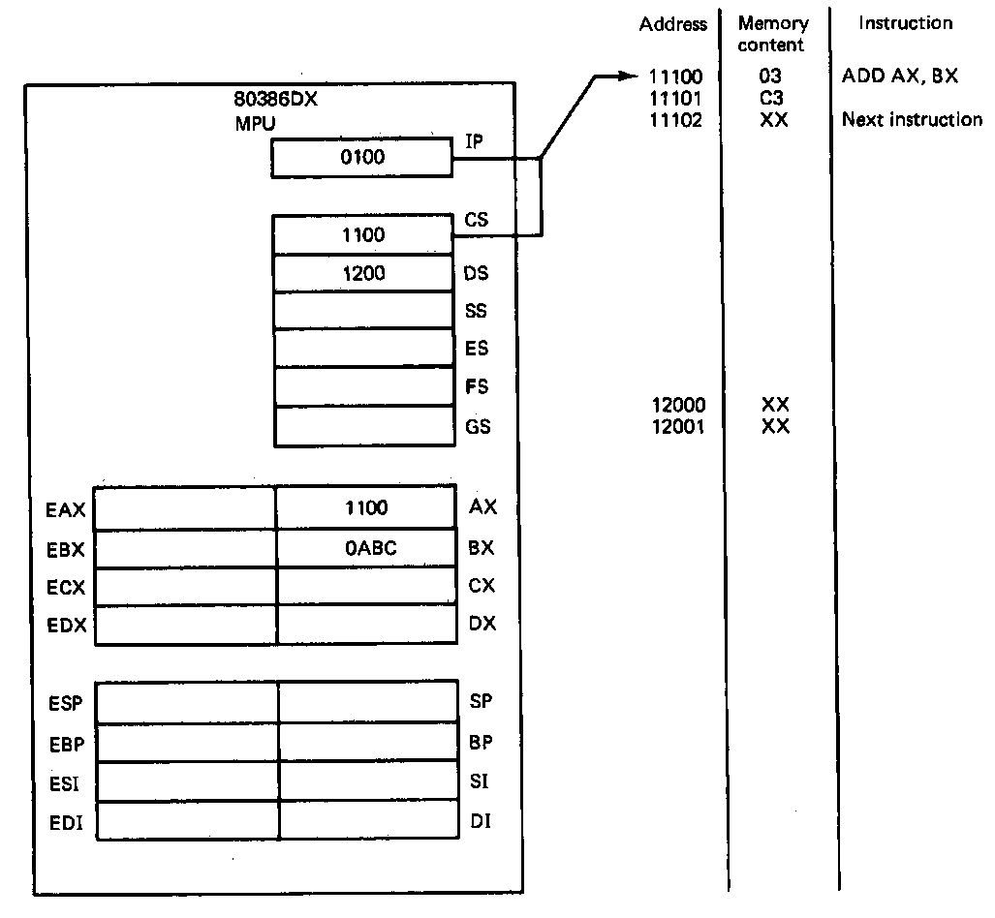
Addition Instructions (example)
Example
  ADD AX,BX
  (AX) + (BX) → (AX)
  Word-wide register to register add
  Half adder operation
State before fetch and execution
  CS:IP = 1100:0100 = 11100H
  ADD instruction code = 03C3H
  (AX) = 1100H
  (BX) = 0ABCH
  (DS) = 1200H
  (1200:0000) = 12000H = XXXX
Microprocessors I: Lecture 9
Notes:
Chapter 5 (I)

Slide 16
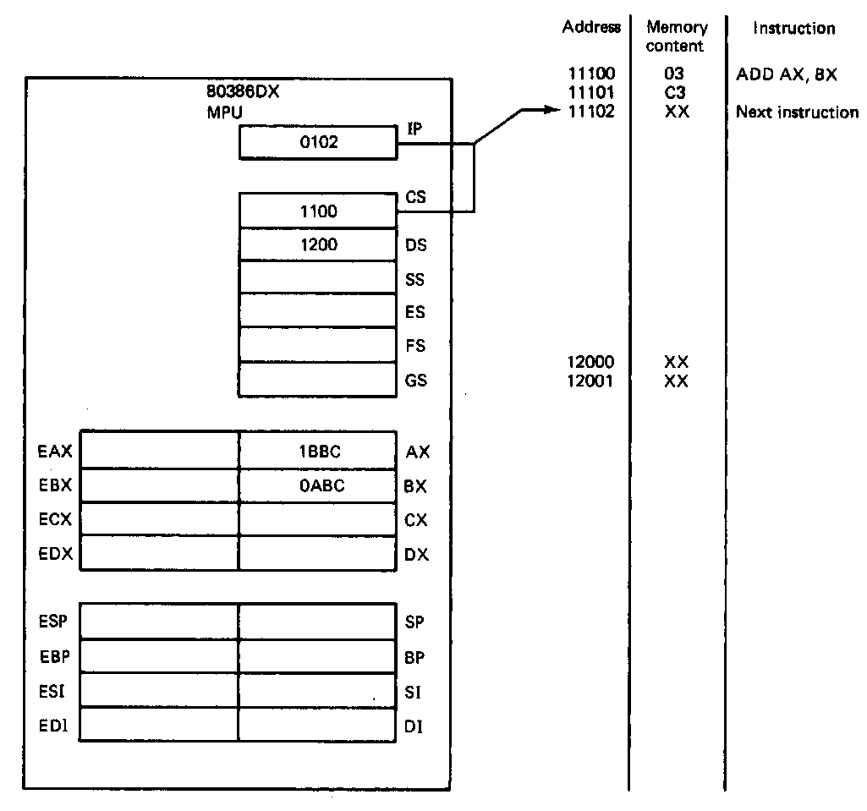
Addition Instructions (example)
Example (continued)
State after execution
  CS:IP = 1100:0102 = 11102H
  01002H → points to next sequential instruction
  Operation performed
(AX) + (BX) = (AX)
  (1100H) + (0ABCH) = 1BBCH
  = 0001101110111100₂
  (AX) = 1BBCH
  Upper bits of (AX) unchanged
  (BX) = unchanged
  Impact on flags
    CF =0 (no carry resulted)
    ZF = 0 (not zero)
    SF = 0 (positive)
    PF = 0 (odd parity)
Microprocessors I: Lecture 9
Notes:
Chapter 5 (I)

Slide 17
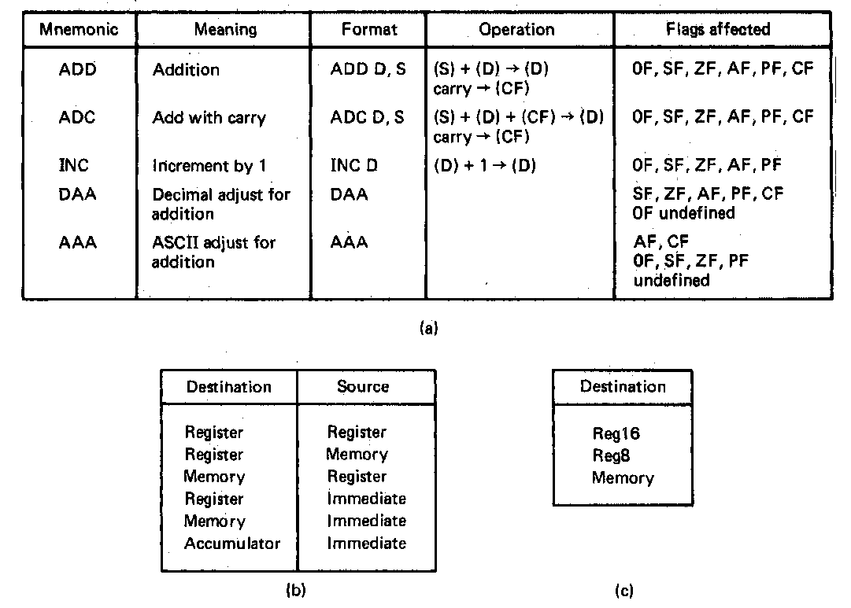
Other Addition Instructions
Add with carry instruction—ADC
  ADC format and operation:
    ADC D,S
    (S) +(D) + (CF) → (D)
    Full-add operation
  Add two registers with carry
  ADC AX,BX
  (AX) + (BX) + (CF) → (AX) & CF
  Add register and memory with carry
  ADC [DI],AX
  (DS:DI) + (AX)+ (CF) → (DS:DI)
  Add immediate operand to a value in a register or memory
    ADC AX,100H
    (AX) + IMM16 + (CF) → (AX)
  Same flags updated as ADD
Increment instruction—INC
  INC format and operation
    INC D
    (D) + 1 → (D)
  Used to increment pointers
Microprocessors I: Lecture 9
Notes:
Chapter 5 (I)

Slide 18
Addition examples
Given the following initial state:
  AX = 1234H
  BL = ABH
  Memory location SUM = 00CDH
Show the results of each step of the following instruction sequence.
ADD AX, [SUM]
  ADC BL, 05H
  INC WORD PTR [SUM]
Microprocessors I: Lecture 9

Slide 19
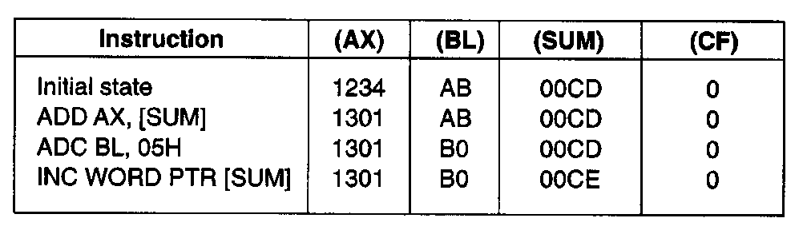
Examples of Addition Instructions
Example—Arithmetic computations
  Initial state:
    (AX) = 1234H
    (BL) = ABH
    (SUM) = 00CDH
    (CF) = 0
  Operation of first instruction
  (DS:SUM) + (AX) → (AX)
  00CDH + 1234H = 1301H
  (AX) = 1301H
  (CF) = unchanged
  Operation of second instruction
  (BL) + IMM8 +(CF) → BL
  ABH + 05H + 0 = B0H
  (BL) = B0H
  (CF) = unchanged
  Operation of third instruction
  (DS:SUM) + 1 → (DS:SUM)
  00CDH + 1 = 00CEH
  (SUM) = 00CEH
  (CF) = unchanged
Microprocessors I: Lecture 9
Notes:
Chapter 5 (I)

Slide 20
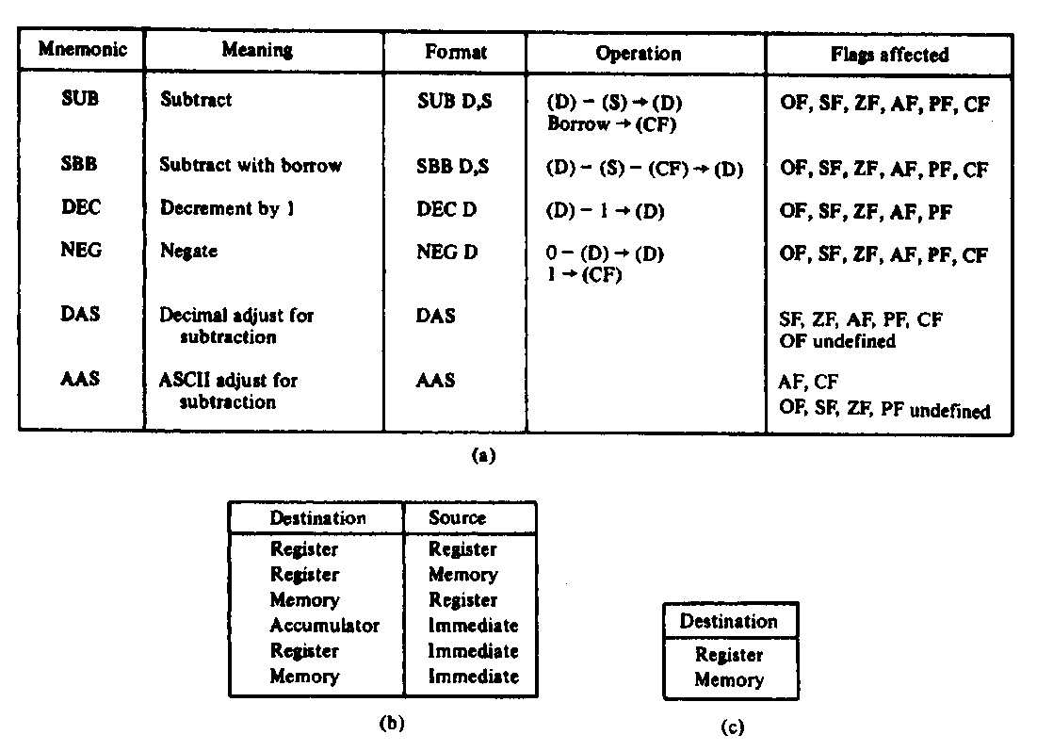
Subtraction Instructions
Variety of arithmetic instructions provided to support integer subtraction—core instructions are
  SUB → Subtract
  SBB → Subtract with borrow
  DEC → Decrement
  NEG → Negate
Subtract Instruction—SUB
  SUB format and operation: SUB D,S
    (D) - (S) → (D)
    Subtract values in two registers
    SUB AX,BX
    (AX) - (BX) → (AX)
    Subtract a value in memory and a value in a register
    SUB [DI],AX
    (DS:DI) - (AX) → (DS:DI)
    Subtract an immediate operand from a value in a register or memory
    SUB AX,100H
    (AX) - IMM16 → (AX)
Flags updated based on result
  CF, OF, SF, ZF, AF, PF
Microprocessors I: Lecture 9
Notes:
Chapter 5 (I)

Slide 21
Subtraction Instructions
Subtract with borrow instruction—SBB
  SBB format and operation:
    SBB D,S
    (D) - (S) - (CF) → (D)
  Subtracts two registers and carry (borrow)
  SBB AX,BX
  Example:
  SBB BX,CX
  (BX) = 1234H
  (CX) = 0123H
  (CF) = 0
  (BX) - (CX) - (CF) → (BX)
  1234H - 01234H - 0H = 1111H
  (BX) = 1111H
Microprocessors I: Lecture 9
Notes:
Chapter 5 (I)

Slide 22
Subtraction Instructions
Negate instruction—NEG
  NEG format and operation
    NEG D
    (0) - (D) → (D)
    (1) → (CF)
  Example:
    NEG BX
    (BX) =003AH
    (0) - (BX) → (BX)
    0000H – 003AH=
    0000H + FFC6H (2’s complement) = FFC6H
    (BX) =FFC6H; CF = 1
Decrement instruction—DEC
  DEC format and operation
    DEC D
    (D) - 1 → (D)
  Used to decrement pointers
  Example
    DEC SI
    (SI) = 0FFFH
    (SI) - 1 → SI
    0FFFH - 1 = 0FFEH
    (DI) = 0FFEH
Microprocessors I: Lecture 9
Notes:
Chapter 5 (I)

Slide 23
Multiplication Instructions
Integer multiply instructions—MUL and IMUL
  Multiply two unsigned or signed byte, word, or double word operands
  General format and operation
    MUL S = Unsigned integer multiply
    IMUL S = Signed integer multiply
    (AL) X (S8)→ (AX) 8-bit product gives 16 bit result
    (AX) X (S16) → (DX), (AX) 16-bit product gives 32 bit result
    (EAX) X (S32)→ (EDX), (EAX) 32-bit product gives 64 bit result
    Source operand (S) can be an 8-bit, 16-bit, or 32-bit value in a register or memory
      Other source operand is “implicit” and is AL, AX, or EAX
    Destination is “implicit”
      AX assumed to be destination for 16 bit result
      DX,AX assumed destination for 32 bit result
      EDX,EAX assumed destination for 64 bit result
    Only CF and OF flags updated; other undefined
Microprocessors I: Lecture 9
Notes:
Chapter 5 (I)

Slide 24
Multiplication Instructions
Integer multiply instructions—MUL and IMUL
  Other formats of the signed multiply instruction
    IMUL R,I = Register operand times immediate operand; result in the register
    Typical operation: (R16) X IMM8 → (R16)
    IMUL R,S,I = Source in a register or memory times immediate operand; result in the register
    Typical operation: (S32) X IMM8 → (R32)
    IMUL R,S = Source time register; result in the register
    Typical operation: (R32) X (S32) → (R32)
Microprocessors I: Lecture 9
Notes:
Chapter 5 (I)

Slide 25
Multiplication Instruction Example
Example: unsigned multiply
  MUL CL
  (AL) = -1₁₀
  (CL) = -2₁₀
  Expressing in 2’s complement
  (AL) = -1 = 11111111₂ = FFH
  (CL) = -2 = 11111110₂ = FEH
  Operation: numbers are treated as unsigned integers
  (AL) X (CL) → (AX)
  255 X 254 = ?
11111111₂ X 11111110₂ = ?
= 1111 1101 0000 0010
(AX) = FD02H
(CF) = CY → carry from AL to AH
Microprocessors I: Lecture 9
Notes:
Chapter 5 (I)

Slide 26
Multiplication Instructions Example
Example: multiplying as signed numbers
  IMUL CL
  (AL) = -1₁₀
  (CL) = -2₁₀
  Result
  (-1) X (-2) = +2
Microprocessors I: Lecture 9
Notes:
Chapter 5 (I)

Slide 27
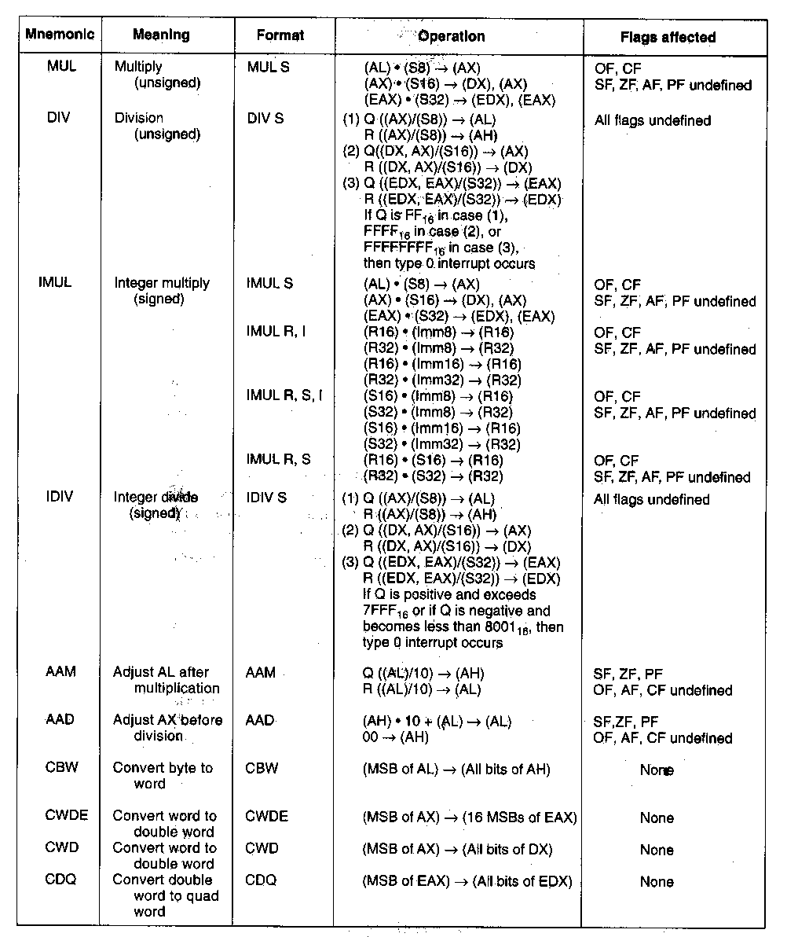
Division Instruction
Integer divide instructions—DIV and IDIV
  Divide unsigned– DIV S
    Operations:
    (AX) / (S8) → (AL) =quotient
        (AH) = remainder
      16 bit dividend in AX divided by 8-bit divisor in a register or memory,
      Quotient of result produced in AL
      Remainder of result produced in AH
    (DX,AX) / (S16) → (AX) =quotient
        (DX) = remainder
      32 bit dividend in DX,AX divided by 16-bit divisor in a register or memory
      Quotient of result produced in AX
      Remainder of result produced in DX
    (EDX,EAX) / (S32) → (EAX) =quotient
        (EDX) = remainder
      64 bit dividend in EDX,EAX divided by 32-bit divisor in a register or memory
      Quotient of result in EAX
      Remainder of result in EDX
    Divide error (Type 0) interrupt may occur
Microprocessors I: Lecture 9
Notes:
Chapter 5 (I)

Slide 28
Convert Instructions
Convert instructions
  Used to sign extension signed numbers for division
  Operations
    CBW = convert byte to word
      (MSB of AL) → (all bits of AH)
    CWDE = convert word to double word
    (MSB of AX) → (16 MSBs of EAX)
    CWD = convert word to double word
      (MSB of AX) → (all bits of DX)
    CDQ = convert word to quad word
      (MSB of EAX) → (all bits of EDX)
  Application:
    To divide two signed 8-bit numbers, the value of the dividend must be sign extended in AX– load into AL and then use CBW to sign extend to 16 bits
  Example
  A1H → AL
  CBW sign extends to give
  FFA1H → AX
  CWD sign extends to give
  FFFFH → DX
Microprocessors I: Lecture 9
Notes:
Chapter 5 (I)

Slide 29
Next time
Arithmetic examples
Logical instructions
Microprocessors I: Lecture 9

