Slide 1
16.317
Microprocessor Systems Design I
Instructor: Dr. Michael Geiger
Fall 2012
Lecture 10:
Flag control instructions
Conditional execution

Slide 2
Lecture outline
Announcements/reminders
  HW 2 due today
    Solution posted by Monday—no late submissions after that
  Next week: lecture on Tuesday, not Monday
  Exam 1: Wednesday, 2/20
    Will be allowed calculator, one 8.5” x 11” double-sided note sheet
    Will be provided list of instructions
Review
  Rotate instructions
  Bit test/bit scan instructions
Today’s lecture
  Flag control instructions
  Compare instructions
Microprocessors I: Lecture 10

Slide 3
Review
Rotate instructions: bits that are shifted out one side are shifted back in other side
  ROL <src>, <amt> or ROR <src>, <amt>
  CF = last bit rotated
Rotate through carry instructions
  CF acts as “extra” bit that is part of value being rotated
  RCL <src>, <amt> or RCR <src>, <amt>
Bit test instructions
  Check state of bit and store in CF
  Basic test (BT) leaves bit unchanged
  Can also set (BTS), clear (BTR), or complement bit (BTC)
Bit scan instructions
  Find first non-zero bit and store index in dest.
  Set ZF = 1 if source non-zero; ZF = 0 if source == 0
  BSF: scan right to left (LSB to MSB)
  BSR: scan left to right (MSB to LSB)
Microprocessors I: Lecture 10

Slide 4
Flag Control Instructions
Modifying the carry flag
  Used to initialize the carry flag
  Clear carry flag (CLC): CF = 0
  Set carry flag (STC): CF = 1
  Complement carry flag (CMC): CF = ~CF
Modifying the interrupt flag
  Used to turn off/on external hardware interrupts
  Clear interrupt flag (CLI): IF = 0
  Set interrupt flag (STI): IF = 1
Microprocessors I: Lecture 10
Notes:
Chapter 6 part 1

Slide 5
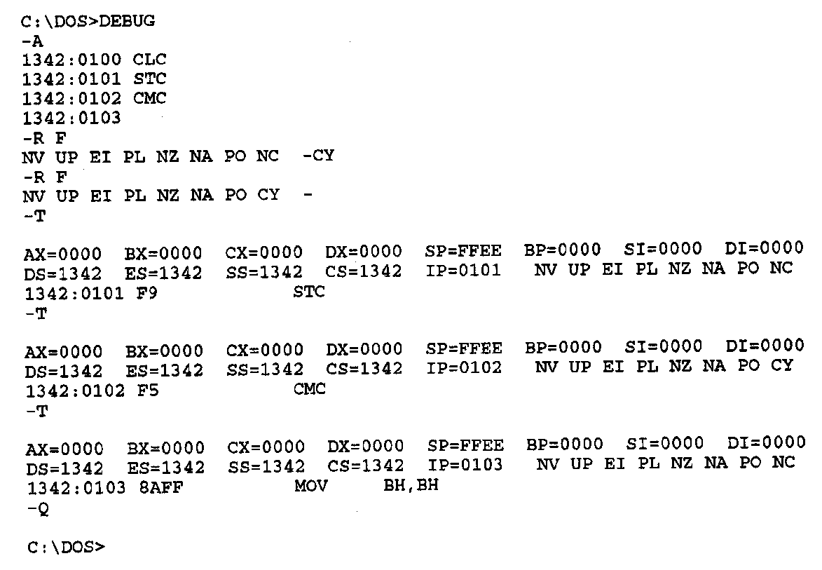
Flag Control Instructions- Example
Debug flag notation
  CF → CY = 1, NC = 0
Example—Execution of carry flag modification instructions
  CY=1
  CLC ;Clear carry flag
    STC ;Set carry flag
    CMC ;Complement carry flag
Microprocessors I: Lecture 10
Notes:
Chapter 6 part 1

Slide 6
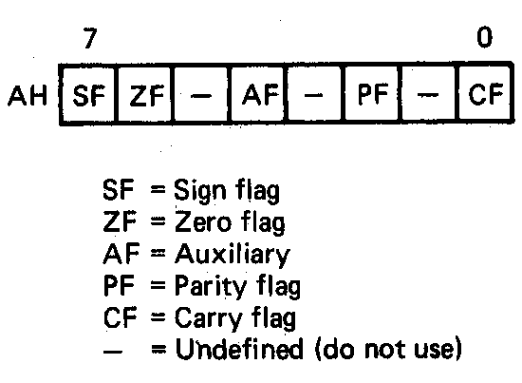
Loading and Saving the Flag Register
All loads and stores of flags take place through the AH register
  Format of the flags in the AH register
    B₀ = CF
    B₂ = PF
    B₄ = AF
    B₆ = ZF
    B₇ = SF
Load AH with content of flags registers (LAHF)
  AH = (Flags)
  Flags unchanged
Store content of AH in flags register (SAHF)
  (Flags) = AH
  SF,ZF,AF,PF,CF → updated
Microprocessors I: Lecture 10
Notes:
Chapter 6 part 1

Slide 7
Loading and Saving the Flag Register
Application—saving a copy of the flags and initializing with new values
LAHF ;Load of flags into AH
MOV [MEM1],AH ;Save old flags at address MEM1
MOV AH,[MEM2] ;Read new flags from MEM2 into AH
SAHF ;Store new flags in flags register
Microprocessors I: Lecture 10
Notes:
Chapter 6 part 1

Slide 8
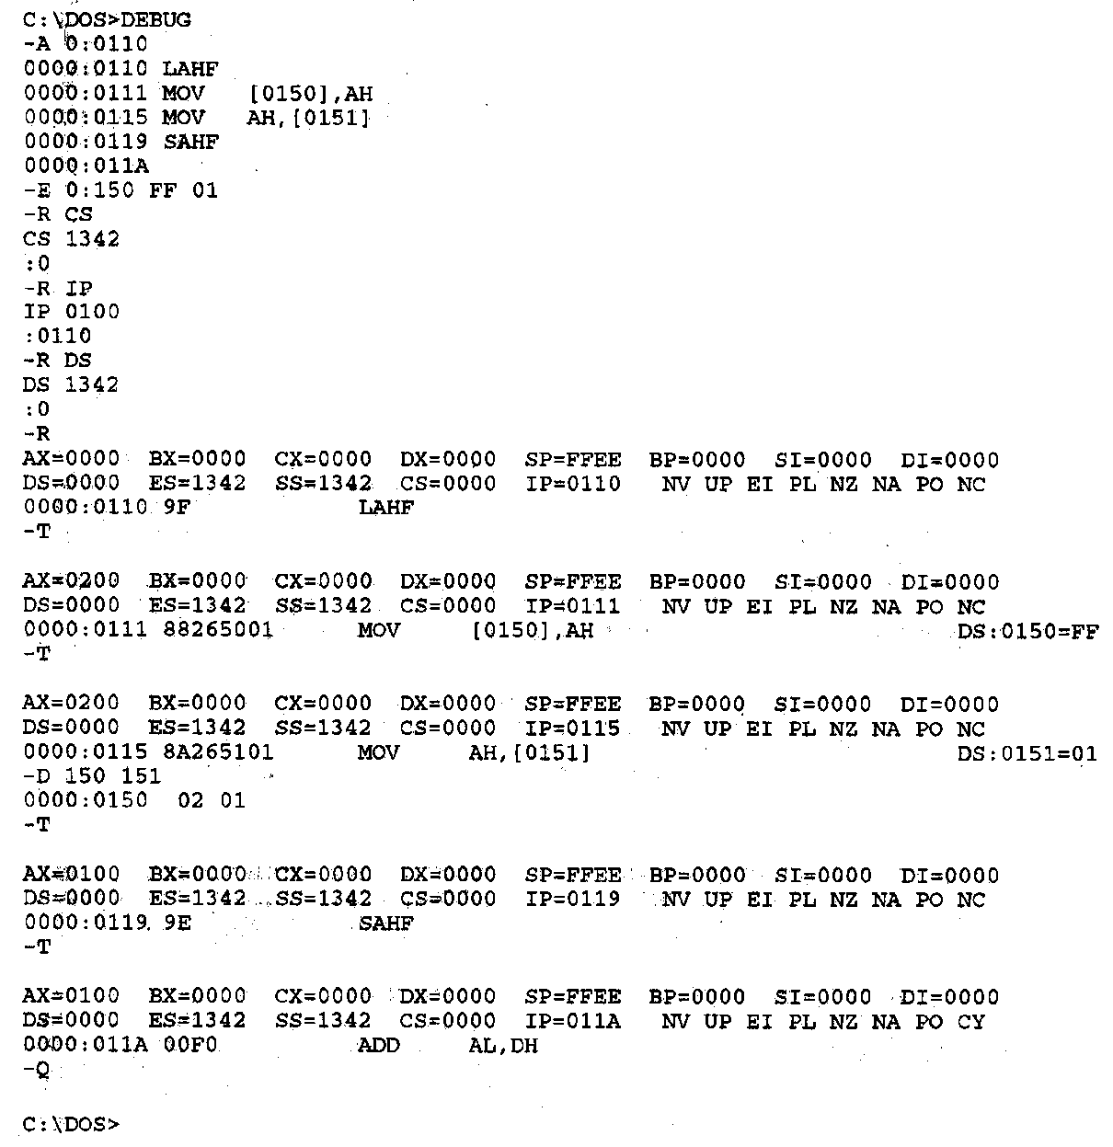
Flag Control Instructions- Example
Example—Execution of the flags save and initialization sequence
Other flag notation:
  Flag = 1/0
  SF = NG/PL
  ZF = ZR/NZ
  AF = AC/NA
  PF = PE/PO
Microprocessors I: Lecture 10
Notes:
Chapter 6 part 1

Slide 9
Example
Given initial state shown in handout
List all changed registers/memory locations and their values, as well as CF
Instructions
  LAHF
  MOV [20H], AH
  MOV AH, [30H]
  SAHF
  MOV AX, [26H]
  CMC
  RCL AX, CL
Microprocessors I: Lecture 10

Slide 10
Example solution
LAHF
  AH = Flags register = 00H
MOV [20H], AH
  Address = DS:20H = 10110H
  Byte at 10110H = 00H
MOV AH, [30H]
  Address = DS:30H = 10120H
  AH = byte at 10120 = 1EH
SAHF
  Flags register = AH = 1EH
  SF = Bit 7 = 0
  ZF = Bit 6 = 0
  AF = Bit 4 = 1
  PF = Bit 2 = 1
  CF = Bit 0 = 0
Microprocessors I: Lecture 10

Slide 11
Example solution (cont.)
MOV AX, [26H]
  Address = DS:26H = 10116H
  AX = word at 10116 = 4020H
CMC
  Complement CF
  CF = ~CF = ~0 = 1
RCL AX, CL
  Rotate AX left through carry by CL places
  (CF,AX) = 1 0100 0000 0010 0000₂ rotated left by 5
  AX = 0000 0100 0001 0100₂ = 0414H, CF = 0
Microprocessors I: Lecture 10

Slide 12
Compare Instructions
Compare 2 values; store result in ZF/SF
General format: CMP D,S
  Works by performing subtraction (D) – (S)
    D, S unchanged
  ZF/SF/OF indicate result (signed values)
    ZF = 1 → D == S
    ZF = 0, (SF XOR OF) = 1 → D < S
    ZF = 0, (SF XOR OF) = 0 → D > S
Microprocessors I: Lecture 10
Notes:
Chapter 6 part 1
(D) (S) result CF SF AF
AX BX
2345>1234 0 0 0
1234<2345 1 1 1
1234>ABCD 1 0 1
ABCD<1234 0 1 0
ABCD>A000 0 0 0
A000<ABCD 1 1 1
7FFF 8000 overflow

Slide 13
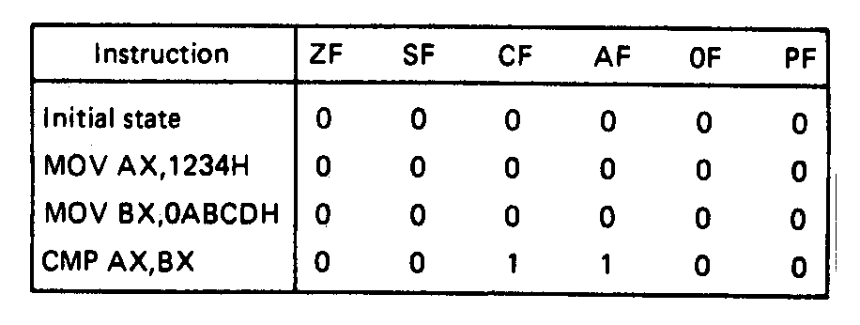
Compare Instructions- Example
Example—Initialization of internal registers with immediate data and compare. Example:
    MOV AX,1234H ;Initialize AX
    MOV BX,ABCDH ;Initialize BX
    CMP AX,BX ;Compare AX-BX
  Data registers AX and BX initialized from immediate data
  IMM16 → (AX) = 1234H → + integer
  IMM16 → (BX) = ABCDH → - integer
  Compare computation performed as:
  (AX) = 0001001000110100₂ (BX) = 1010101111001101₂
(AX) – (BX) = 0001001000110100₂ - 1010101111001101₂
  ZF = 0 = NZ
  SF = 0 = PL ;treats as signed numbers
  CF = 1 = CY
  AF = 1 = AC
  OF = 0 = NV
  PF = 0 = PO
Microprocessors I: Lecture 10
Notes:
Chapter 6 part 1

Slide 14
Condition codes
Conditional execution: result depends on value of flag bit(s)
Intel instructions specify condition codes
  Condition code implies certain flag values
  Opcodes written with cc as part of name
  cc can be replaced by any valid code
  Examples: SETcc, Jcc
    Specific examples: SETL, SETZ, JNE JG
Microprocessors I: Lecture 10

Slide 15
Condition codes (cont.)
Testing overflow alone
  O (OF = 1), NO (OF =0)
Testing carry flag alone
  “Below” or “above” describes carry flag
  Used with unsigned comparisons
  B, NAE, or C (CF = 1)
  NB, AE, or NC (CF = 0)
Testing sign flag alone
  S (SF = 1), NS (SF = 0)
Testing parity flag alone
  P or PE (PF = 1)
  NP or PO (PF = 0)
Microprocessors I: Lecture 10

Slide 16
Condition codes (cont.)
Testing equality/zero result
  E or Z (ZF = 1)
  NE or NZ (ZF = 0)
Codes that combine multiple flags
  Testing “above”/”below” and equality
    BE or NA (CF OR ZF = 1)
    NBE or A (CF OR ZF = 0)
  Testing less than/greater than
    L or NGE (SF XOR OF = 1)
    NL or GE (SF XOR OF = 0)
    LE or NG ((SF XOR OF) OR ZF = 1)
    NLE or G ((SF XOR OF) OR ZF = 0)
Microprocessors I: Lecture 10

Slide 17
Final notes
Next time: Exam 1 Preview (Tuesday)
Reminders:
  HW 2 due today
    Solution posted by Monday—no late submissions after that
  Next week: lecture on Tuesday, not Monday
  Exam 1: Wednesday, 2/20
    Will be allowed calculator, one 8.5” x 11” double-sided note sheet
    Will be provided list of instructions
Microprocessors I: Lecture 10

