Slide 1
16.317
Microprocessor Systems Design I
Instructor: Dr. Michael Geiger
Spring 2013
Lecture 12:
Exam 1 Review

Slide 2
Lecture outline
Announcements/reminders
  Lab 1 to be posted; due date likely 3/6
  Early feedback forms to be distributed Monday
Today’s lecture: Exam 1 Review
  Exam stats
  Regrade requests
  Solution
Microprocessors I: Exam 1 Review

Slide 3
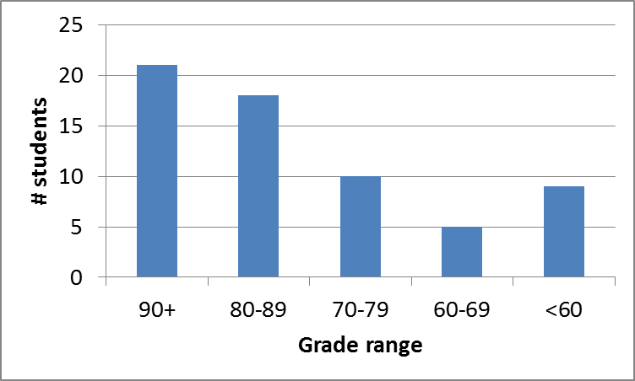
Exam stats & grade distribution
Question-by-question averages:
  Q1: 12.6 / 20 (63%)
  Q2: 23.8 / 30 (79%)
  Q3: 21.1 / 25 (84%)
  Q4: 20.9 / 25 (83%)
Average: 78.3
Median: 85
Std. deviation: 18.7
Max: 99
Microprocessors I: Exam 1 Review

Slide 4
Regrade requests
Due Friday, 3/1
Must be written (preferably on a separate sheet)
You must also return your exam
  Do not write on your exam if you plan on submitting a regrade request
Must demonstrate understanding of problem
  Bad: “I deserve more points on Problem 3.”
  Good: “I deserve more points on Problem 3 because I calculated a wrong result for one instruction based on a wrong result from a previous instruction. I used the right operation; I just plugged in the wrong value.”
Microprocessors I: Exam 1 Review

Slide 5
Final notes
Next time:
  Conditional instructions
    Set on condition
    Jump/loop
  Early feedback forms
Reminders:
  Lab 1 to be posted; due date likely 3/6
Microprocessors I: Exam 1 Review

