Slide 1
16.317
Microprocessor Systems Design I
Instructor: Dr. Michael Geiger
Spring 2013
Lecture 13:
Jump and loop instructions

Slide 2
Lecture outline
Announcements/reminders
  Lab 1 posted; due 3/6
  Exam 1 regrades due 3/1
Today’s lecture
  Review: byte set on condition, jump
  Jump examples
  Loop instructions
Microprocessors I: Lecture 14

Slide 3
Review
SETcc D
  Sets single byte destination to 1 (01H) if condition true; all 0s (00H) if condition false
  Can be used to build up complex conditions
Two general types of jump
  Unconditional: JMP <target>
    Always go to target address
  Conditional: Jcc <target>
    Go to target address if condition true
Target can be:
  Intrasegment: same segment; only IP changes
    Add constant 8/16 bit offset, or
    Replace IP with 16 bit value from register/memory
  Intersegment: different segment; CS/IP both change
    Target is 32-bit value
    Upper 16 bits overwrite CS; lower bits overwrite IP
Microprocessors I: Lecture 14

Slide 4
Example: program structure 1
Given the instructions below, what are the resulting register values if:
  AX = 0010H, BX = 0010H
  AX = 1234H, BX = 4321H
What type of high-level program structure does this sequence demonstrate?
Instructions
  CMP AX, BX
  JE L1
  ADD AX, 1
  JMP L2
  L1: SUB AX, 1
  L2: MOV [100H], AX
Microprocessors I: Lecture 14

Slide 5
Example solution
First case: AX = BX = 0010H
  CMP AX, BX → Shows AX == BX
  JE L1 → Cond. true—jump to L1
  ADD AX, 1
  JMP L2
  L1: SUB AX, 1 → AX = AX – 1 = 000F
  L2: MOV [100H], AX → Store 000F at DS:100H
Microprocessors I: Lecture 14

Slide 6
Example solution (cont.)
Second case: AX = 1234H, BX = 4321H
  CMP AX, BX → Shows AX < BX
  JE L1 → Cond. false—no jump
  ADD AX, 1 → AX = AX + 1 = 1235H
  JMP L2
  L1: SUB AX, 1 → AX = AX – 1 = 000F
  L2: MOV [100H], AX → Store 000F at DS:100H
Microprocessors I: Lecture 14

Slide 7
Example solution (cont.)
High-level program structure: if/else statement
  If part: compare + jump (if (AX == BX))
  Else part: what follows if condition false
  Unconditional jump used to skip “if” part
  Both parts have same exit (L2)
Microprocessors I: Lecture 14

Slide 8
Example: program structure 2
Given the instructions below, what are the resulting register values if, initially, AX = 0001H?
What type of high-level program structure does this sequence demonstrate?
Instructions
  MOV CX, 5
  L: SHL AX, 1
  DEC CX
  JNZ L
Microprocessors I: Lecture 14

Slide 9
Example: program structure 3
Given the instructions below, what are the resulting register values if, initially, AX = 0001H?
What type of high-level program structure does this sequence demonstrate?
Instructions
  MOV CX, 5
  L: JCXZ END
  ADD AX, AX
  DEC CX
  JMP L
  END: MOV [10H], AX
Microprocessors I: Lecture 14

Slide 10
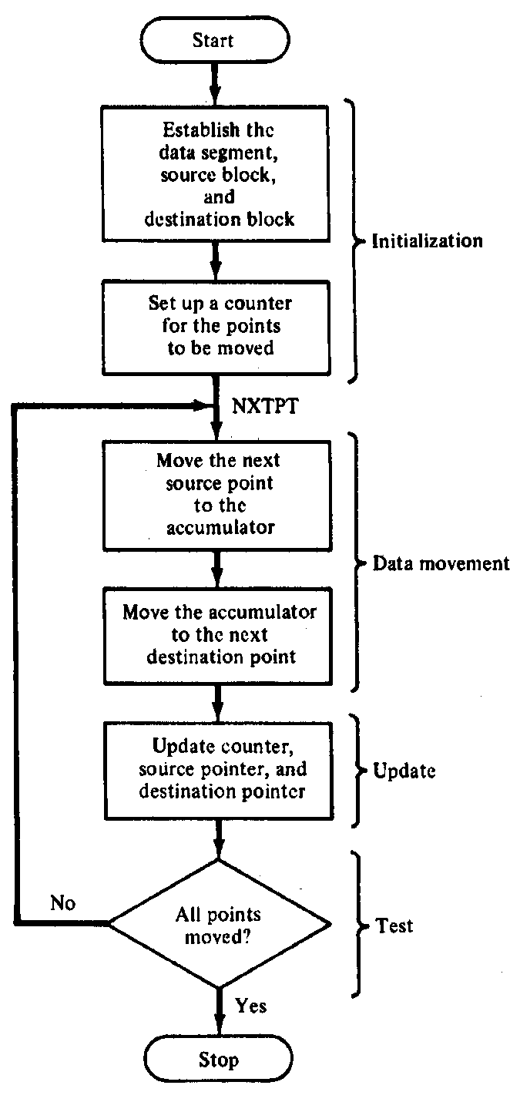
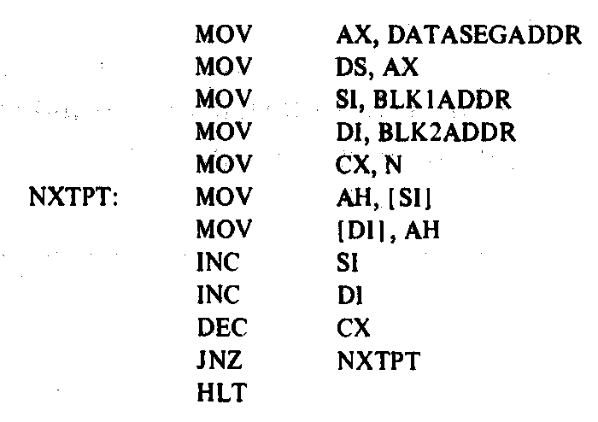
Block Move Program
Microprocessors I: Lecture 14
Notes:
Chapter 6 part 1

Slide 11
Loop instructions
Common operations in basic loops
  Compare
  Conditional jump
  Decrement loop counter (CX)
Loop instructions combine all into one op
  All decrement CX by 1, then check if CX == 0
  <target> must be short-label (8-bit immediate)
  LOOP <target>: Return to <target> if CX != 0
  LOOPE/LOOPZ <target>: Return to <target> if (CX != 0) && (ZF == 1)
  LOOPNE/LOOPNZ <target>: Return to <target> if (CX != 0) && (ZF != 1)
Microprocessors I: Lecture 14

Slide 12
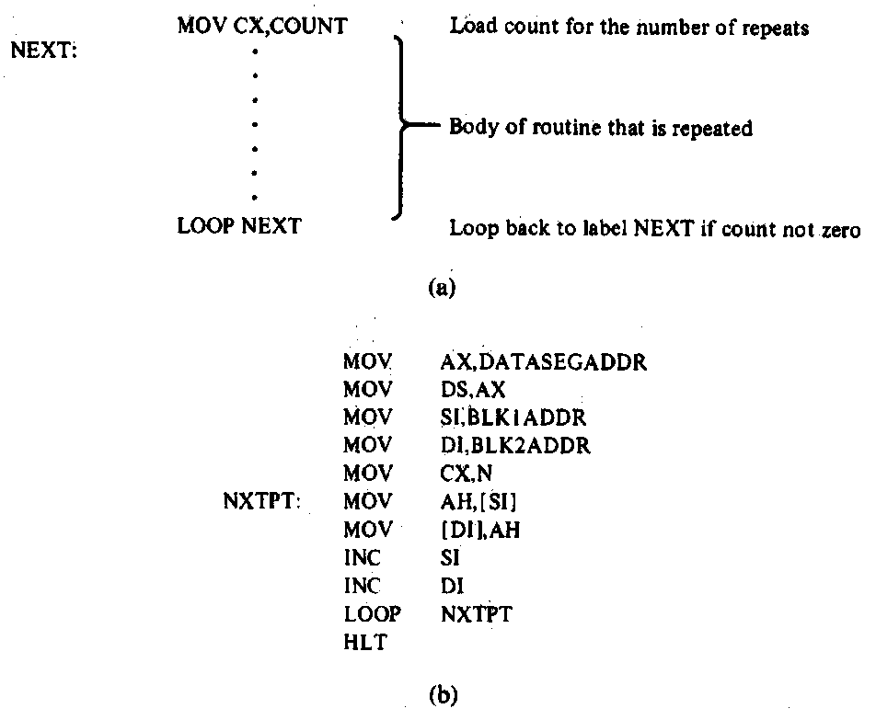
Loop Program Structure
Structure of a loop
  CX = initial count
  Loop body: code to be repeated
  Loop instruction– determines if loop is complete or if the body is to repeat
Example: block move
Microprocessors I: Lecture 14
Notes:
Chapter 6 part 2

Slide 13
Loop example 1
Rewrite the post-tested loop seen earlier using a loop instruction:
  MOV CX, 5
  L: SHL AX, 1
  DEC CX
  JNZ L
Solution:
  MOV CX, 5
  L: SHL AX, 1
  LOOP L
Microprocessors I: Lecture 14

Slide 14
Loop example 2
Describe the operation of the following program (Example 6.15-6.16).
What is the final value of SI if the 15 bytes between 0A001 and 0A00F have the following values?
  00 01 02 03 04 05 06 07 08 09 0A 0B 0C 0D 0E
MOV DL, 05
MOV AX, 0A00
MOV DS, AX
MOV SI, 0000
MOV CX, 000F
AGAIN: INC SI
CMP [SI], DL
LOOPNE AGAIN
Microprocessors I: Lecture 14

Slide 15
Final notes
Next time: Continue with instructions
Reminders:
  Lab 1 due 3/6
  Exam 1 regrades due 3/1
Microprocessors I: Lecture 14

