Slide 1
16.317
Microprocessor Systems Design I
Instructor: Dr. Michael Geiger
Spring 2013
Lecture 17:
Protected mode (cont.)

Slide 2
Lecture outline
Announcements/reminders
  Lab 1 due today
Today’s lecture
  Review: Protected mode
  Local memory accesses
  IDTR
  Multitasking
Microprocessors I: Lecture 17

Slide 3
Review
Protected mode
  Supports memory management, multitasking, protection
  Changes in control/flag registers, IP, memory accesses
Selectors: pointers into descriptor tables
  Contains requested privilege, global/local, and table index
Descriptors: provide info about segments
  8 bytes in length
  4 bytes: base address
  2 bytes: limit (max offset within segment)
    Segment size = (limit + 1) bytes
  2 bytes: access info (privilege, R/W, executable, etc.)
Microprocessors I: Lecture 17

Slide 4
Review (cont.)
Descriptors stored in descriptor tables
  Specific memory range dedicated to table
  GDTR points to global descriptor table
    Contains base address, limit for GDT
  LDTR cache points to local descriptor table
    Contains base address, limit for current LDT
    Values loaded from entry in GDT, pointed to by LDTR
Global memory access
  Selector indicates access is global (TI == 0)
  Index field in selector chooses descriptor from GDT
  Descriptor provides starting address of segment
Local memory access
  Selector indicates access is local (TI == 1)
  Index field in selector chooses descriptor from LDT
  Descriptor provides starting address of segment
Microprocessors I: Lecture 17

Slide 5
Memory access questions
How do we know if an access is global or local?
How do we find the appropriate descriptor on a global memory access?
How do we find the appropriate descriptor on a local memory access?
Microprocessors I: Lecture 17

Slide 6
Illustrating global memory access
MOV AX, [10H]
→ Logical addr = DS:10H
GDT | 00002000H
 | 000020FFH
DS = 0013H =
0000 0000 0001 0 | 0 | 11
RPL = 3
Index = 2
TI = 0 → global
Desc. 2
Base = 00000100H
Limit =
0FFFH
00002010H
GDTR =
00002000 | 00FF
Base Limit
Descriptor addr: (GDT base) + (selector index * 8)
00002000H
+ (0002H * 8)
00002010H
Actual mem addr: (seg base) + (effective address)
00000100H
+ 10H
00000110H
Microprocessors I: Lecture 17

Slide 7
Local Descriptor Table Register (LDTR)
Local descriptor table
  Defines local memory address space for the task
  Each task has its own LDT
  Contains local segment descriptors
LDTR: 16 bit selector pointing into GDT
  Each LDT is essentially a segment in global memory
  LDTR cache automatically loads when LDTR changed
LDTR cache: 48bit
  Lower 2 bytes define LDT LIMIT (or size)
  Upper 4 bytes define LDT base (physical address)
Microprocessors I: Lecture 17
Notes:
Chapter 8

Slide 8
Illustrating local memory access
MOV AX, [10H]
→ Logical addr = DS:10H
GDT | 00002000H
 | 000020FFH
DS = 0027H =
0000 0000 0010 0 | 1 | 11
RPL = 3
Index = 4
TI = 1 → local
Desc. 7
Base = 00002100H
Limit =
001FH
00002038H
LDTR = 003BH =
0000 0000 0011 1 | 0 | 11
GDTR =
00002000 | 00FF
Base Limit
Descriptor addr: (GDT base) + (selector index * 8)
00002000H
+ (0007H * 8)
00002038H
Microprocessors I: Lecture 17

Slide 9
Illustrating local memory access
MOV AX, [10H]
→ Logical addr = DS:10H
GDT | 00002000H
 | 000020FFH
LDT | 00002100H
 | 0000211FH
DS = 0027H =
0000 0000 0010 0 | 1 | 11
RPL = 3
Index = 4
TI = 1 → local
GDT descriptor 7 describes LDT for this task
→ LDTR cache =
00002100 | 001F
Desc. 4
Base = 00100000H
Limit =
001FH
00002120H
Base Limit
Descriptor addr: (LDT base) + (selector index * 8)
00002100H
+ (0004H * 8)
00002120H
Actual mem addr: (seg base) + (effective address)
00100000
+ 10H
00100010H
Microprocessors I: Lecture 17

Slide 10
Interrupt Descriptor Table Register (IDTR)
Interrupt descriptor table
  Up to 256 interrupt descriptors
    Describes segments holding interrupt service routines
  Described by IDTR
  Each entry (interrupt descriptor) takes 8 bytes
IDTR: 48-bit
  Lower 2 bytes define LIMIT (or size)
  Upper 4 bytes define the base (physical address)
  Initialized before switching to protected mode
Microprocessors I: Lecture 17
Notes:
Chapter 8

Slide 11
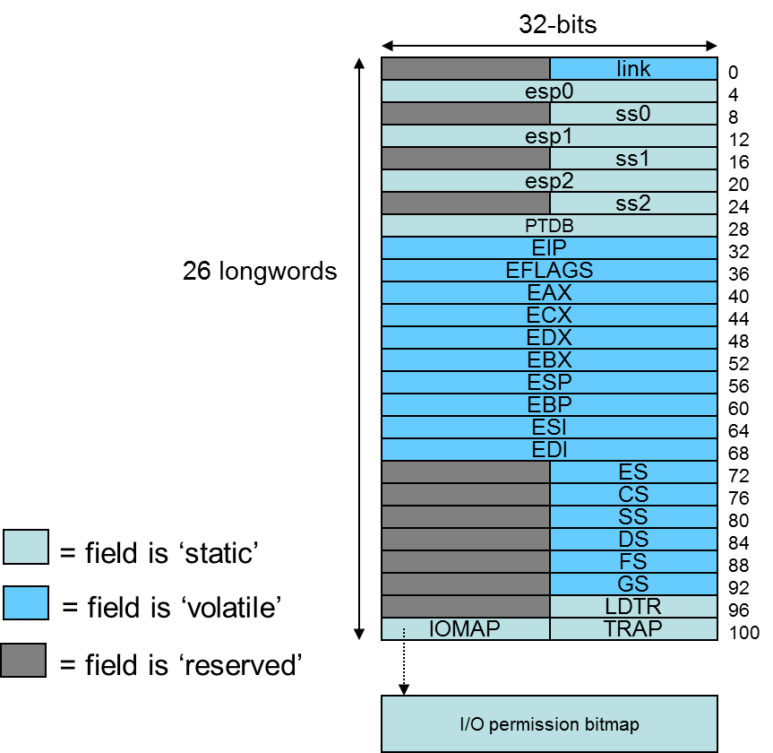
Multitasking
Most systems run multiple tasks
  Different programs
  Different threads in same program
Task switch: save state of current task; transfer control to new task
80386 specifics
  Task state segment (TSS): saved task state (picture at right)
    Every TSS resides in global memory
  Task register (TR): selector pointing to descriptor in GDT for current TSS
    Limit, base of current TSS cached
  Task switch = jump or call instruction that changes task
Figure from cs.usfca.edu/~cruse/cs630f06/lesson08.ppt
Microprocessors I: Lecture 17
Notes:
Chapter 8

Slide 12
Final notes
Next time: Protected mode practice problems
Reminders:
  Lab 1 due today
Microprocessors I: Lecture 17

