Slide 1
16.317
Microprocessor Systems Design I
Instructor: Dr. Michael Geiger
Spring 2013
Lecture 1: Course Overview
General Microprocessor Introduction

Slide 2
Lecture outline
Course overview
  Instructor information
  Course materials
  Course policies
  Resources
  Tentative course outline
General microprocessor introduction
Microprocessors I: Lecture 1

Slide 3
Course staff & meeting times
Lectures:
  Section 201: MWF 8-8:50 AM, Ball 314
  Section 202: MWF 9-9:50 AM, Ball 314
Labs:
  Open lab hours in Ball Hall 407
  Will get card access ASAP
Instructor: Dr. Michael Geiger
  E-mail: Michael_Geiger@uml.edu
  Phone: 978-934-3618 (x3618 on campus)
  Office: 118A Perry Hall
  Office hours: TBD (tentatively MWTh)
TA: Peilong Li; lab hours to be announced
Microprocessors I: Lecture 1

Slide 4
Course materials
Textbook: Walter Triebel, The 80386, 80486, and Pentium Processors: Hardware, Software, and Interfacing, 1998, Prentice Hall.
  ISBN: 0-13-533225-7
Course website: http://mgeiger.eng.uml.edu/16317/sp13/index.htm
  Will contain lecture slides, handouts, assignments
Discussion group through piazza.com
  Allow common questions to be answered for everyone
  All course announcements will be posted here
  Will use as class mailing list—you must enroll by next Monday
Microprocessors I: Lecture 1

Slide 5
Course policies
Prerequisites: 16.265 (Logic Design), 16.365 (Electronics I)
Homework
  Individually done
  Late assignments: 10% penalty per day
Labs
  Can work in groups of 1 or 2 students
  All labs must be checked off by instructor
  Each student must complete individual lab report
    Group members may share data generated in lab (screenshots, etc.) but must write own description
    Report format specified in separate document
  Typed reports due in class on due date
    Late reports penalized 10% per weekday
Microprocessors I: Lecture 1

Slide 6
Course policies (cont.)
Academic honesty
  All assignments are to be done individually unless explicitly specified otherwise by the instructor
  Any copied solutions, whether from another student or an outside source, are subject to penalty
  You may discuss general topics or help one another with specific errors, but not share assignment solutions
    Must acknowledge assistance from classmate in submission
Microprocessors I: Lecture 1

Slide 7
Course policies (cont.)
Grading breakdown
  Labs: 30%
  Homework: 25%
  Exam 1: 15%
  Exam 2: 15%
  Final: 15%
Exam dates
  Exam 1: Wednesday, February 20
  Exam 2: Wednesday, March 27
  Exam 3: During finals; date/time TBD (hopefully, common final for both sections)
Microprocessors I: Lecture 1

Slide 8
What you should learn in this class
Basics of computers vs. microprocessors
Two major aspects:
  How to program
    Focus on assembly language
  How a microprocessor works with other components
    Focus on interfacing circuits and control schemes
Will work with two processors:
  Intel 80386DX → assembly language simulation
  PIC microcontroller → actual microcontroller programming, interfacing
Microprocessors I: Lecture 1
· To understand the interconnection of the CPU, memory, and I/O

Slide 9
Tentative course outline
General microprocessor introduction
Assembly language programming
  Start with 80386DX; PIC microcontroller at end
  Areas will include
    Addressing modes
    Instruction types
    Programming modes
Memory management
  Segmentation
  Virtual memory
External interfacing
  Processor signals used in interfacing
  Interface circuitry
  External memory
Microcontroller-based systems
Microprocessors I: Lecture 1

Slide 10
What is a computer?
From The American Heritage Dictionary:
  “One who computes”
    We could argue that people are computers
  “A device that computes, especially a programmable electronic machine that performs high-speed mathematical or logical operations or that assembles, stores, correlates, or otherwise processes information.”
    Anything from a simple abacus to the microprocessor-based computers of today
“Microcomputer”: computer system with changeable functionality, based on microprocessor
Microprocessors I: Lecture 1

Slide 11
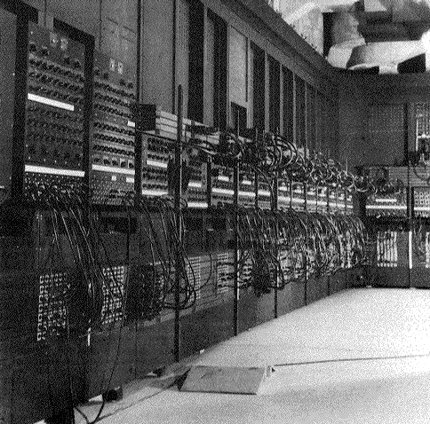
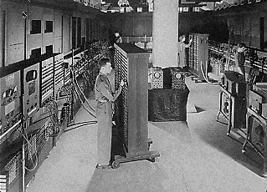
Computing history
Thirty tons
Forced air cooling
200KW
19,000 vacuum tubes
Punch card
Manual wiring
Numerical computation
The first electronic digital computer – ENIAC, built in UPenn in 1946
Source: http://ei.cs.vt.edu/~history/ENIAC.Richey.HTML
Microprocessors I: Lecture 1
Notes:
Chapter 1

Slide 12
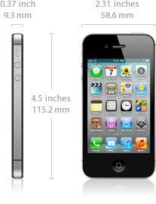
Today’s computer: one example
iPhone 4S Technical Specifications
Screen size 3.5 inches
Screen resolution 960 by 640 at 326 ppi
Input method Multi-touch
Operating system iOS 5.0
Storage 16 / 32 / 64 GB
Cellular network UMTS/GSM/CDMA
Wireless data Wi-Fi (802.11b/g/n) + EDGE + Bluetooth 4.0
Camera 8.0 megapixels
Battery Up to 6 hrs Internet, 8 hrs talk,
10 hrs video, 40 hrs audio,
200 hrs standby
Dimensions 4.5 x 2.3 x 0.37 inches
Weight 4.9 ounces
Microprocessors I: Lecture 1
Notes:
Chapter 1

Slide 13
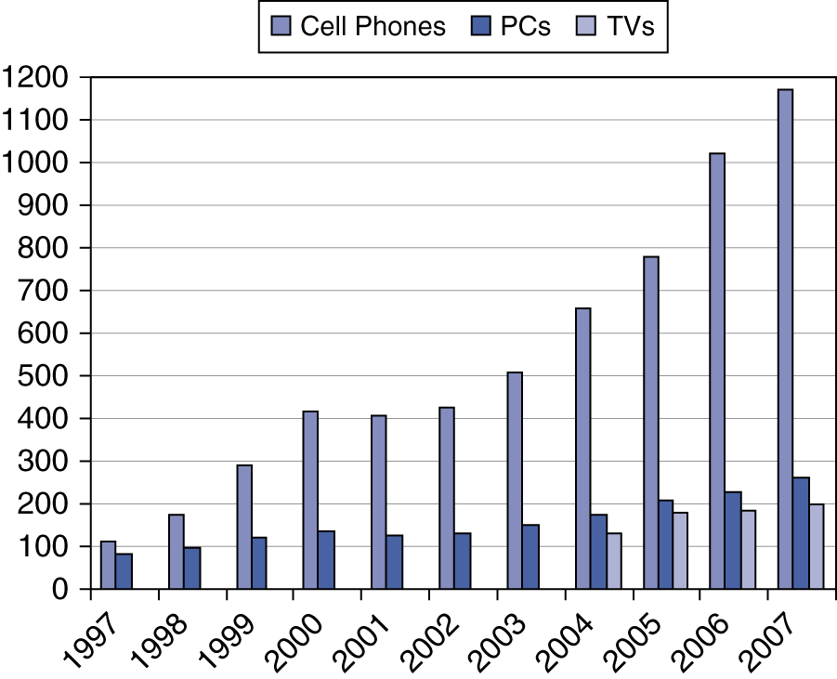
Processor market (as of 2007)
“Computer” used to just refer to PCs
Processors—and, therefore, computers—are now everywhere
Microprocessors I: Lecture 1

Slide 14
Computer components
What are the key components of a computer?
  Microprocessor (MPU/CPU) performs computation
  Input to read data from external devices
    Examples: Keyboard, mouse, ports (Ethernet, USB, etc.)
  Output to transmit data to external devices
    Examples: screen, speaker, VGA interface, ports (Ethernet, USB, etc.)
  Storage to hold program code and data
    RAM, hard disk, possibly other media (CD/DVD, external drive)
Will see that microprocessor contains smaller-scale versions of these components
  Computation engine
  I/O interface
  Internal storage
Microprocessors I: Lecture 1
Notes:
Chapter 1

Slide 15
Final notes
Next time
  Continue general processor overview
  80386DX introduction
Reminders:
  Check the course web page
  Join the course discussion group on piazza.com
Microprocessors I: Lecture 1

