Slide 1
16.317
Microprocessor Systems Design I
Instructor: Dr. Michael Geiger
Spring 2013
Lecture 20:
Converting high level to assembly:
practice problems

Slide 2
Lecture outline
Announcements/reminders
  HW 3 due today
  Lab 2 due 4/5
  Exam 2: Wednesday, 3/27
    Reference material to be posted
Today’s lecture:
  Review HLL → assembly
  HLL → assembly practice problems
Microprocessors I: Lecture 20

Slide 3
Review: HLL → assembly
Data accesses
  Global variables → static; allocated in data segment
  Other variables → dynamic; allocated on stack
  Stack frame for each function contains (from top)
    Saved variables w/in function
    Local variables for function (starting at EBP – 4)
    Saved EBP
    Saved EIP
    Function arguments (starting at EBP + 8)
Conditional statements (if-then-else)
  Evaluate condition (CMP instruction(s))
  Conditional jump (often to “else” case)
  “If” case ends with unconditional jump to skip “else”
Loops
  Initialize variable at start
  Test loop condition (similar to if)
  Change loop variable
Microprocessors I: Lecture 20

Slide 4
Practice problems
See today’s handout for
  Description of how stack frame should be created
  Description of where to access function arguments, local variables
Functions to be written
  int fact(int n): Calculate and return n!
  int max(int v1, int v2): Return largest value between v1 and v2
  void swap(int *a, int *b): Given addresses a & b (offsets into data segment), swap contents
Solutions to be posted as PDF online
  C versions in slides that follow; assembly in PDF file
  Will be covered in class today as well
Microprocessors I: Lecture 20

Slide 5
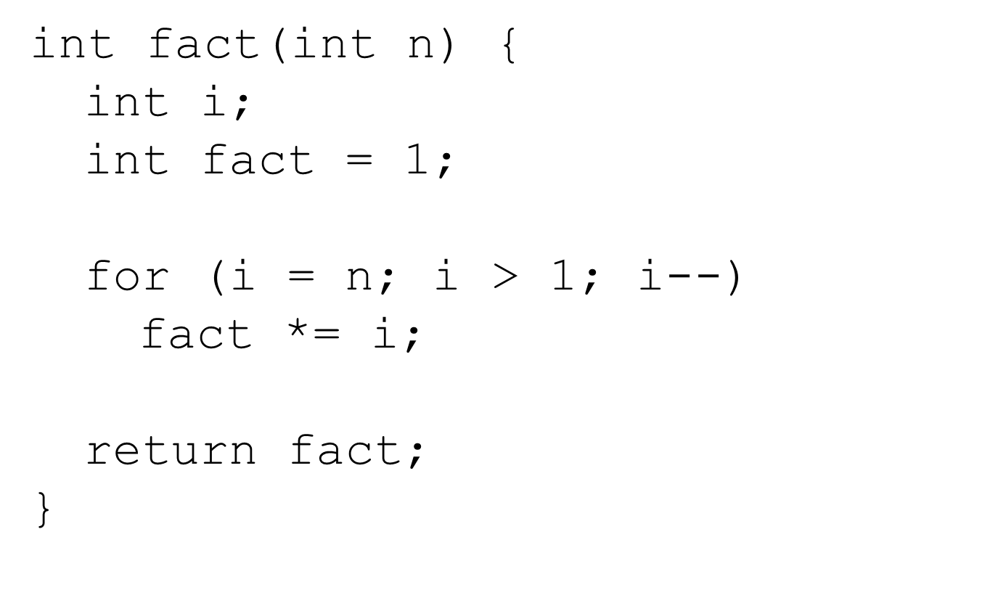
Factorial in C
Microprocessors I: Lecture 20

Slide 6
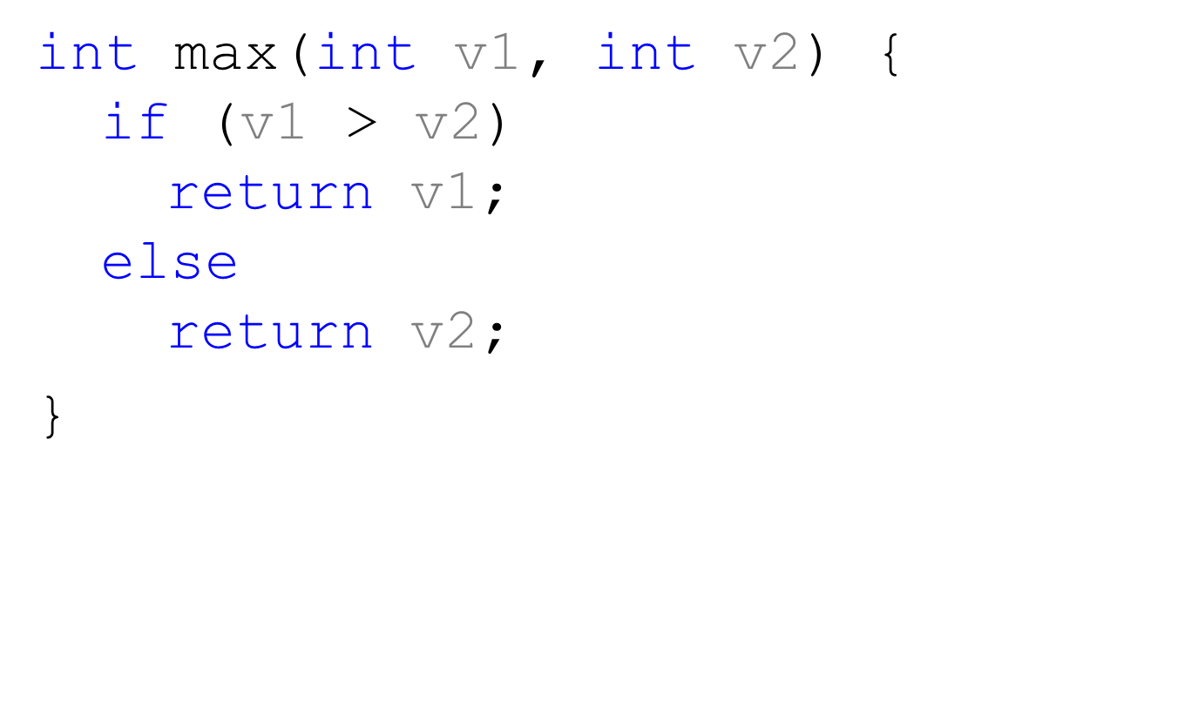
Maximum value function in C
Microprocessors I: Lecture 20

Slide 7
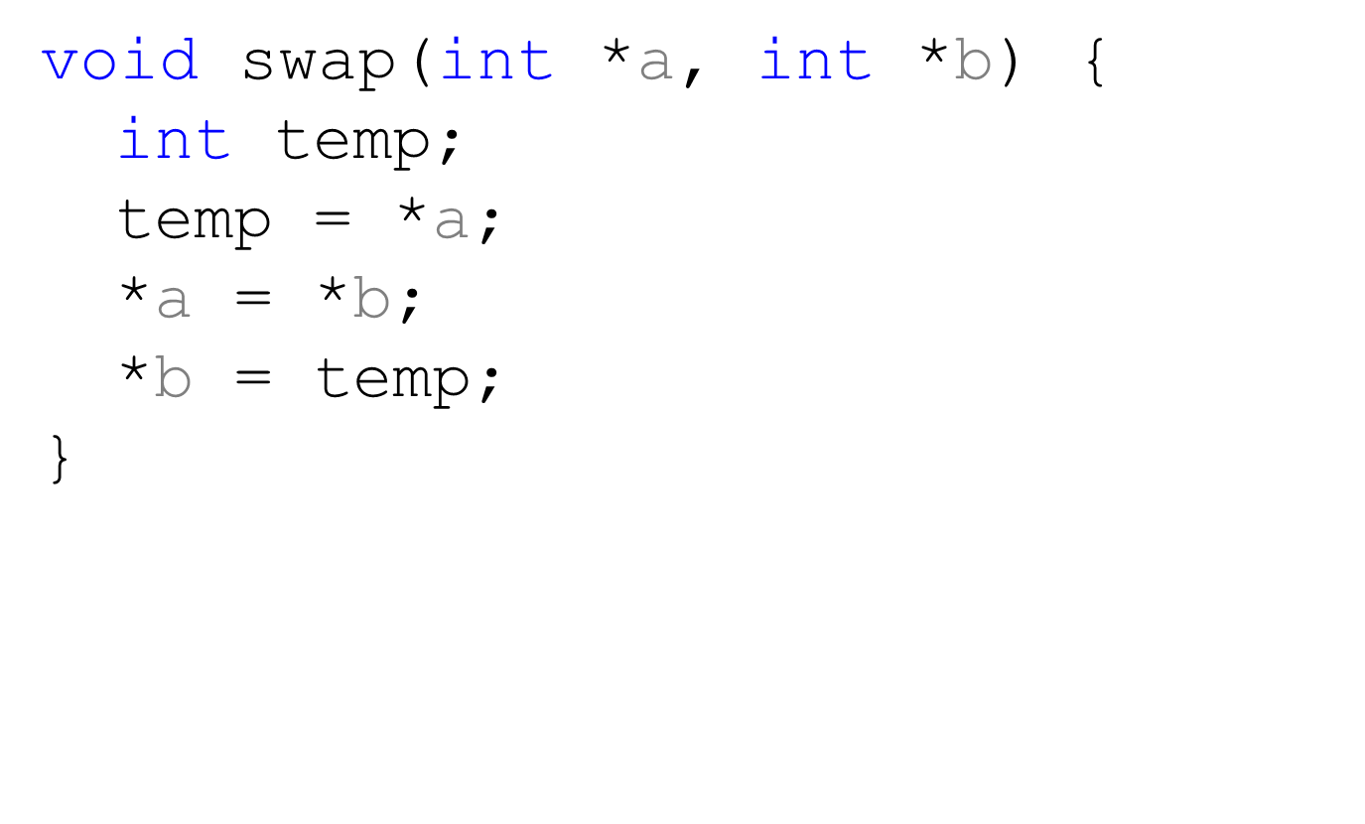
Swap in C
Microprocessors I: Lecture 20

Slide 8
Final notes
Next time: Exam 2 Preview
Reminders:
  HW 3 due today
  Lab 2 due 4/5
  Exam 2: Wednesday, 3/27
    Reference material to be posted
Microprocessors I: Lecture 20

