Slide 1
16.317
Microprocessor Systems Design I
Instructor: Dr. Michael Geiger
Fall 2012
Lecture 5: Assembly intro

Slide 2
Lecture outline
Announcements/reminders
  HW 1 posted, due 2/8
Review
  Addressing modes
  80386 memory
    Segmented memory
    80386 addressing
Today’s lecture
  Assembly intro
  Start 80386DX data transfer instructions
Microprocessors I: Lecture 5

Slide 3
Review: 80386 memory
Six segment registers: CS (code), SS (stack), DS, ES, FS, GS (data)
Each segment 64 KB, starts on 16B boundary
  Lowest hex digit of 20-bit address = 0
Logical address → SBA:EA
  Examples: DS:SI, SS:SP, CS:IP, DS:1000H
Physical address: actual memory address
  Shift 16-bit segment register to left by 4 bits = SBA
  Add 16-bit EA to SBA
Calculating EA
  Direct addressing: EA = const
  Register indirect—either “based” or “indexed”: EA = reg
    Possible register: SI, DI, BX, BP
    Only BP uses SS; others use DS by default
  Based-indexed: EA = base reg. + index reg.
  Based-indexed + displacement: EA = base reg + index reg + const
Microprocessors I: Lecture 5

Slide 4
Software
Instruction -> Program -> Software
Machine language -> Assembly Language -> High Level Language (C/C++, Java)
Source code -> Object code -> Executable
Assembly language
  Instruction: Label: Instruction ; comment
  Example: START: MOV EAX, EBX; COPY EBX INTO EAX
  List file: line number, offset, machine language (code), instruction, comments
Microprocessors I: Lecture 5

Slide 5
Instruction Assembly Notation
Each instruction is represented by a mnemonic that describes its operation—called its operation code (opcode)
  MOV = move (data transfer)
  ADD = add (arithmetic)
  AND = logical AND (logic)
  JMP = unconditional jump (control transfer)
Operands are the other parts of an assembly language instructions
    Identify whether the elements of data to be processed are in registers or memory
      Source operand– location of one operand to be process
      Destination operand—location of the other operand to be processed and the location of the result
Microprocessors I: Lecture 5

Slide 6
Assembly Language Statements
General structure of an assembly language statement
LABEL: INSTRUCTION ;COMMENT
  Label—address identifier for the statement
  Instruction—the operation to be performed
  Comment—documents the purpose of the statement
  Example:
START: MOV AX, BX ; Copy BX into AX
Other examples:
  INC SI ;Update pointer
ADD AX, BX
  Few instructions have a label—usually marks a jump to point
  Not all instructions need a comment
Microprocessors I: Lecture 5
Notes:
Chapter 3

Slide 7
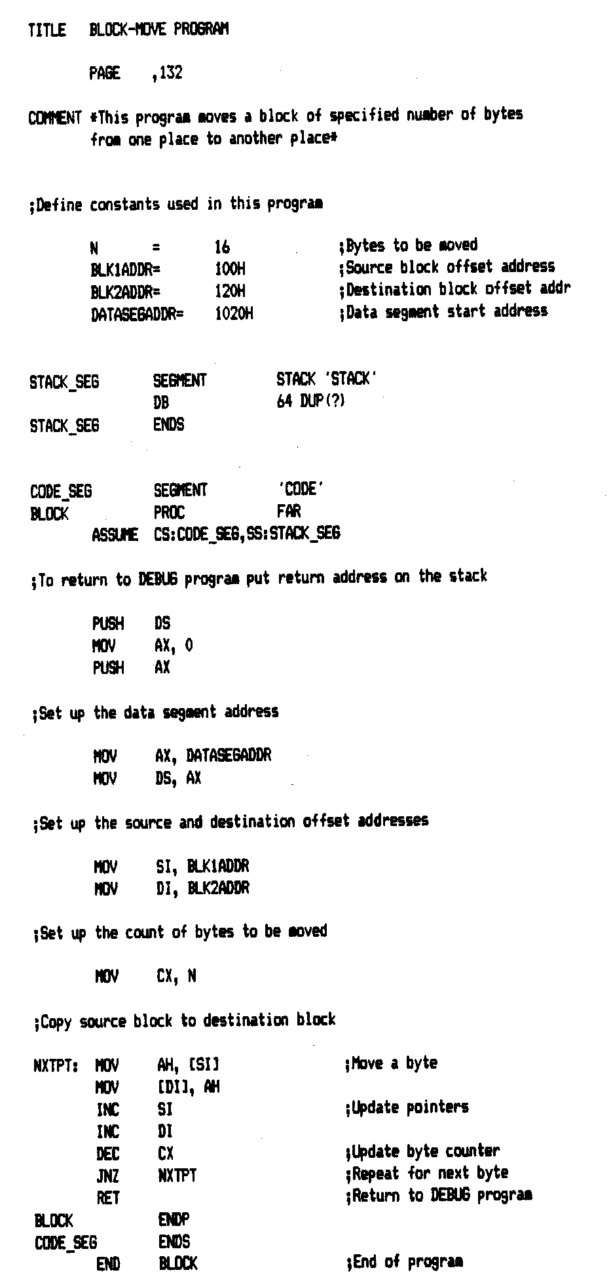
Source Program
Title/comment
Constant declaration
  Similar to #define
Set up segments
  SEGMENT directive for SS, CS
  Explicitly set DS
Actual code within process (PROC)
Microprocessors I: Lecture 5
Notes:
Chapter 3

Slide 8
Assembler and the source program
Assembly language program
  Assembly language program (.asm) file—known as source code
  Converted to machine code by a process called assembling
  Assembling performed by a software program—an 80x86 assembler
  Machine (object ) code that can be run is output in the executable (.exe) file
  Source listing output in (.lst) file—printed and used during execution and debugging of program
DEBUG—part of disk operating system (DOS) of the PC
  Permits programs to be assembled and disassembled
  Line-by-line assembler
  Also permits program to be run and tested
Microprocessors I: Lecture 5

Slide 9
The Listing File
Instruction statements—operations to be performed by the program
  Example—line 53
0013 8A 24 NXTPT: MOV AH, [SI] ;Move a byte
Where:
0013 = offset address of first byte of code in the current CS
8A24 = machine code of the instruction
NXTPT: = Label
MOV = instruction mnemonic
AH = destination operand—a register
[SI] = source operand—in memory
;Move xxxxx = comment
Directives—provides directions to the assembler program
  Example—line 20
  0000 0040 DB 64 DUP(?)
Defines and leaves un-initialized a block of 64 bytes in memory for the stack
Microprocessors I: Lecture 5

Slide 10
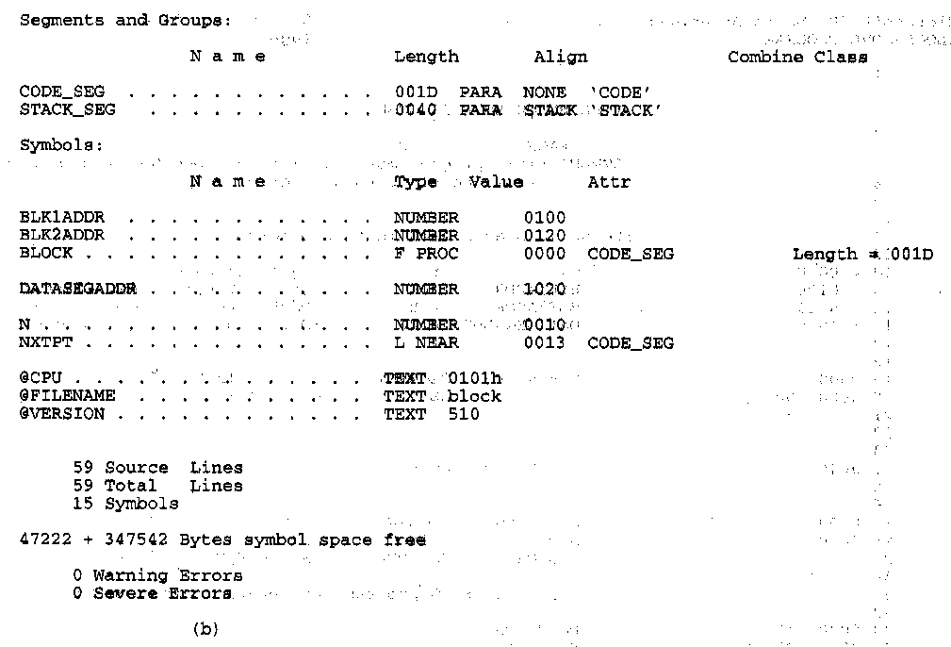
More Information in the Listing
Other information provided in the listing
  Size of code segment and stack
  Names, types, and values of constants and variables
  # lines and symbols used in the program
  # errors that occurred during assembly
Microprocessors I: Lecture 5
Notes:
Chapter 3

Slide 11
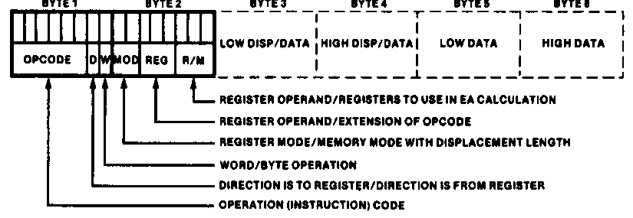
Instruction Encoding
80x86’s instruction set is variable length
  Multiple instruction sizes
    1 to 6 bytes in length for 8088/8086
    Up to 17 bytes for 80386,80486, and Pentium
  Variable length advantages (trait of CISC)
    Allows for many addressing modes
    Allows full size (32-bit) immediate data and addresses
    Instructions can use as many bytes as necessary
  Disadvantage of variable length
    Requires more complicated decoding hardware—speed of decoding is critical in modern uP
    Most uP use fixed length (trait of RISC)
Microprocessors I: Lecture 5
Notes:
Chapter 4

Slide 12
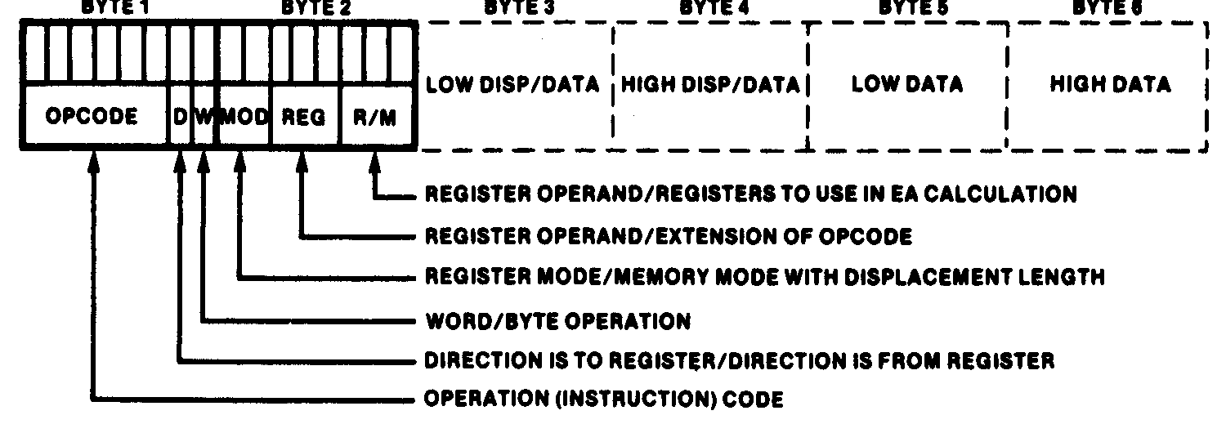
Instruction Encoding
Information encoded in an instruction
  What operation ?
  What operands ?
  Byte, word or double-word ?
  Operands in register or memory ?
  How the address is to be generated, if mem?
Microprocessors I: Lecture 5

Slide 13
80386DX data types (“review”)
Refresher on 80386DX registers
  Gen. purpose registers: 16 or 32 bits
  Data registers can hold 8 bit data as well
  Determining size: register name
  Example: “accumulator” register
    8 bit data: AL = lowest byte; AH = next lowest byte
    16 bit data: AX = lowest 16 bits (AH/AL together as word)
    32 bit data: EAX = entire 32 bits
Say EAX = 1A2B3C4DH
  What are AL, AH, and AX?
  AL = 4DH, AH = 3CH, AX = 3C4DH
Microprocessors I: Lecture 5

Slide 14
80386 memory accesses
# bytes from memory usually = # bytes in register
Example: MOV AX, [100H]
  AX is 16-bit register → move word from DS:100H to AX
Sometimes necessary to specify size
  Use “<size> PTR”: BYTE PTR, WORD PTR, DWORD PTR
  Example: MOVZX EAX, BYTE PTR [100H]
    Take byte from memory
    Zero-extend data to 32 bits and store in EAX
Remember, 80386DX uses little-endian data
Microprocessors I: Lecture 5

Slide 15
Instruction types
Recall the four general types of instructions used by most microprocessors
  Data transfer
  Arithmetic
  Logical (including shifts, bitwise, etc.)
  Program control
80386DX has some additional types (many of which we won’t cover)
  Processor control
  String instructions
  Input/output instructions
Microprocessors I: Lecture 5

Slide 16
Data transfer instructions
MOV
MOVSX
MOVZX
XCHG
LEA
Load full pointer
Microprocessors I: Lecture 5

Slide 17
MOV
Used to copy data between
  Registers
  Registers/memory
  Immediate value (source only) to register/memory
Format: MOV D, S
Operation: (D) = (S)
Restrictions
  Immediate value can only be used as source
  If segment register is destination, source must be memory or register (no immediate)
Microprocessors I: Lecture 5

Slide 18
MOV examples
Assume: AX = 0100H, CS = 3000H, (DS:100H) = 00H, (DS:101H) = FFH
MOV BL, AL
  BL = AL = 00H
MOV DX, CS
  DX = CS = 3000H
MOV CX, [100H]
  CX = word starting at DS:100H = FF00H
Microprocessors I: Lecture 5

Slide 19
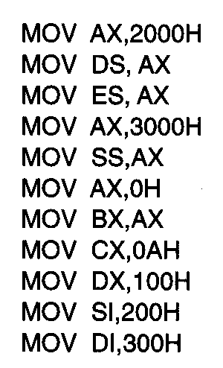
Usage of Move Instruction
Example—Initialization of internal registers with immediate data and address information
  What is the final state of all affected registers?
  Why is AX used to initialize segment registers?
Microprocessors I: Lecture 5
Notes:
Chapter 5 (I)

Slide 20
Usage of Move Instruction (soln)
MOV AX, 2000H → AX = 2000H
MOV DS, AX → DS = AX = 2000H
MOV ES, AX → ES = AX = 2000H
MOV AX, 3000H → AX = 3000H
MOV SS, AX → SS = 3000H
MOV AX, 0H → AX = 0000H
MOV BX, AX → BX = AX = 0000H
MOV CX, 0AH → CX = 000AH
MOV DX, 100H → DX = 0100H
MOV SI, 200H → SI = 0200H
MOV DI, 300H → DI = 0300H
Microprocessors I: Lecture 5
Notes:
Chapter 5 (I)

Slide 21
Final notes
Next time: More instructions
  Finish data transfer
  Arithmetic instructions
Reminders:
  HW 1 due 2/8
Microprocessors I: Lecture 5

