Slide 1
16.317
Microprocessor Systems Design I
Instructor: Dr. Michael Geiger
Spring 2013
Lecture 6:
Data transfer instructions

Slide 2
Lecture outline
Announcements/reminders
  HW 1 due Friday, 2/8
Review
  80386 data
  MOV instruction
Today’s lecture: more data transfer instructions
Microprocessors I: Lecture 6

Slide 3
Review
80386 data
  Registers: access as 8-bit (e.g. AL, AH), 16-bit (AX), 32-bit (EAX)
  Memory
    Data size usually matches register
    If not, explicitly specify (BYTE PTR, WORD PTR, DWORD PTR)
MOV: basic data transfer
  Can use registers, memory, immediates
  If segment reg. is destination, source must be register
Microprocessors I: Lecture 6

Slide 4
MOVSX/MOVDX
Move and extend data (fill upper bits with 0/1)
  ZX → zero extend
  SX → sign extend → copy MSB of source
Format: MOVZX D, S
MOVSX D, S
Operation: lower bits of D = S
upper bits of D = 0 (MOVZX) or
upper bits of D = MSB of S (MOVSX)
Restrictions
  Only register/memory operands (no immediates)
  Source must contain fewer bits than destination
  If memory operand used, size must be specified
Microprocessors I: Lecture 5

Slide 5
MOVSX/MOVZX examples
Assume: AX = 0100H, DX = 8100H, (DS:100H) = 00H, (DS:101H) = FFH
What are the results of the following instructions?
MOVSX EBX, AX
MOVSX EBX, DX
MOVZX EBX, DX
MOVSX EBX, BYTE PTR [100H]
MOVSX EBX, WORD PTR [100H]
Microprocessors I: Lecture 5

Slide 6
MOVSX/MOVZX examples (soln)
Assume: AX = 0100H, DX = 8100H, (DS:100H) = 00H, (DS:101H) = FFH
What are the results of the following instructions?
MOVSX EBX, AX
  EBX = AX sign-extended = 00000100H (orig. value underlined)
MOVSX EBX, DX
  EBX = DX sign-extended = FFFF8100H
MOVZX EBX, DX
  EBX = DX zero-extended = 00008100H
MOVSX EBX, BYTE PTR [100H]
  EBX = byte at DS:100 sign-extended = 00000000H
MOVSX EBX, WORD PTR [100H]
  EBX = word at DS:100 sign-extended = FFFFFF00H
Microprocessors I: Lecture 5

Slide 7
XCHG
Swap contents of source and destination
Format: XCHG D, S
Operation: (D) = (S)
(S) = (D)
Restrictions:
  Memory operand can only be used as destination
Microprocessors I: Lecture 6

Slide 8
LEA
Perform effective address computation and store result in register
Format: LEA D, EA
Operation: D = EA
Example: LEA SI, [10H + DI]
Microprocessors I: Lecture 6

Slide 9
Load full pointer
Load contents of memory into both register and segment register
Format: Lxx D, addr
  xx = DS, ES, FS, GS, SS
Operation:
  (D) = contents of addr
  Segment register xx = contents of:
    addr + 2 if D is 16-bit register
    addr + 4 if D is 32-bit register
Microprocessors I: Lecture 6

Slide 10
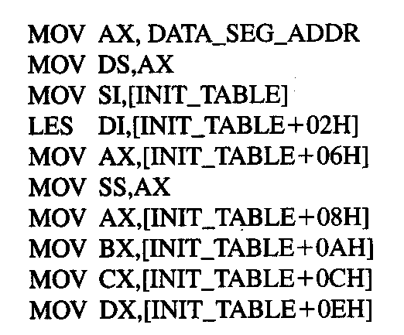
Example
DATA_SEG_ADDR:0000
DATA_SEG_ADDR:INIT_TABLE | 11 | 22
 | 33 | 44
 | 55 | 66
 | 77 | 88
 | 99 | AA
 | BB | CC
 | DD | EE
 | FF | 16
 | 03 | 17
Show the results of running the following program if DATA_SEG_ADDR = 1200H:
Microprocessors I: Lecture 6

Slide 11
Example solution
DATA_SEG_ADDR:0000
DATA_SEG_ADDR:INIT_TABLE | 11 | 22
 | 33 | 44
 | 55 | 66
 | 77 | 88
 | 99 | AA
 | BB | CC
 | DD | EE
 | FF | 16
 | 03 | 17
MOV AX,DATA_SEG_ADDR
  AX = DATA_SEG_ADDR
  = 1200H
MOV DS, AX
  DS = AX = 1200H
MOV SI, [INIT_TABLE]
  SI = memory @ DS:INIT_TABLE
  = 2211H
LES DI,[INIT_TABLE+02H]
  DI = memory @ DS:INIT_TABLE+02H
  = 4433H
  ES = memory @ DS:INIT_TABLE+04H
  = 6655H
Microprocessors I: Lecture 6

Slide 12
Example solution (cont.)
DATA_SEG_ADDR:0000
DATA_SEG_ADDR:INIT_TABLE | 11 | 22
 | 33 | 44
 | 55 | 66
 | 77 | 88
 | 99 | AA
 | BB | CC
 | DD | EE
 | FF | 16
 | 03 | 17
MOV AX,[INIT_TABLE+06H]
  AX = memory @ DS:INIT_TABLE+06H
  = 8877H
MOV SS, AX
  SS = AX = 8877H
MOV AX,[INIT_TABLE+08H]
  AX = memory @ DS:INIT_TABLE+08H
  = AA99H
MOV BX,[INIT_TABLE+0AH]
  BX = memory @ DS:INIT_TABLE+0AH
  = CCBBH
Microprocessors I: Lecture 6

Slide 13
Example solution (cont.)
DATA_SEG_ADDR:0000
DATA_SEG_ADDR:INIT_TABLE | 11 | 22
 | 33 | 44
 | 55 | 66
 | 77 | 88
 | 99 | AA
 | BB | CC
 | DD | EE
 | FF | 16
 | 03 | 17
MOV CX,[INIT_TABLE+0CH]
  CX = memory @ DS:INIT_TABLE+0CH
  = EEDDH
MOV DX,[INIT_TABLE+0EH]
  DX = memory @ DS:INIT_TABLE+0EH
  = 16FFH
Microprocessors I: Lecture 6

Slide 14
Final notes
Next time: Arithmetic instructions
Reminders:
  HW 1 due Friday, 2/8
  HW 2, Lab 1 coming soon
Microprocessors I: Lecture 6

