Slide 1
16.317
Microprocessor Systems Design I
Instructor: Dr. Michael Geiger
Spring 2013
Lecture 9:
Rotate instructions
Bit test/scan instructions

Slide 2
Lecture outline
Announcements/reminders
  HW 2 due 2/15
    Point values updated (Q1: 40 → 60, Q3: 10 extra credit)
    Q2 & Q3 changed slightly (rotates moved to Q3)
  Next week: lecture on Tuesday, not Monday
  Exam 1: Wednesday, 2/20
    Will be allowed calculator, one 8.5” x 11” double-sided note sheet
    Will be provided list of instructions
Review
  Logical instructions
  Shift instructions
Today’s lecture
  Rotate instructions
  Bit test/bit scan instructions
Microprocessors I: Lecture 9

Slide 3
Review
Logical instructions (AND/OR/XOR/NOT)
Basic shift instructions
  Move value by <amt> bits; add 0s to left or right
  CF = last bit shifted out
  SHL <src>, <amt>: Move <src> to left
    SAL exactly the same
  SHR <src>, <amt>: Move <src> to right
Arithmetic right shift
  Move value right by <amt> bits
  Copy sign bit to fill remaining bits
  CF = last bit shifted out
  SAR <src>, <amt>
Microprocessors I: Lecture 9

Slide 4
Rotate instructions
Difference between rotates and shifts
  Shifts discard bits that are shifted out
  Rotates take bits that are shifted out and use them to fill vacated bits
Rotate instruction format: <op> D, <shamt>
  Destination may be register/memory
  <shamt>: shift amount
    May be immediate or register CL
All rotate instructions store last bit shifted out in carry flag (CF)
Microprocessors I: Lecture 9

Slide 5
ROR / ROL / RCR / RCL
ROR: rotate right
  Shift (D) to right by <shamt> bits
  <shamt> LS bits are moved to MS bits
ROL: rotate left
  Shift (D) to left by <shamt> bits
  <shamt> MS bits are moved to LS bits
RCR: rotate right through carry
  Treat (CF) as extra LS bit
  Shift (D,CF) to right by <shamt> bits
  <shamt> LS bits (from (D,CF)) are moved to MS bits
RCL: rotate left through carry
  Treat (CF) as extra MS bit
  Shift (CF,D) to left by <shamt> bits
  <shamt> MS bits (from (CF,D)) are moved to LS bits
Microprocessors I: Lecture 9

Slide 6
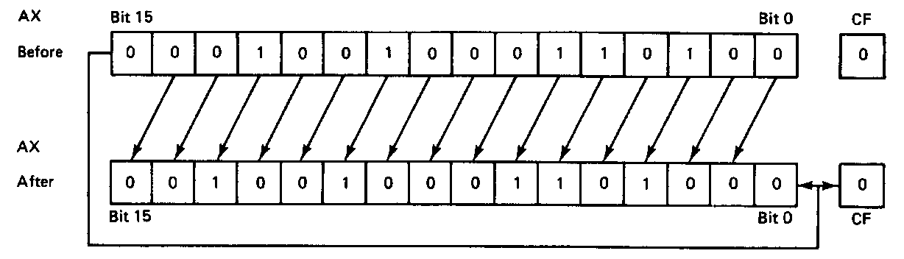
ROL example
ROL AX,1
Before execution
  Dest = (AX) = 1234H = 0001 0010 0011 0100₂
  Count = 1, CF = 0
Operation
  The value in all bits of AX are rotated left one bit position
  Value rotated out of the MSB is reloaded at LSB
  Value rotated out of MSB copied to carry flag
After execution
  Dest = (AX) = 2468H = 0010010001101000₂
  CF = 0
Microprocessors I: Lecture 9

Slide 7
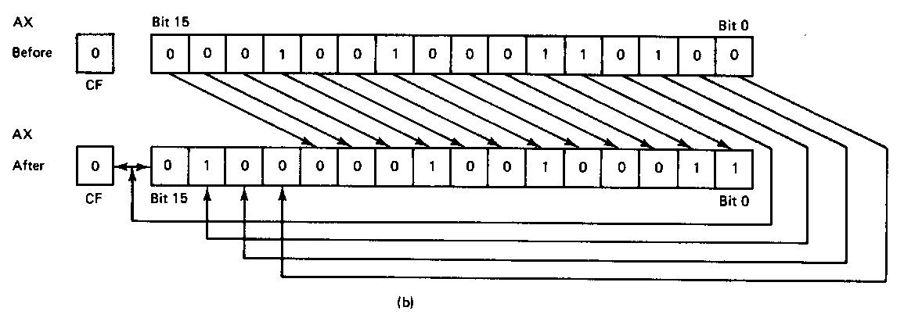
ROR example
ROR AX,CL
Before execution
  Dest = (AX) = 1234H = 0001 0010 0011 0100₂
  Count = 04H, CF = 0
Operation
  The value in all bits of AX are rotated right four bit positions
  Values rotated out of the LSB are reloaded at MSB
  Values rotated out of MSB copied to carry flag
After execution
  Dest = (AX) = 4123H = 01000001001000112
  CF = 0
Note position of hex characters in AX have been rearranged
Microprocessors I: Lecture 9

Slide 8
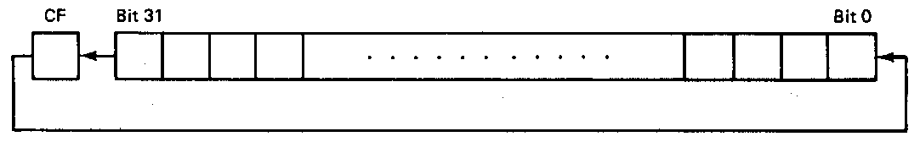
RCL example
RCL BX,CL
Before execution
  Dest = (BX) = 1234H = 0001 0010 0011 0100₂
  Count = 04H, CF = 0
Operation
  The value in all bits of AX are shifted left four bit positions
  Emptied MSBs are rotated through the carry bit back into the LSB
  Last value rotated out of MSB retained in carry flag
  First rotate loads prior value of CF at the LSB
After execution
  Dest = (BX) = 2340H = 0010 0011 0100 0000₂
  CF = 1
Microprocessors I: Lecture 9

Slide 9
Rotate example
Given AL = 43H, CL = 04H, and CF = 0, show the state of AL after each instruction in the sequence below:
  ROR AL, 2
  ROL AL, CL
  RCR AL, 3
  RCL AL, 4
Microprocessors I: Lecture 9

Slide 10
Solution
Initially, AL = 43H = 01000011₂
ROR AL, 2
  AL = 01000011 rotated right by 2
  = 11010000 = D0H
  CF = last bit rotated in = 1
ROL AL, CL
  AL = 11010000 rotated left by 4
  = 00001101 = 0DH
  CF = last bit rotated in = 1
Microprocessors I: Lecture 9

Slide 11
Solution (cont.)
RCR AL, 3
  (AL,CF) = 00001101 1 rotated right by 3
  = 01100001 1
  CF = 1, AL = 01100001₂ = 61H
RCL AL, 4
  (CF,AL) = 1 01100001 rotated left by 4
  = 0 00011011
  CF = 0, AL = 00011011₂ = 1BH
Microprocessors I: Lecture 9

Slide 12
Bit Test Instructions
BT → Bit test
BTR → Bit test and reset
BTS → Bit test and set
BTC → Bit test and complement
Format of bit test instruction: BT(x) D,S
  (S) → index that selects the position of the bit tested
  (D) → Holds value tested
Operation:
  Enables programmer to test bit in a value in register or memory
  All → Save the value of the selected bit in the CF
  BT → Leaves selected bit unchanged
  BTR → Clears the bit (bit = 0)
  BTS → Sets the bit (bit = 1)
  BTC → Complements the bit (bit = ~bit)
Microprocessors I: Lecture 9
Notes:
Chapter 5 part 2

Slide 13
Bit Test Instructions
Example:
  BTC BX,7
Before execution
  (BX) = 03F0H = 0000 0011 1111 0000₂
After Execution
  (CF) = bit 7 of BX = 1
  (BX) = 0370H = 0000 0011 0111 0000₂
Microprocessors I: Lecture 9
Notes:
Chapter 5 part 2

Slide 14
Bit Scan Instructions
BSF → Bit scan forward
BSR → Bit scan reverse
Format of bit scan instructions: BS(x) D,S
  (S) → Holds value for which bits are tested to be 0
  (D) → Index of first bit that tests as non-zero
Operation:
  Enable programmer to test value to determine if all bits are 0
  BSF → Scans bits starting from bit 0
    Set ZF = 0 if all bits are found to be zero
    Sets ZF = 1 when first 1 bit detected and places index of that bit into destination
  BSR → Scans bits starting from MSB
    Set ZF = 0 if all bits are found to be zero
    Sets ZF = 1 when first 1 bit detected and places index of that bit into destination
Example:
  BSF ESI,EDX → 32-bits of EDX scanned starting from B₀
  If EDX = 00000000 → ZF = 0 (all bits zero)
  If EDX = 00000001 → ESI = 00000000, ZF = 1 (bit 0 is 1)
  If EDX = 00003000 → ESI = 0000000C, ZF = 1 (bit 12 is first bit set to 1)
Microprocessors I: Lecture 9
Notes:
Chapter 5 part 2

Slide 15
Example
Given initial state shown in handout
List all changed registers/memory locations and their values, as well as CF
Instructions
  BT WORD PTR [02H], 4
  BTC WORD PTR [10H], 1
  BTS WORD PTR [04H], 1
  BSF CX, WORD PTR [0EH]
  BSR DX, WORD PTR [09H]
Microprocessors I: Lecture 9

Slide 16
Example solution
BT WORD PTR [02H], 4
  Address = DS:02H = 21102H
  Word at 21102 = 1010H = 0001 0000 0001 0000
  CF = bit 4 = 1
BTC WORD PTR [10H], 1
  Address = DS:10H = 21110H
  Word at 21110 = 001EH = 0000 0000 0001 1110
  CF = bit 1 = 1
  Complement bit 1
    Word at 21110 = 0000 0000 0001 1100 = 001CH
Microprocessors I: Lecture 9

Slide 17
Example solution (cont.)
BTS WORD PTR [04H], 1
  Address = DS:04H = 21104H
  Word at 21104 = 0189H = 0000 0001 1000 1001
  CF = bit 1 = 0
  Set bit 1
    Word at 21110 = 0000 0001 1000 1011 = 018BH
BSF CX, WORD PTR [0EH]
  Address = DS:0EH = 2110EH
  Word at 2110E = 00FFH = 0000 0000 1111 1111
  Word is not zero → ZF = 1
  First non-zero bit (starting from bit 0) is bit 0 → CX = 0000H
BSR DX, WORD PTR [09H]
  Address = DS:09H = 21109H
  Word at 2110E = 0000H = 0000 0000 0000 0000
  Word is zero → ZF = 0
  DX unchanged
Microprocessors I: Lecture 9

Slide 18
Final notes
Next time: Continue with instructions
Reminders:
  HW 2 due 2/15
    Point values updated (Q1: 40 → 60, Q3: 10 extra credit)
    Q2 & Q3 changed slightly (rotates moved to Q3)
  Next week: lecture on Tuesday, not Monday
  Exam 1: Wednesday, 2/20
    Will be allowed calculator, one 8.5” x 11” double-sided note sheet
    Will be provided list of instructions
Microprocessors I: Lecture 9

