Slide 1
16.317
Microprocessor Systems Design I
Instructor: Dr. Michael Geiger
Spring 2014
Lecture 11:
Exam 1 Review

Slide 2
Lecture outline
Announcements/reminders
  Early feedback forms to be distributed next week
  HW 3 to be posted; due date TBD
Today’s lecture: Exam 1 Review
  Regrade requests
  Exam stats
  Solution
Microprocessors I: Exam 1 Review

Slide 3
Regrade requests
Due Friday, 2/28
Must be written (preferably on a separate sheet)
You must also return your exam
  Do not write on your exam if you plan on submitting a regrade request
Must demonstrate understanding of problem
  Bad: “I deserve more points on Problem 3.”
  Good: “I deserve more points on Problem 3 because I calculated a wrong result for one instruction based on a wrong result from a previous instruction. I used the right operation; I just plugged in the wrong value.”
Microprocessors I: Exam 1 Review

Slide 4
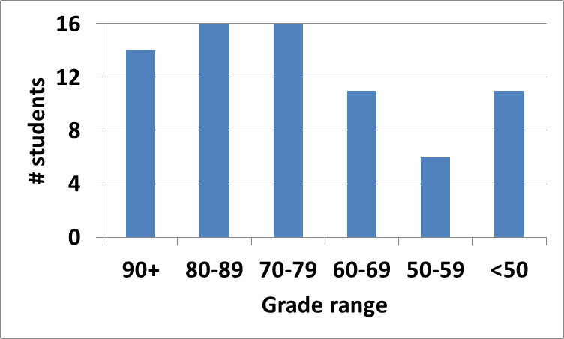
Exam stats & grade distribution
Question-by-question averages:
  Q1: 11.4 / 20 (57%)
  Q2: 23.7 / 30 (79%)
  Q3: 18.7 / 25 (75%)
  Q4: 17.5 / 25 (70%)
  Q5: 3.9 / 10 (34 responses)
Average: 71.4
Median: 75.5
Std. deviation: 19.8
Max: 98
Microprocessors I: Exam 1 Review

Slide 5
Final notes
Next time:
  Rotate, bit test/scan instructions
Microprocessors I: Exam 1 Review

