Slide 1
16.317
Microprocessor Systems Design I
Instructor: Dr. Michael Geiger
Spring 2014
Lecture 16
HLL → assembly

Slide 2
Lecture outline
Announcements/reminders
  HW 3 due today
  HW 4 to be posted; due date TBD
    Likely a longer assignment to be due after spring break
Review
  Subroutines
  Basics of stack usage
Today’s lecture
  Translation from HLL → assembly
Microprocessors I: Lecture 16

Slide 3
Review: subroutines
Subroutines: low-level functions
  When called, address of next instruction saved
    Return instruction ends routine; goes to that point
  May need to save state on stack
x86 specifics
  CALL <proc>: call procedure
    <proc> can be label (16-/32-bit imm), reg, mem
  RET: return from procedure
  Saving state to stack: push instructions
    Store data “above” current TOS; decrement SP
    Basic PUSH stores word or double word
    Directly storing flags: PUSHF
    Storing all 16-/32-bit general purpose registers: PUSHA/PUSHAD
  Restoring state: POP/POPF/POPA/POPAD
Microprocessors I: Lecture 16

Slide 4
HLL → assembly
Given some brief examples already; want to think about common HLL concepts and their assembly counterparts
Compiling HLL to assembly
  Data accesses
  Stack usage with function calls
  Conditional statements (if-then-else)
  Loops
Microprocessors I: Lecture 16

Slide 5
Sample program
int X[10], Y[10]; // integer arrays
int i, j; // index variables
for (i = 0; i < 10; i++) { // outer loop
X[i] = i * 2; // set X[i]
for (j = 0; j < 10; j++) { // inner loop
if (j < 5) // set Y[j]
Y[j] = X[i] + j; // based on
else // value of j
Y[j] = X[i] – j;
}
}
Microprocessors I: Lecture 16

Slide 6
Data representations
Program references four pieces of data
  Two integer arrays: X[10], Y[10]
  Two integer index variables: i, j
Compilers must account for:
  Data size: is variable a double word, word, or byte?
    Characters (char) are always 8 bits → 1 byte
    Other types system-dependent
      In x86, integers (int) are 32 bits → 4 bytes → double word
      Short integers (short) are 16 bits → 2 bytes → word
  Data location: where is data allocated?
    Depends on how it’s allocated …
    If writing assembly by hand, static data → directly allocated in memory
    If compiled code or function call, allocated on stack
      Variables declared inside functions, function arguments
Microprocessors I: Lecture 16

Slide 7
Static data accesses
Global declarations in high-level program
Stored in data segment
Offset into data segment declared as symbol
Example (from testfile2.asm)
  mov eax, DWORD PTR _c
Microprocessors I: Lecture 16

Slide 8
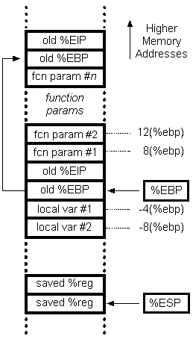
Stack accesses
On function call
SP or ESP: points to current top of stack
  Lowest address in current stack frame
BP or EBP: used to reference data within frame
  Arguments
  Local variables
Microprocessors I: Lecture 16

Slide 9
Stack accesses (cont.)
Arguments start at offset 8 from EBP
Local variables start at offset -4 from EBP
Starting offset of each variable can be defined as symbol
Ex. (testfile1.asm)
_j$ = -120; size = 4
_i$ = -108; size = 4
_Y$ = -96; size = 40
_X$ = -48; size = 40
mov DWORD PTR _i$[ebp], 0
→ sets i = 0
Microprocessors I: Lecture 16

Slide 10
Final notes
Next time:
  More on HLL → assembly translation
Reminders:
  HW 3 due today
  HW 4 to be posted; due date TBD
    Likely a longer assignment to be due after spring break
Microprocessors I: Lecture 16

