Slide 1
16.317
Microprocessor Systems Design I
Instructor: Dr. Michael Geiger
Spring 2014
Lecture 19
Interrupts

Slide 2
Lecture outline
Announcements/reminders
  HW 4 posted; due 3/26
Today’s lecture: Interrupt basics
Microprocessors I: Lecture 19

Slide 3
Exceptions
Exception: unexpected event altering normal program flow
  Often result of an error
  Can occur in HW or SW
    HW exceptions often handled by OS
    Will signal running program to stop
  Examples: divide by 0, system reset, invalid address accessed, breakpoint
  Some programming languages (Java, C++, C#) have software exceptions for program-related events
    Application-level try/catch blocks—attempt code that may fail and “catch” exception if that occurs
  Exceptions are typically synchronous events
    Occur in the course of executing a single instruction
Microprocessors I: Lecture 19

Slide 4
Interrupts
Interrupt: CPU signal that external event has occurred
  Usually generated by external hardware
    Signals processor to interact with peripheral
    Example: key pressed on keyboard, printer reading from memory, timer completing
  Can be generated by specific instructions
    x86 INT, INTO, BOUND instructions
  Interrupts sometimes seen as subset of exceptions
Interrupts typically asynchronous events
  HW signals can be generated at any time
  Current instruction completes before interrupt is handled
Microprocessors I: Lecture 19

Slide 5
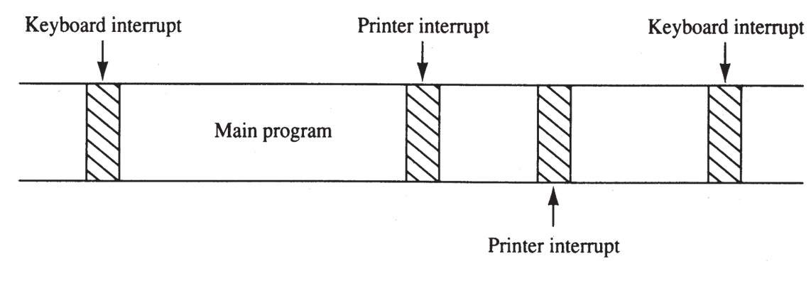
Interrupt timeline
Shows time dedicated to two potential recurring interrupts + main program
Interrupt service routines (ISRs) kept relatively short
  Functions used to handle interrupts
Microprocessors I: Lecture 19

Slide 6
General interrupt processing
Decide whether or not to service
  Steps for doing so are processor-dependent
If servicing:
  Complete current instruction
  Save PC
    Need to know where to return after servicing interrupt
    ISR is like a function, but you don’t explicitly call it
  Save processor state
    Registers, condition codes
  Jump to start of ISR
  Actually handle interrupt
  Return from interrupt
Microprocessors I: Lecture 19

Slide 7
Vectors
Interrupt/exception vector: starting address of service routine
  On x86 processors, composed of both segment and instruction pointer
Typically stored in vector table
  Often in lowest memory range (start at address 0)
  Some vectors dedicated to specific exceptions/interrupts
    Examples: divide by 0, page fault, alignment error
  Range allowed for user-defined interrupts as well
Microprocessors I: Lecture 19

Slide 8
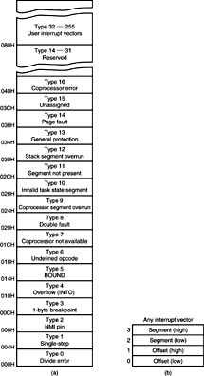
x86 vector table
First 32 vectors reserved
  First five same on all Intel processors
Remaining 224 available for users
Microprocessors I: Lecture 19

Slide 9
x86 interrupt instructions
Used to invoke specific interrupt handlers
INT n: invoke interrupt with vector number n
  INT 3: one byte breakpoint
  Often used as breakpoint interrupt
INTO: check for overflow
  If OF = 1, call overflow handler (vector #4)
  Otherwise, proceed to next instruction
BOUND: compare register to 2 words of memory data
Returning from interrupt handler: IRET
Microprocessors I: Lecture 19

Slide 10
x86 interrupt processing
If interrupt occurs
  Flag register contents are pushed on the stack
  Interrupt (IF) & trap (TF) flags clear
    IF: enables interrupts if IF = 1
    TF: causes trap interrupt after each instruction
      Essentially “single steps” through program
  CS & IP pushed on stack
  Interrupt vector fetched; used to overwrite CS/IP
    Next instruction: start of ISR
Microprocessors I: Lecture 19

Slide 11
Interrupt pins
Processors supporting external interrupts have at least one interrupt pin
If multiple pins, varying level of priority
  Higher priority interrupts can interrupt lower priority ones, but not vice-versa
  Lower priority interrupts “masked out” when higher priority interrupts executing
If only one pin (or multiple devices at same priority), need method for determining specific device causing interrupt
Microprocessors I: Lecture 19

Slide 12
x86 interrupt pins
Intel processors have two interrupt inputs
  INTR: basic interrupt line
    Can be enabled/disabled by IF bit
  NMI: non-maskable interrupt
    Cannot be disabled
    Used for major errors (i.e. parity fault, power failure)
Single output: INTA (interrupt acknowledge)
  Signal external device that interrupt being handled
  Device typically responds with vector number
  Device may have some stored state that it needs to clear to avoid requesting multiple interrupts
Microprocessors I: Lecture 19

Slide 13
Determining correct vector
External circuitry can be used to combine interrupt request (IRQ) lines to drive INTR
If multiple devices connected, need ability to choose correct vector
  Hardware solution: logic to generate correct vector # depending on device causing interrupt
    Multiple devices active: separate vector or priority scheme
    Programmable interrupt controllers: dedicated circuits that can be initialized to handle this task
  Software solution: ISR polls devices to find which one caused interrupts
Microprocessors I: Lecture 19

Slide 14
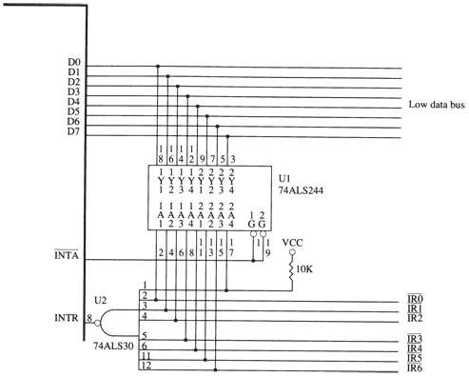
Example circuit #1
74ALS244: octal tri-state buffer driver
  Enabled on INTA low
  Any active IRQ line driven onto data bus
IRx lines active low; NAND produces 1 if any IRx line is 0
Microprocessors I: Lecture 19

Slide 15
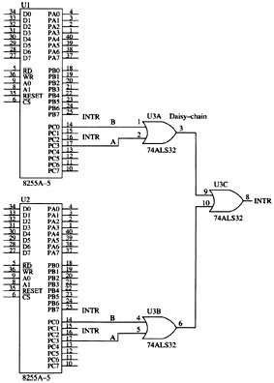
Example circuit #2
82C55: peripheral interface controller
Each 82C55 has its own memory address
  Can be accessed to determine which device caused interrupt
Microprocessors I: Lecture 19

Slide 16
Final notes
Next time
  Spring break
  Monday, 3/24: PIC introduction
Reminders:
  HW 4 posted; due 3/26
Microprocessors I: Lecture 19

