Slide 1
16.317
Microprocessor Systems Design I
Instructor: Dr. Michael Geiger
Spring 2014
Lecture 7:
Data transfer instructions (cont.)
Arithmetic instructions

Slide 2
Lecture outline
Announcements/reminders
  HW 1 due today (by end of the day)
  HW 2 to be posted; due 2/14
Review
  Data transfer instructions
Today’s lecture
  Finish data transfer instructions
  Start arithmetic instructions (time permitting)
Microprocessors I: Lecture 7

Slide 3
Review: data & data transfer instructions
x86 data accesses
  Registers: access as 8-bit (e.g. AL, AH), 16-bit (AX), 32-bit (EAX)
  Memory
    Data size usually matches register
    If not, explicitly specify (BYTE PTR, WORD PTR, DWORD PTR)
MOV: basic data transfer
  Can use registers, memory, immediates
  If segment reg. is destination, source must be register
MOVSX/MOVZX
  Sign-extend or zero-extend register/memory value
Microprocessors I: Lecture 7

Slide 4
XCHG
Swap contents of source and destination
Format: XCHG D, S
Operation: (D) = (S)
(S) = (D)
Restrictions:
  Memory operand can only be used as destination
Microprocessors I: Lecture 7

Slide 5
LEA
Perform effective address computation and store result in register
Format: LEA D, EA
Operation: D = EA
Example: LEA SI, [10H + DI]
Microprocessors I: Lecture 7

Slide 6
Load full pointer
Load contents of memory into both register and segment register
Format: Lxx D, addr
  xx = DS, ES, FS, GS, SS
Operation:
  (D) = contents of addr
  Segment register xx = contents of:
    addr + 2 if D is 16-bit register
    addr + 4 if D is 32-bit register
Microprocessors I: Lecture 7

Slide 7
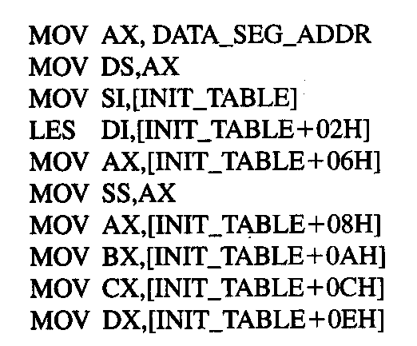
Example
DATA_SEG_ADDR:0000
DATA_SEG_ADDR:INIT_TABLE | 11 | 22
 | 33 | 44
 | 55 | 66
 | 77 | 88
 | 99 | AA
 | BB | CC
 | DD | EE
 | FF | 16
 | 03 | 17
Show the results of running the following program if DATA_SEG_ADDR = 1200H:
Microprocessors I: Lecture 7

Slide 8
Example solution
DATA_SEG_ADDR:0000
DATA_SEG_ADDR:INIT_TABLE | 11 | 22
 | 33 | 44
 | 55 | 66
 | 77 | 88
 | 99 | AA
 | BB | CC
 | DD | EE
 | FF | 16
 | 03 | 17
MOV AX,DATA_SEG_ADDR
  AX = DATA_SEG_ADDR
  = 1200H
MOV DS, AX
  DS = AX = 1200H
MOV SI, [INIT_TABLE]
  SI = memory @ DS:INIT_TABLE
  = 2211H
LES DI,[INIT_TABLE+02H]
  DI = memory @ DS:INIT_TABLE+02H
  = 4433H
  ES = memory @ DS:INIT_TABLE+04H
  = 6655H
Microprocessors I: Lecture 7

Slide 9
Example solution (cont.)
DATA_SEG_ADDR:0000
DATA_SEG_ADDR:INIT_TABLE | 11 | 22
 | 33 | 44
 | 55 | 66
 | 77 | 88
 | 99 | AA
 | BB | CC
 | DD | EE
 | FF | 16
 | 03 | 17
MOV AX,[INIT_TABLE+06H]
  AX = memory @ DS:INIT_TABLE+06H
  = 8877H
MOV SS, AX
  SS = AX = 8877H
MOV AX,[INIT_TABLE+08H]
  AX = memory @ DS:INIT_TABLE+08H
  = AA99H
MOV BX,[INIT_TABLE+0AH]
  BX = memory @ DS:INIT_TABLE+0AH
  = CCBBH
Microprocessors I: Lecture 7

Slide 10
Example solution (cont.)
DATA_SEG_ADDR:0000
DATA_SEG_ADDR:INIT_TABLE | 11 | 22
 | 33 | 44
 | 55 | 66
 | 77 | 88
 | 99 | AA
 | BB | CC
 | DD | EE
 | FF | 16
 | 03 | 17
MOV CX,[INIT_TABLE+0CH]
  CX = memory @ DS:INIT_TABLE+0CH
  = EEDDH
MOV DX,[INIT_TABLE+0EH]
  DX = memory @ DS:INIT_TABLE+0EH
  = 16FFH
Microprocessors I: Lecture 7

Slide 11
Arithmetic instructions
Addition
  ADD
  ADC
  INC
Subtraction
  SUB
  SBB
  DEC
  NEG
Multiplication/division
  MUL
  IMUL
  DIV
  IDIV
Microprocessors I: Lecture 7

Slide 12
Flags
All arithmetic instructions set flags
  CF = carry flag (carry output from MSB of add/sub)
  OF = overflow flag
  ZF = zero flag (result is zero)
  SF = sign flag (1 if negative, 0 if positive)
  PF = parity flag (even parity in LSB)
  AF = auxiliary carry (carry between nibbles)
Stored in FLAGS register
Referenced in conditional instructions
Microprocessors I: Lecture 7

Slide 13
Addition instructions
ADD D, S
  Operation: (D) = (D) + (S)
ADC D, S
  Operation: (D) = (D) + (S) + (CF)
INC D
  Operation: (D) = (D) + 1
Microprocessors I: Lecture 7

Slide 14
Subtraction instructions
SUB D, S
  Operation: (D) = (D) – (S)
SBB D, S
  Operation: (D) = (D) – (S) – (CF)
DEC D
  Operation: (D) = (D) – 1
NEG D
  Operation: (D) = -(D)
  Two’s complement negation
Microprocessors I: Lecture 7

Slide 15
Final notes
Next time:
  Continue with arithmetic instructions
  Logical instructions
Reminders:
  HW 1 due today (by end of the day)
  HW 2 to be posted; due 2/14
Microprocessors I: Lecture 7

