Slide 1
16.317
Microprocessor Systems Design I
Instructor: Dr. Michael Geiger
Summer 2012
Lecture 4
Instructions: multiply/divide, logical, shift/rotate,
Exam 1 Preview

Slide 2
Lecture outline
Announcements/reminders
  Lab 1, HW 1 both due today (HW1 solution to be posted later)
  Lab 2 posted; due Monday, 7/23
  HW 2 to be posted; due Wednesday, 7/25
  Should now have lab access in Ball 407
  Exam 1 this Friday, 7/20 in Olsen 407
Review
  Assembly intro
  80386DX instructions
    Data transfer
    Arithmetic
Today’s lecture
  More 80386DX instructions
    Multiply/divide
    Logical instructions
    Shift/rotate
  Exam 1 Preview
Microprocessors I: Lecture 4

Slide 3
Review
80386 data
  Registers: access as 8-bit (e.g. AL, AH), 16-bit (AX), 32-bit (EAX)
  Memory
    Data size usually matches register
    If not, explicitly specify (BYTE PTR, WORD PTR, DWORD PTR)
MOV: basic data transfer
  Can use registers, memory, immediates
  If segment reg. is destination, source must be register
MOVSX/MOVZX
  Sign-extend or zero-extend register/memory value
XCHG
  Exchange contents of source, dest
Microprocessors I: Lecture 4

Slide 4
Review (cont.)
LEA: load effective address
  Calculate EA/store in register
Load full pointer (LDS/LES/LFS/LGS/LSS)
  Load dest & segment register from memory
Reviewed flags: CF, AF, SF, ZF, PF, OF
Addition instructions
  ADD AX,BX → AX = AX + BX
  ADC AX,BX → AX = AX + BX + CF
  INC AX → AX = AX + 1
Subtraction instructions
  SUB AX,BX → AX = AX – BX
  SBB AX,BX → AX = AX – BX – CF
  DEC AX → AX = AX – 1
  NEG AX → AX = -AX = 0 - AX
Microprocessors I: Lecture 4

Slide 5
Arithmetic instructions
Addition
  ADD
  ADC
  INC
Subtraction
  SUB
  SBB
  DEC
  NEG
Multiplication/division
  MUL
  IMUL
  DIV
  IDIV
Microprocessors I: Lecture 4

Slide 6
Multiplication/division
Both signed and unsigned integer versions
Register A is always one of the sources
Destination always same; size-dependent
  Exception: signed multiplication does allow for slightly different operation
Easiest way to evaluate instructions: figure out decimal values of operands, do operation in decimal, then figure out binary/hex values of results
Microprocessors I: Lecture 4

Slide 7
MUL/IMUL
MUL S → unsigned multiplication
IMUL S → signed multiplication
Byte: (AX) = (AL) * (S)
Word: (DX,AX) = (AX) * (S)
Double-word: (EDX,EAX) = (EAX) * (S)
Only CF, OF updated
Microprocessors I: Lecture 4

Slide 8
DIV/IDIV
DIV S → unsigned division
IDIV S → signed division
Result split into quotient, remainder
Byte: (AL) = (AX) / (S)
(AH) = (AX) % (S)
Word: (AX) = (DX,AX) / (S)
(DX) = (DX,AX) % (S)
Dword: (EAX) = (EDX,EAX) / (S)
(EDX) = (EDX,EAX) % (S)
Special “convert” instructions used to sign-extend value in register A before division
Microprocessors I: Lecture 4

Slide 9
Logical instructions (+ shift, rotate)
AND
OR
XOR
NOT
SAL/SHL
SHR
SAR
SHLD
SHRD
ROL
ROR
RCL
RCR
Microprocessors I: Lecture 4

Slide 10
AND / OR / XOR / NOT
All logical operations use form: <op> D, S → (D) = (D) <op> (S)
  May have one memory operand
  Source may be immediate
Flags updated: CF, OF, SF, ZF, PF
AND → Logical AND
OR → Logical inclusive-OR
XOR → Logical exclusive-OR
NOT → Logical NOT
Microprocessors I: Lecture 4
Notes:
Chapter 5 part 2

Slide 11
Logical instructions: example
Show the state of AL after each instruction in the following sequence:
  MOV AL, 55H
  AND AL, 1FH
  OR AL, C0H
  XOR AL, 0FH
  NOT AL
Microprocessors I: Lecture 4

Slide 12
Logical instructions: solution
Show the state of AL after each instruction
  MOV AL, 55H
    AL = 55H
  AND AL, 1FH
    AL = 55H AND 1FH = 01010101 AND 00011111
    = 00010101 = 15H
  OR AL, C0H
    AL = 15H OR C0H = 00010101 OR 11000000
    = 11010101 = D5H
  XOR AL, 0FH
    AL = D5H XOR 0FH = 11010101 XOR 00001111
    = 11011010 = DAH
  NOT AL
    AL = NOT DAH = NOT(11011010) = 00100101 = 25H
Microprocessors I: Lecture 4

Slide 13
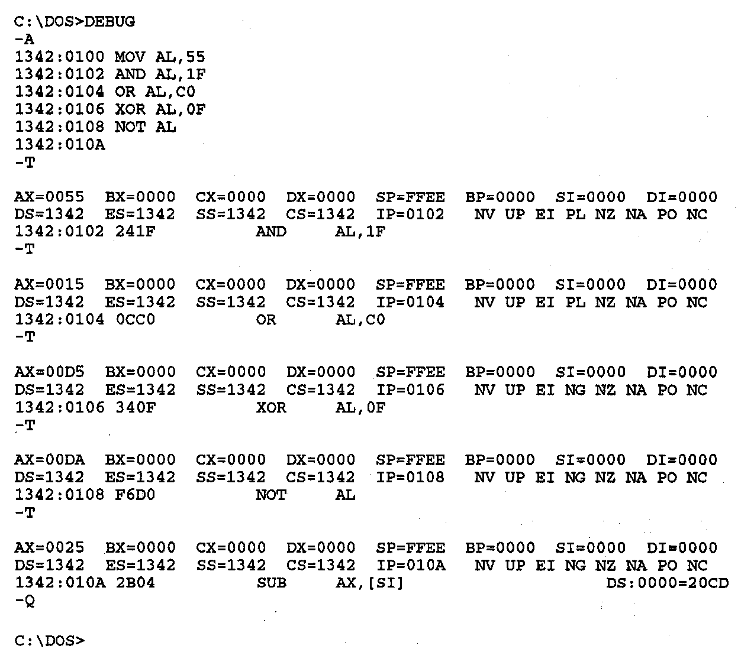
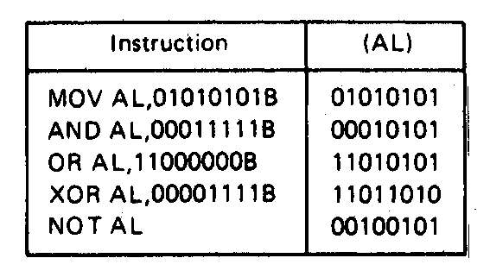
Logic Instructions- Example
Figure on right shows DEBUG program running this code
Each “T” executes one instruction; shows state of all registers/flags
Microprocessors I: Lecture 4
Notes:
Chapter 5 part 2

Slide 14
SHL / SAL / SHR / SAR
Shift instruction format: <op> D, <shamt>
  Destination may be register/memory
  <shamt>: shift amount
    May be immediate or register CL
All shift instructions store last bit shifted out in carry flag (CF)
SHL: logical shift left (double-precision version SHLD)
SAL: arithmetic shift left
  Shift to left by <shamt> bits; shift 0s into LS bits
SHR: logical shift right (double-precision version SHRD)
  Shift to right by <shamt> bits; shift 0s into MS bits
SAR: arithmetic shift right
  Shift to right by <shamt> bits; copy original MSB to fill MS bits (keep sign of value intact)
Microprocessors I: Lecture 4

Slide 15
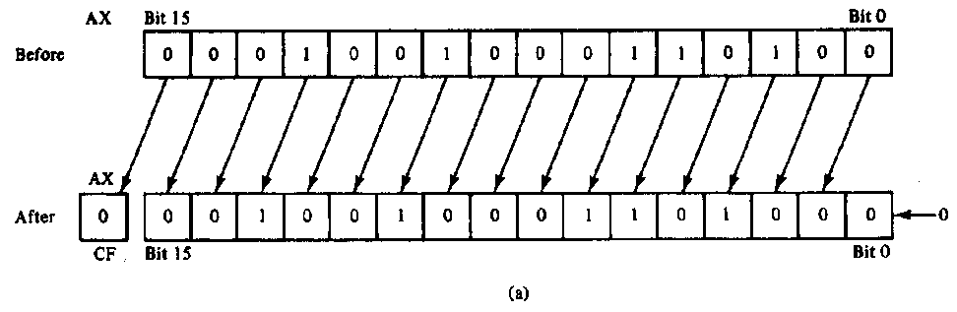
SAL/SHL example
SHL AX,1
Before execution
  Dest = (AX) = 1234H = 0001 0010 0011 0100₂ ,
  Count = 1, CF = X
Operation
  The value in all bits of AX are shifted left one bit position
  Emptied LSB is filled with 0
  Value shifted out of MSB goes to carry flag
After execution
  Dest = (AX) = 2468H = 0010 0100 0110 1000₂ , CF = 0
Notes
  MSB isolated in CF; can be used by conditional instruction
  Result has been multiplied by 2
Microprocessors I: Lecture 4

Slide 16
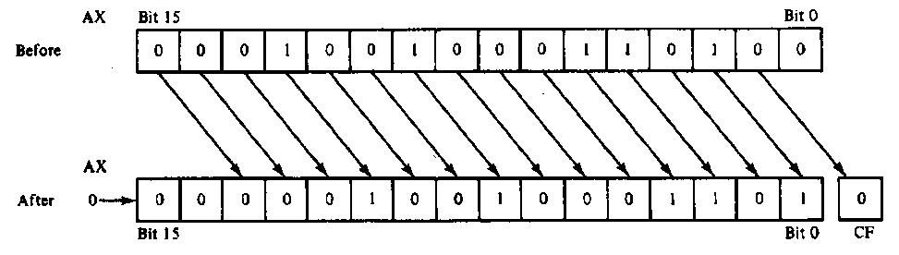
SHR example
SHR AX,CL
Before execution
  Dest = (AX) = 1234H = 466010 = 0001 00100011 0100₂
  Count = (CL) = 02H , CF = X
Operation
  The value in all bits of AX are shifted right two bit positions
  Emptied MSBs are filled with 0s
  Values shifted out of LSBs go to carry flag
After execution
  Dest = (AX) = 048DH = 116510 = 0000 0100 1000 1101₂ ,CF = 0
Notes:
  Bit 1 isolated in CF
  Result has been divided by 4
    4 X 1165 = 4660
Microprocessors I: Lecture 4

Slide 17
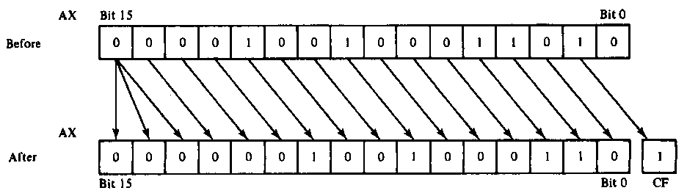
SAR example
SAR AX,CL
Before execution
  Dest = (AX) = 091AH = 0000100100011010₂ = +2330, Count = 02H , CF = X
Operation
  The value in all bits of AX are shifted right two bit positions
  Emptied MSB is filled with the value of the sign bit—sign maintained
  Values shifted out of LSBs go to carry flag
After execution
  Dest = (AX) = 0246H = 0000001001000110₂ = +582 , CF = 1
Conclusion
  Bit 1 isolated in CF
  Result has been sign extended
  Result value has been divided by 4 and rounded to integer
    4 X +582 = +2328
Microprocessors I: Lecture 4

Slide 18
Shift Instructions- Application
Application–Isolating a bit from a byte of data in memory in the carry flag
Example:
  Instruction sequence
    MOV AL,[CONTROL_FLAGS]
    MOV CL, 04H
    SHR AL,CL
  Before execution
    (CONTROL_FLAGS) = B₇B₆B₅B₄B₃B₂B₁B₀
  After executing 1st instruction
    (AL) =B₇B₆B₅B₄B₃B₂B₁B₀
  After executing 2nd instruction
    (CL) = 04H
  After executing 3rd instruction
    (AL) = 0000B₇B₆B₅B₄
    (CF) = B₃
Microprocessors I: Lecture 4
Notes:
Chapter 5 part 2

Slide 19
Shift example
Example: Given AL = 15H, CL = 03H, and CF = 0 show the state of AL and CF after each instruction in the sequence below:
  SHL AL, 1
  SHR AL, CL
  SAL AL, 5
  SAR AL, 2
Microprocessors I: Lecture 4

Slide 20
Solution
Initially, AL = 15H = 00010101₂
SHL AL, 1
  AL = (00010101 << 1) = 00101010₂ = 2AH
  CF = last bit shifted out = 0
SHR AL, CL
  AL = (00101010 >> 3) = 00000101₂ = 05H
  CF = last bit shifted out = 0
SAL AL, 5
  “Arithmetic” left shift same as SHL
  AL = (00000101 << 5) = 10100000₂ = A0H
  CF = last bit shifted out = 0
SAR AL, 2
  Arithmetic right shift keeps sign intact—copy MSB to fill leftmost positions
  AL = (10100000 >> 2) = 11101000₂ = E8H
  CF = last bit shifted out = 0
Microprocessors I: Lecture 4

Slide 21
Rotate instructions
Difference between rotates and shifts
  Shifts discard bits that are shifted out
  Rotates take bits that are shifted out and use them to fill vacated bits
Rotate instruction format: <op> D, <shamt>
  Destination may be register/memory
  <shamt>: shift amount
    May be immediate or register CL
All rotate instructions store last bit shifted out in carry flag (CF)
Microprocessors I: Lecture 4

Slide 22
ROR / ROL / RCR / RCL
ROR: rotate right
  Shift (D) to right by <shamt> bits
  <shamt> LS bits are moved to MS bits
ROL: rotate left
  Shift (D) to left by <shamt> bits
  <shamt> MS bits are moved to LS bits
RCR: rotate right through carry
  Treat (CF) as extra LS bit
  Shift (D,CF) to right by <shamt> bits
  <shamt> LS bits (from (D,CF)) are moved to MS bits
RCL: rotate left through carry
  Treat (CF) as extra MS bit
  Shift (CF,D) to left by <shamt> bits
  <shamt> MS bits (from (CF,D)) are moved to LS bits
Microprocessors I: Lecture 4

Slide 23
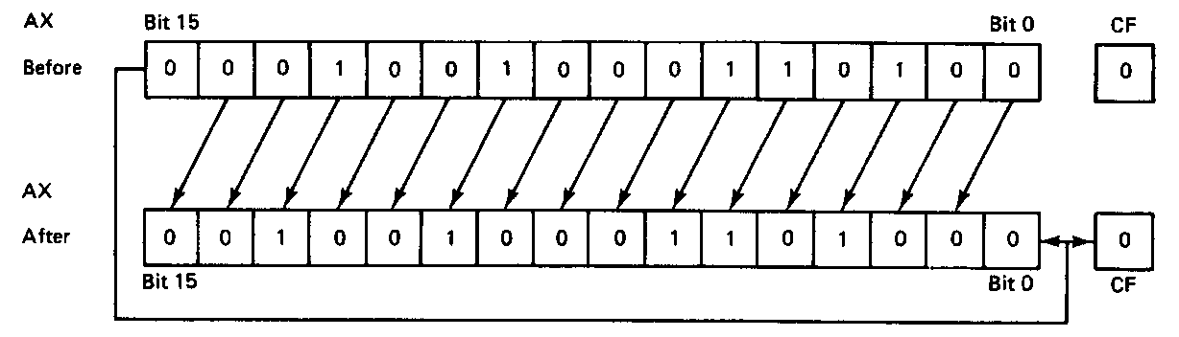
ROL example
ROL AX,1
Before execution
  Dest = (AX) = 1234H = 0001 0010 0011 0100₂
  Count = 1, CF = 0
Operation
  The value in all bits of AX are rotated left one bit position
  Value rotated out of the MSB is reloaded at LSB
  Value rotated out of MSB copied to carry flag
After execution
  Dest = (AX) = 2468H = 0010010001101000₂
  CF = 0
Microprocessors I: Lecture 4

Slide 24
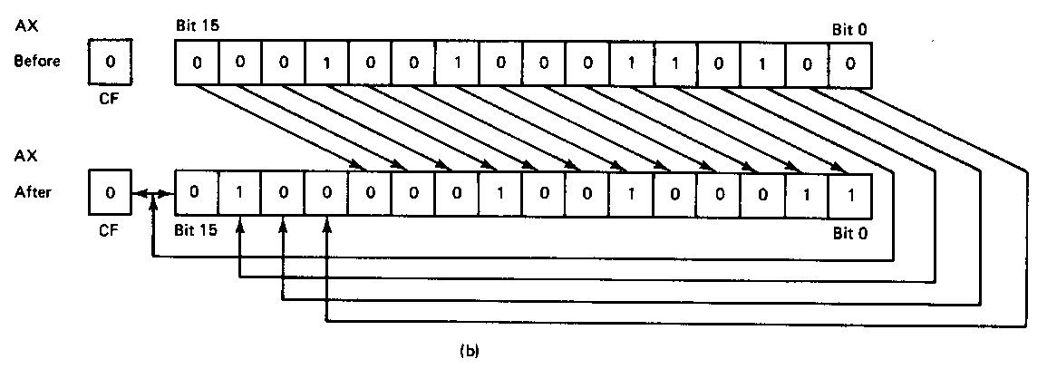
ROR example
ROR AX,CL
Before execution
  Dest = (AX) = 1234H = 0001 0010 0011 0100₂
  Count = 04H, CF = 0
Operation
  The value in all bits of AX are rotated right four bit positions
  Values rotated out of the LSB are reloaded at MSB
  Values rotated out of MSB copied to carry flag
After execution
  Dest = (AX) = 4123H = 01000001001000112
  CF = 0
Note position of hex characters in AX have been rearranged
Microprocessors I: Lecture 4

Slide 25
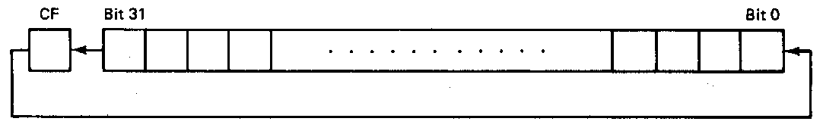
RCL example
RCL BX,CL
Before execution
  Dest = (BX) = 1234H = 0001 0010 0011 0100₂
  Count = 04H, CF = 0
Operation
  The value in all bits of AX are shifted left four bit positions
  Emptied MSBs are rotated through the carry bit back into the LSB
  Last value rotated out of MSB retained in carry flag
  First rotate loads prior value of CF at the LSB
After execution
  Dest = (BX) = 2340H = 0010 0011 0100 0000₂
  CF = 1
Microprocessors I: Lecture 4

Slide 26
Rotate example
Given AL = 43H, CL = 04H, and CF = 0, show the state of AL after each instruction in the sequence below:
  ROR AL, 2
  ROL AL, CL
  RCR AL, 3
  RCL AL, 4
Microprocessors I: Lecture 4

Slide 27
Solution
Initially, AL = 43H = 01000011₂
ROR AL, 2
  AL = 01000011 rotated right by 2
  = 11010000 = D0H
  CF = last bit rotated in = 1
ROL AL, CL
  AL = 11010000 rotated left by 4
  = 00001101 = 0DH
  CF = last bit rotated in = 1
Microprocessors I: Lecture 4

Slide 28
Solution (cont.)
RCR AL, 3
  (AL,CF) = 00001101 1 rotated right by 3
  = 01100001 1
  CF = 1, AL = 01100001₂ = 61H
RCL AL, 4
  (CF,AL) = 1 01100001 rotated left by 4
  = 0 00011011
  CF = 0, AL = 00011011₂ = 1BH
Microprocessors I: Lecture 4

Slide 29
Exam 1 notes
Allowed
  One 8.5” x 11” double-sided sheet of notes
  Calculator
No other notes or electronic devices (phone, laptop, etc.)
Exam will be written for 50 minutes
Covers all lectures through today
Microprocessors I: Lecture 4

Slide 30
Lec. 1 Review
Processor components
  Microprocessor for computation
  Input/output to communicate with outside world
  Storage to hold code/data
Instruction set architecture
  Defines how programmer interfaces with hardware
  Operations generally fall into one of four groups
    Data transfer: move data across storage locations
    Arithmetic: add, subtract, etc.
    Logical: AND, OR, shifts, etc.
    Program control: jumps/branches/calls
Microprocessors I: Lecture 4

Slide 31
Lec. 1 Review (cont.)
Instruction set architecture (cont.)
  Operands: the data being operated on
    How are the bits interpreted? (int, FP, signed/unsigned)
    What size are they? (byte, word, etc.)
    How do we reference operands?
  Instruction formats: how instructions are encoded
Data storage
  Registers
    Small, fast set of on-chip storage (primarily for speed)
    Referenced by name
  Memory
    Larger, slower set of storage (primarily for capacity)
    Organized as hierarchy …
    … but programmer references single range of addresses
    Memory issues
      Aligned data: address divisible by number of bytes
      Endianness: 80x86 data is little endian
Microprocessors I: Lecture 4

Slide 32
Lec. 2 Review (cont.)
More 80386 memory specifics
  Six segment registers: CS (code), SS (stack), DS, ES, FS, GS (data)
  Each segment 64 KB, starts on 16B boundary
    Lowest hex digit of 20-bit address = 0
  Logical address → SBA:EA
    Examples: DS:SI, SS:SP, CS:IP, DS:1000H
  Physical address: actual memory address
    Shift 16-bit segment register to left by 4 bits = SBA
    Add 16-bit EA to SBA
  Calculating EA
    Direct addressing: EA = const
    Register indirect—either “based” or “indexed”: EA = reg
      Possible register: SI, DI, BX, BP
      Only BP uses SS; others use DS by default
    Based-indexed: EA = base reg. + index reg.
    Based-indexed + displacement: EA = base reg + index reg + const
Microprocessors I: Lecture 4

Slide 33
Lec. 2 Review
Addressing modes
  Register addressing → data in register
  Immediate addressing → data in instruction
  Memory addressing → data in memory
    Need effective address
    EA calculation
      Direct addressing → EA = constant
      Register indirect → EA = register value
      Base + displacement addressing → EA = constant + reg(s)
80386 memory
  Data/code and I/O separated
  General memory uses segmented architecture
    Only subset of memory active at time
    Segment register(s) hold starting address of segment(s)
Microprocessors I: Lecture 4

Slide 34
Lec. 3 Review
80386 data
  Registers: access as 8-bit (e.g. AL, AH), 16-bit (AX), 32-bit (EAX)
  Memory
    Data size usually matches register
    If not, explicitly specify (BYTE PTR, WORD PTR, DWORD PTR)
MOV: basic data transfer
  Can use registers, memory, immediates
  If segment reg. is destination, source must be register
MOVSX/MOVZX
  Sign-extend or zero-extend register/memory value
XCHG
  Exchange contents of source, dest
Microprocessors I: Lecture 4

Slide 35
Lec. 3 Review (cont.)
LEA: load effective address
  Calculate EA/store in register
Load full pointer (LDS/LES/LFS/LGS/LSS)
  Load dest & segment register from memory
Reviewed flags: CF, AF, SF, ZF, PF, OF
Addition instructions
  ADD AX,BX → AX = AX + BX
  ADC AX,BX → AX = AX + BX + CF
  INC AX → AX = AX + 1
Subtraction instructions
  SUB AX,BX → AX = AX – BX
  SBB AX,BX → AX = AX – BX – CF
  DEC AX → AX = AX – 1
  NEG AX → AX = -AX = 0 - AX
Microprocessors I: Lecture 4

Slide 36
Lec. 4 Review
Multiplication instructions
  MUL (unsigned), IMUL (signed)
  Result uses 2x bits of source
  Source usually implied (AL/AX/EAX)
Division instructions
  DIV (unsigned), IDIV (signed)
  Implied source (AX, (DX,AX), (EDX,EAX)) 2x bits of specified source
  Quotient/remainder split across result
Microprocessors I: Lecture 4

Slide 37
Lec. 4 Review (cont.)
Logical instructions (AND/OR/XOR/NOT)
Basic shift instructions
  Move value by <amt> bits; add 0s to left or right
  CF = last bit shifted out
  SHL <src>, <amt>: Move <src> to left
    SAL exactly the same
  SHR <src>, <amt>: Move <src> to right
Arithmetic right shift
  Move value right by <amt> bits
  Copy sign bit to fill remaining bits
  CF = last bit shifted out
  SAR <src>, <amt>
Microprocessors I: Lecture 4

Slide 38
Lec. 4 Review (cont.)
Rotate instructions: bits that are shifted out one side are shifted back in other side
  ROL <src>, <amt> or ROR <src>, <amt>
  CF = last bit rotated
Rotate through carry instructions
  CF acts as “extra” bit that is part of value being rotated
  RCL <src>, <amt> or RCR <src>, <amt>
Microprocessors I: Lecture 4

Slide 39
Final notes
Next time: Exam 1
  Please arrive as close to on time as possible!
Reminders
  Lab 2 due Monday, 7/23
  HW 2 to be posted, due Wednesday, 7/25
Microprocessors I: Lecture 4

