Slide 1
16.317
Microprocessor Systems Design I
Instructor: Dr. Michael Geiger
Summer 2013
Lecture 6:
HLL → assembly

Slide 2
Lecture outline
Announcements/reminders
  HW 4 posted; due Tuesday, 7/30
    No late submissions allowed
  Exam 2: Thursday, August 1
Review
  Jump instructions
  Loop instructions
  Subroutines & stack details
Today’s lecture
  HLL → assembly
  Return Exam 1
Microprocessors I: Lecture 6

Slide 3
Review: jump, loop
Two general types of jump
  Unconditional: JMP <target>
    Always go to target address
  Conditional: Jcc <target>
    Go to target address if condition true
Loop instructions
  Combines CX decrement with JNZ test
  May add additional required condition
    LOOPE/LOOPZ: loop if ((CX != 0) && (ZF == 1))
    LOOPNE/LOOPNZ: loop if (CX != 0) && (ZF == 0))
Microprocessors I: Lecture 6

Slide 4
Review: subroutines
Subroutines: low-level functions
  When called, address of next instruction saved
    Return instruction ends routine; goes to that point
  May need to save state on stack
x86 specifics
  CALL <proc>: call procedure
    <proc> can be label (16-/32-bit imm), reg, mem
  RET: return from procedure
  Saving state to stack: push instructions
    Store data “above” current TOS; decrement SP
    Basic PUSH stores word or double word
    Directly storing flags: PUSHF
    Storing all 16-/32-bit general purpose registers: PUSHA/PUSHAD
  Restoring state: POP/POPF/POPA/POPAD
Microprocessors I: Lecture 6

Slide 5
HLL → assembly
Given some brief examples already; want to think about common HLL concepts and their assembly counterparts
Compiling HLL to assembly
  Data accesses
  Stack usage with function calls
  Conditional statements (if-then-else)
  Loops
Microprocessors I: Lecture 6

Slide 6
Sample program
int X[10], Y[10]; // integer arrays
int i, j; // index variables
for (i = 0; i < 10; i++) { // outer loop
X[i] = i * 2; // set X[i]
for (j = 0; j < 10; j++) { // inner loop
if (j < 5) // set Y[j]
Y[j] = X[i] + j; // based on
else // value of j
Y[j] = X[i] – j;
}
}
Microprocessors I: Lecture 6

Slide 7
Data representations
Program references four pieces of data
  Two integer arrays: X[10], Y[10]
  Two integer index variables: i, j
Compilers must account for:
  Data size: is variable a double word, word, or byte?
    Characters (char) are always 8 bits → 1 byte
    Other types system-dependent
      In x86, integers (int) are 32 bits → 4 bytes → double word
      Short integers (short) are 16 bits → 2 bytes → word
  Data location: where is data allocated?
    Depends on how it’s allocated …
    If writing assembly by hand, static data → directly allocated in memory
    If compiled code or function call, allocated on stack
      Variables declared inside functions, function arguments
Microprocessors I: Lecture 6

Slide 8
Static data accesses
Global declarations in high-level program
Stored in data segment
Offset into data segment declared as symbol
Example (from testfile2.asm)
  mov eax, DWORD PTR _c
Microprocessors I: Lecture 6

Slide 9
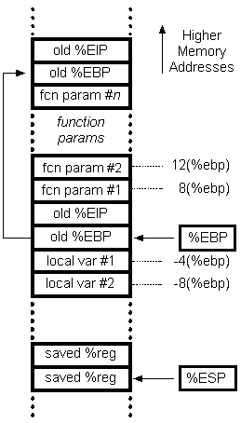
Stack accesses
On function call
SP or ESP: points to current top of stack
  Lowest address in current stack frame
BP or EBP: used to reference data within frame
  Arguments
  Local variables
Microprocessors I: Lecture 6

Slide 10
Stack accesses (cont.)
Arguments start at offset 8 from EBP
Local variables start at offset -4 from EBP
Starting offset of each variable can be defined as symbol
Ex. (testfile1.asm)
_j$ = -120; size = 4
_i$ = -108; size = 4
_Y$ = -96; size = 40
_X$ = -48; size = 40
mov DWORD PTR _i$[ebp], 0
→ sets i = 0
Microprocessors I: Lecture 6

Slide 11
Array accesses
To access array element, need
  Base address of array
  Offset into array
    Offset = index * (size of each element)
    For example, X[2] is 2*4 = 8 bytes into array X
In some ISAs, need to explicitly calculate this address
  Multiply index by element size
  Add to base address
x86 uses scaled addressing → multiplication done in memory access
  Example: code for X[i] = i * 2 from testfile1:
  mov eax, DWORD PTR _i$[ebp]
  shl eax, 1
  mov ecx, DWORD PTR _i$[ebp]
  mov DWORD PTR _X$[ebp+ecx*4], eax
Microprocessors I: Lecture 6

Slide 12
Conditional statements
If-then-else statements typically take form similar to:
<code to evaluate condition>
<conditional jump to else if false>
<code if condition true>
jmp end
else: <code if condition false>
end: …
<code to evaluate condition>
  Always requires a conditional branch
  Must add label to branch to “else” statement
Once statement for “if” condition is complete, jump past “else” statement
    Requires insertion of another label for jump target
Microprocessors I: Lecture 6

Slide 13
Conditional statements (cont.)
Body of inner loop:
if (j < 5)
Y[j] = X[i] + j;
else
Y[j] = X[i] – j;
cmp DWORD PTR _j$[ebp], 5
jge SHORT $LN2@main
mov eax, DWORD PTR _i$[ebp]
mov ecx, DWORD PTR _X$[ebp+eax*4]
add ecx, DWORD PTR _j$[ebp]
mov edx, DWORD PTR _j$[ebp]
mov DWORD PTR _Y$[ebp+edx*4], ecx
jmp SHORT $LN1@main
$LN2@main:
mov eax, DWORD PTR _i$[ebp]
mov ecx, DWORD PTR _X$[ebp+eax*4]
sub ecx, DWORD PTR _j$[ebp]
mov edx, DWORD PTR _j$[ebp]
mov DWORD PTR _Y$[ebp+edx*4], ecx
$LN1@main:
Microprocessors I: Lecture 6

Slide 14
Loops
Essentially three parts
  Initializing loop index
  Checking boundary condition
    Similar idea to if-then-else statements, but simpler
    If condition is false, end of loop
      Branch to label at first instruction after loop
    Usually done at start of loop, since no iterations should occur unless condition is true
      End of loop then contains jump back to beginning
  Incrementing loop index
Microprocessors I: Lecture 6

Slide 15
Loops (cont.)
for (j = 0; j < 10; j++) {// inner loop
mov DWORD PTR _j$[ebp], 0
jmp SHORT $LN5@main
$LN4@main:
mov eax, DWORD PTR _j$[ebp]
add eax, 1
mov DWORD PTR _j$[ebp], eax
$LN5@main:
cmp DWORD PTR _j$[ebp], 10
jge SHORT $LN3@main ; jmp to end
.
. ; Loop body here
.
jmp SHORT $LN4@main
$LN3@main:
Microprocessors I: Lecture 6

Slide 16
Practice problems
See today’s handout for
  Description of how stack frame should be created
  Description of where to access function arguments, local variables
Functions to be written
  int fact(int n): Calculate and return n!
  int max(int v1, int v2): Return largest value between v1 and v2
  void swap(int *a, int *b): Given addresses a & b (offsets into data segment), swap contents
Solutions to be posted as PDF online
  C versions in slides that follow; assembly in PDF file
  Will be covered in class today as well
Microprocessors I: Lecture 6

Slide 17
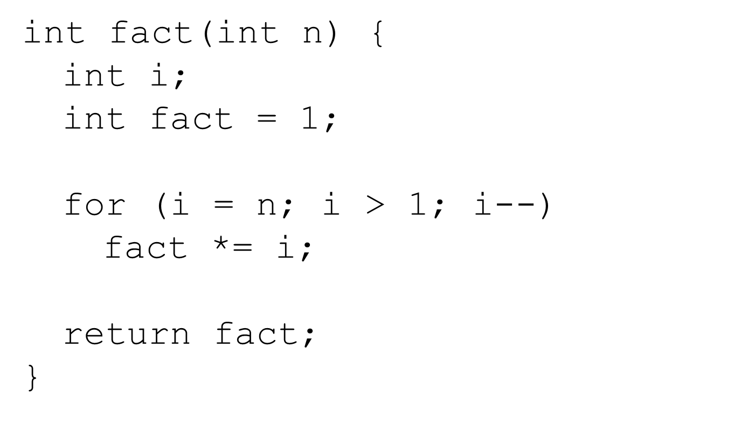
Factorial in C
Microprocessors I: Lecture 6

Slide 18
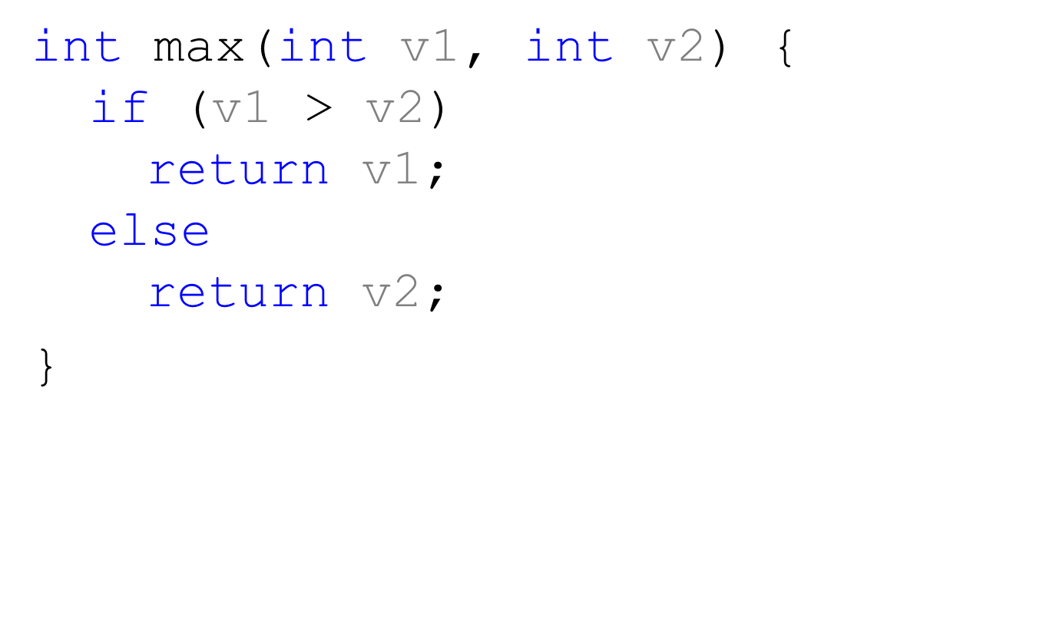
Maximum value function in C
Microprocessors I: Lecture 6

Slide 19
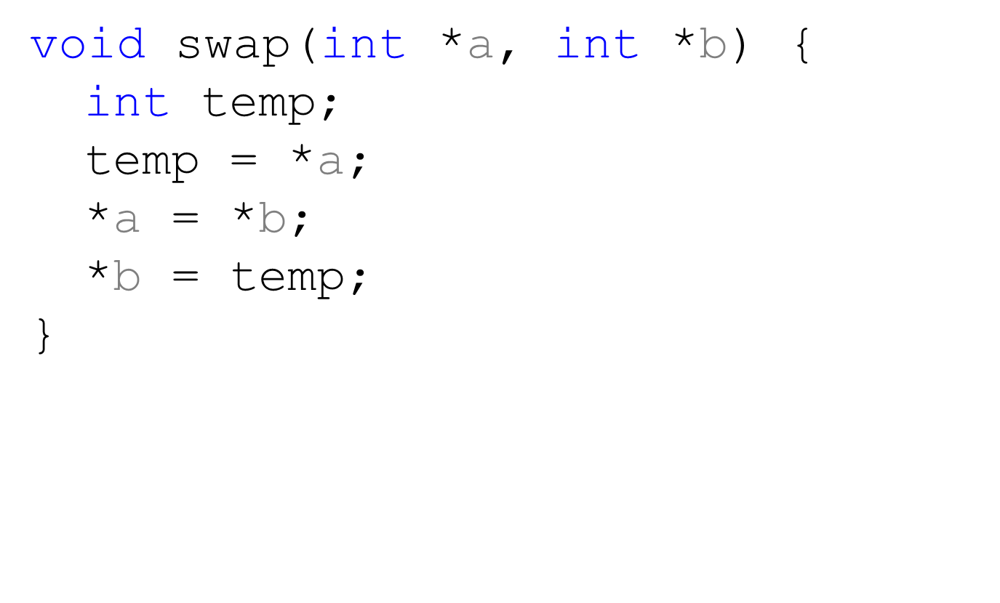
Swap in C
Microprocessors I: Lecture 6

Slide 20
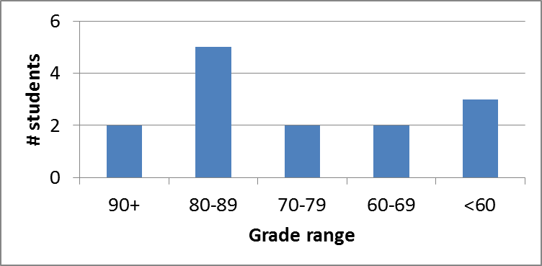
Exam stats & grade distribution
Question-by-question averages:
  Q1: 12.9 / 20 (64%)
  Q2: 21.5 / 30 (72%)
  Q3: 20.1 / 25 (81%)
  Q4: 18.1 / 25 (73%)
Average: 72.6
Median: 78.5
Std. deviation: 20
Max: 100
Microprocessors I: Lecture 6

Slide 21
Regrade requests
Due Thursday, 8/1
Must be written (preferably on a separate sheet)
You must also return your exam
  Do not write on your exam if you plan on submitting a regrade request
Must demonstrate understanding of problem
  Bad: “I deserve more points on Problem 3.”
  Good: “I deserve more points on Problem 3 because I calculated a wrong result for one instruction based on a wrong result from a previous instruction. I used the right operation; I just plugged in the wrong value.”
Microprocessors I: Lecture 6

Slide 22
Final notes
Next time
  Topics TBD
    Either x86 protected mode or interfacing/interrupts
  Exam 2 preview
Announcements/reminders
  HW 4 posted; due Tuesday, 7/30
    No late submissions allowed
  Exam 2: Thursday, August 1
Microprocessors I: Lecture 6

