Slide 1
16.317
Microprocessor Systems Design I
Instructor: Dr. Michael Geiger
Spring 2015
Lecture 18:
PIC microcontroller intro

Slide 2
Lecture outline
Announcements/reminders
  HW 3 due today
  HW 4 to be posted; due date TBD
Today’s lecture: PIC microcontroller intro
Microprocessors I: Lecture 20

Slide 3
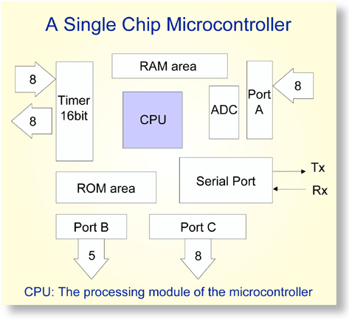
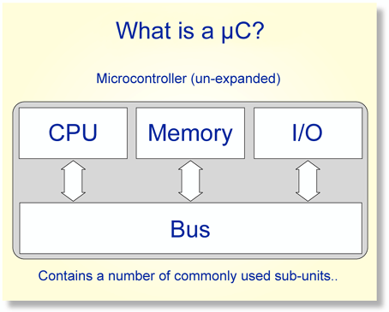
Overview of Microcontrollers
Basically, a microcontroller is a device which integrates a number of the components of a microprocessor system onto a single microchip.
Reference: http://mic.unn.ac.uk/miclearning/modules/micros/ch1/micro01notes.html#1.4
Microprocessors I: Lecture 20
Notes:
Chapter 9

Slide 4
Microcontroller features
Processor
  Usually general-purpose but can be app-specific
On-chip memory
  Often RAM for data, EEPROM/Flash for code
Integrated peripherals
  Common peripherals
    Parallel I/O port(s)
    Clock generator(s)
    Timers/event counters
  Special-purpose devices such as:
    Analog-to-digital converter (sensor inputs)
    Mixed signal components
    Serial port + other serial interfaces (SPI, USB)
    Ethernet
Microprocessors I: Lecture 20

Slide 5
Microcontroller features
Benefits
  Typically low-power/low-cost
    Target for embedded applications
  Easily programmable
    Simple ISAs (RISC processors)
    Use of development kits simplifies process
Limitations
  Small storage space (registers, memory)
  Restricted instruction set
  May be required to multiplex pins
  Not typically used for high performance
Microprocessors I: Lecture 20

Slide 6
PIC microcontrollers
Manufactured by Microchip Technology
High performance/low cost for embedded applications
Work strictly with 8-bit data*
  *unless you’re using one of the newer 16- or 32-bit ones
Varying complexity, characterized by
  Interfaces supported
    SPI, I²C, Ethernet, etc.
  Number of instructions
    Anywhere from ~35 to ~80
  Amount of internal memory available
  Internal modules
    Capture, compare, timers, etc.
Microprocessors I: Lecture 20

Slide 7
PIC16F1829
Mid-range PIC microcontroller
  49 different instructions
  Interrupt capability
  Direct, indirect, relative addressing mode
Low Power
  650nA @ 32KHz, 1.8V
Peripheral Features
  Up to 17 I/O pins with individual direction control
  10-bit A/D converter
  8/16-bit timer/counters
Special Microcontroller Features
  Internal/external oscillator
  Power saving sleep mode
  High Endurance Flash/EEPROM cell
Microprocessors I: Lecture 20
Notes:
Chapter 9

Slide 8
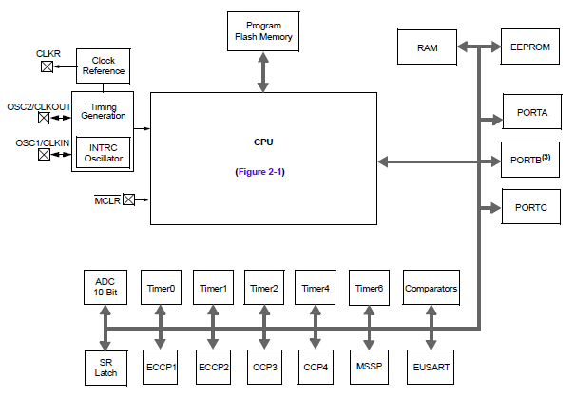
PIC16F1829 Block Diagram
Microprocessors I: Lecture 20
Notes:
Chapter 9

Slide 9
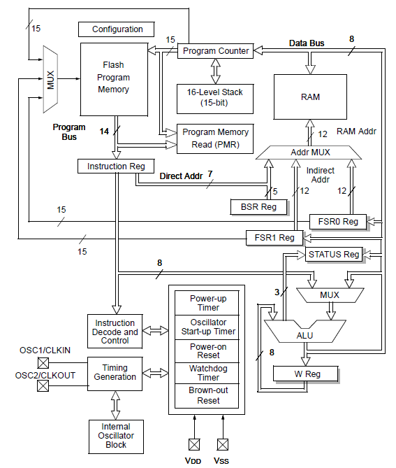
PIC16F1829 CPU Block Diagram
Microprocessors I: Lecture 20

Slide 10
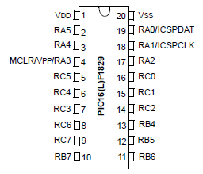
PIC16F1829 Pinout
20 pins
Mostly I/O ports A/B/C
Some pins multiplexed for in circuit debug (ICD)
Microprocessors I: Lecture 20
Notes:
Chapter 9

Slide 11
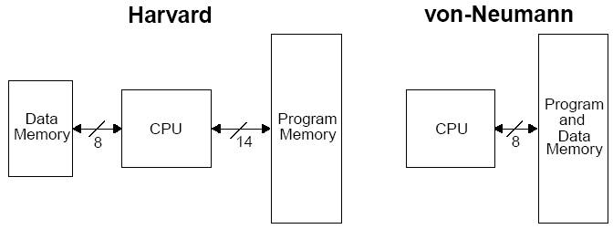
Harvard vs Von Neumann
Organization of program and data memory
PIC MCU technically “modified Harvard architecture”
Microprocessors I: Lecture 20
Notes:
Chapter 9

Slide 12
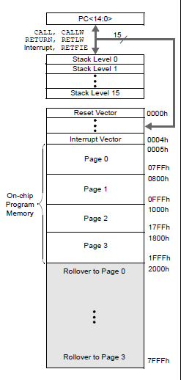
Program Memory Space
15-bit program counter to address 32K locations
Each location is 14-bit wide (instructions are 14 bits long)
RESET vector is 0000h
  When the CPU is reset, its PC is automatically cleared to zero.
Interrupt Vector is 0004h
  0004h is automatically loaded into the program counter when an interrupt occurs
Vector → address of code to be executed for given interrupt
Microprocessors I: Lecture 20
Notes:
Chapter 9

Slide 13
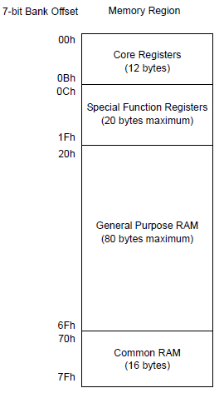
Data Memory Map
Core registers
  Affect basic operation of device
  Shared across all banks
Special function registers (SFRs)
  Control peripheral operations
General purpose registers/RAM (GPRs)
  Data storage/scratch pad operations
Common RAM
  Same 16 bytes accessible in all banks
Microprocessors I: Lecture 20
Notes:
Chapter 9

Slide 14
Core registers
WREG, the working register
  To move values from one register to another register, the value must pass through the W register.
FSR0/FSR1, File Select Register
  Indirect data memory addressing pointer
INDF0/INDF1
  accessing INDF accesses the location pointed by IRP+FSR
PC, the Program Counter, PCL/PCLATH
BSR, Bank Select Register
  Selects which bank of memory is actually being accessed
Microprocessors I: Lecture 20

Slide 15
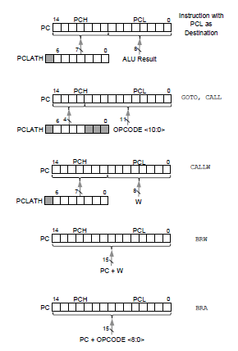
PCL and PCLATH
PC: Program Counter, 15 bits
PCL (02h): 8 bits, the lower 8 bits of PC
PCLATH (0Ah): PC Latch, provides the upper 7 bits of PC when PCL is written
Can change by
  Writing PCL directly
  Jump (GOTO)
  Calling function (CALL, CALLW)
  Relative branches (BRA/BRW)
Microprocessors I: Lecture 20
Notes:
Chapter 9

Slide 16

STATUS register
STATUS
  NOT_TO: Time Out bit, reset status bit
  NOT_PD: Power-Down bit, reset status bit
  Z: Zero bit ~ ZF in x86
  DC: Digital Carry bit ~ AF in x86
  C: Carry bit ~ CF in x86 (note: for subtraction, borrow is opposite)
Microprocessors I: Lecture 20
Notes:
Chapter 9

Slide 17
Stack
16-level deep x 15-bit wide hardware stack
The stack space is not part of either program or data space
The PC is “PUSHed” onto the stack when a CALL instruction is executed, or an interrupt causes a branch.
The stack is “POPed” in the event of a RETURN, RETLW or a RETFIE instruction execution.
However, NO PUSH or POP instructions !
The stack operates as a circular buffer:
  After the stack has been PUSHed 16 times, the 17th push overwrites the value that was stored from the first push.
  Can track stack overflow/underflow to handle such conitions
Microprocessors I: Lecture 20

Slide 18
Banking
Data memory is partitioned into banks
In this PIC family, each bank holds 128 bytes (max offset = 7Fh)
  16F1829 has 32 banks (bank 0-bank 31)
  Total data memory: 32 * 128 = 4096 = 4 KB
Overall data memory address: 12 bits
  Upper 5 bits: bits 4:0 from BSR (bank select)
    To switch banks, simply write new bank number to BSR
  Lower 7 bits: bits 6:0 from instruction
Microprocessors I: Lecture 20
Notes:
Chapter 9

Slide 19
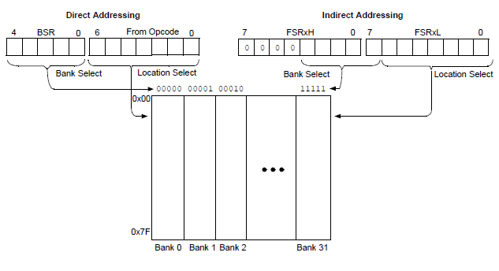
Direct/Indirect Addressing
Microprocessors I: Lecture 20
Notes:
Chapter 9

Slide 20
Final notes
Next time:
  Start discussing PIC instruction set
Reminders:
  HW 3 due today
  HW 4 to be posted; due date TBD
Microprocessors I: Lecture 20

