Slide 1
16.317
Microprocessor Systems Design I
Instructor: Dr. Michael Geiger
Spring 2015
Lecture 1:
Course overview
General microprocessor introduction

Slide 2
Lecture outline
Course overview
  Instructor information
  Course materials
  Course policies
  Resources
  Tentative course outline
General microprocessor introduction
  History
  Role of the instruction set architecture
Microprocessors I: Lecture 1

Slide 3
Course staff & meeting times
Lectures: MWF 9-9:50 AM, Ball 214
Lab: Will have card access to Ball 407
Instructor: Dr. Michael Geiger
  E-mail: Michael_Geiger@uml.edu
  Phone: 978-934-3618 (x43618 on campus)
  Office: 118A Perry Hall
  Office hours: M 10-11:30, W 10-11:30, Th 5-6
    Student questions are top priority during these hours
    Also available by appointment at other times
    May not be available regularly at start of term, but I plan to be on campus more as semester goes on. Will announce additional times as they become available.
TA: Peilong Li & Lu He (contact info, office hours to be posted)
Microprocessors I: Lecture 1

Slide 4
Course materials
Textbook: Barry B. Brey, The Intel Microprocessors: Architecture Programming, and Interfacing, 2008, Prentice Hall.
  ISBN: 0135026458
Course website: http://mgeiger.eng.uml.edu/16317/sp15/index.htm
  Will contain lecture slides, handouts, assignments
Discussion group through piazza.com
  Allow common questions to be answered for everyone
  All course announcements will be posted here
  Will use as class mailing list—please enroll ASAP
Microprocessors I: Lecture 1

Slide 5
Prerequisites
16.265 (Logic Design)
16.365 (Electronics I) (not a co-requisite)
Recommended: 16.216 (ECE Application Programming)
Microprocessors I: Lecture 1

Slide 6
Assignments
  Homework, labs, and some “hybrid” assignments (problems + programming exercise(s))
  Late assignments: 10% penalty per day
  All HW individual unless otherwise specified
  Some assignments require instructor “check-off”
Microprocessors I: Lecture 1

Slide 7
Academic honesty
All assignments are to be done individually unless explicitly specified otherwise by the instructor
Any copied solutions, whether from another student or an outside source, are subject to penalty
You may discuss general topics or help one another with specific errors, but not share assignment solutions
  Must acknowledge assistance from classmate in submission
Microprocessors I: Lecture 1

Slide 8
Course policies (cont.)
Grading breakdown
  Assignments: 55%
  Exam 1: 15%
  Exam 2: 15%
  Final: 15%
Exam dates
  Exam 1: Wednesday, February 18 in class
  Exam 2: Wednesday, April 1 in class
  Exam 3: TBD (during finals)
Microprocessors I: Lecture 1

Slide 9
What you should learn in this class
Basics of computers vs. microprocessors
Two major aspects:
  How to program
    Focus on assembly language
    Will look at HLL → assembly translation, integration
    Use of HLL with microcontrollers
  How a microprocessor works with other components
    Focus on interfacing circuits and control schemes
Will work with two processor families:
  Intel x86 architecture → assembly language simulation
  PIC microcontroller → actual microcontroller programming, interfacing
Microprocessors I: Lecture 1
· To understand the interconnection of the CPU, memory, and I/O

Slide 10
Tentative course outline
General microprocessor introduction
Assembly language programming
  Start with x86; introduce PIC microcontroller about halfway
  Areas will include
    Addressing modes
    Instruction types
    Programming modes
    HLL and assembly—translation; combination
External interfacing
  Processor signals used in interfacing
  Interface circuitry
  External memory
Interrupts
Microcontroller-based systems
  Microcontrollers vs. microprocessors
  Design of microcontroller-based circuits
  High-level programming of microcontrollers
Microprocessors I: Lecture 1

Slide 11
What is a computer?
From The American Heritage Dictionary:
  “One who computes”
    We could argue that people are computers
  “A device that computes, especially a programmable electronic machine that performs high-speed mathematical or logical operations or that assembles, stores, correlates, or otherwise processes information.”
    Anything from a simple abacus to the microprocessor-based computers of today
Microprocessors I: Lecture 1

Slide 12
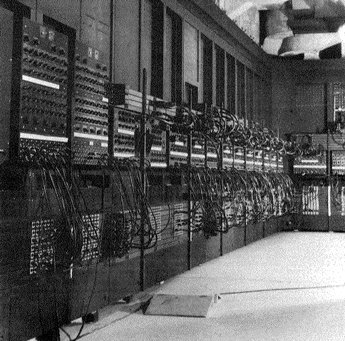
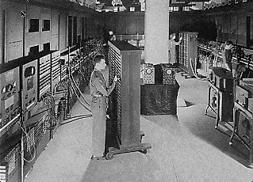
Computing history
Thirty tons
Forced air cooling
200KW
19,000 vacuum tubes
Punch card
Manual wiring
Numerical computation
The first electronic digital computer – ENIAC, built in UPenn in 1946
Source: http://ei.cs.vt.edu/~history/ENIAC.Richey.HTML
Microprocessors I: Lecture 1
Notes:
Chapter 1

Slide 13
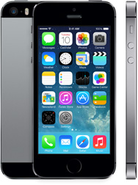
Today’s computer: one example
iPhone 5s Technical Specifications
(I’m too lazy to update this slide to include the 6 & 6 Plus)
Screen size 4 inches
Screen resolution 1136 by 640 at 326 ppi
Input method Multi-touch
Operating system iOS 7.0.4
Storage 16 / 32 / 64 GB
Cellular network UMTS/GSM/CDMA
Wireless data Wi-Fi (802.11a/b/g/n) + LTE + Bluetooth 4.0
Camera 8.0 megapixels
Battery Up to 10 hrs Internet, 10 hrs talk,
10 hrs video, 40 hrs audio,
250 hrs standby
Dimensions 4.87 x 2.31 x 0.3 inches
Weight 3.95 ounces
Source: http://www.apple.com/iphone/specs.html
Microprocessors I: Lecture 1
Notes:
Chapter 1

Slide 14
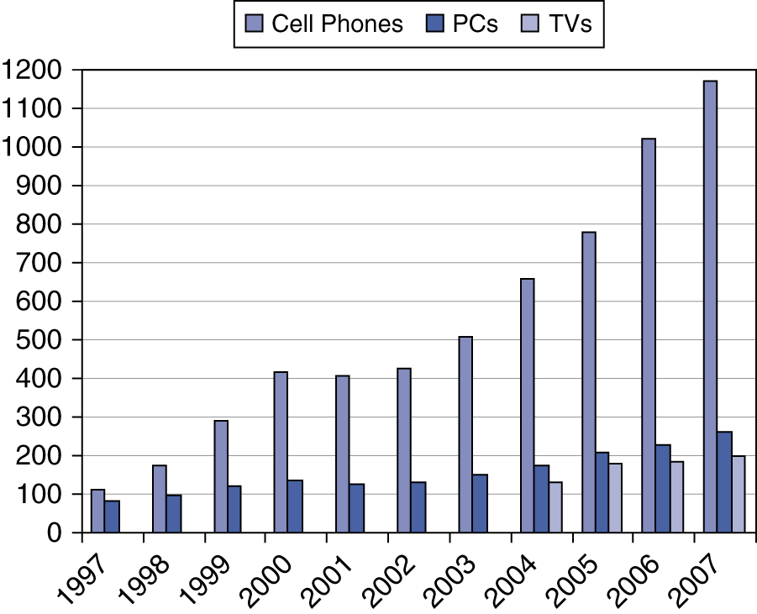
Processor market (as of 2007)
“Computer” used to just refer to PCs
Processors—and, therefore, computers—are now everywhere
Microprocessors I: Lecture 1

Slide 15
Computer components
What are the key components of a computer?
  Microprocessor (MPU/CPU) performs computation
  Input to read data from external devices
    Examples: Keyboard, mouse, ports (Ethernet, USB, etc.)
  Output to transmit data to external devices
    Examples: screen, speaker, VGA interface, ports (Ethernet, USB, etc.)
  Storage to hold program code and data
    RAM, hard disk, possibly other media (CD/DVD, external drive)
Will see that microprocessor contains smaller-scale versions of these components
  Computation engine
  I/O interface
  Internal storage
Microprocessors I: Lecture 1
Notes:
Chapter 1

Slide 16
Processor architecture
“Architecture” can refer to
  High-level description of hardware; could be
    Overall system
    Microprocessor
    Subsystem within processor
  Operations available to programmer
    Instruction set architecture
  Other applications to computing (e.g., “software architecture”) we won’t discuss
Commonly used to discuss functional units and how they work together
Microprocessors I: Lecture 1

Slide 17

Role of the ISA
User writes high-level language (HLL) program
Compiler converts HLL program into assembly for the particular instruction set architecture (ISA)
Assembler converts assembly into machine language (bits) for that ISA
Resulting machine language program is loaded into memory and run
Microprocessors I: Lecture 1

Slide 18
Abstraction of program control
Easiest for humans to understand high-level languages
Processor interprets machine language
Assembly language: abstraction with intermediate level of detail
  Breaks machine code into instructions
  Gives some insight into how each instruction behaves
  More readable than bit patterns!
Microprocessors I: Lecture 1

Slide 19
ISA design
Think about a HLL statement like
X[i] = i * 2;
ISA defines how such statements are translated to machine code
  What information is needed?
Microprocessors I: Lecture 1

Slide 20
ISA design (cont.)
Think about a HLL statement like
X[i] = i * 2;
Questions answered in every ISA (or “software model”)
  How will the processor implement this statement?
    What operations are available?
    How many operands does each instruction use?
  Where are X[i] and i?
    How do we reference the operands?
  What type(s) of data are X[i] and i?
    What types of operands are supported?
    How big are those operands?
  Instruction format issues
    How many bits per instruction?
    What does each bit or set of bits represent?
    Are all instructions the same length?
Microprocessors I: Lecture 1

Slide 21
Operation types
Operations: what should processor be able to do?
  Data transfer
    Move data between storage locations
  Arithmetic operations
    Typical: add, subtract, maybe multiply/divide, negation
  Logical operations
    Typical: AND, OR, NOT, XOR
    Often includes bit manipulation: shifts, rotates, test/set/clear single bit
  Program control
    “Jump” to another part of program
    May be based on condition
    Used to implement loops, conditionals, function call/return
  Typically some processor-specific special purpose ops
Microprocessors I: Lecture 1

Slide 22
Operands
Two major questions when dealing with data
  “How” do we store them? → what do the bits represent?
  Where do we store them?
    … and how do we access those locations)?
First question deals with data types
Second question deals with data storage and addressing
Microprocessors I: Lecture 1

Slide 23
Final notes
Next time:
  Data types
  Data storage
  Addressing modes
Reminders:
  Sign up for the discussion group on Piazza
Microprocessors I: Lecture 1

