Slide 1
16.317
Microprocessor Systems Design I
Instructor: Dr. Michael Geiger
Spring 2015
Lecture 25:
PIC assembly programming (continued)

Slide 2
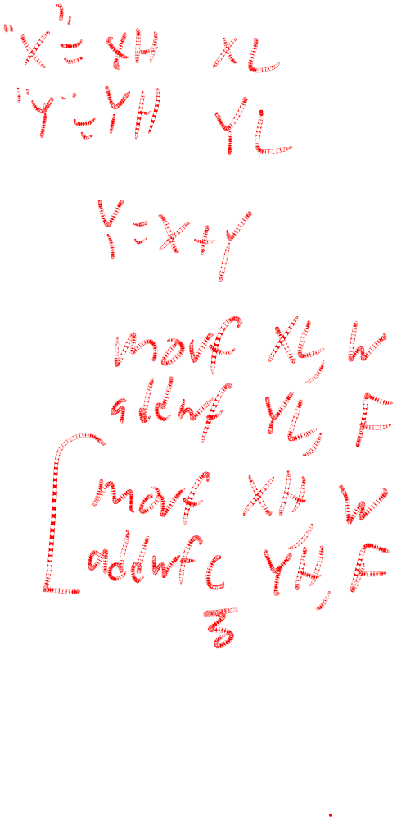
Lecture outline
Announcements/reminders
  HW 5 to be posted; due date TBD
Review
  Multi-byte data
Today’s lecture
  Sample programming sequences
Microprocessors I: Lecture 25

Slide 3
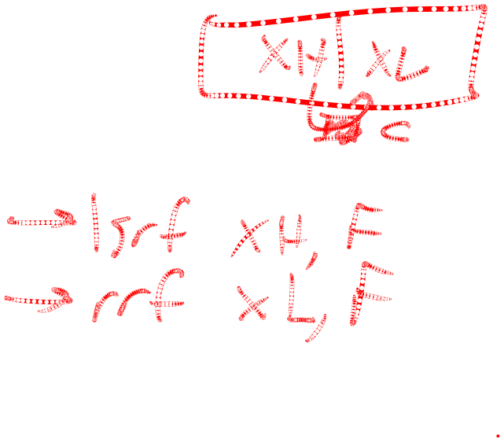
Review: Multi-byte data
Logical operations can be done byte-by-byte
Arithmetic and shift/rotate operations require you to account for data flow between bytes
  Carry/borrow in arithmetic
    Addition: if carry from lower byte, increment one of the upper bytes
    Subtraction: if borrow from lower byte, decrement one of the upper bytes
  Bit shifted between bytes in shift/rotate
    Performing rrf/rlf instructions in correct order ensures bit transferred correctly through C bit
    Rotate/shift left: start with LSB
    Rotate/shift right: start with MSB
Microprocessors I: Lecture 25

Slide 4

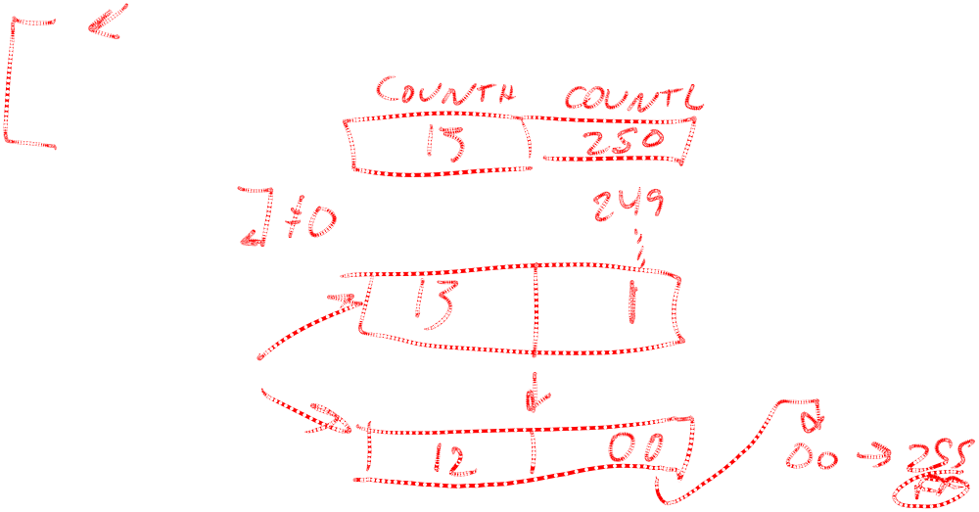
A Delay Subroutine
; ***********************************************************************************
; TenMs subroutine and its call inserts a delay of exactly ten milliseconds
; into the execution of code.
; It assumes a 4 MHz crystal clock. One instruction cycle = 4 * Tosc.
; TenMsH equ 13 ; Initial value of TenMs Subroutine's counter
; TenMsL equ 250
; COUNTH and COUNTL are two variables
TenMs
nop ; one cycle
movlw TenMsH ; Initialize COUNT
movwf COUNTH
movlw TenMsL
movwf COUNTL
Ten_1
decfsz COUNTL,F ; Inner loop
goto Ten_1
decfsz COUNTH,F ; Outer loop
goto Ten_1
return
Microprocessors I: Lecture 25
Notes:
Chapter 9

Slide 5
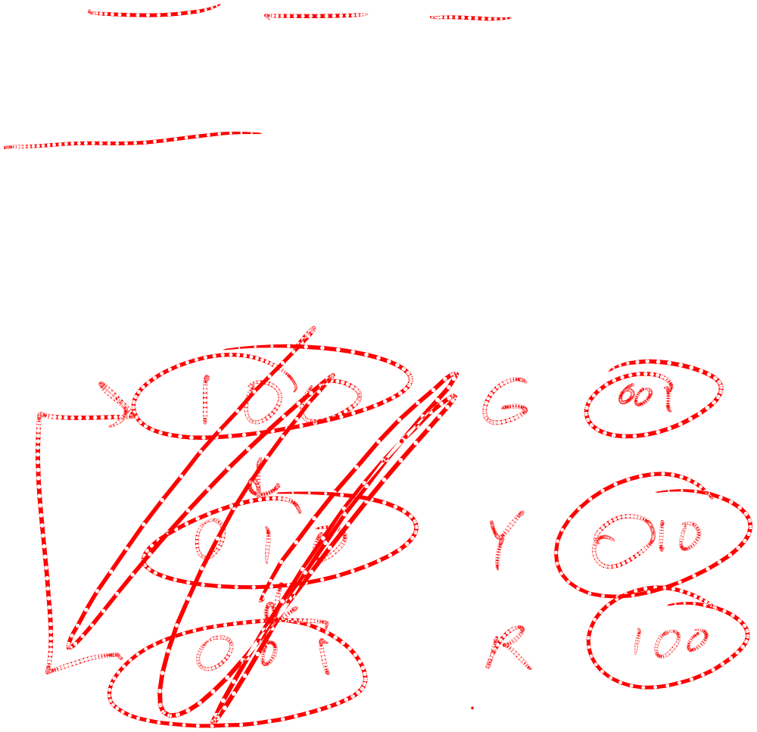
Blinking LED example
Assume three LEDs (Green, Yellow, Red) are attached to Port D bit 0, 1 and 2. Write a program for the PIC16F874 that toggles the three LEDs every half second in sequence: green, yellow, red, green, ….
For this example, assume that the system clock is 4MHz.
Microprocessors I: Lecture 25

Slide 6
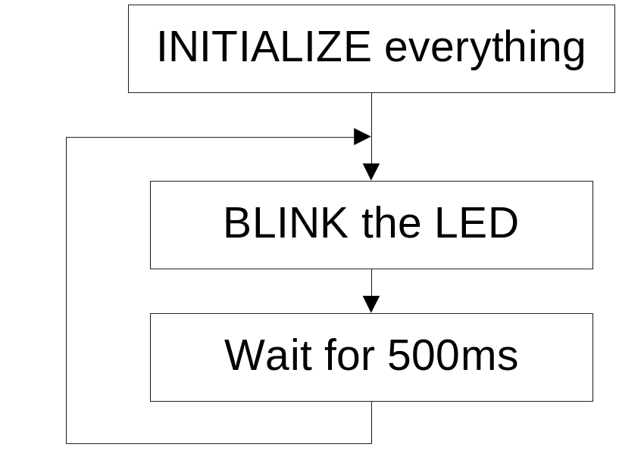

Top Level Flowchart
Initialize: Initialize port D, initialize the counter for 500ms.
Blink: Toggle the LED in sequence, green, yellow, red, green, …. Which LED to be toggled is determined by the previous state.
Wait for 500ms: Keep the LED on for 500ms and then toggle the next one.
Microprocessors I: Lecture 25

Slide 7

Strategy to “Blink”
The LEDs are toggled in sequence - green, yellow, red, green, yellow, red…
Let’s look at the lower three bits of PORTD
  001=green, 010=yellow, 100=red
The next LED to be toggled is determined by the current LED.
001->010->100->001->…
Microprocessors I: Lecture 25

Slide 8
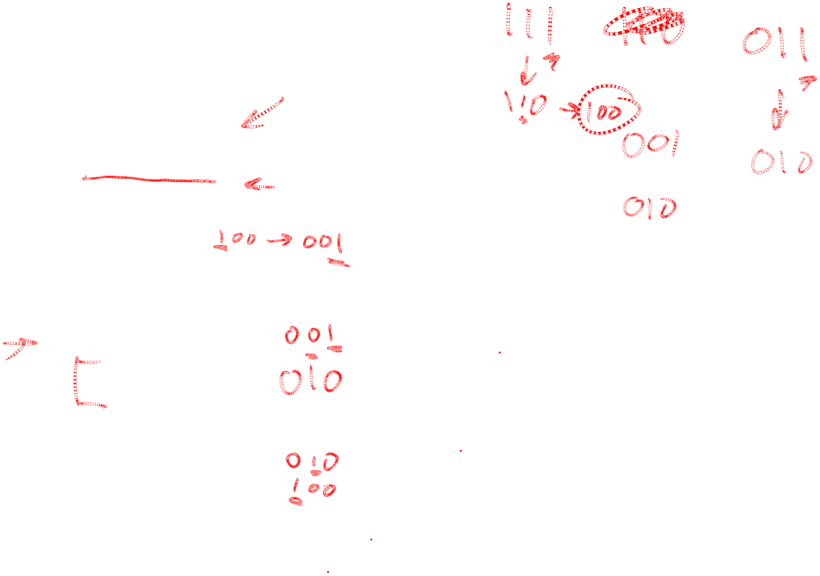
“Blink” Subroutine
Blink
btfsc PORTD, 0 ; is it Green?
goto toggle1 ; yes, goto toggle1
btfsc PORTD, 1 ; else is it Yellow?
goto toggle2 ; yes, goto toggle2
;toggle0
bcf PORTD, 2 ; otherwise, must be red, change to green
bsf PORTD, 0 ; 100->001
return
toggle1
bcf PORTD, 0 ; change from green to yellow
bsf PORTD, 1 ; 001->010
return
toggle2
bcf PORTD, 1 ; change from yellow to red
bsf PORTD, 2 ; 010->100
return
Microprocessors I: Lecture 25

Slide 9
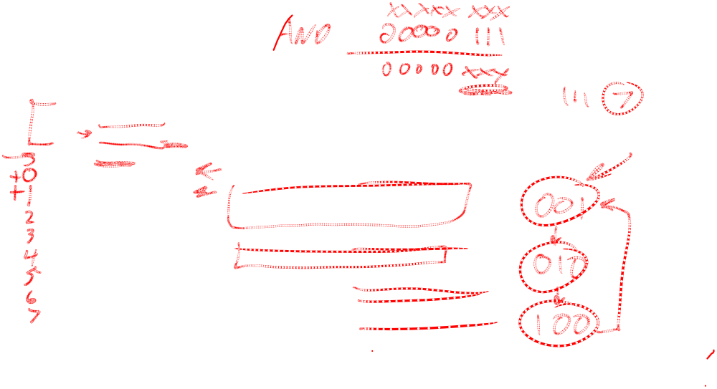
Another way to code “Blink” ---- Table Use
BlinkTable
movf PORTD, W ; Copy present state of LEDs into W
andlw B'00000111' ; and keep only LED bits
addwf PCL,F ; Change PC with PCLATH and offset in W
retlw B'00000001' ; (000 -> 001) reinitialize to green
retlw B'00000011' ; (001 -> 010) green to yellow
retlw B'00000110' ; (010 -> 100) yellow to red
retlw B'00000010' ; (011 -> 001) reinitialize to green
retlw B'00000101' ; (100 -> 001) red to green
retlw B'00000100' ; (101 -> 001) reinitialize to green
retlw B'00000111' ; (110 -> 001) reinitialize to green
retlw B'00000110' ; (111 -> 001) reinitialize to green
In calling program
call BlinkTable ; get bits to change into W
xorwf PORTD, F ; toggle them into PORTD
Microprocessors I: Lecture 25

Slide 10
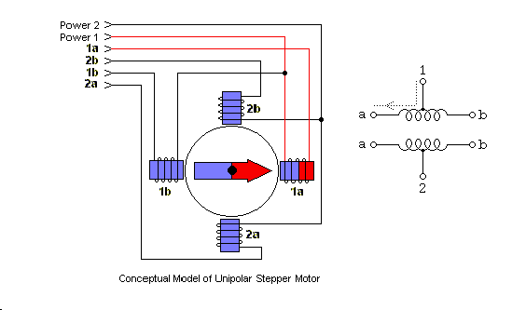
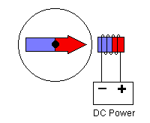
Application: Driving stepper motor
Magnet attached to shaft
Current through coil → magnetic field
  Reverse current → reverse field
Pair of coils used to attract magnet to one of 4 different directions
Unipolar stepper motor: center taps on coil make current reversal easy
  Microcontroller can activate drive transistors
Magnet rotor
coil
Microprocessors I: Lecture 25
Notes:
Major differences between uni-polar and bi-polar.
Uni-polar
has logically two windings per phase, so a magnetic pole can be reversed without switching the direction of current,
A microcontroller or stepper motor controller can be used to activate the drive transistors in the right order,
Less torque
bi-polar
has logically a single winding per phase, so current in a winding needs to be reversed in order to reverse a magnetic pole,
driving circuit must be more complicated, typically with an H-bridge arrangement
More torque

Slide 11
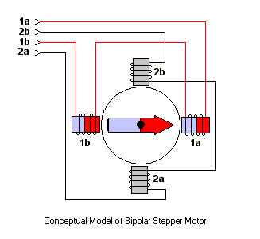
How Bi-polar Stepper Motor Works
Bipolar stepper motor
  More torque than unipolar motor
  Similar principle, but no center taps
    Need glue circuitry (use H-bridge)
Microprocessors I: Lecture 25

Slide 12
Sequences (1 = phase activated)
Table of Stepping Sequences
Sequence | Polarity | Name | Description
0001 0010 0100 1000 | ---+ --+- -+-- +--- | Wave Drive, One-Phase | Consumes the least power. Only one phase is energized at a time. Assures positional accuracy regardless of any winding imbalance in the motor.
0011 0110 1100 1001 | --++ -++- ++-- +--+ | Hi-Torque, Two-Phase | Hi Torque - This sequence energizes two adjacent phases, which offers an improved torque-speed product and greater holding torque.
0001 0011 0010 0110 0100 1100 1000 1001 | ---+ --++ --+- -++- -+-- ++-- +--- +--+ | Half-Step | Half Step - Effectively doubles the stepping resolution of the motor, but the torque is not uniform for each step. (Since we are effectively switching between Wave Drive and Hi-Torque with each step, torque alternates each step.) Note that this sequence is 8 steps.
Microprocessors I: Lecture 25

Slide 13
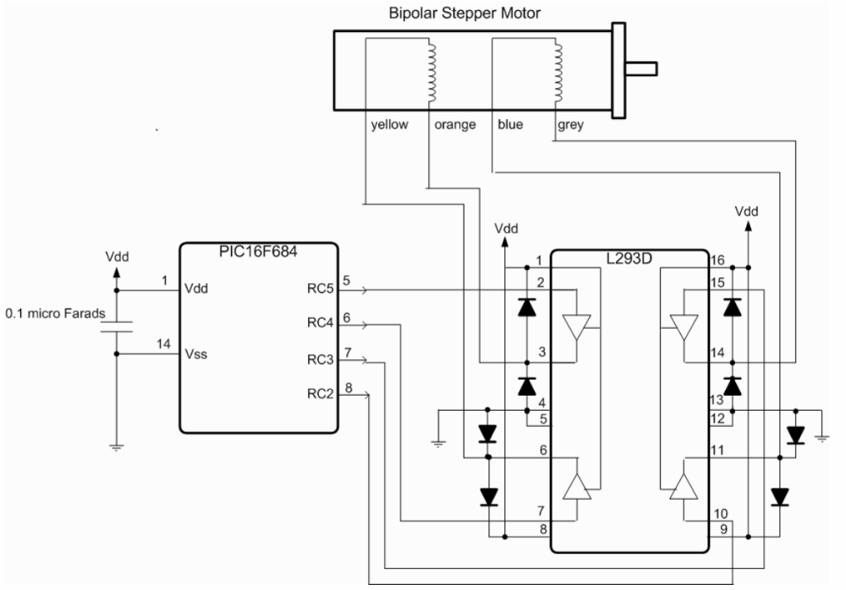
The Schematic
Microprocessors I: Lecture 25
Notes:
Because of power requirements, induction of the windings, and temperature management, motors cannot be directly powered by most digital controllers. Some "glue circuitry," such as a motor controller (H-bridge) is necessary between digital controller and motor. The above image shows the basic circuit of a motor controller which can also sense motor current. (One wire of the motor is shown; a stepper motor would require such a circuit for four wires, and a normal DC motor for two. This circuitry is typically all included in an integrated H-bridge chip.

Slide 14
Our energization pattern
Step | Up-down Coil | East-West Coil
1 | South | Off
2 | South | South
3 | Off | South
4 | North | South
5 | North | Off
6 | North | North
7 | Off | North
8 | South | North
Microprocessors I: Lecture 25

Slide 15
Our control sequence
RC5 | RC4 | RC3 | RC2
0 | 1 | 1 | 1
0 | 1 | 0 | 1
0 | 0 | 0 | 1
1 | 0 | 0 | 1
1 | 0 | 0 | 0
1 | 0 | 1 | 0
1 | 1 | 1 | 0
0 | 1 | 1 | 0
Microprocessors I: Lecture 25

Slide 16
Sequence 0111
OFF
0
1
1
1
Microprocessors I: Lecture 25

Slide 17
Sequence 0101
0
1
0
1
Microprocessors I: Lecture 25

Slide 18
The code (comments, directives)
title "asmStepper - PIC16F684 Bipolar Stepper Motor Control"
;
; This Program Outputs a new Bipolar Stepper Motor Sequence
; once every 250 ms.
;
; Hardware Notes:
; PIC16F684 running at 4 MHz Using the Internal Clock
; Internal Reset is Used
; RC5:RC2 - L293D Stepper Motor Control
;;
; Myke Predko
; 05.01.14
;
LIST R=DEC ;yluo note: list directive to specify assembler options
INCLUDE "p16f684.inc"
Microprocessors I: Lecture 25
Notes:
List directive is used to specify different assembly and listing commands to the assembler program.
R=DEC means the default number base in 10.
_CONFIG directive is used to specify the configuration word bits. Each parameter is ANDed together to specify which bits are reset and set.

Slide 19
The Code (configuration code and data variables)
__CONFIG _FCMEN_OFF & _IESO_OFF & _BOD_OFF & _CPD_OFF & _CP_OFF & _MCLRE_OFF & _PWRTE_ON & _WDT_OFF & _INTOSCIO
; Variables
CBLOCK 0x20
Dlay, i
ENDC
PAGE
; Mainline
org 0
nop ; For ICD Debug
Microprocessors I: Lecture 25

Slide 20
The code (initialization)
movlw 1 << 2 ; Start with Bit 2 Active
movwf PORTC
movlw 7 ; Turn off Comparators
movwf CMCON0
bsf STATUS, RP0 ; Execute out of Bank 1
clrf ANSEL ^ 0x080 ; All Bits are Digital
movlw b'000011' ; RC5:RC2 are Outputs
movwf TRISC ^ 0x080
bcf STATUS, RP0 ; Return Execution to Bank 0
clrf i
Microprocessors I: Lecture 25

Slide 21
The code (main loop)
Loop: ; Return Here for Next Value
movlw HIGH ((250000 / 5) + 256)
movwf Dlay
movlw LOW ((250000 / 5) + 256)
addlw -1 ; 250 ms Delay
btfsc STATUS, Z
decfsz Dlay, f
goto $ - 3
movf i, w
call SwitchRead
movwf PORTC
incf i, f ; i = (i + 1) % 8;
bcf i, 3
goto Loop
SwitchRead:
addwf PCL, f ; Staying in First 256 Instructions
dt b'011100', b'010100', b'000100', b'100100'
dt b'100000', b'101000', b'111000', b'011000'
end
Microprocessors I: Lecture 25

Slide 22
Final notes
Next time:
  Return exams
Reminders:
  HW 5 to be posted, due date TBD
Microprocessors I: Lecture 25

