Slide 1
16.317
Microprocessor Systems Design I
Instructor: Dr. Michael Geiger
Spring 2015
Lecture 25:
Exam 2 Review

Slide 2
Lecture outline
Announcements/reminders
  HW 5 to be posted; due date TBD
Today’s lecture
  Exam 2 Review
Microprocessors I: Lecture 25

Slide 3
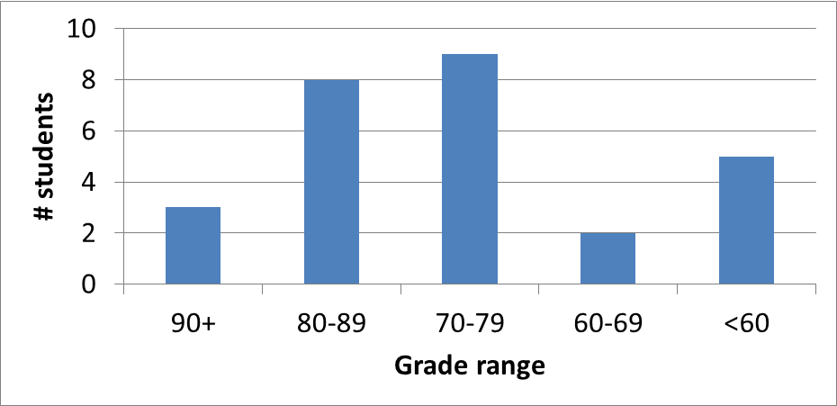
Exam stats & grade distribution
Question-by-question averages:
  Q1: 10.4 / 16 (65%)
  Q2: 13.1 / 16 (82%)
  Q3: 17.5 / 28 (62%)
  Q4: 31.5 / 40 (79%)
Extra credit
  14 students
  4.6 / 10 average
Average: 72.6
Median: 74
Std. deviation: 15.7
Max: 100
Microprocessors I: Lecture 25

Slide 4
Figuring out where you stand
Homework: 55% (4 done; 2 graded; 6 or 7 total)
Exams: 45% (15% + 15% + 15%)
~1/3 of your grade still to be determined
Estimating your grade
  Homework avg (HWA) =
  (HW1 + HW2) / 2
  Exam avg (EA) =
  ((Exam1) + (Exam2)) / 2
  Overall avg = HWA * 0.55 + EA * 0.45
Microprocessors I: Lecture 25

Slide 5
Figuring out where you stand
Estimated avg. = HWA * 0.55 + EA * 0.45
Current course averages
  Without extra credit: ~83%, SD ≈ 14.2
  With extra credit: ~84%, SD ≈ 14.5
Key points
  Very possible there will be no grading curve
  Therefore, right now:
    Min grade for C-: 70
    Min grade for D: 60
    THESE NUMBERS WILL ALMOST CERTAINLY CHANGE BEFORE SEMESTER’S END—THESE FIGURES ARE JUST ROUGH ESTIMATES!!!!!
Microprocessors I: Lecture 25

Slide 6
Final notes
Next time:
  PICkit intro
Reminders:
  HW 5 to be posted; due date TBD
Microprocessors I: Lecture 25

