Slide 1
16.317
Microprocessor Systems Design I
Instructor: Dr. Michael Geiger
Spring 2015
Lecture 31:
Exam 3 Preview

Slide 2
Lecture outline
Announcements/reminders
  No lecture Friday—Dr. Geiger out of town Th-Sun
  HW 6 due today
    Remember to return PICkit
  Exam 3: Monday, 5/4, 8:00-11:00 AM
    Will need to complete course eval (to be posted online) prior to exam
Today’s lecture: Exam 3 Preview
Microprocessors I: Lecture 31

Slide 3
Exam 3 notes
Allowed
  One 8.5” x 11” double-sided sheet of notes
  Calculator
No other notes or electronic devices (phone, laptop, etc.)
Exam will last three hours
  Will be written for ~1 hour, but you’ll have whole exam period
Covers most PIC programming material (Lec. 22, 24-30)
  Will not have basic “reading PIC instructions” problem
  Includes one lecture given before Exam 2
Format similar to previous exams
  1 multiple choice question
  2-3 short problems to solve
Microprocessors I: Lecture 31

Slide 4
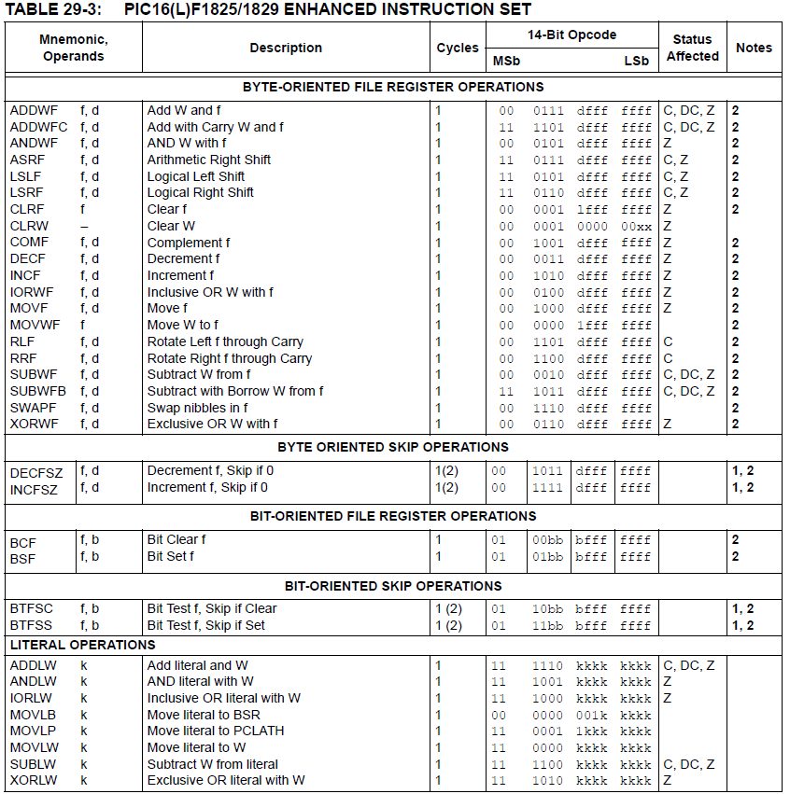
Microprocessors I: Lecture 31

Slide 5
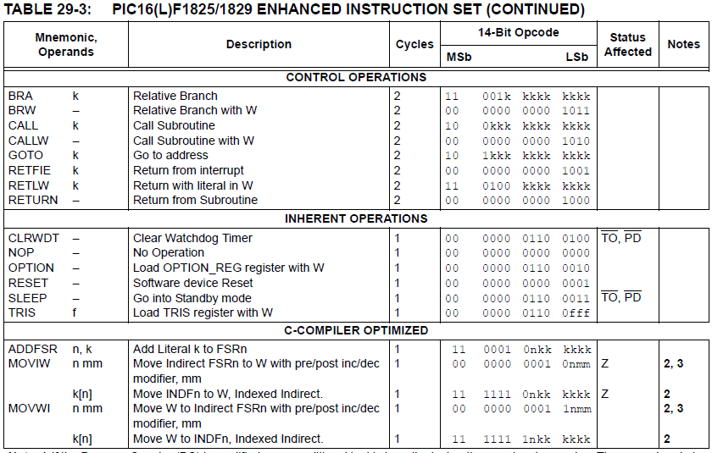
Microprocessors I: Lecture 31

Slide 6
Review: PIC instructions (cont.)
Clearing register: clrw/clrf
Moving values: movlw/movwf/movf
Swap nibbles: swapf
Single bit manipulation: bsf/bcf
Unary operations: incf/decf/comf
Arithmetic: addlw/addwf/addwfc/
sublw/subwf/subwfb
Microprocessors I: Lecture 31

Slide 7
Review: PIC instructions (cont.)
Logical operations
  andlw/andwf
  iorlw/iorwf
  xorlw/xorwf
Rotates/shifts
  rrf/lsrf/asrf
  rlf/lslf
Jumps/calls/return
  goto/bra
  call
  return/retlw/retfie
Conditional execution
  Test bit and skip next instruction if clear/set: btfsc/btfss
  Increment/decrement register and skip next instruction if zero: incfsz/decfsz
Example use: combined with goto to create conditional jump
Microprocessors I: Lecture 31

Slide 8
Review: complex operations
Multiple registers
  Data must be transferred through working register
Conditional jumps
  Usually btfsc/btfss instruction + goto
  Equality/inequality—use subtract in place of CMP
  If you subtract X – Y:
    X > Y → Z = 0, C = 1
    X == Y → Z = 1, C = 1
    X < Y → Z = 0, C = 0
    X <= Y → Z == C
    X != Y → Z = 0
    X >= Y → C = 1
Shift/rotate
  Manipulate carry before operation (or appropriate bit after)
  Use loop for multi-bit shift/rotate
Microprocessors I: Lecture 31

Slide 9
Review: Multi-byte data
Logical operations can be done byte-by-byte
Arithmetic and shift/rotate operations require you to account for data flow between bytes
  Carry/borrow in arithmetic
    Addition: if carry from lower byte, increment one of the upper bytes (addwfc)
    Subtraction: if borrow from lower byte, decrement one of the upper bytes (subwfb)
  Bit shifted between bytes in shift/rotate
    Performing instructions in correct order ensures bit transferred correctly through C bit
    All instructions after first one must be rrf/rlf
    Rotate/shift left: start with LSB
    Rotate/shift right: start with MSB
Microprocessors I: Lecture 31

Slide 10

Review: A Delay Subroutine
; ***********************************************************************************
; TenMs subroutine and its call inserts a delay of exactly ten milliseconds
; into the execution of code.
; It assumes a 4 MHz crystal clock. One instruction cycle = 4 * Tosc.
; TenMsH equ 13 ; Initial value of TenMs Subroutine's counter
; TenMsL equ 250
; COUNTH and COUNTL are two variables
TenMs
nop ; one cycle
movlw TenMsH ; Initialize COUNT
movwf COUNTH
movlw TenMsL
movwf COUNTL
Ten_1
decfsz COUNTL,F ; Inner loop
goto Ten_1
decfsz COUNTH,F ; Outer loop
goto Ten_1
return
Microprocessors I: Lecture 31
Notes:
Chapter 9

Slide 11

Review: Strategy to “Blink”
The LEDs are toggled in sequence - green, yellow, red, green, yellow, red…
Let’s look at the lower three bits of PORTD
  001=green, 010=yellow, 100=red
The next LED to be toggled is determined by the current LED.
001->010->100->001->…
Microprocessors I: Lecture 31

Slide 12
Coding “Blink” with Table Use
BlinkTable
movf PORTD, W ; Copy present state of LEDs into W
andlw B'00000111' ; and keep only LED bits
addwf PCL,F ; Change PC with PCLATH and offset in W
retlw B'00000001' ; (000 -> 001) reinitialize to green
retlw B'00000011' ; (001 -> 010) green to yellow
retlw B'00000110' ; (010 -> 100) yellow to red
retlw B'00000010' ; (011 -> 001) reinitialize to green
retlw B'00000101' ; (100 -> 001) red to green
retlw B'00000100' ; (101 -> 001) reinitialize to green
retlw B'00000111' ; (110 -> 001) reinitialize to green
retlw B'00000110' ; (111 -> 001) reinitialize to green
In calling program
call BlinkTable ; get bits to change into W
xorwf PORTD, F ; toggle them into PORTD
Microprocessors I: Lecture 31

Slide 13
Review: PICkit example programs
Be comfortable with the following:
  Working with I/O ports
    Configuring as inputs (1)/outputs (0) using TRISx
    Writing using LATx
    Reading using PORTx
  Delay
    Instruction count-based
    Timer-based
  Interrupts
    General setups
    Specific ones we covered (timer, negative edge)
  Analog-to-digital conversion
    General setup
    Performing conversion
    Reading result from ADRESH or ADRESL
Microprocessors I: Lecture 31

Slide 14
Final notes
Next time:
  Exam 3
Reminders:
  No lecture Friday—Dr. Geiger out of town Th-Sun
  HW 6 due today
    Remember to return PICkit
  Exam 3: Monday, 5/4, 8:00-11:00 AM
    Will need to complete course eval (to be posted online) prior to exam
Microprocessors I: Lecture 31

