Slide 1
16.317
Microprocessor Systems Design I
Instructor: Dr. Michael Geiger
Spring 2015
Lecture 3:
x86 introduction

Slide 2
Lecture outline
Announcements/reminders
  Sign up for the course discussion group on Piazza
  HW 1 to be posted this week
Review
  Data types
  Storage media
Today’s lecture
  Alignment
  Endianness
  x86 introduction
Microprocessors I: Lecture 3

Slide 3
Review: ISA, storage
Operands: the data being operated on
  How are the bits interpreted? (int, FP, signed/unsigned)
  What size are they? (byte, word, etc.)
Data storage
  Registers
    Small, fast set of on-chip storage (primarily for speed)
    Referenced by name
  Memory
    Larger, slower set of storage (primarily for capacity)
    Organized as hierarchy …
    … but programmer references single range of addresses
    Memory issues
      Aligned data: address divisible by number of bytes
      Endianness: 80x86 data is little endian
Microprocessors I: Lecture 3

Slide 4
Aligned Words, Double words
Aligned word
Aligned data: address is divisible by # of bytes
  2 bytes → address must be even
  4 bytes → address must be multiple of 4
x86 architecture doesn’t require aligned data access
  Performance impact for accessing unaligned data in memory (32-bit data bus)
Byte address
0
4
8
12
16
20
Aligned double word
Unaligned
word
Unaligned
double
word
Microprocessors I: Lecture 2
Notes:
Chapter 2

Slide 5
Byte order (“endianness”)
In a multi-byte operand, how are the bytes ordered in memory?
Assume the double word value 1,000,000 (0x000F4240) is stored at address 80
  In a little-endian ISA (like x86), the least significant byte (the “little” end) is at address 80
  In a big-endian ISA (like MIPS), it’s the other way around
 |  | 40 | 42 | 0F | 00
… | 79 | 80 | 81 | 82 | 83 | 84 | …
 |  | 00 | 0F | 42 | 40
… | 79 | 80 | 81 | 82 | 83 | 84 | …
Computer Architecture Lecture 1

Slide 6
Examples
Given the following memory contents:
  Starting address of each line shown on left
  Leftmost byte has lowest address
    First line: addresses 0x200C, 0x200D, 0x200E, 0x200F
What is the value of:
  The word starting at address 0x200D?
  The double word starting at address 0x2012?
Are these data aligned?
 | Lo |  |  | Hi
0x200C | 40 | 96 | 2C | 00
0x2010 | 55 | 12 | CD | AB
0x2014 | 01 | 23 | 88 | 99
Microprocessors I: Lecture 2

Slide 7
Solution
 | Lo |  |  | Hi
0x200C | 40 | 96 | 2C | 00
0x2010 | 55 | 12 | CD | AB
0x2014 | 01 | 23 | 88 | 99
Word at 0x200D = 0x2C96
  Address is not divisible by 2 → unaligned
Double word at 0x2012 = 0x2301ABCD
  Address is not divisible by 4 → unaligned
    Remember, hexadecimal is base 16—0x12 = 18₁₀
Microprocessors I: Lecture 2

Slide 8
Addressing modes
Addressing modes: ways of specifying operand location
Where are operands stored? (3 location types)
  Registers → register addressing
    Provide name of register; value read from register
  Memory
    Provide address in memory; value read from that location
    Several modes for specifying memory address
  In the instruction → immediate addressing
Microprocessors I: Lecture 3

Slide 9
Memory addressing
Instructions accessing memory generate effective address (EA)
  Address calculated as part of instruction
  EA can be used as
    Actual memory address in a simple memory system
    Address within a particular segment in a segmented memory architecture
Effective address calculations can involve
  A constant value
  One or more values stored in registers
  Some combination of register and constant
Microprocessors I: Lecture 3

Slide 10
General memory addressing modes
Memory direct addressing
  EA = constant value encoded in instruction
Register indirect addressing
  EA = value stored in register
Base + displacement addressing
  EA = constant displacement + base register(s)
  Can have variations of this mode based on number and type of registers
Scaled addressing
  EA = base + (scale * index)
  Used for array addressing
Microprocessors I: Lecture 3

Slide 11
x86 intro
“x86” → family of Intel processors
  Starts with 8086 processor (1978)
  Used (w/extensions) in current processors
General purpose processor
Supports use of 8, 16, 32, or 64 bit data
Allows both register and memory operands
Segmented or flat memory architecture
Real and protected mode operation
  Protected mode supports virtual memory
Microprocessors I: Lecture 3

Slide 12
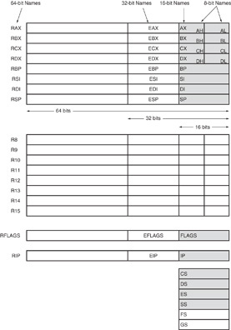
Register Set
Nine 32-bit registers
  (4) Data registers- EAX, EBX, ECX, EDX, can be used as 32, 16 or 8bit
  (2) Pointer registers- EBP, ESP
  (2) Index registers- ESI, EDI
  (1) Instruction pointer- EIP
Six 16-bit registers
  (6) Segment registers- CS, DS, SS, ES, FS, GS
Flags (status) register-EFLAGS
Microprocessors I: Lecture 3
Notes:
Chapter 2

Slide 13
Register Set
64-bit extensions
  Added with Pentium 4
  Data/pointer/index/IP/ flag register extended to 64 bits
  For example:
    RAX = 64-bit register A
    RSP = 64-bit stack pointer
  8 additional data registers (R8-R15)
Microprocessors I: Lecture 3
Notes:
Chapter 2

Slide 14
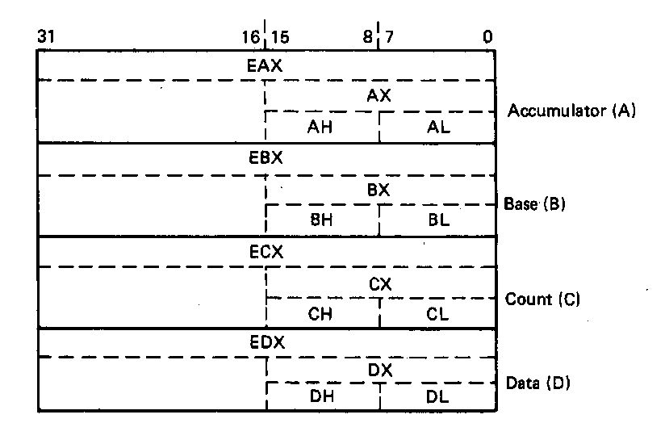
General Purpose Data Registers
Four general purpose data registers
  Accumulator (A) register
  Base (B) register
  Count (C) register
  Data (D) register
Can hold 8-bit, 16-bit, or 32-bit data
  AH/AL = high and low byte value
  AX = word value
  EAX = double word value
General uses:
  Hold data such as source or destination operands for most operations—ADD, AND, SHL
  Hold address pointers for accessing memory
Some also have dedicated special uses
  C—count for loop,
  B—table look-up translations, base address
  D—indirect I/O and string I/O
Microprocessors I: Lecture 3
Notes:
Chapter 2

Slide 15
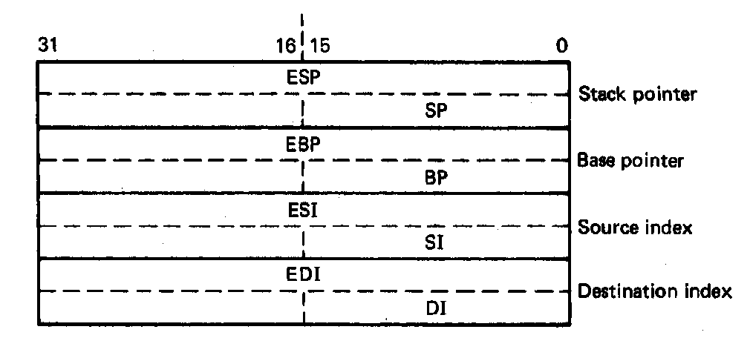
Pointer Registers
Two pointer registers
  Stack pointer register
    ESP = 32-bit extended stack pointer
    SP = 16-bit stack pointer
    Points to top of stack
  Base pointer register
    EBP = 32-bit extended base pointer
    BP = 16-bit base pointer
    Points to fixed location within current stack frame
Microprocessors I: Lecture 3
Notes:
Chapter 2

Slide 16
Index Registers
Source index register
  ESI = 32-bit source index register
  SI = 16-bit source index register
Destination index registers
  EDI = 32-bit destination index register
  DI = 16-bit destination index register
Typically used to access source and destination operands
Microprocessors I: Lecture 3
Notes:
Chapter 2

Slide 17
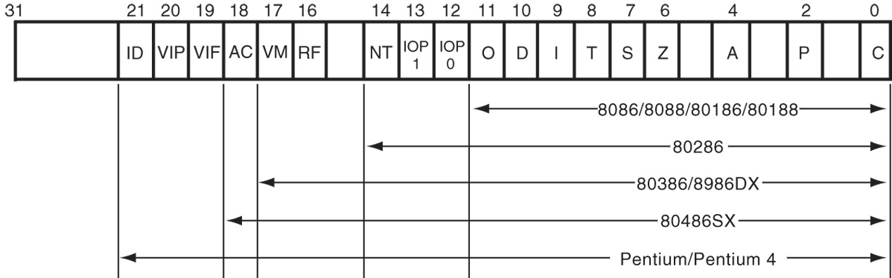
Flags Register
32-bit register holding single bit status and control information
9 active flags in real mode
Two categories
  Status flags: conditions resulting from instruction
    Most instructions update status
    Used as test conditions
  Control flags: control processor functions
    Used by software to turn on/off operating capabilities
Microprocessors I: Lecture 3
Notes:
Chapter 2

Slide 18
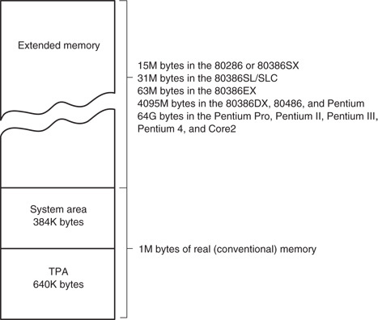
x86 memory spaces
x86 architecture implements independent memory and input/output (not shown) address spaces
Memory address space
  1 MB “real” memory
    System + transient program area (TPA)
  Extended memory size dependent on processor
Input/output address space- 65,536 bytes long (64KB)
Microprocessors I: Lecture 3
Notes:
Chapter 2

Slide 19
x86 memory modes
Two general modes of access
  Real mode (DOS)
  Protected mode (Windows)
Two memory models
  Segmented memory model
  Flat memory model
    We’ll use this model
Microprocessors I: Lecture 3

Slide 20
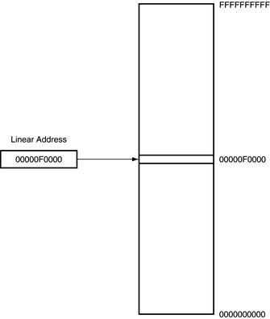
Flat mode addressing
No segmentation
  Entire address space active
Address generated by instruction = linear address being accessed
Generates 40-bit external address
Microprocessors I: Lecture 3

Slide 21
Final notes
Next time:
  Assembly programming basics
Reminders:
  Sign up for the discussion group on Piazza
  HW 1 to be posted this week; due date TBD
Microprocessors I: Lecture 3

