Slide 1
16.317
Microprocessor Systems Design I
Instructor: Dr. Michael Geiger
Spring 2015
Lecture 8:
Rotate, bit test, and bit scan instructions

Slide 2
Lecture outline
Announcements/reminders
  HW 2 due 2/18 at 12:00 PM (no late submissions)
  Lecture next Tuesday, not Monday (Presidents’ Day)
  Exam 1: Friday, 2/20
    Allowed calculator, one double-sided 8.5” x 11” note sheet
    Will be given list of instructions covered so far
Review
  Logical instructions
  Shift instructions
Today’s lecture
  Rotate instructions
  Bit test/scan instructions
Microprocessors I: Lecture 8

Slide 3
Review: Logical instructions
Logical instructions (AND/OR/XOR/NOT)
Basic shift instructions
  Move value by <amt> bits; add 0s to left or right
  CF = last bit shifted out
  SHL <src>, <amt>: Move <src> to left
    SAL exactly the same
  SHR <src>, <amt>: Move <src> to right
Arithmetic right shift
  Move value right by <amt> bits
  Copy sign bit to fill remaining bits
  CF = last bit shifted out
  SAR <src>, <amt>
Microprocessors I: Lecture 8

Slide 4
Shift example
Example: Given AL = 15H, CL = 03H, and CF = 0 show the state of AL and CF after each instruction in the sequence below:
  SHL AL, 1
  SHR AL, CL
  SAL AL, 5
  SAR AL, 2
Microprocessors I: Lecture 7

Slide 5
Solution
Initially, AL = 15H = 00010101₂
SHL AL, 1
  AL = (00010101 << 1) = 00101010₂ = 2AH
  CF = last bit shifted out = 0
SHR AL, CL
  AL = (00101010 >> 3) = 00000101₂ = 05H
  CF = last bit shifted out = 0
SAL AL, 5
  “Arithmetic” left shift same as SHL
  AL = (00000101 << 5) = 10100000₂ = A0H
  CF = last bit shifted out = 0
SAR AL, 2
  Arithmetic right shift keeps sign intact—copy MSB to fill leftmost positions
  AL = (10100000 >> 2) = 11101000₂ = E8H
  CF = last bit shifted out = 0
Microprocessors I: Lecture 7

Slide 6
Rotate instructions
Difference between rotates and shifts
  Shifts discard bits that are shifted out
  Rotates take bits that are shifted out and use them to fill vacated bits
Rotate instruction format: <op> D, <shamt>
  Destination may be register/memory
  <shamt>: shift amount
    May be immediate or register CL
All rotate instructions store last bit shifted out in carry flag (CF)
Microprocessors I: Lecture 8

Slide 7

Microprocessors I: Lecture 8

Slide 8
ROR / ROL / RCR / RCL
ROR: rotate right
  Shift (D) to right by <shamt> bits
  <shamt> LS bits are moved to MS bits
ROL: rotate left
  Shift (D) to left by <shamt> bits
  <shamt> MS bits are moved to LS bits
RCR: rotate right through carry
  Treat (CF) as extra LS bit
  Shift (D,CF) to right by <shamt> bits
  <shamt> LS bits (from (D,CF)) are moved to MS bits
RCL: rotate left through carry
  Treat (CF) as extra MS bit
  Shift (CF,D) to left by <shamt> bits
  <shamt> MS bits (from (CF,D)) are moved to LS bits
Microprocessors I: Lecture 8

Slide 9
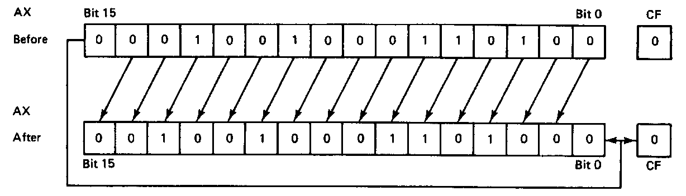
ROL example
ROL AX,1
Before execution
  Dest = (AX) = 1234H = 0001 0010 0011 0100₂
  Count = 1, CF = 0
Operation
  The value in all bits of AX are rotated left one bit position
  Value rotated out of the MSB is reloaded at LSB
  Value rotated out of MSB copied to carry flag
After execution
  Dest = (AX) = 2468H = 0010010001101000₂
  CF = 0
Microprocessors I: Lecture 8

Slide 10
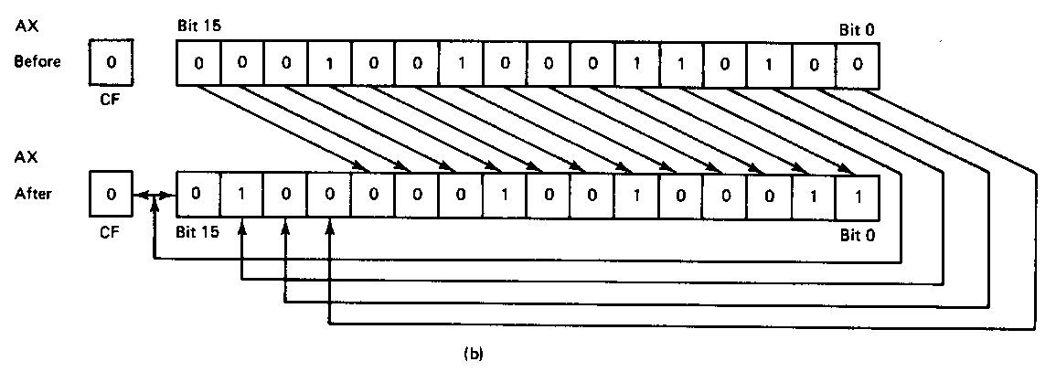
ROR example
ROR AX,CL
Before execution
  Dest = (AX) = 1234H = 0001 0010 0011 0100₂
  Count = 04H, CF = 0
Operation
  The value in all bits of AX are rotated right four bit positions
  Values rotated out of the LSB are reloaded at MSB
  Values rotated out of MSB copied to carry flag
After execution
  Dest = (AX) = 4123H = 01000001001000112
  CF = 0
Note position of hex characters in AX have been rearranged
Microprocessors I: Lecture 8

Slide 11
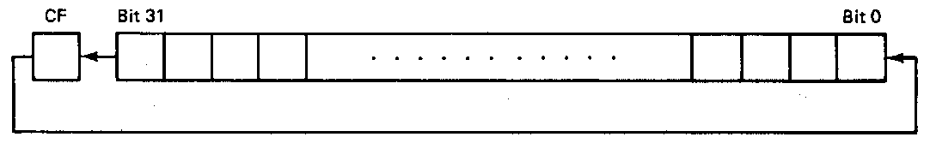
RCL example
RCL BX,CL
Before execution
  Dest = (BX) = 1234H = 0001 0010 0011 0100₂
  Count = 04H, CF = 0
Operation
  The value in all bits of AX are shifted left four bit positions
  Emptied MSBs are rotated through the carry bit back into the LSB
  Last value rotated out of MSB retained in carry flag
  First rotate loads prior value of CF at the LSB
After execution
  Dest = (BX) = 2340H = 0010 0011 0100 0000₂
  CF = 1
Microprocessors I: Lecture 8

Slide 12
Rotate example
Given AL = 43H, CL = 04H, and CF = 0, show the state of AL after each instruction in the sequence below:
  ROR AL, 2
  ROL AL, CL
  RCR AL, 3
  RCL AL, 4
Microprocessors I: Lecture 8

Slide 13
Solution
Initially, AL = 43H = 01000011₂
ROR AL, 2
  AL = 01000011 rotated right by 2
  = 11010000 = D0H
  CF = last bit rotated in = 1
ROL AL, CL
  AL = 11010000 rotated left by 4
  = 00001101 = 0DH
  CF = last bit rotated in = 1
Microprocessors I: Lecture 8

Slide 14
Solution (cont.)
RCR AL, 3
  (AL,CF) = 00001101 1 rotated right by 3
  = 01100001 1
  CF = 1, AL = 01100001₂ = 61H
RCL AL, 4
  (CF,AL) = 1 01100001 rotated left by 4
  = 0 00011011
  CF = 0, AL = 00011011₂ = 1BH
Microprocessors I: Lecture 8

Slide 15
Bit Test Instructions
BT → Bit test
BTR → Bit test and reset
BTS → Bit test and set
BTC → Bit test and complement
Format of bit test instruction: BT(x) D,S
  (S) → index that selects the position of the bit tested
  (D) → Holds value tested
Operation:
  Enables programmer to test bit in a value in register or memory
  All → Save the value of the selected bit in the CF
  BT → Leaves selected bit unchanged
  BTR → Clears the bit (bit = 0)
  BTS → Sets the bit (bit = 1)
  BTC → Complements the bit (bit = ~bit)
Microprocessors I: Lecture 8
Notes:
Chapter 5 part 2

Slide 16
Bit Test Instructions
Example:
  BTC BX,7
Before execution
  (BX) = 03F0H = 0000 0011 1111 0000₂
After Execution
  (CF) = bit 7 of BX = 1
  (BX) = 0370H = 0000 0011 0111 0000₂
Microprocessors I: Lecture 8
Notes:
Chapter 5 part 2

Slide 17
Bit Scan Instructions
BSF → Bit scan forward
BSR → Bit scan reverse
Format of bit scan instructions: BS(x) D,S
  (S) → Holds value for which bits are tested to be 0
  (D) → Index of first bit that tests as non-zero
Operation:
  Enable programmer to test value to determine if all bits are 0
  BSF → Scans bits starting from bit 0
    Set ZF = 0 if all bits are found to be zero
    Sets ZF = 1 when first 1 bit detected and places index of that bit into destination
  BSR → Scans bits starting from MSB
    Set ZF = 0 if all bits are found to be zero
    Sets ZF = 1 when first 1 bit detected and places index of that bit into destination
Example:
  BSF ESI,EDX → 32-bits of EDX scanned starting from B₀
  If EDX = 00000000 → ZF = 0 (all bits zero)
  If EDX = 00000001 → ESI = 00000000, ZF = 1 (bit 0 is 1)
  If EDX = 00003000 → ESI = 0000000C, ZF = 1 (bit 12 is first bit set to 1)
Microprocessors I: Lecture 8
Notes:
Chapter 5 part 2

Slide 18
Final notes
Next time:
  Conditional execution (Tuesday, 2/17)
Reminders:
  HW 2 due 2/18
  Lecture next Tuesday, not Monday (Presidents’ Day)
  Exam 1: Friday, 2/20
    Allowed calculator, one double-sided 8.5” x 11” note sheet
    Will be given list of instructions covered so far
Microprocessors I: Lecture 8

