Slide 1
16.482 / 16.561
Computer Architecture and Design
Instructor: Dr. Michael Geiger
Fall 2013
Lecture 1:
Course overview
Introduction to computer architecture

Slide 2
Lecture outline
Course overview
  Instructor information
  Course materials
  Course policies
  Resources
  Course outline
Introduction to computer architecture
Computer Architecture Lecture 1

Slide 3
Course staff & meeting times
Lectures:
  M 6:30-9:20, Ball 326
Instructor: Dr. Michael Geiger
  E-mail: Michael_Geiger@uml.edu
  Phone: 978-934-3618 (x43618 on campus)
  Office: 118A Perry Hall
  Office hours: M 1-2:30, W 1-2:30, Th 1-3
Computer Architecture Lecture 1

Slide 4
Course materials
Textbooks:
  John L. Hennessy and David A. Patterson, Computer Architecture: A Quantitative Approach, 5th edition, 2012, Morgan Kaufmann.
    ISBN: 978-0-12-383872-8
  David A. Patterson and John L. Hennessy, Computer Organization and Design: The Hardware/Software Interface, revised 4th edition, 2011.
    ISBN: 978-0-12-374750-1
Course tools: TBD, but will likely work with QtSpim simulator (link on web page)
Computer Architecture Lecture 1

Slide 5
Additional course materials
Course websites: http://mgeiger.eng.uml.edu/compArch/f13/index.htm
http://mgeiger.eng.uml.edu/compArch/f13/schedule.htm
  Will contain lecture slides, handouts, assignments
Discussion group through piazza.com:
  Allow common questions to be answered for everyone
  All course announcements will be posted here
  Will use as class mailing list—please enroll ASAP
Computer Architecture Lecture 1

Slide 6
Course policies
Prerequisites: 16.265 (Logic Design) and 16.317 (Microprocessors I)
Academic honesty
  All assignments are to be done individually unless explicitly specified otherwise by the instructor
  Any copied solutions, whether from another student or an outside source, are subject to penalty
  You may discuss general topics or help one another with specific errors, but do not share assignment solutions
    Must acknowledge assistance from classmate in submission
Computer Architecture Lecture 1

Slide 7
Grading and exam dates
Grading breakdown
  Homework assignments: 55%
  Midterm exam: 20%
  Final exam: 25%
Exam dates
  Midterm exam: Monday, October 21 in class
  Final exam: TBD (during finals)
Computer Architecture Lecture 1

Slide 8
Tentative course outline
General computer architecture introduction
Instruction set architecture
Digital arithmetic
Datapath/control design
  Basic datapath
  Pipelining
  Multiple issue and instruction scheduling
Memory hierarchy design
  Caching
  Virtual memory
Storage and I/O
Multiprocessor systems
Computer Architecture Lecture 1

Slide 9
Classes of Computers
Desktop computers
  General purpose, variety of software
  Subject to cost/performance tradeoff
Server computers
  Network based
  High capacity, performance, reliability
  Range from small servers to building sized
Embedded computers
  Hidden as components of systems
  Stringent power/performance/cost constraints
Computer Architecture Lecture 1
Notes:
Morgan Kaufmann Publishers
Chapter 1 — Computer Abstractions and Technology

Slide 10
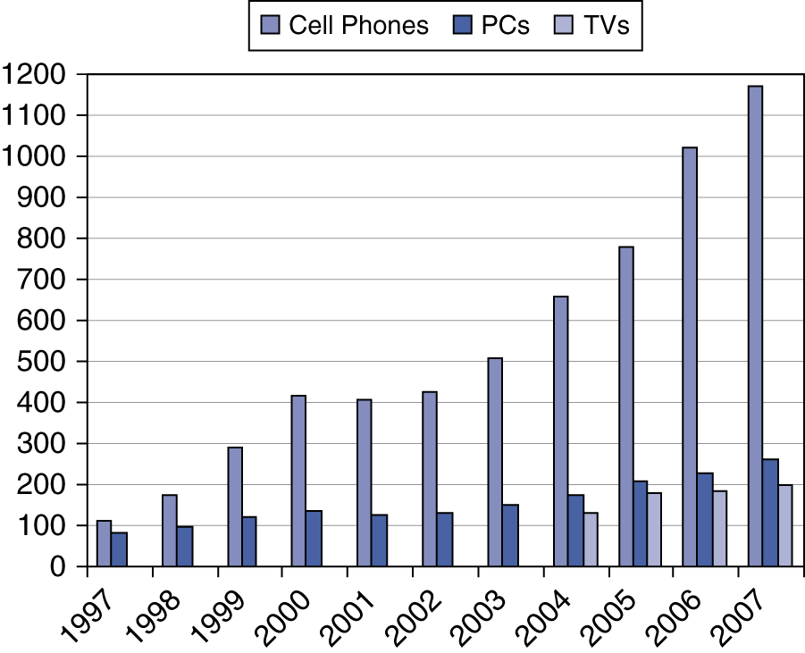
The Processor Market
Computer Architecture Lecture 1
Notes:
Morgan Kaufmann Publishers
Chapter 1 — Computer Abstractions and Technology

Slide 11
Understanding Performance
Algorithm
  Determines number of operations executed
Programming language, compiler, architecture
  Determine number of machine instructions executed per operation
Processor and memory system
  Determine how fast instructions are executed
I/O system (including OS)
  Determines how fast I/O operations are executed
Computer Architecture Lecture 1
Notes:
Morgan Kaufmann Publishers
Chapter 1 — Computer Abstractions and Technology

Slide 12
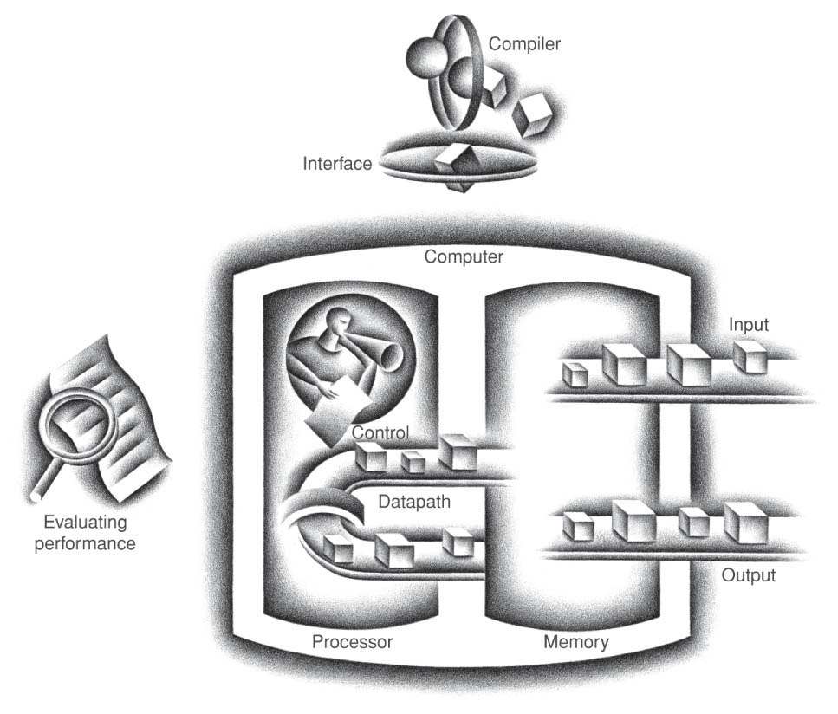
Components of modern computer
Input/output allow communication to/from computer
Memory stores data and code
Processor: datapath and control
  Datapath performs computation
  How do we control processor?
Computer Architecture Lecture 1

Slide 13
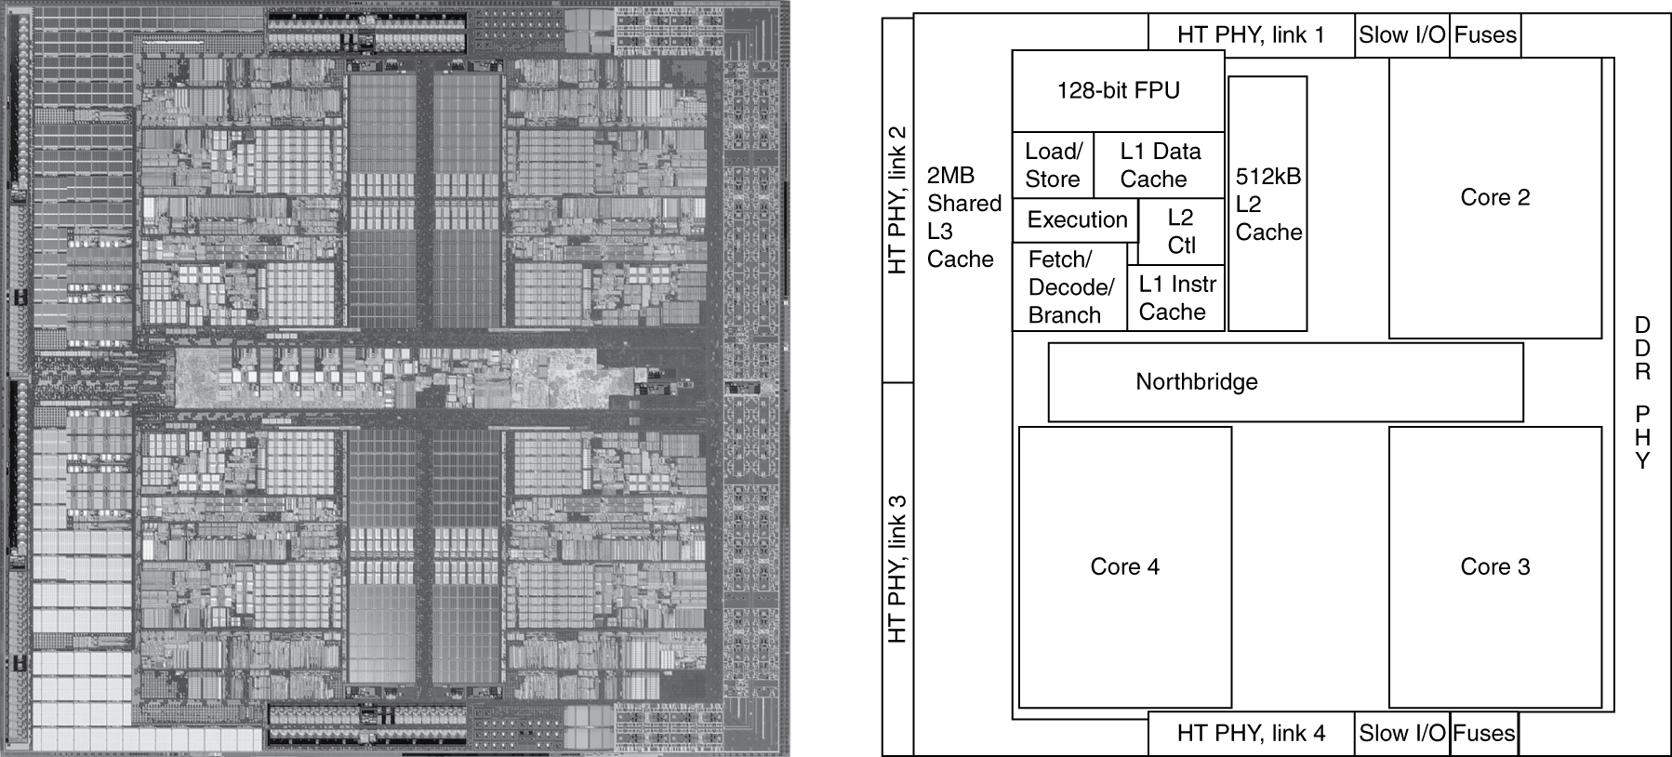
Processor architecture
AMD Barcelona: 4 processor cores
Computer Architecture Lecture 1
Notes:
Morgan Kaufmann Publishers
Chapter 1 — Computer Abstractions and Technology

Slide 14

Computer system layers
Application software
  Written in high-level language
System software
  Compiler: translates HLL code to machine code
  Operating System: service code
    Handling input/output
    Managing memory and storage
    Scheduling tasks & sharing resources
Hardware
  Processor, memory, I/O controllers
Computer Architecture Lecture 1

Slide 15
Abstractions
Abstraction helps us deal with complexity
  Hide lower-level detail
Instruction set architecture (ISA)
  The hardware/software interface
Application binary interface
  The ISA plus system software interface
Implementation
  The details underlying and interface
Computer Architecture Lecture 1
Notes:
Morgan Kaufmann Publishers
Chapter 1 — Computer Abstractions and Technology

Slide 16
What is computer architecture?
High-level description of
  Computer hardware
    Less detail than logic design, more detail than black box
  Interaction between software and hardware
    Look at how performance can be affected by different algorithms, code translations, and hardware designs
Can use to explain
  General computation
  A class of computers
  A specific system
Computer Architecture Lecture 1

Slide 17
What is computer architecture?
software
instruction set
hardware
Classical view: instruction set architecture (ISA)
  Boundary between hardware and software
  Provides abstraction at both high level and low level
More modern view: ISA + hardware design
  Can talk about processor architecture, system architecture
Computer Architecture Lecture 1

Slide 18

Role of the ISA
User writes high-level language (HLL) program
Compiler converts HLL program into assembly for the particular instruction set architecture (ISA)
Assembler converts assembly into machine language (bits) for that ISA
Resulting machine language program is loaded into memory and run
Computer Architecture Lecture 1

Slide 19
ISA design goals
The ultimate goals of the ISA designer are
  To create an ISA that allows for fast hardware implementations
  To simplify choices for the compiler
  To ensure the longevity of the ISA by anticipating future technology trends
Often tradeoffs (particularly between 1 & 2)
Example ISAs: X86, PowerPC, SPARC, ARM, MIPS, IA-64
  May have multiple hardware implementations of the same ISA
    Example: i386, i486, Pentium, Pentium Pro, Pentium II, Pentium III, Pentium IV
Computer Architecture Lecture 1

Slide 20
ISA design
Think about a HLL statement like
X[i] = i * 2;
ISA defines how such statements are translated to machine code
  What information is needed?
Computer Architecture Lecture 1

Slide 21
ISA design (continued)
Questions every ISA designer must answer
  How will the processor implement this statement?
    What operations are available?
    How many operands does each instruction use?
    How do we reference the operands?
  Where are X[i] and i located?
    What types of operands are supported?
    How big are those operands
  Instruction format issues
    How many bits per instruction?
    What does each bit or set of bits represent?
    Are all instructions the same length?
Computer Architecture Lecture 1

Slide 22
Design goal: fast hardware
From ISA perspective, must understand how processor executes instruction
  Fetch the instruction from memory
  Decode the instruction
  Determine addresses for operands
  Fetch operands
  Execute instruction
  Store result (and go back to step 1 … )
Steps 1, 2, and 5 involve operation issues
  What types of operations are supported?
Steps 2-6 involve operand issues
  Operand size, number, location
Steps 1-3 involve instruction format issues
  How many bits in instruction, what does each field mean?
Computer Architecture Lecture 1

Slide 23
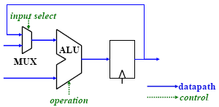
Designing fast hardware
To build a fast computer, we need
  Fast fetching and decoding of instructions
  Fast operand access
  Fast operation execution
Two broad areas of hardware that we must optimize to ensure good performance
  Datapaths pass data to different units for computation
  Control determines flow of data through datapath and operation of each functional unit
Computer Architecture Lecture 1

Slide 24
Designing fast hardware
Fast instruction fetch and decode
  We’ll address this (from an ISA perspective) today
Fast operand access
  ISA classes: where do we store operands?
  Addressing modes: how do we specify operand locations?
    We’ll also discuss this today
  We know registers can be used for fast accesses
  We’ll talk about increasing memory speeds later
Fast execution of simple operations
  Optimize common case
  Implementing single-cycle operations: review
  Dealing with multi-cycle operations: one of our first challenges
Computer Architecture Lecture 1

Slide 25
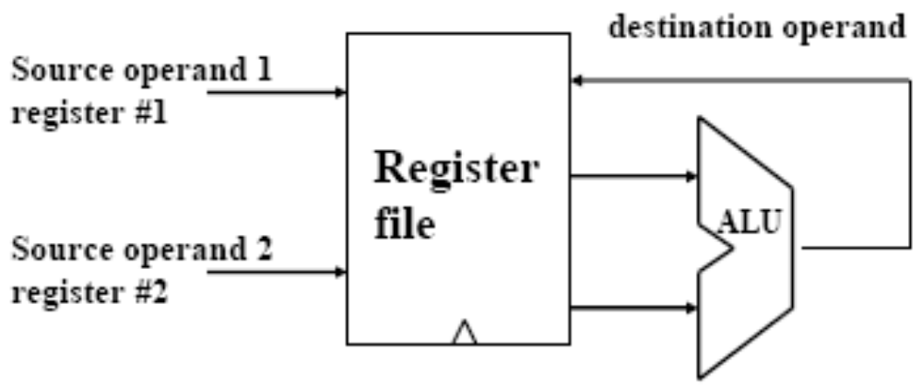
Making operations fast
More complex operations take longer → keep things simple!
Many programs contain mostly simple operations
  add, and, load, branch …
Optimize the common case
  Make these simple operations work well!
  Can execute them in a single cycle (with a fast clock, too)
    If you’re wondering how, wait until we talk about pipelining ...
Computer Architecture Lecture 1

Slide 26
Specifying operands
Most common arithmetic instructions have three operands
  2 source operands, 1 destination operand
  e.g. A = B + C → add A, B, C
ISA classes for specifying operands:
  Accumulator
    Uses a single register (fast memory location close to processor)
    Requires only one address per instruction (ADD addr)
  Stack
    Requires no explicit memory addresses (ADD)
  Memory-Memory
    All 3 operands may be in memory (ADD addr1, addr2, addr3)
  Load-Store
    All arithmetic operations use only registers (ADD r1, r2, r3)
    Only load and store instructions reference memory
Computer Architecture Lecture 1

Slide 27
Accumulator machines
Also known as 1-address machines
  e.g. early Intel microprocessors (4004, 8008)
Use a single register (called the accumulator) for one of the sources as well as the destination
Sample instructions:
Instruction | Meaning/oper.
ADD addr LOAD addr STORE addr | acc = acc + mem[addr] acc = mem[addr] mem[addr] = acc
Computer Architecture Lecture 1

Slide 28
Stack machines
Also known as 0-address machines
PUSH instruction pushes its operand onto the top of the stack (TOS)
POP instruction pops its operand off the top of the stack
All other operations remove operands from the stack and replace them with the result
Sample instructions:
Instruction | Meaning/oper.
ADD PUSH addr POP addr | TOS = TOS + (TOS-1) TOS = mem[addr] mem[addr] = TOS
Computer Architecture Lecture 1

Slide 29
Memory-memory machines
Arithmetic instructions can directly access memory for all 3 operands
  No registers necessary
Sample instruction:
  ADD addr1, addr2, addr3 →
mem[addr1] = mem[addr2] + mem[addr3]
Computer Architecture Lecture 1

Slide 30
Load-store machines
Also known as register-register machines
Arithmetic instructions cannot access the memory and can only use data in registers
Data moved from memory to registers with LOAD and STORE instructions
Instruction | Meaning/oper.
ADD Rd, Rs1, Rs2 LOAD Rd, addr STORE addr, Rs | Rd = Rs1 + Rs2 Rd = mem[addr] mem[addr] = Rs
Computer Architecture Lecture 1

Slide 31
Comparison of ISA classes
Instructions to implement C code: A = B + C;
Assessing performance
  Which one uses the fewest instructions?
  Which one features the fewest memory accesses?
Accumulator | Stack | Memory-memory | Load-store
LOAD B ADD C STORE A | PUSH B PUSH C ADD POP A | ADD A, B, C | LOAD R1, B LOAD R2, C ADD R3, R1, R2 STORE R3, A
Computer Architecture Lecture 1

Slide 32
Comparison of ISA classes (cont.)
Given the following C code:
  A = B - C;
  B = A + C;
Find the instruction sequence for each of the following types of machines
  Accumulator
  Stack
  Memory-memory
  Load-store
For all classes, “SUB” performs subtraction
Computer Architecture Lecture 1

Slide 33
Comparison of ISA classes
Instructions to implement C code:
A = B - C; B = A + C
Accumulator | Stack | Memory-memory | Load-store
LOAD B SUB C STORE A ADD C STORE B | PUSH B PUSH C SUB POP A PUSH A PUSH C ADD POP B | SUB A, B, C ADD B, A, C | LOAD R1, B LOAD R2, C SUB R3, R1, R2 STORE R3, A ADD R1, R3, R2 STORE R1, B
Computer Architecture Lecture 1

Slide 34
Making operand access fast
Operands (generally) in one of two places
  Memory
  Registers
Which would we prefer to use? Why?
Advantages of registers as operands
  Instructions are shorter
    Fewer possible locations to specify → fewer bits
  Fast implementation
    Fast to access and easy to reuse values
We’ll talk about fast memory later …
Where else can operands be encoded?
  Directly in the instruction: ADDI R1, R2, 3
  Called immediate operands
Computer Architecture Lecture 1

Slide 35
RISC approach
Fixed-length instructions that have only a few formats
  Simplify instruction fetch and decode
  Sacrifice code density
    Some bits are wasted for some instruction types
    Requires more memory
Load-store architecture
  Allows fast implementation of simple instructions
  Easier to pipeline
  Sacrifice code density
    More instructions than register-memory and memory-memory ISAs
Limited number of addressing modes
  Simplify effective address (EA) calculation to speed up memory access
Few (if any) complex arithmetic functions
  Build these from simpler instructions
Computer Architecture Lecture 1

Slide 36
MIPS: A "Typical" RISC ISA
32-bit fixed format instruction (3 formats)
Registers
  32 32-bit integer GPRs (R1-R31, R0 always = 0)
  32 32-bit floating-point GPRs (F0-F31)
    For double-precision FP, registers paired
3-address, reg-reg arithmetic instruction
Single address mode for load/store:
base + displacement
Simple branch conditions
Delayed branch
Computer Architecture Lecture 1

Slide 37
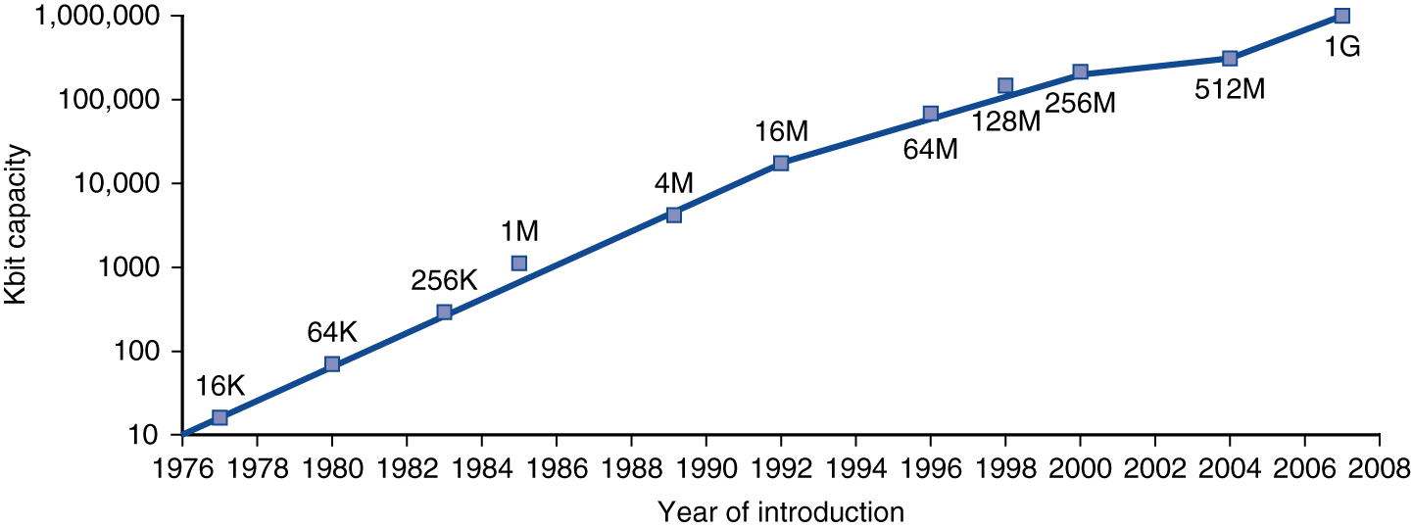
Technology Trends
Electronics technology continues to evolve
  Increased capacity and performance
  Reduced cost
DRAM capacity
Year | Technology | Relative performance/cost
1951 | Vacuum tube | 1
1965 | Transistor | 35
1975 | Integrated circuit (IC) | 900
1995 | Very large scale IC (VLSI) | 2,400,000
2005 | Ultra large scale IC | 6,200,000,000
Computer Architecture Lecture 1
Notes:
Morgan Kaufmann Publishers
Chapter 1 — Computer Abstractions and Technology

Slide 38
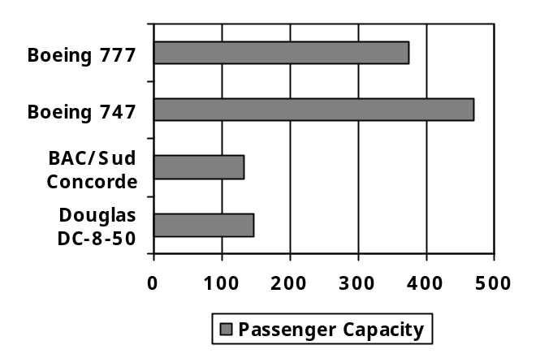
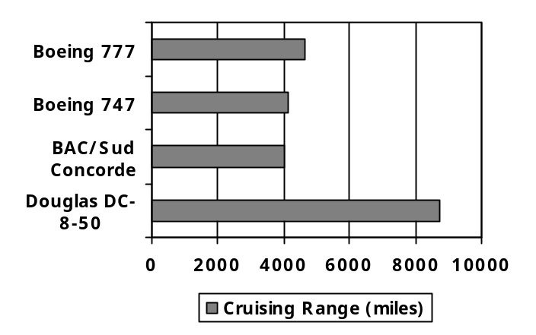
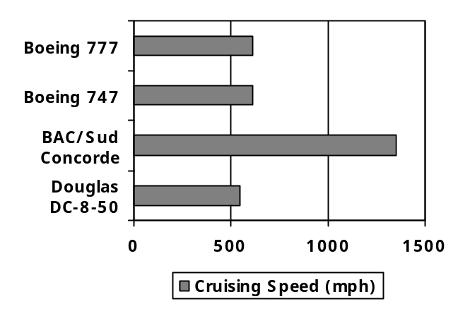
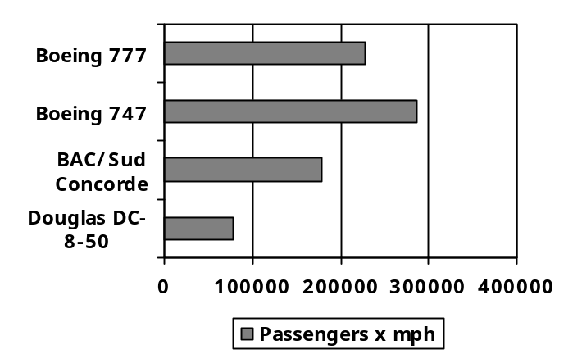
Defining Performance
Which airplane has the best performance?
Computer Architecture Lecture 1
Notes:
Morgan Kaufmann Publishers
Chapter 1 — Computer Abstractions and Technology

Slide 39
Response Time and Throughput
Response time
  How long it takes to do a task
Throughput
  Total work done per unit time
    e.g., tasks/transactions/… per hour
How are response time and throughput affected by
  Replacing the processor with a faster version?
  Adding more processors?
We’ll focus on response time for now…
Computer Architecture Lecture 1
Notes:
Morgan Kaufmann Publishers
Chapter 1 — Computer Abstractions and Technology

Slide 40
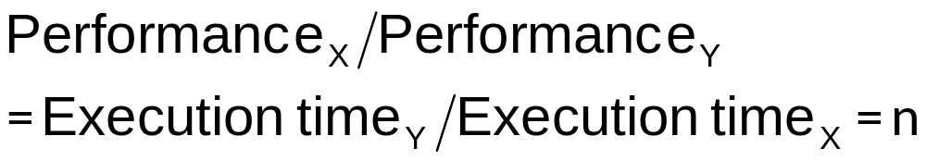
Relative Performance
Define Performance = 1/Execution Time
“X is n time faster than Y”
Example: time taken to run a program
  10s on A, 15s on B
  Execution Time_{B} / Execution Time_{A}
  = 15s / 10s = 1.5
  So A is 1.5 times faster than B
Computer Architecture Lecture 1
Notes:
Morgan Kaufmann Publishers
Chapter 1 — Computer Abstractions and Technology

Slide 41
Measuring Execution Time
Elapsed time
  Total response time, including all aspects
    Processing, I/O, OS overhead, idle time
  Determines system performance
CPU time
  Time spent processing a given job
    Discounts I/O time, other jobs’ shares
  Comprises user CPU time and system CPU time
  Different programs are affected differently by CPU and system performance
Computer Architecture Lecture 1
Notes:
Morgan Kaufmann Publishers
Chapter 1 — Computer Abstractions and Technology

Slide 42
CPU Clocking
Operation of digital hardware governed by a constant-rate clock
Clock period
Clock (cycles)
Data transfer
and computation
Update state
Clock period: duration of a clock cycle
  e.g., 250ps = 0.25ns = 250×10^{–12}s
Clock frequency (rate): cycles per second
  e.g., 4.0GHz = 4000MHz = 4.0×10⁹Hz
Computer Architecture Lecture 1
Notes:
Morgan Kaufmann Publishers
Chapter 1 — Computer Abstractions and Technology

Slide 43

CPU Time
Performance improved by
  Reducing number of clock cycles
  Increasing clock rate
  Hardware designer must often trade off clock rate against cycle count
Computer Architecture Lecture 1
Notes:
Morgan Kaufmann Publishers
Chapter 1 — Computer Abstractions and Technology

Slide 44

CPU Time Example
Computer A: 2GHz clock, 10s CPU time
Designing Computer B
  Aim for 6s CPU time
  Can do faster clock, but causes 1.2 × clock cycles
How fast must Computer B clock be?
Computer Architecture Lecture 1
Notes:
Morgan Kaufmann Publishers
Chapter 1 — Computer Abstractions and Technology

Slide 45

Instruction Count and CPI
Instruction Count for a program
  Determined by program, ISA and compiler
Average cycles per instruction
  Determined by CPU hardware
  If different instructions have different CPI
    Average CPI affected by instruction mix
Computer Architecture Lecture 1
Notes:
Morgan Kaufmann Publishers
Chapter 1 — Computer Abstractions and Technology

Slide 46

CPI Example
Computer A: Cycle Time = 250ps, CPI = 2.0
Computer B: Cycle Time = 500ps, CPI = 1.2
Same ISA
Which is faster, and by how much?
A is faster…
…by this much
Computer Architecture Lecture 1
Notes:
Morgan Kaufmann Publishers
Chapter 1 — Computer Abstractions and Technology

Slide 47
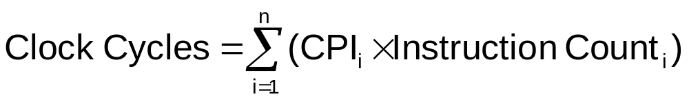

CPI in More Detail
If different instruction classes take different numbers of cycles
Weighted average CPI
Relative frequency
Computer Architecture Lecture 1
Notes:
Morgan Kaufmann Publishers
Chapter 1 — Computer Abstractions and Technology

Slide 48
CPI Example
Alternative compiled code sequences using instructions in classes A, B, C
Class | A | B | C
CPI for class | 1 | 2 | 3
IC in sequence 1 | 2 | 1 | 2
IC in sequence 2 | 4 | 1 | 1
Sequence 1: IC = 5
  Clock Cycles
  = 2×1 + 1×2 + 2×3
  = 10
  Avg. CPI = 10/5 = 2.0
Sequence 2: IC = 6
  Clock Cycles
  = 4×1 + 1×2 + 1×3
  = 9
  Avg. CPI = 9/6 = 1.5
Computer Architecture Lecture 1
Notes:
Morgan Kaufmann Publishers
Chapter 1 — Computer Abstractions and Technology

Slide 49

Performance Summary
Performance depends on
  Algorithm: affects IC, possibly CPI
  Programming language: affects IC, CPI
  Compiler: affects IC, CPI
  Instruction set architecture: affects IC, CPI, T_{c}
Computer Architecture Lecture 1
Notes:
Morgan Kaufmann Publishers
Chapter 1 — Computer Abstractions and Technology

Slide 50
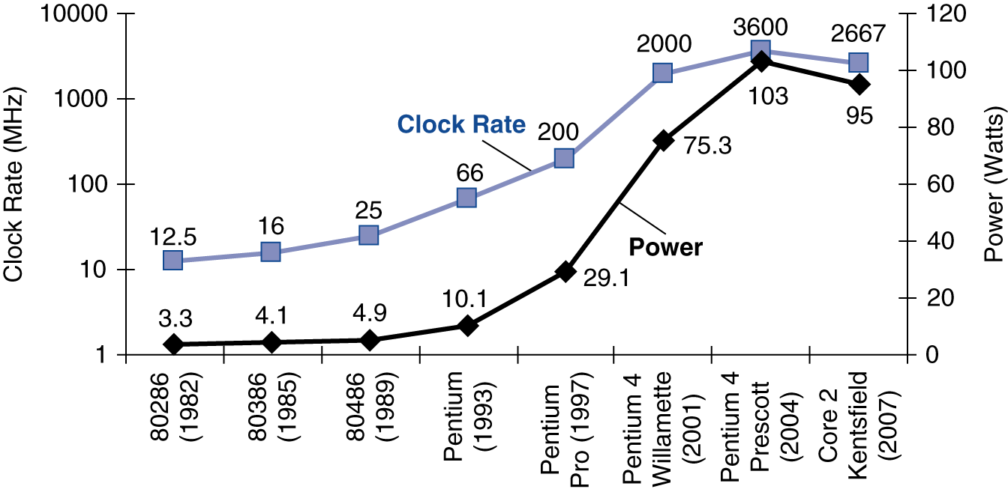
Power Trends
In CMOS IC technology
×30
5V → 1V
×1000
Computer Architecture Lecture 1
Notes:
Morgan Kaufmann Publishers
Chapter 1 — Computer Abstractions and Technology

Slide 51

Reducing Power
Suppose a new CPU has
  85% of capacitive load of old CPU
  15% voltage and 15% frequency reduction
The power wall
  We can’t reduce voltage further
  We can’t remove more heat
How else can we improve performance?
Computer Architecture Lecture 1
Notes:
Morgan Kaufmann Publishers
Chapter 1 — Computer Abstractions and Technology

Slide 52
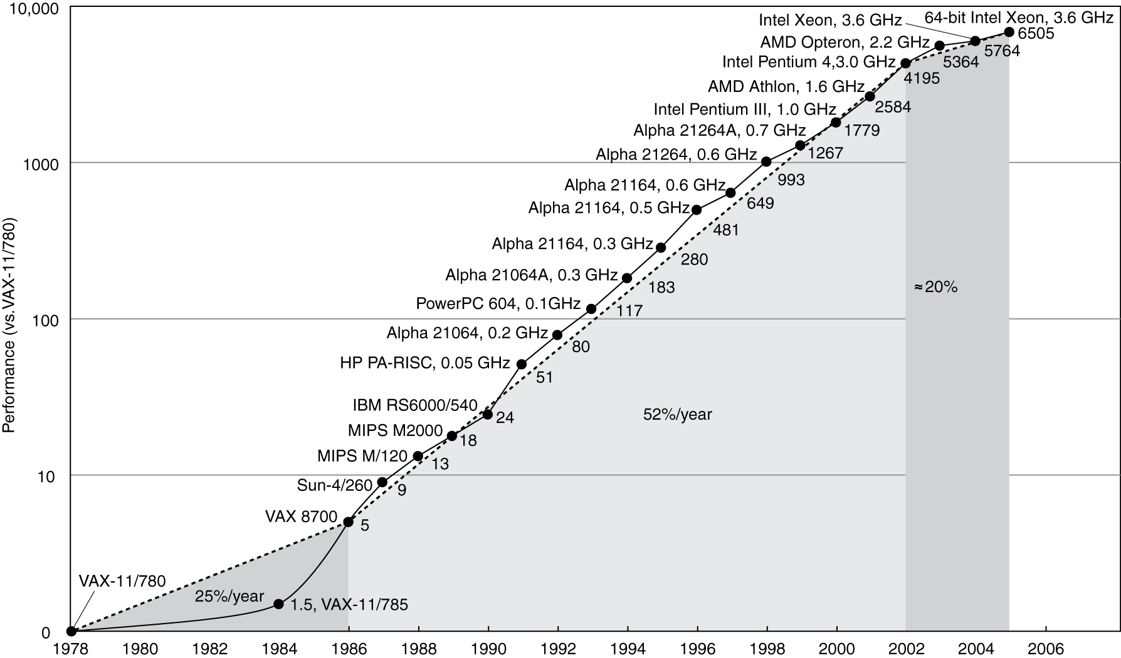
Uniprocessor Performance
Constrained by power, instruction-level parallelism, memory latency
Computer Architecture Lecture 1
Notes:
Morgan Kaufmann Publishers
Chapter 1 — Computer Abstractions and Technology

Slide 53
Multiprocessors
Multicore microprocessors
  More than one processor per chip
Requires explicitly parallel programming
  Compare with instruction level parallelism
    Hardware executes multiple instructions at once
    Hidden from the programmer
  Hard to do
    Programming for performance
    Load balancing
    Optimizing communication and synchronization
Computer Architecture Lecture 1
Notes:
Morgan Kaufmann Publishers
Chapter 1 — Computer Abstractions and Technology

Slide 54
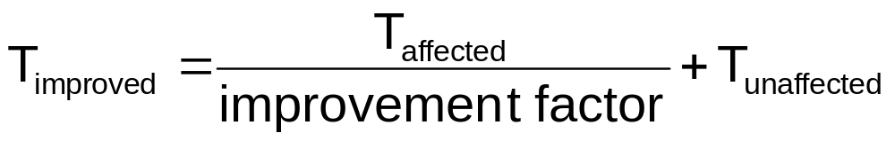

Pitfall: Amdahl’s Law
Improving an aspect of a computer and expecting a proportional improvement in overall performance
Example: multiply accounts for 80s/100s
  How much improvement in multiply performance to get 5× overall?
  Can’t be done!
Corollary: make the common case fast
Computer Architecture Lecture 1
Notes:
Morgan Kaufmann Publishers
Chapter 1 — Computer Abstractions and Technology

Slide 55
Final notes
Next time:
  More on instruction set architecture
  MIPS instruction set
Announcements/reminders:
  Sign up for the course discussion group on Piazza!
  HW 1 to be posted; due 9/16
Computer Architecture Lecture 1

