Slide 1
16.482 / 16.561
Computer Architecture and Design
Instructor: Dr. Michael Geiger
Fall 2013
Lecture 4:
Datapath and control introduction

Slide 2
Lecture outline
Announcements/reminders
  HW 3 due today
  HW 4 to be posted; due 10/7 ... or 10/16
Review: Arithmetic for computers
  Integer multiplication/division
  Floating point representations
  Floating point arithmetic
Today’s lecture: Processor datapath and control discussion
Computer Architecture Lecture 4

Slide 3
Review: Binary multiplication
Generate shifted partial products and add them
Hardware can be condensed to two registers
  N-bit multiplicand
  2N-bit running product / multiplier
  At each step
    Check LSB of multiplier
    Add multiplicand/0 to left half of product/multiplier
    Shift product/multiplier right
Signed multiplication: Booth’s algorithm
  Add extra bit to left of all regs, right of prod./multiplier
  At each step
    Check two rightmost bits of prod./multiplier
    Add multiplicand, -multiplicand, or 0 to left half of prod./multiplier
    Shift product multiplier right
  Discard extra bits to get final product
CIS 273: Lecture 12

Slide 4
Review: IEEE Floating-Point Format
single: 8 bits
double: 11 bits
single: 23 bits
double: 52 bits
S
Exponent
Fraction
S: sign bit (0 ⇒ non-negative, 1 ⇒ negative)
Normalize significand: 1.0 ≤ |significand| < 2.0
  Always has a leading pre-binary-point 1 bit, so no need to represent it explicitly (hidden bit)
  Significand is Fraction with the “1.” restored
Actual exponent = (encoded value) - bias
  Ensures exponent is unsigned
  Single: Bias = 127; Double: Bias = 1023
Encoded exponents 0 and 111 ... 111 reserved
Computer Architecture Lecture 3
Notes:
Morgan Kaufmann Publishers
Chapter 3 — Arithmetic for Computers

Slide 5
Datapath & control intro
Recall: How does a processor execute an instruction?
  Fetch the instruction from memory
  Decode the instruction
  Determine addresses for operands
  Fetch operands
  Execute instruction
  Store result (and go back to step 1 … )
First two steps are the same for all instructions
Next steps are instruction-dependent
Computer Architecture Lecture 4

Slide 6
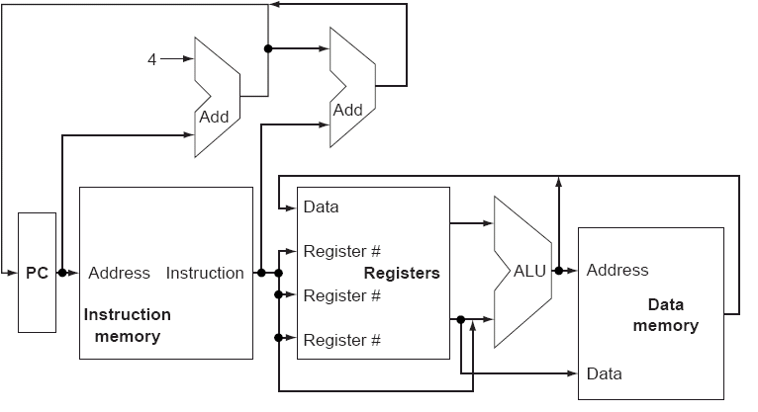
Basic processor implementation
Shows datapath elements: logic blocks that operate on or store data
Need control signals to specify multiplexer selection, functional unit operations
Computer Architecture Lecture 4

Slide 7
Implementation issues: datapath / control
Basic implementation shows datapath elements: logic blocks that either
  Operate on data (ALU)
  Store data (registers, memory)
Need some way to determine
  What data to use
  What operations to perform
Control signals: signals used for
  Multiplexer selection
  Specifying functional unit operation
Computer Architecture Lecture 4

Slide 8
Design choices
Single-cycle implementation
  Every instruction takes one clock cycle
  Instruction fetch, decoding, execution, memory access, and result writeback in same cycle
  Cycle time determined by longest instruction
  Will discuss first as a means for simply introducing the different hardware required to execute each instruction
Pipelined implementation
  Simultaneously execute multiple instructions in different stages of execution
Computer Architecture Lecture 4

Slide 9
MIPS subset
We’ll go through simple processor design for subset of MIPS ISA
  add, sub, and, or (also immediate versions)
  lw, sw
  slt
  beq, j
Datapath design
  What elements are necessary (and which ones can be re-used for multiple instructions)?
Control design
  How do we get the datapath elements to perform the desired operations?
Will then discuss other operations
Computer Architecture Lecture 4

Slide 10
Datapath design
What steps in the execution sequence do all instructions have in common?
  Fetch the instruction from memory
  Decode the instruction
Instruction fetch brings data in from memory
Decoding determines control over datapath
Computer Architecture Lecture 4

Slide 11
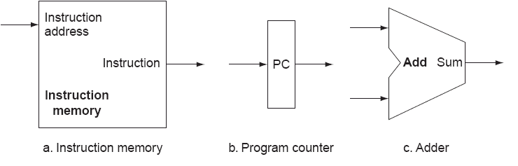
Instruction fetch
What logic is necessary for instruction fetch?
  Instruction storage → Memory
  Register to hold instruction address → program counter
  Logic to generate next instruction address
    Sequential code is easy: PC + 4
    Jumps/branches more complex (we’ll discuss later)
Computer Architecture Lecture 4

Slide 12
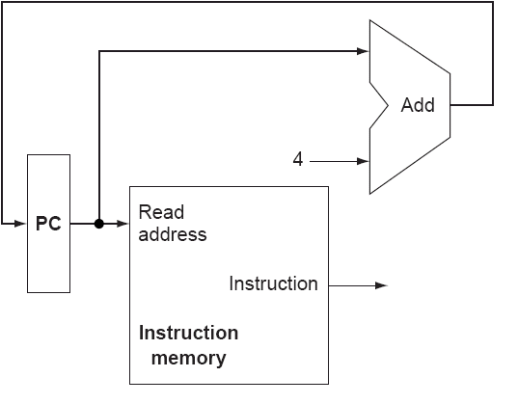
Instruction fetch (cont.)
Loader places starting address of main program in PC
PC + 4 points to next sequential address in main memory
Computer Architecture Lecture 4

Slide 13
Executing MIPS instructions
Look at different classes within our subset (ignore immediates for now)
  add, sub, and, or
  lw, sw
  slt
  beq, j
2 things processor does for all instructions except j
  Reads operands from register file
  Performs an ALU operation
1 additional thing for everything but sw, beq, and j
  Processor writes a result into register file
Computer Architecture Lecture 4

Slide 14
Instruction decoding
Generate control signals from instruction bits
Recall: MIPS instruction formats
  Register instructions: R-type
  Immediate instructions: I-type
  Jump instructions: J-type
31 26 | 25 21 | 20 16 | 15 11 | 10 6 | 5 0
op | rs | rt | rd | shamt | funct
31 26 | 25 21 | 20 16 | 15 0
op | rs | rt | immediate/address
31 26 | 25 0
op | target (address)
Computer Architecture Lecture 4
Notes:
ADD FIGURES

Slide 15
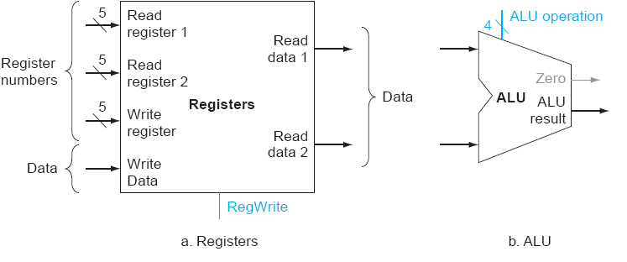
R-type execution datapath
R-type instructions (in our subset)
  add, sub, and, or, slt
What logic is necessary?
  Register file to provide operands
  ALU to operate on data
31 26 | 25 21 | 20 16 | 15 11 | 10 6 | 5 0
op | rs | rt | rd | shamt | funct
Computer Architecture Lecture 4

Slide 16
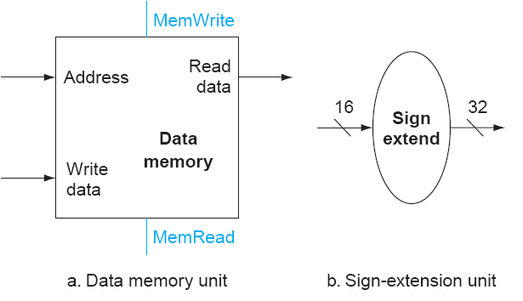
Memory instructions
lw, sw → I-type instructions
Use register file
  Base address
  Source data for store
  Destination for load
Compute address using ALU
What additional logic is necessary?
  Data memory
  Sign extension logic (why?)
Computer Architecture Lecture 4

Slide 17
Branch instructions
Simple beq implementation
  Branch if (a – b) == 0; use ALU to evaluate condition
Branch address = (PC + 4) + (offset << 2)
  Where’s offset encoded?
    Immediate field
  Why shift by 2?
    Instruction addresses word aligned—2 least significant bits are 0
Computer Architecture Lecture 4

Slide 18
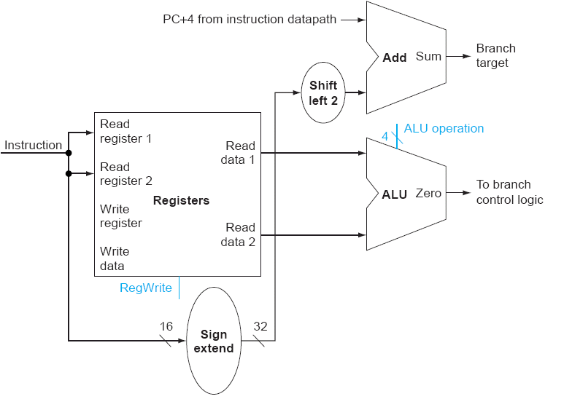
Branch instruction datapath
31 26 | 25 21 | 20 16 | 15 0
op | rs | rt | immediate/address
Computer Architecture Lecture 4

Slide 19
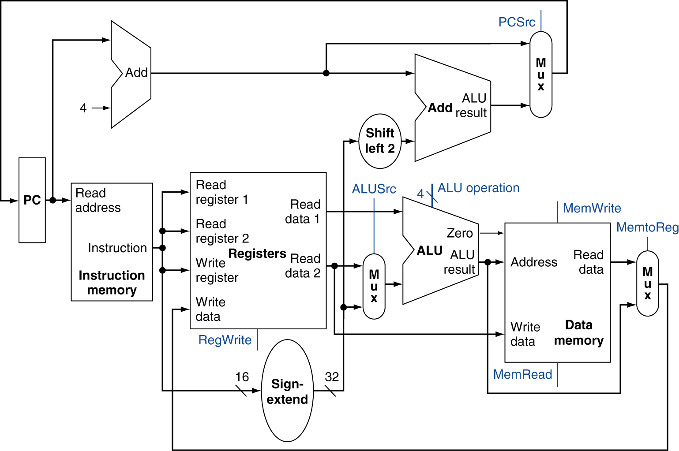
Putting the pieces together
Chooses PC+4 or branch target
Chooses ALU output or memory output
Chooses register or sign-extended immediate
Computer Architecture Lecture 4

Slide 20
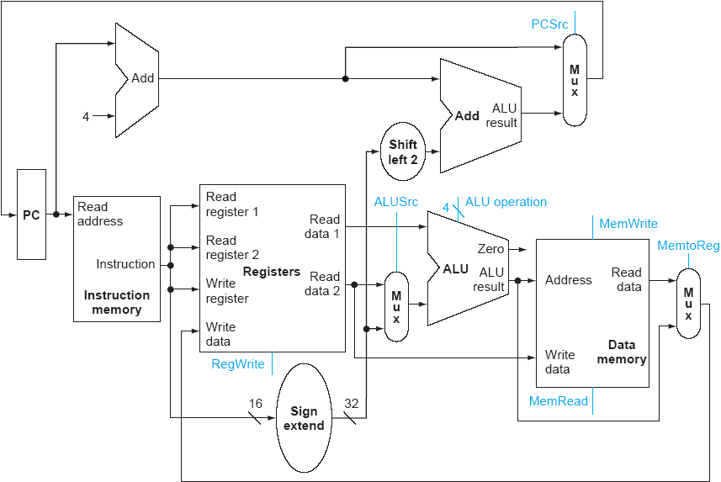
Datapath for R-type instructions
EXAMPLE:
add $4, $10, $30
($4 = $10 + $30)
Computer Architecture Lecture 4

Slide 21
Datapath for I-type ALU instructions
EXAMPLE:
addi $4, $10, 15
($4 = $10 + 15)
Computer Architecture Lecture 4

Slide 22
Datapath for beq (not taken)
EXAMPLE:
beq $1,$2,label
(branch to label if
$1 == $2)
Computer Architecture Lecture 4

Slide 23
Datapath for beq (taken)
EXAMPLE:
beq $1,$2,label
(branch to label if
$1 == $2)
Computer Architecture Lecture 4

Slide 24
Datapath for lw instruction
EXAMPLE:
lw $2, 10($3)
($2 = mem[$3 + 10])
Computer Architecture Lecture 4

Slide 25
Datapath for sw instruction
EXAMPLE:
sw $2, 10($3)
(mem[$3 + 10] = $2)
Computer Architecture Lecture 4

Slide 26
The Main Control Unit
Control signals derived from instruction
R-type
0
rs
rt
rd
shamt
funct
31:26
25:21
20:16
15:11
10:6
5:0
Load/
Store
35 or 43
rs
rt
address
31:26
25:21
20:16
15:0
Branch
4
rs
rt
address
31:26
25:21
20:16
15:0
opcode
always read
read, except for load
write for R-type and load
sign-extend and add
Computer Architecture Lecture 4
Notes:
Morgan Kaufmann Publishers
Chapter 4 — The Processor

Slide 27
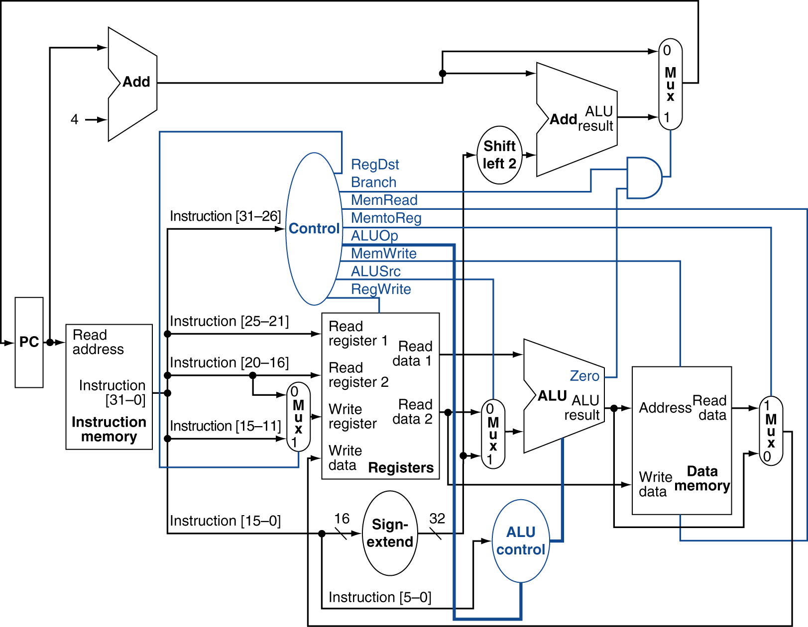
Datapath With Control
Computer Architecture Lecture 4
Notes:
Morgan Kaufmann Publishers
Chapter 4 — The Processor

Slide 28
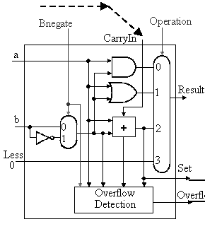
ALU control
ALU control (Bnegate/Operation) | ALU operation | Used for
0 / 00 | and | and
0 / 01 | or | or
0 / 10 | add | add, lw, sw
1 / 10 | subtract | sub, beq
1 / 11 | set on less than | slt
Two steps to generate control inputs
  Use opcode to choose between R-type (and, or, add, sub, slt), lw / sw, and beq
  If R-type, use funct field to determine ALU control inputs
Computer Architecture Lecture 4

Slide 29
ALU control (continued)
Opcode generates 2-bit signal (ALUOp)
Opcode | ALUOp | Instruction operation | funct field | ALU operation | ALU control
lw | 00 | Load word | xxxxxx | add | 010
sw | 00 | Store word | xxxxxx | add | 010
beq | 01 | Branch if eq. | xxxxxx | subtract | 110
R-type | 10 | Add | 100000 | add | 010
R-type | 10 | Subtract | 100010 | subtract | 110
R-type | 10 | Logical AND | 100100 | and | 000
R-type | 10 | Logical OR | 100101 | or | 001
R-type | 10 | Set on less than | 101010 | slt | 111
Computer Architecture Lecture 4

Slide 30
Adding j instruction
J-type format
Next PC = (PC+4)[31:28] combined with (target<<2)
3 choices for next PC
  PC + 4
  beq target address
  j target address
Need another multiplexer and control bit!
31 26 | 25 0
2 | target (address)
Computer Architecture Lecture 4

Slide 31
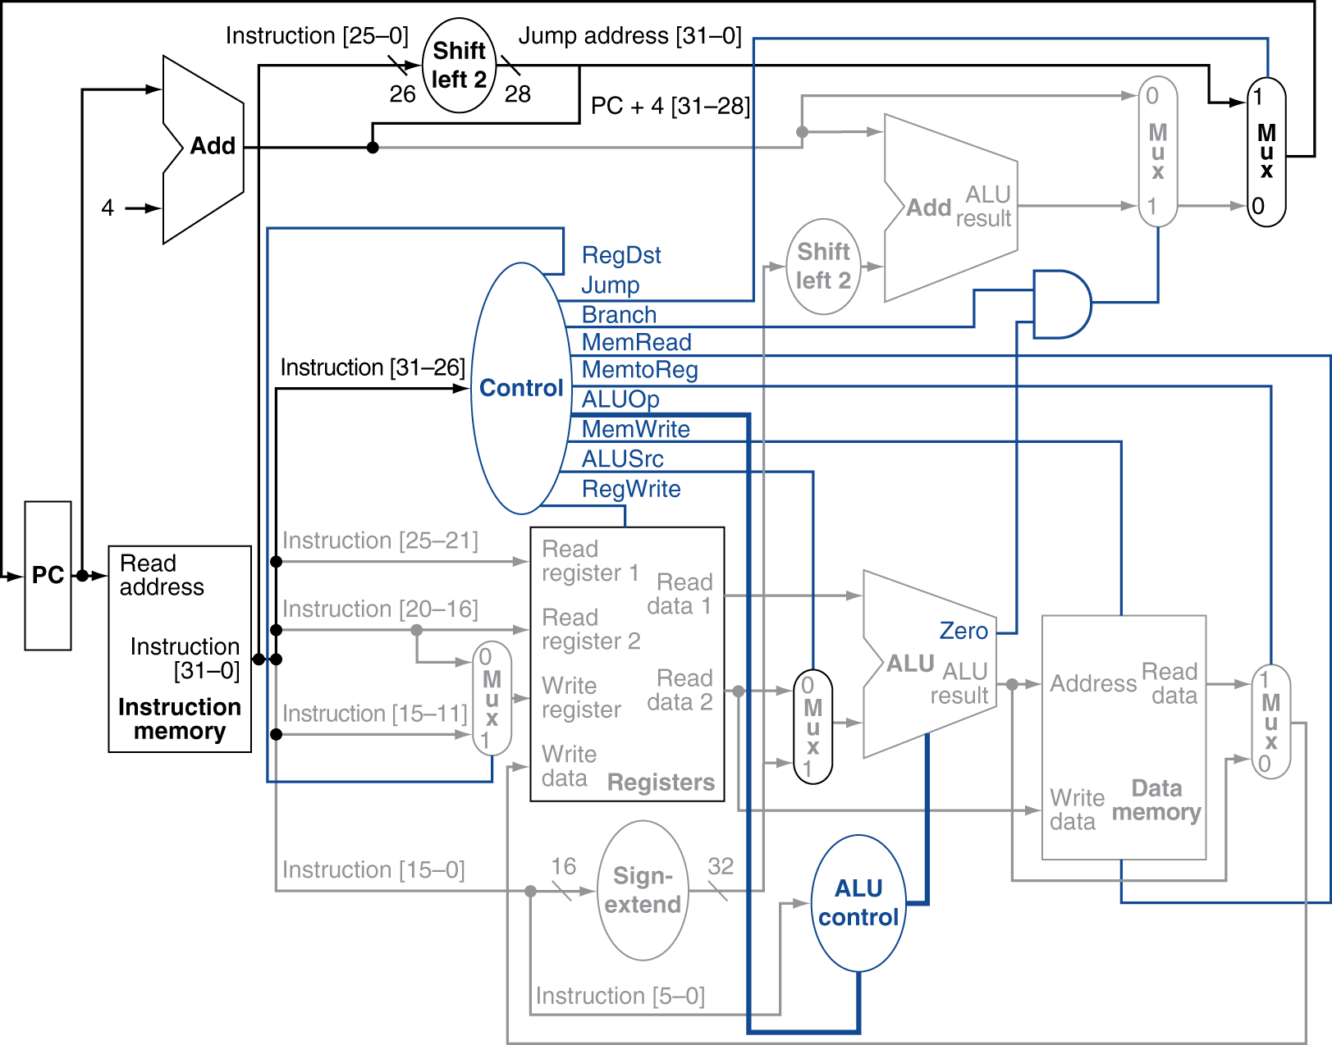
Datapath with jump support
Computer Architecture Lecture 4

Slide 32
Control signals
PCWriteCond: conditionally enables write to PC if branch condition is true (if Zero flag = 1)
PCWrite: enables write to PC; used for both normal PC increment and jump instructions
IorD: indicates if memory address is for instruction (i.e., PC) or data (i.e., ALU output)
MemRead, MemWrite: controls memory operation
MemtoReg: determines if write data comes from memory or ALU output
IRWrite: enables writing of instruction register
Computer Architecture Lecture 4

Slide 33
Control signals (cont.)
PCSource: controls multiplexer that determines if value written to PC comes from ALU (PC = PC+4), branch target (stored ALU output), or jump target
ALUOp: feeds ALU control module to determine ALU operation
ALUSrcA: controls multiplexer that chooses between PC or register as A input of ALU
ALUSrcB: controls multiplexter that chooses between register, constant ‘4’, sign-extended immediate, or shifted immediate as B input of ALU
RegWrite: enables write to register file
RegDst: determines if rt or rd field indicates destination register
Computer Architecture Lecture 4

Slide 34
Summary of execution phases
Phase | R-type | Memory (lw/sw) | Branch/Jump
Instruction fetch | IR = Mem[PC] PC = PC + 4
Instruction decode/ register fetch | A = Reg[IR[25:21]] B = Reg[IR[20:16]] ALUout = PC + (sign-extend(IR[15:0]) << 2)
Execution, address computation, branch and jump completion | ALUout = A op B | ALUout = A + sign-extend(IR[15:0]) | Branch: if (A == B) PC = ALUout Jump: PC = {PC[31:28],IR[25:0],(00)}
Memory access, R-type completion | Reg[IR[15:11]] = ALUout | Load: MDR = Mem[ALUout] Store: Mem[ALUout] = B
Memory read completion |  | Load: Reg[IR[20:16]] = MDR
Computer Architecture Lecture 4

Slide 35
Final notes
Next time:
  Pipelining
Announcements/reminders
  HW 3 due today
  HW 4 to be posted; due date TBD
Computer Architecture Lecture 4

