Slide 1
16.482 / 16.561
Computer Architecture and Design
Instructor: Dr. Michael Geiger
Fall 2013
Lecture 5:
Pipelining

Slide 2
Lecture outline
Announcements/reminders
  HW 4 to be posted; due 10/16
  Lecture next week on Wednesday, 10/16
Review: Processor datapath and control
Today’s lecture: Pipelining
Computer Architecture Lecture 5

Slide 3
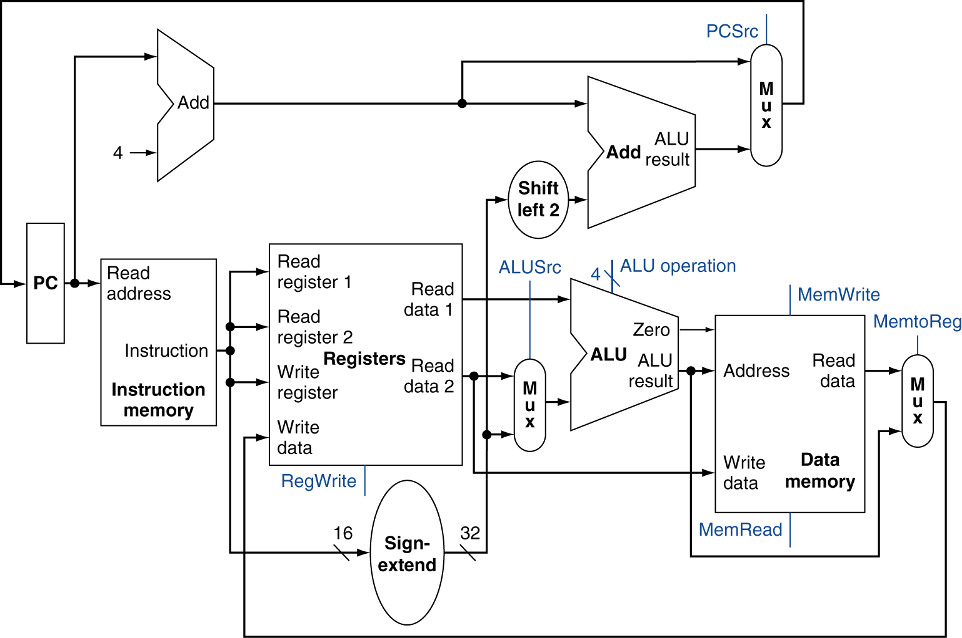
Review: Simple MIPS datapath
Chooses PC+4 or branch target
Chooses ALU output or memory output
Chooses register or sign-extended immediate
Computer Architecture Lecture 5

Slide 4
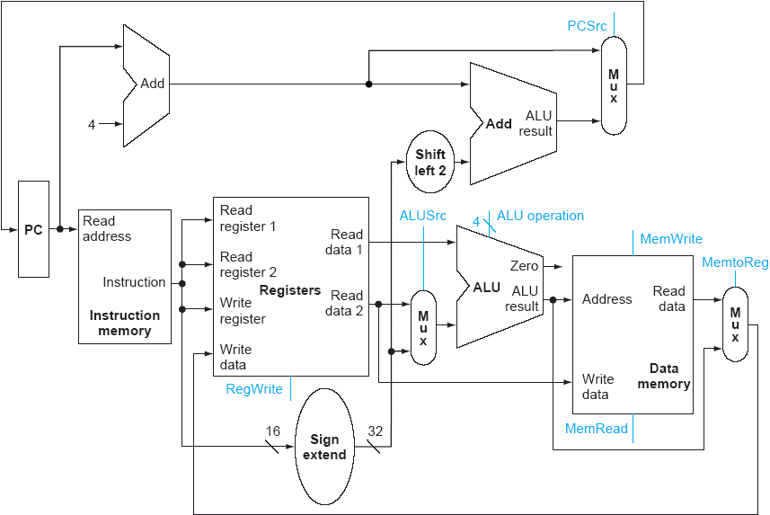
Datapath for R-type instructions
EXAMPLE:
add $4, $10, $30
($4 = $10 + $30)
Computer Architecture Lecture 5

Slide 5
Datapath for I-type ALU instructions
EXAMPLE:
addi $4, $10, 15
($4 = $10 + 15)
Computer Architecture Lecture 5

Slide 6
Datapath for beq (not taken)
EXAMPLE:
beq $1,$2,label
(branch to label if
$1 == $2)
Computer Architecture Lecture 5

Slide 7
Datapath for beq (taken)
EXAMPLE:
beq $1,$2,label
(branch to label if
$1 == $2)
Computer Architecture Lecture 5

Slide 8
Datapath for lw instruction
EXAMPLE:
lw $2, 10($3)
($2 = mem[$3 + 10])
Computer Architecture Lecture 5

Slide 9
Datapath for sw instruction
EXAMPLE:
sw $2, 10($3)
(mem[$3 + 10] = $2)
Computer Architecture Lecture 5

Slide 10
Motivating pipelining
We’ve seen basic single-cycle datapath
  Offers 1 CPI ...
  ... but cycle time determined by longest instruction
    Load essentially uses all stages
We’d like both low CPI and a short cycle
Solution: pipelining
  Simultaneously execute multiple instructions
  Use multi-cycle “assembly line” approach
Computer Architecture Lecture 5

Slide 11
Pipelining is like …
… doing laundry (no, really)
Say 4 people (Ann, Brian, Cathy, Don) want to use a laundry service that has four components:
  Washer, which takes 30 minutes
  Dryer, which takes 30 minutes
  “Folder,” which takes 30 minutes
  “Storer,” which takes 30 minutes
Computer Architecture Lecture 5

Slide 12
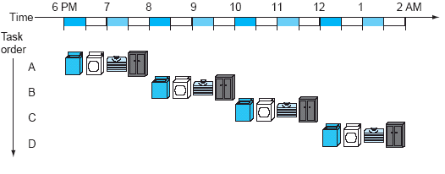
Sequential laundry service
Each person starts when previous one finishes
4 loads take 8 hours
Computer Architecture Lecture 5

Slide 13
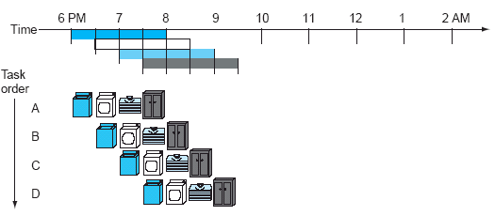
Pipelined laundry service
As soon as a particular component is free, next person can use it
4 loads take 3 ½ hours
Computer Architecture Lecture 5

Slide 14
Pipelining questions
Does pipelining improve latency or throughput?
  Throughput—time for each instruction same, but more instructions per unit time
What’s the maximum potential speedup of pipelining?
  The number of stages, N—before, each instruction took N cycles, now we can (theoretically) finish 1 instruction per cycle
If one stage can run faster, how does that affect the speedup?
  No effect—cycle time depends on longest stage, because you may be using hardware from all stages at once
Computer Architecture Lecture 5

Slide 15
Principles of pipelining
Every instruction takes same number of steps
  Pipeline stages
  1 stage per cycle (like multi-cycle datapath)
  MIPS (like most simple processors) has 5 stages
    IF: Instruction fetch
    ID: Instruction decode and register read
    EX: Execution / address calculation
    MEM: Memory access
    WB: Write back result to register
Computer Architecture Lecture 5

Slide 16
Pipeline Performance
Assume time for stages is
  100ps for register read or write
  200ps for other stages
Compare pipelined datapath with single-cycle datapath
Instr | Instr fetch | Register read | ALU op | Memory access | Register write | Total time
lw | 200ps | 100 ps | 200ps | 200ps | 100 ps | 800ps
sw | 200ps | 100 ps | 200ps | 200ps |  | 700ps
R-format | 200ps | 100 ps | 200ps |  | 100 ps | 600ps
beq | 200ps | 100 ps | 200ps |  |  | 500ps
Computer Architecture Lecture 5
Notes:
Morgan Kaufmann Publishers
Chapter 4 — The Processor

Slide 17
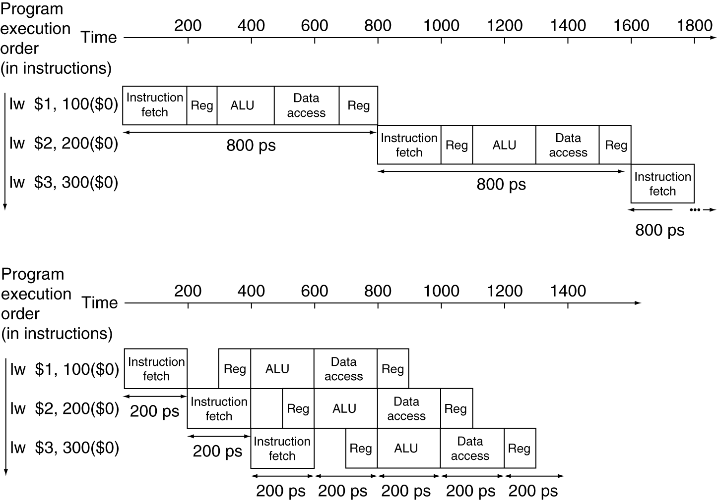
Pipeline Performance
Single-cycle (T_{c}= 800ps)
Pipelined (T_{c}= 200ps)
Computer Architecture Lecture 5
Notes:
Morgan Kaufmann Publishers
Chapter 4 — The Processor

Slide 18
Pipeline diagram
 | Cycle 1 | 2 | 3 | 4 | 5 | 6 | 7 | 8
lw | IF | ID | EX | MEM | WB
add |  | IF | ID | EX | MEM | WB
beq |  |  | IF | ID | EX | MEM | WB
sw |  |  |  | IF | ID | EX | MEM | WB
Pipeline diagram shows execution of multiple instructions
  Instructions listed vertically
  Cycles shown horizontally
  Each instruction divided into stages
  Can see what instructions are in a particular stage at any cycle
Computer Architecture Lecture 5

Slide 19
Performance example
Say we have the following code:
loop: add $t1, $t2, $t3
lw $t4, 0($t1)
beq $t4, $t3, end
sw $t3, 4($t1)
add $t2, $t2, 8
j loop
end: ...
Assume each pipeline stage takes 4 ns
How long would one loop iteration take in an ideal pipelined processor (i.e., no delays between instructions)?
Computer Architecture Lecture 5

Slide 20
Solution
 | Cycle 1 | 2 | 3 | 4 | 5 | 6 | 7 | 8 | 9 | 10
add | IF | ID | EX | MEM | WB
lw |  | IF | ID | EX | MEM | WB
beq |  |  | IF | ID | EX | MEM | WB
sw |  |  |  | IF | ID | EX | MEM | WB
add |  |  |  |  | IF | ID | EX | MEM | WB
j |  |  |  |  |  | IF | ID | EX | MEM | WB
Can draw pipelining diagram to show # cycles
In ideal pipelining, with M instructions & N pipeline stages, total time = N + (M-1)
  Here, M = 6, N = 5 → 5 + (6-1) = 10 cycles
  Total time = (10 cycles) * (4 ns/cycle) = 40 ns
Computer Architecture Lecture 5

Slide 21
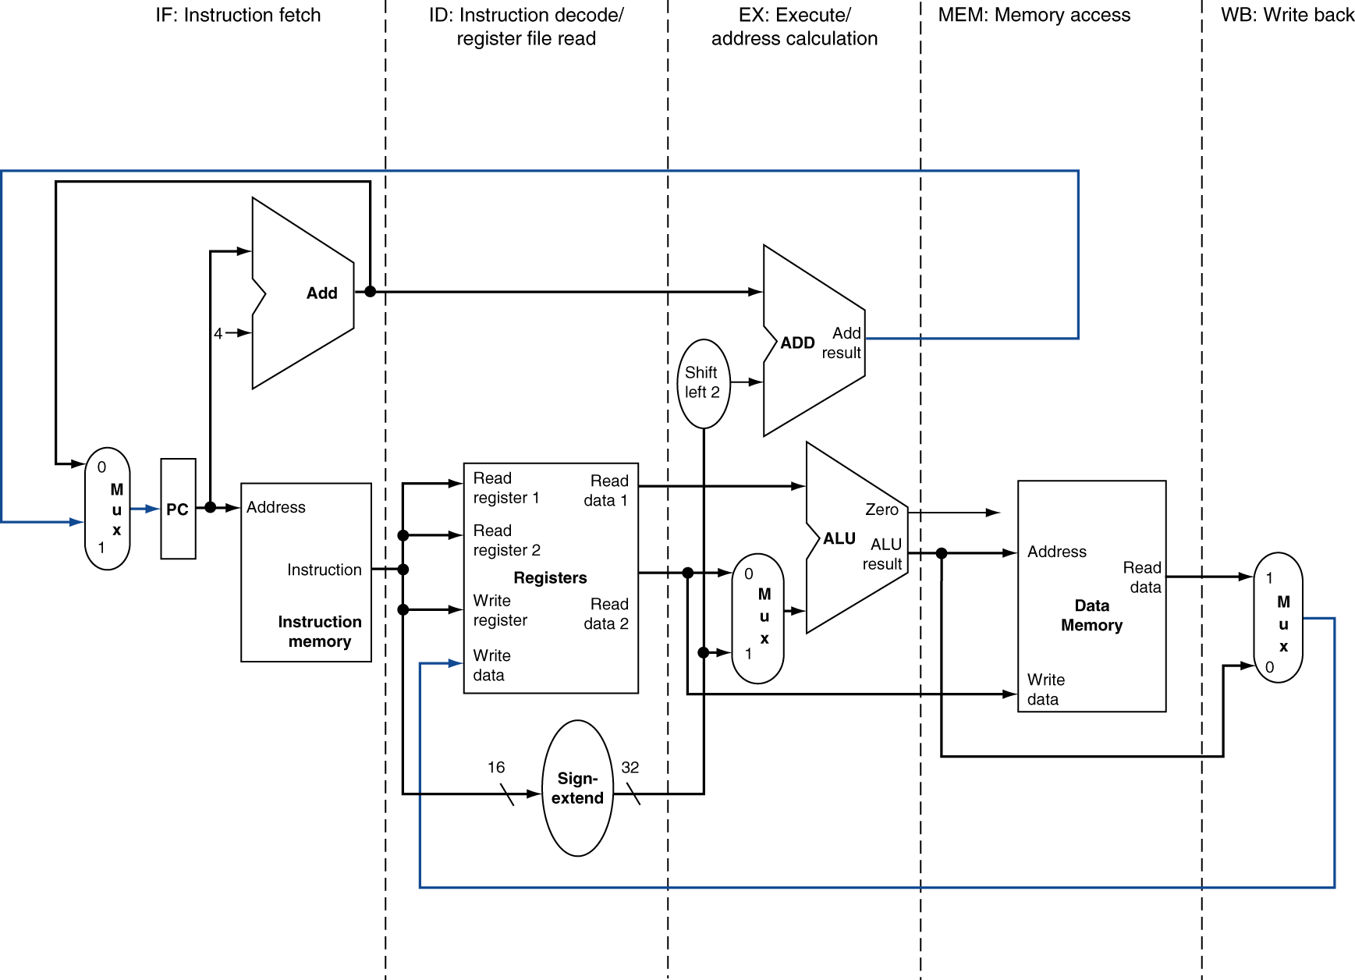
Pipelined datapath principles
MEM
Right-to-left flow leads to hazards
WB
Computer Architecture Lecture 5
Notes:
Morgan Kaufmann Publishers
Chapter 4 — The Processor

Slide 22
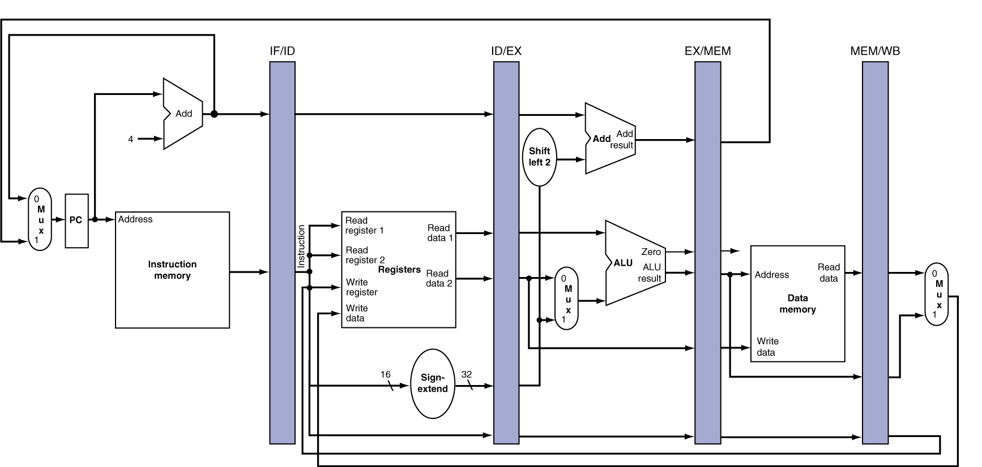
Pipeline registers
Need registers between stages for info from previous cycles
Register must be able to hold all needed info for given stage
  For example, IF/ID must be 64 bits—32 bits for instruction, 32 bits for PC+4
May need to propagate info through multiple stages for later use
  For example, destination reg. number determined in ID, but not used until WB
Computer Architecture Lecture 5
Notes:
Morgan Kaufmann Publishers
Chapter 4 — The Processor

Slide 23
Pipeline hazards
A hazard is a situation that prevents an instruction from executing during its designated clock cycle
3 types:
  Structure hazards: two instructions attempt to simultaneously use the same hardware
  Data hazards: instruction attempts to use data before it’s ready
  Control hazards: attempt to make a decision before condition is evaluated
Computer Architecture Lecture 5

Slide 24
Structure hazards
Examples in MIPS pipeline
  May need to calculate addresses and perform operations → need multiple adders + ALU
  May need to access memory for both instructions and data → need instruction & data memories (caches)
  May need to read and write register file
  → write in first half of cycle, read in second
 | Cycle 1 | 2 | 3 | 4 | 5 | 6 | 7 | 8
lw | IF | ID | EX | MEM | WB
add |  | IF | ID | EX | MEM | WB
beq |  |  | IF | ID | EX | MEM | WB
sw |  |  |  | IF | ID | EX | MEM | WB
Computer Architecture Lecture 5

Slide 25
Data Hazard Example
Consider this sequence:
  sub $2, $1,$3
  and $12,$2,$5
  or $13,$6,$2
  add $14,$2,$2
  sw $15,100($2)
Can’t use value of $2 until it’s actually computed and stored
  No hazard for sw
  Register hardware takes care of add
  What about and, or?
Computer Architecture Lecture 5
Notes:
Morgan Kaufmann Publishers
Chapter 4 — The Processor

Slide 26
Software solution: no-ops
No-ops: instructions that do nothing
Effectively “stalls” pipeline until data is ready
Compiler can recognize hazards ahead of time and insert nop instructions
 | Cycle 1 | 2 | 3 | 4 | 5 | 6 | 7 | 8
sub | IF | ID | EX | MEM | WB
nop |  | IF | ID | EX | MEM | WB
nop |  |  | IF | ID | EX | MEM | WB
and |  |  |  | IF | ID | EX | MEM | WB
Result written to reg file
Computer Architecture Lecture 5

Slide 27
No-op example
Given the following code, where are no-ops needed?
add $t2, $t3, $t4
sub $t5, $t1, $t2
or $t6, $t2, $t7
slt $t8, $t9, $t5
Computer Architecture Lecture 5

Slide 28
Solution
Given the following code, where are no-ops needed?
add $t2, $t3, $t4 ←$t2 used by sub, or
nop
nop
sub $t5, $t1, $t2 ← $t5 used by slt
or $t6, $t2, $t7
nop ← could also be before or
slt $t8, $t9, $t5
Computer Architecture Lecture 5

Slide 29
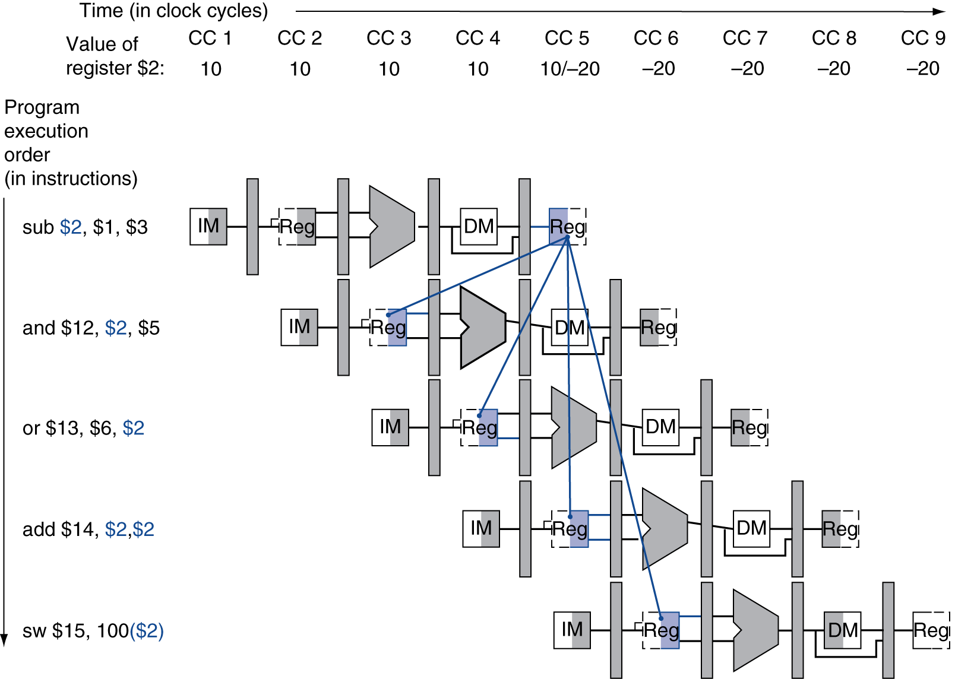
Avoiding stalls
Inserting no-ops rarely best solution
  Complicates compiler
  Reduces performance
Can we solve problem in hardware? (Hint: when do we know value of $2?)
Computer Architecture Lecture 5

Slide 30
Dependencies & Forwarding
Value computed at end of EX stage
Use pipeline registers to forward
  Add additional paths to ALU inputs from EX/MEM, MEM/WB
Computer Architecture Lecture 5
Notes:
Morgan Kaufmann Publishers
Chapter 4 — The Processor

Slide 31
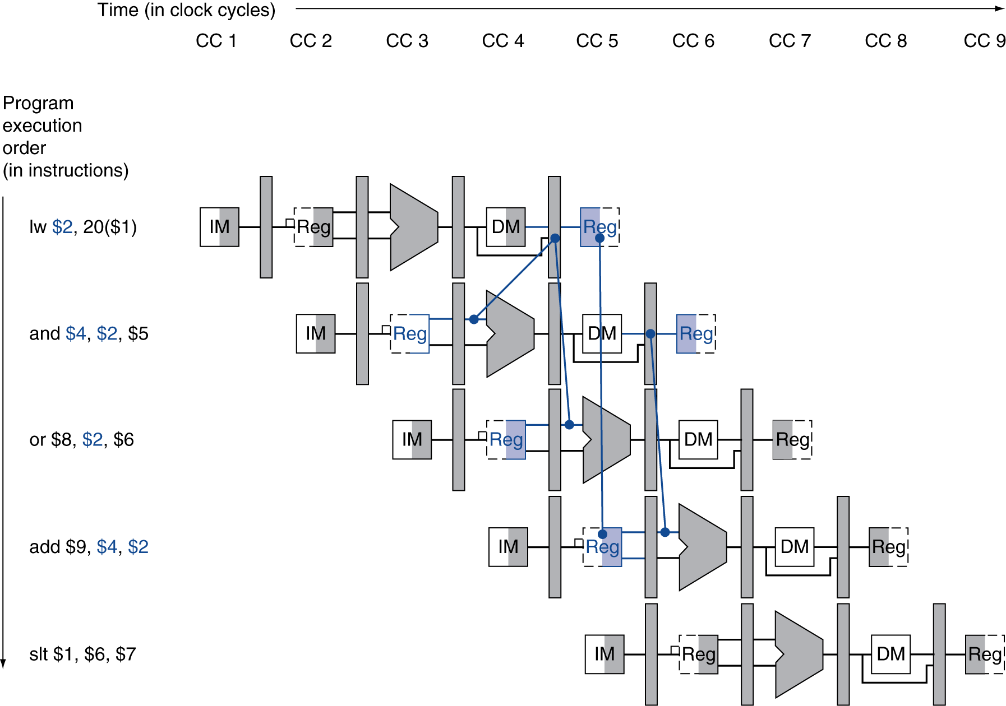
Load-Use Data Hazard
Need to stall for one cycle
Chapter 4 — The Processor — <number>
Notes:
Morgan Kaufmann Publishers
Chapter 4 — The Processor

Slide 32
How to Stall the Pipeline
Force control values in ID/EX register
to 0
  EX, MEM and WB do nop (no-operation)
Prevent update of PC and IF/ID register
  Using instruction is decoded again
  Following instruction is fetched again
  1-cycle stall allows MEM to read data for lw
    Can subsequently forward to EX stage
Chapter 4 — The Processor — <number>
Notes:
Morgan Kaufmann Publishers
Chapter 4 — The Processor

Slide 33
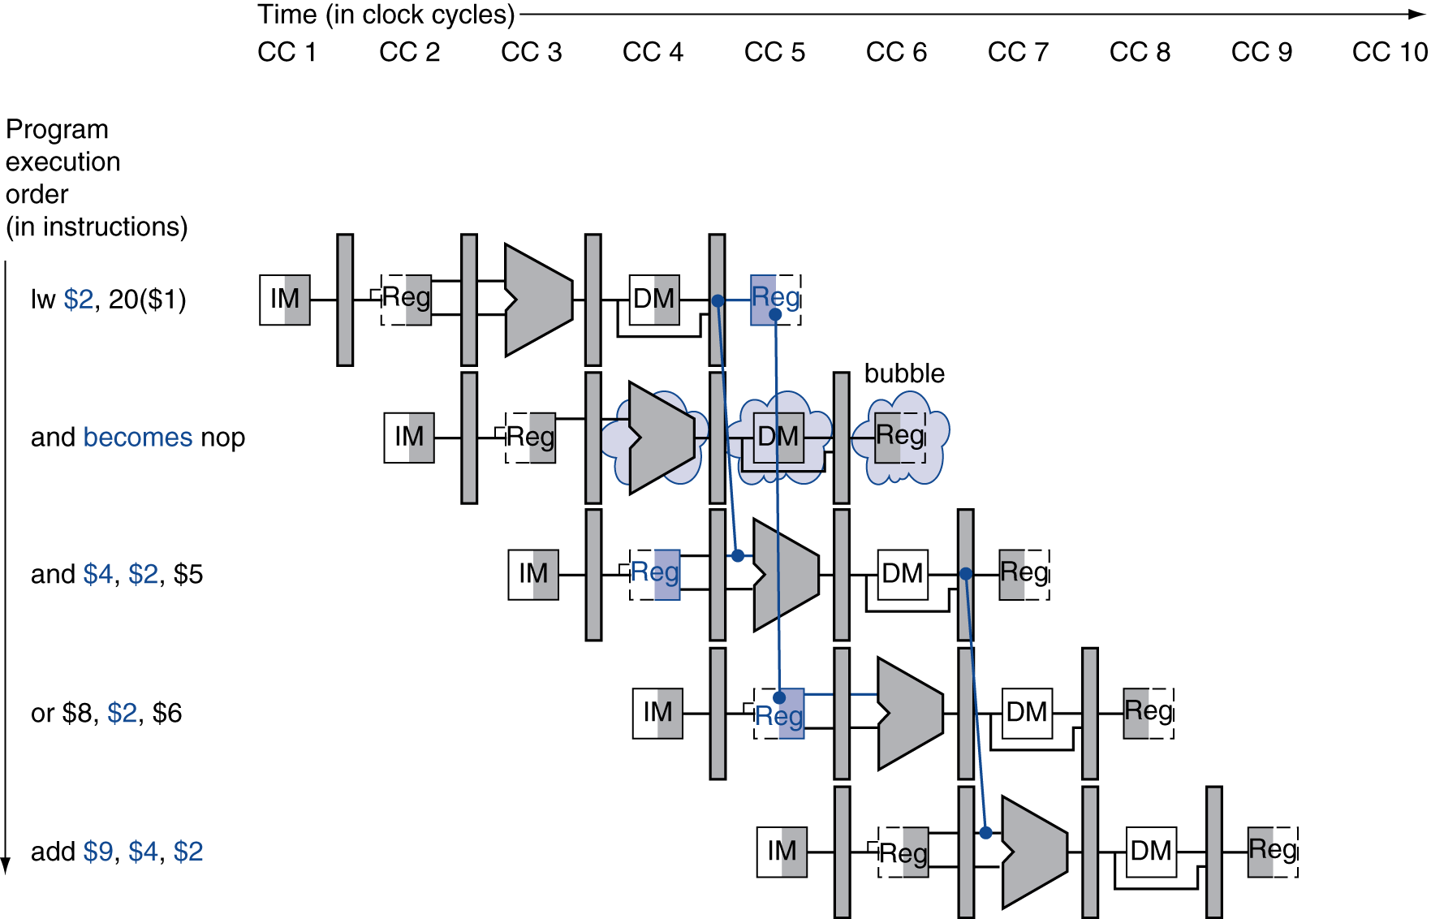
Stall/Bubble in the Pipeline
Stall inserted here
Chapter 4 — The Processor — <number>
Notes:
Morgan Kaufmann Publishers
Chapter 4 — The Processor

Slide 34
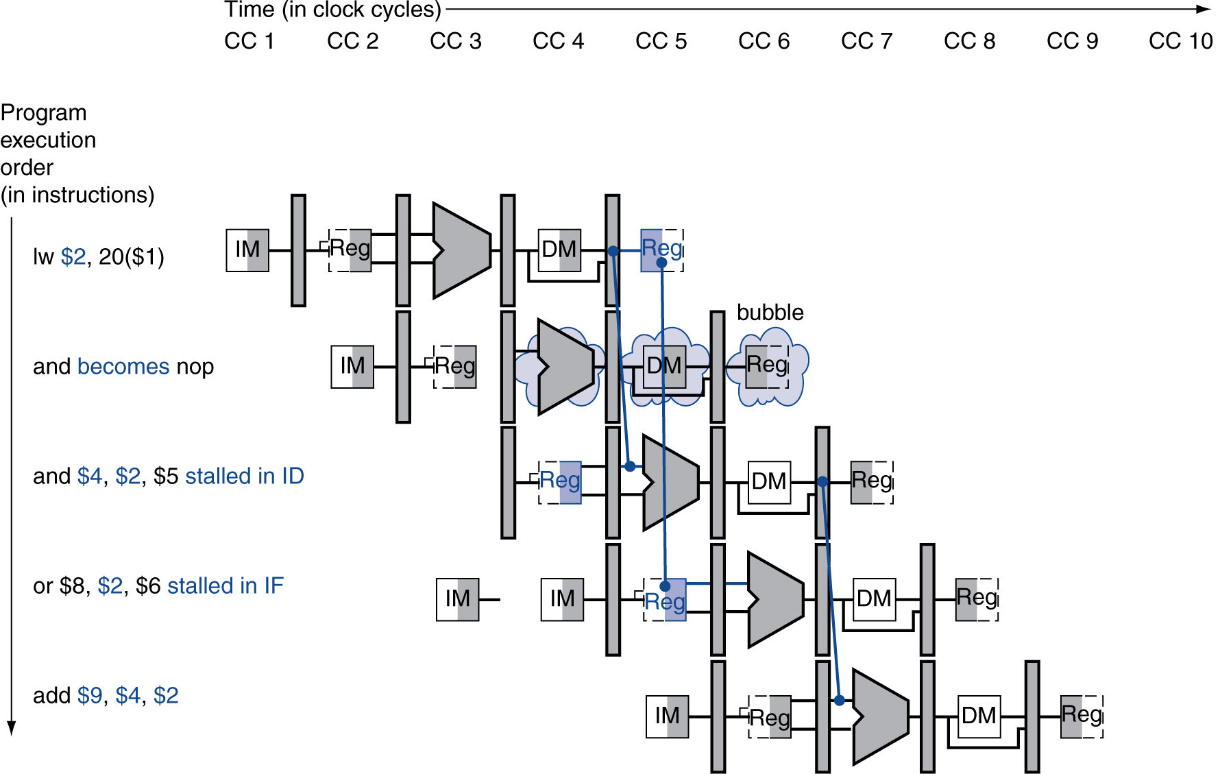
Stall/Bubble in the Pipeline
Or, more accurately…
Chapter 4 — The Processor — <number>
Notes:
Morgan Kaufmann Publishers
Chapter 4 — The Processor

Slide 35
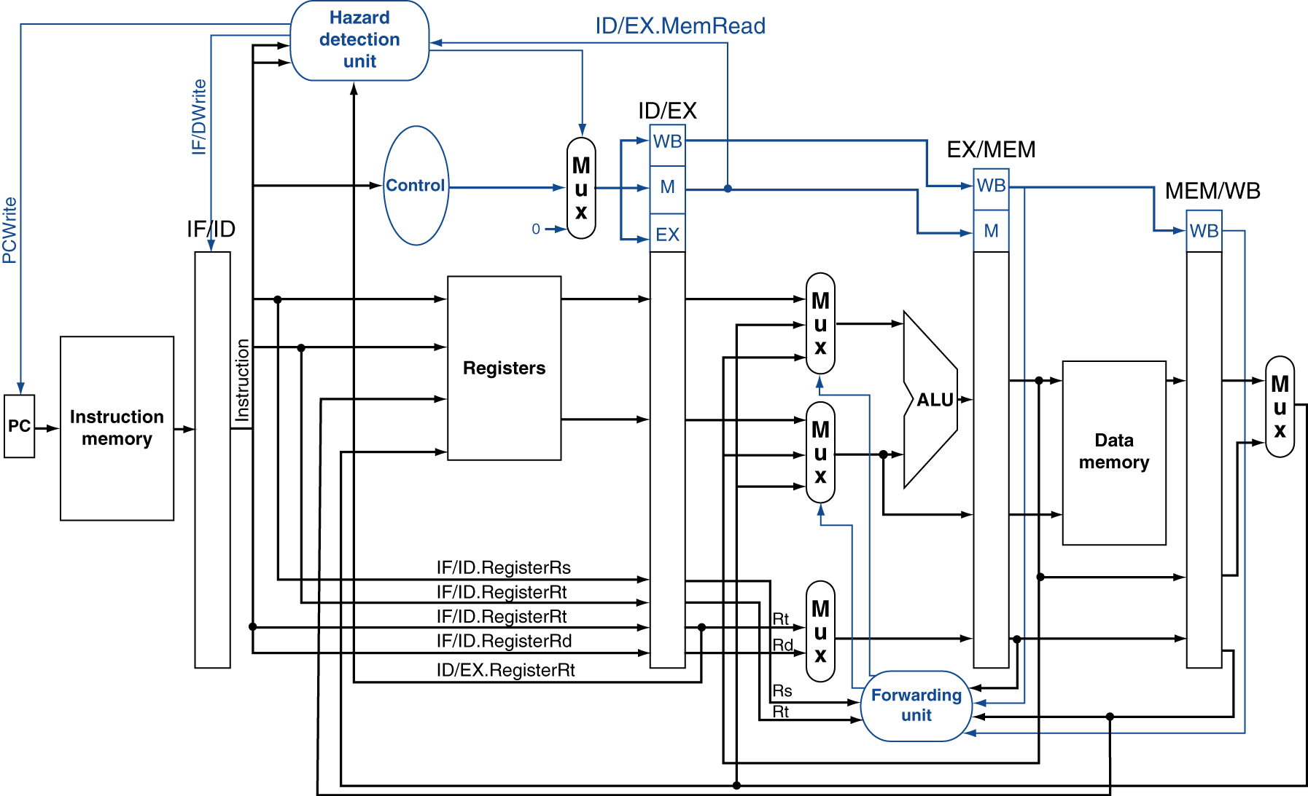
Datapath with Hazard Detection
Chapter 4 — The Processor — <number>
Notes:
Morgan Kaufmann Publishers
Chapter 4 — The Processor

Slide 36
Code Scheduling to Avoid Stalls
Reorder code to avoid use of load result in the next instruction
C code for A = B + E; C = B + F;
lw $t1, 0($t0)
lw $t2, 4($t0)
add $t3, $t1, $t2
sw $t3, 12($t0)
lw $t4, 8($t0)
add $t5, $t1, $t4
sw $t5, 16($t0)
lw $t1, 0($t0)
lw $t2, 4($t0)
lw $t4, 8($t0)
add $t3, $t1, $t2
sw $t3, 12($t0)
add $t5, $t1, $t4
sw $t5, 16($t0)
stall
stall
13 cycles
11 cycles
Computer Architecture Lecture 5
Notes:
Morgan Kaufmann Publishers
Chapter 4 — The Processor

Slide 37
Control Hazards
Branch determines flow of control
  Fetching next instruction depends on branch outcome
  Pipeline can’t always fetch correct instruction
    Still working on ID stage of branch
In MIPS pipeline
  Need to compare registers and compute target early in the pipeline
  Add hardware to do it in ID stage
Computer Architecture Lecture 5
Notes:
Morgan Kaufmann Publishers
Chapter 4 — The Processor

Slide 38
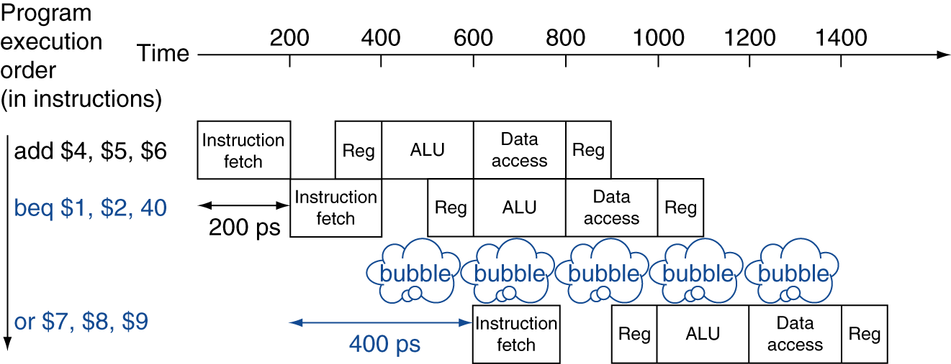
Stall on Branch
Wait until branch outcome determined before fetching next instruction
Computer Architecture Lecture 5
Notes:
Morgan Kaufmann Publishers
Chapter 4 — The Processor

Slide 39
Branch Prediction
Longer pipelines can’t readily determine branch outcome early
  Stall penalty becomes unacceptable
Predict outcome of branch
  Only stall if prediction is wrong
In MIPS pipeline
  Can predict branches not taken
  Fetch instruction after branch, with no delay
Computer Architecture Lecture 5
Notes:
Morgan Kaufmann Publishers
Chapter 4 — The Processor

Slide 40
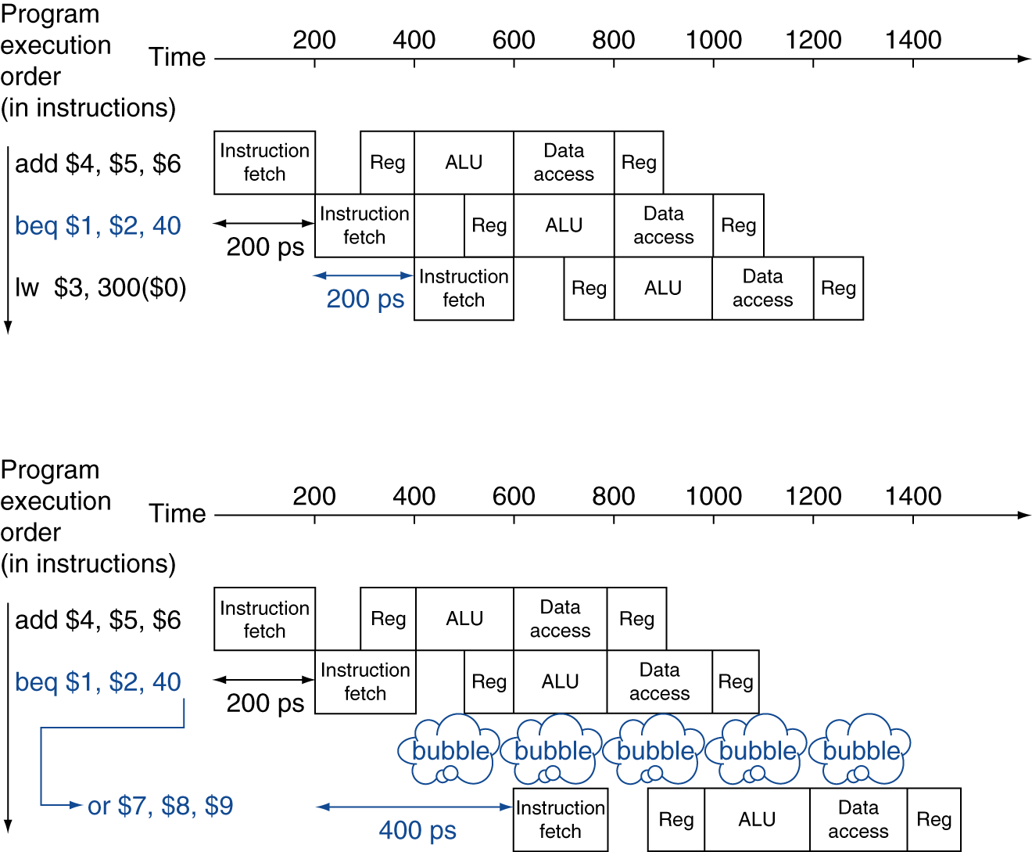
MIPS with Predict Not Taken
Prediction correct
Prediction incorrect
Computer Architecture Lecture 5
Notes:
Morgan Kaufmann Publishers
Chapter 4 — The Processor

Slide 41
More-Realistic Branch Prediction
Static branch prediction
  Based on typical branch behavior
  Example: loop and if-statement branches
    Predict backward branches taken
    Predict forward branches not taken
Dynamic branch prediction
  Hardware measures actual branch behavior
    e.g., record recent history of each branch
  Assume future behavior will continue the trend
    When wrong, stall while re-fetching, and update history
Computer Architecture Lecture 5
Notes:
Morgan Kaufmann Publishers
Chapter 4 — The Processor

Slide 42
Final notes
Next time:
  Instruction scheduling issues
    Dynamic branch prediction
    Dynamic scheduling
    Multiple issue
  Midterm exam preview
Announcements/reminders
  HW 4 to be posted; due 10/16
  Lecture next week on Wednesday, 10/16
Computer Architecture Lecture 5

