Slide 1
16.482 / 16.561
Computer Architecture and Design
Instructor: Dr. Michael Geiger
Fall 2013
Lecture 6:
ILP and dynamic branch prediction

Slide 2
Lecture outline
Announcements/reminders
  HW 4 due today
  HW 5 to be posted after exam
  Midterm exam: Monday, 10/21
Review: Pipelining
Today’s lecture
  Instruction level parallelism
  Dynamic branch prediction
  Midterm exam review
Computer Architecture Lecture 6

Slide 3
Review: Pipelining
Pipelining → low CPI and a short cycle
  Simultaneously execute multiple instructions
  Use multi-cycle “assembly line” approach
  Use staging registers between cycles to hold information
Hazards: situation that prevents instruction from executing during a particular cycle
  Structural hazards: hardware conflicts
  Data hazards: dependences cause instruction stalls; can resolve using:
    No-ops: compiler inserts stall cycles
    Forwarding: add hardware paths to ALU inputs
  Control hazards: must wait for branches
    Can move target, comparison into ID → only 1 cycle delay
Computer Architecture Lecture 6

Slide 4
Review: Pipeline diagram
 | Cycle 1 | 2 | 3 | 4 | 5 | 6 | 7 | 8
lw | IF | ID | EX | MEM | WB
add |  | IF | ID | EX | MEM | WB
beq |  |  | IF | ID | EX | MEM | WB
sw |  |  |  | IF | ID | EX | MEM | WB
Pipeline diagram shows execution of multiple instructions
  Instructions listed vertically
  Cycles shown horizontally
  Each instruction divided into stages
  Can see what instructions are in a particular stage at any cycle
Computer Architecture Lecture 6

Slide 5
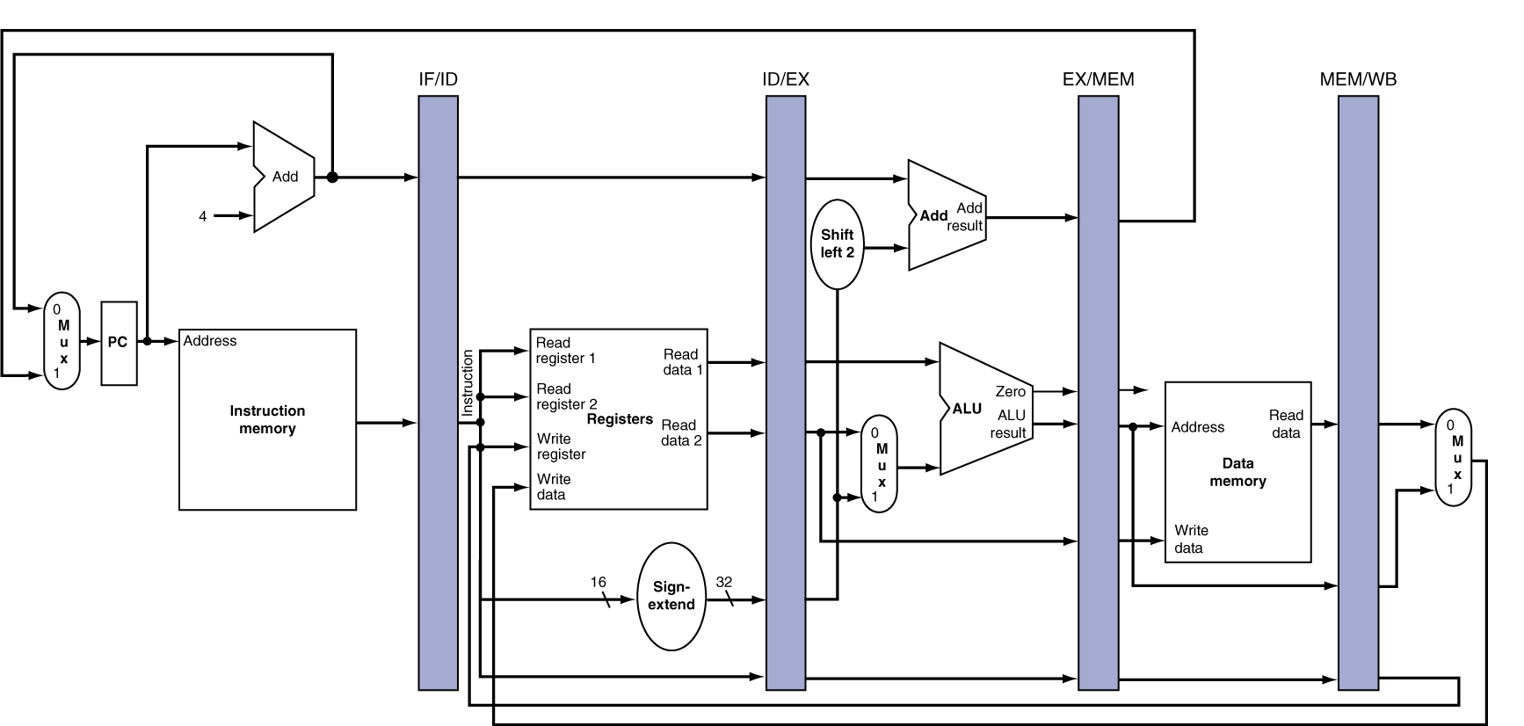
Review: Pipeline registers
Need registers between stages for info from previous cycles
Register must be able to hold all needed info for given stage
  For example, IF/ID must be 64 bits—32 bits for instruction, 32 bits for PC+4
May need to propagate info through multiple stages for later use
  For example, destination reg. number determined in ID, but not used until WB
Computer Architecture Lecture 6
Notes:
Morgan Kaufmann Publishers
Chapter 4 — The Processor

Slide 6
Branch Stall Impact
If CPI = 1, 30% branch,
Stall 3 cycles => new CPI = 1.9!
Two part solution:
  Determine branch taken or not sooner, AND
  Compute taken branch address earlier
MIPS branch tests if register = 0 or ≠ 0
MIPS Solution:
  Move Zero test to ID/RF stage
  Adder to calculate new PC in ID/RF stage
  1 clock cycle penalty for branch versus 3
Computer Architecture Lecture 6

Slide 7
Four Branch Hazard Alternatives
#1: Stall until branch direction is clear
#2: Predict Branch Not Taken
  Execute successor instructions in sequence
  “Squash” instructions in pipeline if branch actually taken
  Advantage of late pipeline state update
  47% MIPS branches not taken on average
  PC+4 already calculated, so use it to get next instruction
#3: Predict Branch Taken
  53% MIPS branches taken on average
  But haven’t calculated branch target address in MIPS
    MIPS still incurs 1 cycle branch penalty
    Other machines: branch target known before outcome
Computer Architecture Lecture 6

Slide 8
Four Branch Hazard Alternatives
#4: Delayed Branch
  Define branch to take place AFTER a following instruction
  branch instruction
  sequential successor₁
  sequential successor₂
  ........
  sequential successor_{n}
  branch target if taken
  1 slot delay allows proper decision and branch target address in 5 stage pipeline
  MIPS uses this
Branch delay of length n
Computer Architecture Lecture 6

Slide 9
Delayed Branch
Compiler effectiveness for single branch delay slot:
  Fills about 60% of branch delay slots
  About 80% of instructions executed in branch delay slots useful in computation
  About 50% (60% x 80%) of slots usefully filled
Downside: deeper pipelines/multiple issue → more branch delay
  Dynamic approaches now more common
    More expensive, but also more flexible
    Will revisit in discussion of ILP
Computer Architecture Lecture 6

Slide 10
Instruction Level Parallelism
Instruction-Level Parallelism (ILP): the ability to overlap instruction execution
2 approaches to exploit ILP & improve performance:
  Use hardware to dynamically find parallelism while running program
  Use software to find parallelism statically at compile-time
Computer Architecture Lecture 6

Slide 11
Finding ILP
Basic Block (BB) ILP is quite small
  BB: a code sequence with 1 entry and 1 exit point
  average dynamic branch frequency 15% to 25%
  => 4 to 7 instructions execute between branches
  Instructions in BB likely to depend on each other
Must exploit ILP across multiple BB
Simplest: loop-level parallelism
  Parallelism across iterations of a loop:
for (i=1; i<=1000; i=i+1)
x[i] = x[i] + y[i];
Computer Architecture Lecture 6

Slide 12
Loop-Level Parallelism
Exploit loop-level parallelism by “unrolling loop” either
dynamically via branch prediction or
static via loop unrolling by compiler
Determining instruction dependence is critical to Loop Level Parallelism
If 2 instructions are
  parallel, they can execute simultaneously in a pipeline of arbitrary depth without causing any stalls
  dependent, they are not parallel and must be executed in order, although they may often be partially overlapped
    A stall caused by a dependence is a hazard
Computer Architecture Lecture 6

Slide 13
Static solution to LLP: Loop unrolling
Loop iterations are often independent, e.g.
for (i=1000; i>0; i=i–1)
x[i] = x[i] + s;
Can create multiple copies of loop, then schedule them to avoid stalls
  Replicate loop body, renaming registers as you go
  Reorder appropriately to eliminate stalls
  Update entry/exit code
Unrolling goals
  Cover all stalls (without using too many registers)
  # old iterations should be divisible by # times unrolled
    Example: loop with 100 iterations can be unrolled 2, 4, 5 times; not 3
Computer Architecture Lecture 6

Slide 14
3 Limits to Loop Unrolling
Decrease in amount of overhead amortized with each extra unrolling
  Amdahl’s Law
Growth in code size
  For larger loops, concern it increases the instruction cache miss rate
Register pressure: potential shortfall in registers created by aggressive unrolling and scheduling
  If not be possible to allocate all live values to registers, may lose some or all of its advantage
Loop unrolling reduces branch impact on pipeline; another way is dynamic branch prediction
Computer Architecture Lecture 6

Slide 15
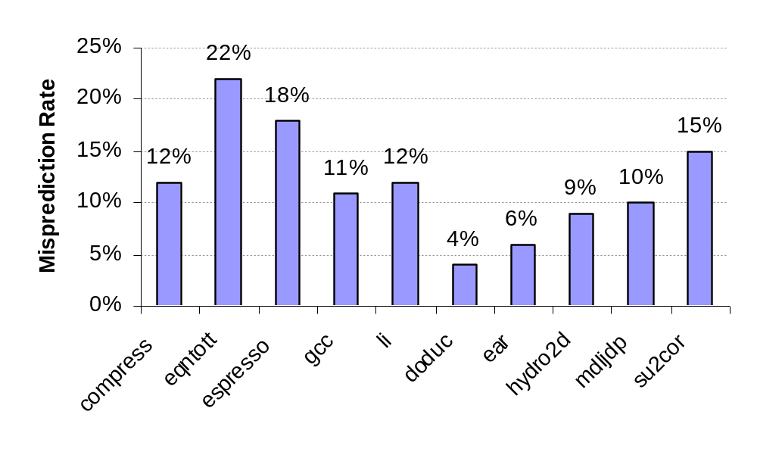
Static Branch Prediction
Earlier lecture showed scheduling code around delayed branch
To reorder code around branches, need to predict branch statically during compilation
Simplest scheme is to predict a branch as taken
  Average misprediction = untaken branch frequency = 34% SPEC
More accurate scheme predicts branches using profile information collected from earlier runs, and modify prediction based on last run:
Computer Architecture Lecture 6
Integer
Floating Point

Slide 16
Dynamic Branch Prediction
Why does prediction work?
  Underlying algorithm has regularities
  Data that is being operated on has regularities
  Instruction sequence has redundancies that are artifacts of way that humans/compilers think about problems
Is dynamic branch prediction better than static branch prediction?
  Seems to be
  There are a small number of important branches in programs which have dynamic behavior
Computer Architecture Lecture 6

Slide 17
Dynamic Branch Prediction
Performance = ƒ(accuracy, cost of misprediction)
Branch History Table: Lower bits of PC address index table of 1-bit values
  Says whether or not branch taken last time
  No address check
Problem: in a loop, 1-bit BHT will cause two mispredictions (avg is 9 iterations before exit):
  End of loop case, when it exits instead of looping as before
  First time through loop on next time through code, when it predicts exit instead of looping
Computer Architecture Lecture 6

Slide 18
Dynamic Branch Prediction
Solution: 2-bit scheme where change prediction only if get misprediction twice
Red: “stop” (branch not taken)
Green: “go” (branch taken)
Adds hysteresis to decision making process
T
NT
Predict Taken
11
10
Predict Taken
T
T
NT
NT
Predict Not
Taken
01
00
Predict Not
Taken
T
NT
Computer Architecture Lecture 6

Slide 19
BHT example 1
Simple loop with 1 branch, 4 iterations
BHT state initially 00
First iteration: predict NT, actually T
  Update BHT entry: 00 → 01
Second iteration: predict NT, actually T
  Update BHT entry: 01 → 11
Third iteration: predict T, actually T
  No change to BHT entry
Fourth iteration: predict T, actually NT
  Update BHT entry: 11 → 10
Computer Architecture Lecture 6

Slide 20
BHT example 1
Doesn’t seem to be very helpful
  4 instances of branch executed, 3 mispredictions
What if we return to the loop later?
  Initial BHT entry state is 10
  First iteration: predict T, actually T
    Update BHT entry to 11
  Second iteration: predict T, actually T
  Third iteration: predict T, actually T
  Fourth iteration: predict T, actually NT
    Update BHT entry
  → 4 instances, only 1 misprediction
Computer Architecture Lecture 6

Slide 21
BHT example 2
Given a nested loop:
Address
0 Loop1: ...
8 Loop2: ...
16 BNE R4, Loop2
20 ...
28 BEQ R7, Loop1
Assume 4-entry BHT
Questions:
  How many bits to index?
    And which ones?
  What’s initial prediction?
Say inner loop has 8 iterations, outer loop has 4
  How many mispredictions?
Line # | Prediction
0 | 00
1 | 00
2 | 00
3 | 00
Computer Architecture Lecture 6

Slide 22
BHT example 2 solution
4 = 2² entries in BHT → 2 bits to index
Use lowest order PC bits that actually change
  All instructions 32 bits → lowest 2 bits always 0
  Use next two bits
    For address 16 = 0…0001 0000₂, line 0 of BHT
    For address 28 = 0…0001 1100₂, line 3 of BHT
Computer Architecture Lecture 6

Slide 23
BHT example 2 solution (cont.)
First iteration of outer loop
  Reach inner loop for first time: BHT entry 0 = 00
    First iteration: predict NT, actually T
      Update BHT entry to 01
    Second iteration: predict NT, actually T
      Update BHT entry to 11
    Third iteration: predict T, actually T
      Can see that 4th-7th iterations will be exactly the same
    Eighth iteration: predict T, actually NT
      Update BHT entry to 10
  Reach branch at end of outer loop: BHT entry 3 = 00
    Predict NT, actually T
      Update BHT entry to 01
For this outer loop iteration
  5 correct predictions → Iterations 3-7 of inner loop
  4 mispredictions → Iterations 1, 2, & 8 of inner loop; iteration 1 of outer loop
Computer Architecture Lecture 6

Slide 24
BHT example 2 solution (cont.)
Second iteration of outer loop
  Reach inner loop: BHT entry 0 = 10
    First iteration: predict T, actually T
      Update BHT entry to 11
    2nd-7th iterations: predict T, actually T, no BHT entry transitions
    Eighth iteration: predict T, actually NT
      Update BHT entry to 10
  Reach branch at end of outer loop: BHT entry 3 = 01
    Predict NT, actually T
      Update BHT entry to 11
For this outer loop iteration
  7 correct predictions → Iterations 1-7 of inner loop
  2 mispredictions → Iteration 8 of inner loop; iteration 2 of outer loop
Computer Architecture Lecture 6

Slide 25
BHT example 2 solution (cont.)
Third iteration of outer loop
  Inner loop exactly the same
    Predict iterations 1-7 correctly, 8 incorrectly
  Correctly predict outer loop branch this time
    BHT entry 3 = 11, so predict T and branch actually T
  8 correct predictions, 1 misprediction
Fourth and final iteration of outer loop
  Inner loop again the same
  Outer loop branch mispredicted
    Predict T, branch actually NT
  7 correct predictions, 2 mispredictions
Overall
  5 + 7 + 8 + 7 = 27 correct predictions
  4 + 2 + 1 + 2 = 9 mispredictions
  Misprediction rate = 9 / (9 + 27) = 9 / 36 = 25%
Computer Architecture Lecture 6

Slide 26
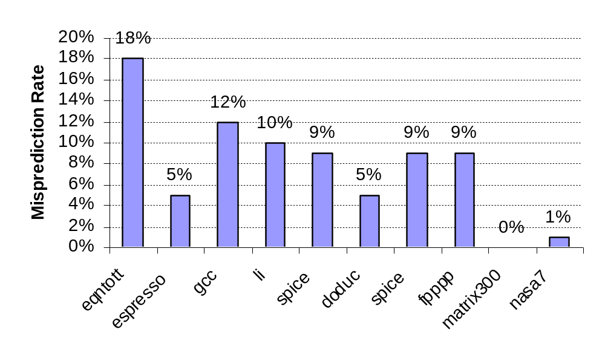
BHT Accuracy
Mispredict because either:
  Wrong guess for that branch
  Got branch history of wrong branch when index the table
4096 entry table:
Integer
Floating Point
Computer Architecture Lecture 6

Slide 27
Correlated Branch Prediction
Idea: record m most recently executed branches as taken or not taken, and use that pattern to select the proper n-bit branch history table
In general, (m,n) predictor means record last m branches to select between 2^{m} history tables, each with n-bit counters
  Thus, old 2-bit BHT is a (0,2) predictor
Global Branch History: m-bit shift register keeping T/NT status of last m branches.
Each entry in table has an n-bit predictor
  Choose entry same way you do in a basic BHT (low-order address bits)
Computer Architecture Lecture 6

Slide 28
Correlating Branches
(2,2) predictor
  – Behavior of recent branches selects between four predictions of next branch, updating just that prediction
Branch address
4
2-bits per branch predictor
Prediction
2-bit global branch history
Computer Architecture Lecture 6

Slide 29
Correlating example
Look at one entry of a simple (2,2) predictor
Assume
  The program has been running for some time
  Entry state is currently: (00, 10, 11, 01)
  Global history is currently: 01
    Last two branches were NT, T (T most recent)
Say we have a branch accessing this entry
  First 2 times, branch is taken
  Next 2 times, branch is not taken
  Final time, branch is taken
Computer Architecture Lecture 6

Slide 30
Correlating example (cont.)
First access
  Global history = 01 → entry[1] = 10
  Predict T, actually T
    Update entry[1] = 11
  Update global history = 11
Second access
  Global history = 11 → entry[3] = 01
  Predict NT, actually T
    Update entry[3] = 11
  Update global history = 11
    Looks the same, but you are shifting in a 1
Computer Architecture Lecture 6

Slide 31
Correlating example (cont.)
Third access
  Global history = 11 → entry[3] = 11
  Predict T, actually NT
    Update entry[3] = 10
  Update global history = 10
Fourth access
  Global history = 10 → entry[2] = 11
  Predict T, actually NT
    Update entry[2] = 10
  Update global history = 00
Fifth access
  Global history = 00 → entry[0] = 00
  Predict NT, actually T
    Update entry[0] = 01
  Update global history = 01
Computer Architecture Lecture 6

Slide 32
Accuracy of Different Schemes
20%
4096 Entries 2-bit BHT
Unlimited Entries 2-bit BHT
1024 Entries (2,2) BHT
18%
16%
14%
12%
11%
Frequency of Mispredictions
10%
8%
6%
6%
6%
6%
5%
5%
4%
4%
2%
1%
1%
0%
0%
nasa7
matrix300
tomcatv
doducd
spice
fpppp
gcc
expresso
eqntott
li
4,096 entries: 2-bits per entry
Unlimited entries: 2-bits/entry
1,024 entries (2,2)
Computer Architecture Lecture 6

Slide 33
Branch Target Buffers (BTB)
Branch prediction logic: relatively fast
Branch target calculation is slower
  Must actually decode instruction
  To remove stalls in speculative execution, need target more quickly
    Store previously calculated targets in branch target buffer
Send PC of branch to the BTB
  Check if matching address exists (tag check, like cache)
If match is found, corresponding Predicted PC is returned
If the branch was predicted taken, instruction fetch continues at the returned predicted PC
Computer Architecture Lecture 6

Slide 34
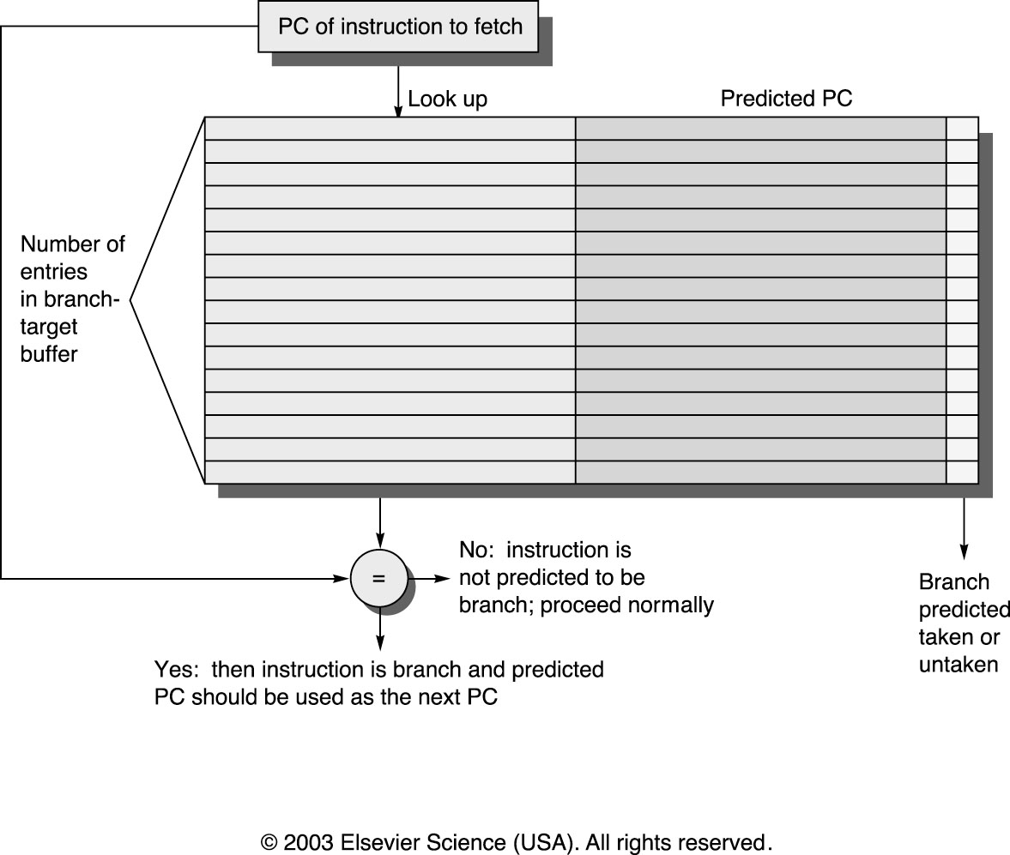
Branch Target Buffers
Computer Architecture Lecture 6

Slide 35
Midterm exam notes
Allowed to bring:
  Two 8.5” x 11” double-sided sheets of notes
  Calculator
No other notes or electronic devices (phone, laptop, etc.)
Exam will last until 9:30
  Will be written for ~90 minutes
Covers all lectures through this week
  Material starts with performance portion of first lecture
Question formats
  Problem solving
  Some short answer
  Similar to homework, but shorter
Computer Architecture Lecture 6

Slide 36
Review: Performance
Measure of how well a computer performs a user’s applications
Requires basis for comparison and metric for evaluation
Discussed a couple of metrics so far
  Latency: time required to complete a task
    Also called execution time or response time
  Throughput: number of tasks completed per unit of time
Computer Architecture Lecture 2

Slide 37
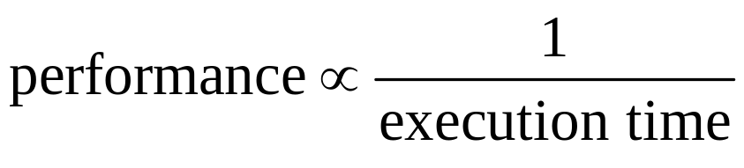
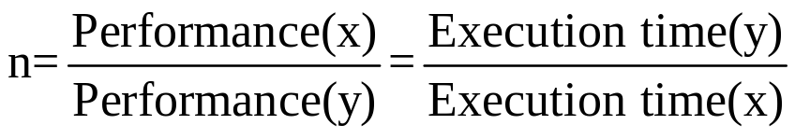
Review: Performance equations
In general:
Execution time = (cycles / program) x (cycle time)
= (Instruction count) x (Avg. CPI) x (cycle time)
Computer Architecture Lecture 2

Slide 38

Review: performance (continued)
Average CPI: weighted average of cycle count for each instruction class
Amdahl’s Law: effect of performance improvement limited by fraction of time improvement can be used
Computer Architecture Lecture 2

Slide 39
Review: MIPS addressing modes
MIPS implements several of the addressing modes discussed earlier
To address operands
  Immediate addressing
    Example: addi $t0, $t1, 150
  Register addressing
    Example: sub $t0, $t1, $t2
  Base addressing (base + displacement)
    Example: lw $t0, 16($t1)
To transfer control to a different instruction
  PC-relative addressing
    Used in conditional branches
  Pseudo-direct addressing
    Concatenates 26-bit address (from J-type instruction) shifted left by 2 bits with the 4 upper bits of the PC
Computer Architecture Lecture 2

Slide 40
Review: MIPS integer registers
Name | Register number | Usage
$zero | 0 | Constant value 0
$v0-$v1 | 2-3 | Values for results and expression evaluation
$a0-$a3 | 4-7 | Function arguments
$t0-$t7 | 8-15 | Temporary registers
$s0-$s7 | 16-23 | Callee save registers
$t8-$t9 | 24-25 | Temporary registers
$gp | 28 | Global pointer
$sp | 29 | Stack pointer
$fp | 30 | Frame pointer
$ra | 31 | Return address
List gives mnemonics used in assembly code
  Can also directly reference by number ($0, $1, etc.)
Conventions
  $s0-$s7 are preserved on a function call (callee save)
  Register 1 ($at) reserved for assembler
  Registers 26-27 ($k0-$k1) reserved for operating system
Computer Architecture Lecture 2

Slide 41
Review: MIPS data transfer instructions
For all cases, calculate effective address first
  MIPS doesn’t use segmented memory model like x86
  Flat memory model → EA = address being accessed
lb, lh, lw
  Get data from addressed memory location
  Sign extend if lb or lh, load into rt
lbu, lhu, lwu
  Get data from addressed memory location
  Zero extend if lb or lh, load into rt
sb, sh, sw
  Store data from rt (partial if sb or sh) into addressed location
Computer Architecture Lecture 2

Slide 42
Review: MIPS computational instructions
Arithmetic
  Signed: add, sub, mult, div
  Unsigned: addu, subu, multu, divu
  Immediate: addi, addiu
    Immediates are sign-extended
Logical
  and, or, nor, xor
  andi, ori, xori
    Immediates are zero-extended
Shift (logical and arithmetic)
  srl, sll – shift right (left) logical
    Shift the value in rs by shamt digits to right or left
    Fill empty positions with 0s
    Store the result in rd
  sra – shift right arithmetic
    Same as above, but sign-extend the high-order bits
  Can be used for multiply / divide by powers of 2
CIS 273: Lecture 3

Slide 43
Review: computational instructions (cont.)
Set less than
  Used to evaluate conditions
    Set rd to 1 if condition is met, set to 0 otherwise
  slt, sltu
    Condition is rs < rt
  slti, sltiu
    Condition is rs < immediate
    Immediate is sign-extended
Load upper immediate (lui)
  Shift immediate 16 bits left, append 16 zeros to right, put 32-bit result into rd
Computer Architecture Lecture 2

Slide 44
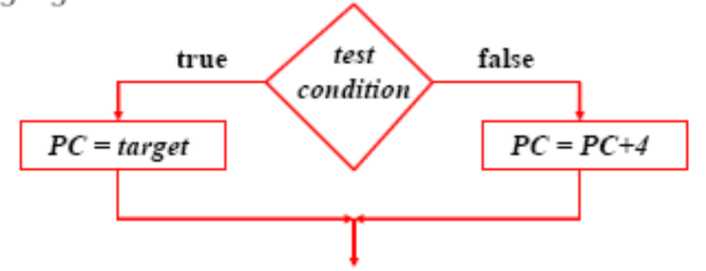
Review: MIPS control instructions
Branch instructions test a condition
  Equality or inequality of rs and rt
    beq, bne
    Often coupled with slt, sltu, slti, sltiu
  Value of rs relative to rt
    Pseudoinstructions: blt, bgt, ble, bge
Target address → add sign extended immediate to the PC
  Since all instructions are words, immediate is shifted left two bits before being sign extended
Computer Architecture Lecture 2

Slide 45
Review: MIPS control instructions (cont.)
Jump instructions unconditionally branch to the address formed by either
  Shifting left the 26-bit target two bits and combining it with the 4 high-order PC bits
    j
  The contents of register $rs
    jr
Branch-and-link and jump-and-link instructions also save the address of the next instruction into $ra
  jal
  Used for subroutine calls
  jr $ra used to return from a subroutine
Computer Architecture Lecture 2

Slide 46
Review: Binary multiplication
Generate shifted partial products and add them
Hardware can be condensed to two registers
  N-bit multiplicand
  2N-bit running product / multiplier
  At each step
    Check LSB of multiplier
    Add multiplicand/0 to left half of product/multiplier
    Shift product/multiplier right
Signed multiplication: Booth’s algorithm
  Add extra bit to left of all regs, right of prod./multiplier
  At each step
    Check two rightmost bits of prod./multiplier
    Add multiplicand, -multiplicand, or 0 to left half of prod./multiplier
    Shift product multiplier right
  Discard extra bits to get final product
CIS 273: Lecture 12

Slide 47
Review: IEEE Floating-Point Format
single: 8 bits
double: 11 bits
single: 23 bits
double: 52 bits
S
Exponent
Fraction
S: sign bit (0 ⇒ non-negative, 1 ⇒ negative)
Normalize significand: 1.0 ≤ |significand| < 2.0
  Always has a leading pre-binary-point 1 bit, so no need to represent it explicitly (hidden bit)
  Significand is Fraction with the “1.” restored
Actual exponent = (encoded value) - bias
  Ensures exponent is unsigned
  Single: Bias = 127; Double: Bias = 1023
Encoded exponents 0 and 111 ... 111 reserved
Computer Architecture Lecture 3
Notes:
Morgan Kaufmann Publishers
Chapter 3 — Arithmetic for Computers

Slide 48
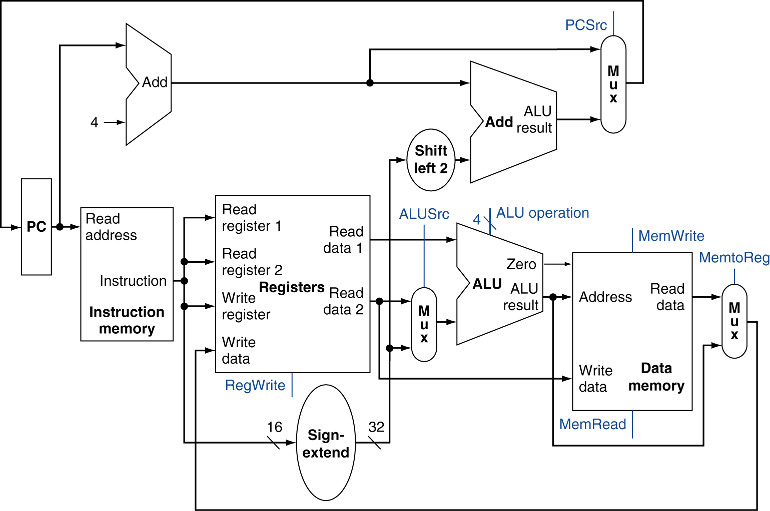
Review: Simple MIPS datapath
Chooses PC+4 or branch target
Chooses ALU output or memory output
Chooses register or sign-extended immediate
Computer Architecture Lecture 5

Slide 49
Review: Pipelining
Pipelining → low CPI and a short cycle
  Simultaneously execute multiple instructions
  Use multi-cycle “assembly line” approach
  Use staging registers between cycles to hold information
Hazards: situation that prevents instruction from executing during a particular cycle
  Structural hazards: hardware conflicts
  Data hazards: dependences cause instruction stalls; can resolve using:
    No-ops: compiler inserts stall cycles
    Forwarding: add hardware paths to ALU inputs
  Control hazards: must wait for branches
    Can move target, comparison into ID → only 1 cycle delay
Computer Architecture Lecture 6

Slide 50
Review: Pipeline diagram
 | Cycle 1 | 2 | 3 | 4 | 5 | 6 | 7 | 8
lw | IF | ID | EX | MEM | WB
add |  | IF | ID | EX | MEM | WB
beq |  |  | IF | ID | EX | MEM | WB
sw |  |  |  | IF | ID | EX | MEM | WB
Pipeline diagram shows execution of multiple instructions
  Instructions listed vertically
  Cycles shown horizontally
  Each instruction divided into stages
  Can see what instructions are in a particular stage at any cycle
Computer Architecture Lecture 6

Slide 51
Review: Pipeline registers
Need registers between stages for info from previous cycles
Register must be able to hold all needed info for given stage
  For example, IF/ID must be 64 bits—32 bits for instruction, 32 bits for PC+4
May need to propagate info through multiple stages for later use
  For example, destination reg. number determined in ID, but not used until WB
Computer Architecture Lecture 6
Notes:
Morgan Kaufmann Publishers
Chapter 4 — The Processor

Slide 52
Review: Dynamic Branch Prediction
Want to avoid branch delays
Dynamic branch predictors: hardware to predict branch outcome (T/NT) in 1 cycle
  Use branch history to determine predictions
  Doesn’t calculate target
Branch history table: basic predictor
  Which line of table should we use?
    Use appropriate bits of PC to choose BHT entry
    # index bits = log₂(# BHT entries)
  What’s prediction?
  How does actual outcome affect next prediction?
M. Geiger CIS 570 Lec. 9

Slide 53
Review: BHT
Solution: 2-bit scheme where change prediction only if get misprediction twice
Red: “stop” (branch not taken)
Green: “go” (branch taken)
T
NT
Predict Taken
11
10
Predict Taken
T
T
NT
NT
Predict Not
Taken
01
00
Predict Not
Taken
T
NT
Computer Architecture Lecture 6

Slide 54
Review: Correlated predictors, BTB
Correlated branch predictors
  Track both individual branches and overall program behavior (global history)
    Makes some branches easier to predict
  To make a prediction
    Branch address chooses row
    Global history chooses column
    Once entry chosen, make prediction in same way as basic BHT (11/10 → predict T, 00/01→predict NT)
Branch target buffers
  Save previously calculated branch targets
  Use branch address to do fully associative search
M. Geiger CIS 570 Lec. 11

Slide 55
Final notes
Next time: Midterm exam
Computer Architecture Lecture 6

