Slide 1
16.482 / 16.561
Computer Architecture and Design
Instructor: Dr. Michael Geiger
Fall 2014
Lecture 8:
Set associative caches
Virtual memory
Cache optimizations

Slide 2
Lecture outline
Announcements/reminders
  HW 7 due today
  HW 8 to be posted; due 11/13
  Poll re: final exam date (12/4 vs. 12/18)
    Link on discussion group, schedule page
    So far, 24/24 respondents voted to hold exam earlier
    10 of you have yet to respond—please do so ASAP!
Review
  Memory hierarchy design
Today’s lecture
  Set associative caches
  Virtual memory
  Cache optimizations
Computer Architecture Lecture 8

Slide 3
Review: memory hierarchies
We want a large, fast, low-cost memory
  Can’t get that with a single memory
Solution: use a little bit of everything!
  Small SRAM array → cache
    Small means fast and cheap
    More available die area → multiple cache levels on chip
  Larger DRAM array → main memory
    Hope you rarely have to use it
  Extremely large hard disk
    Costs are decreasing at a faster rate than we fill them
Computer Architecture Lecture 8

Slide 4
Review: Cache operation & terminology
Accessing data (and instructions!)
  Check the top level of the hierarchy
    If data is present, hit, if not, miss
    On a miss, check the next lowest level
      With 1 cache level, you check main memory, then disk
      With multiple levels, check L2, then L3
Average memory access time gives overall view of memory performance
AMAT = (hit time) + (miss rate) x (miss penalty)
  Miss penalty = AMAT for next level
Caches work because of locality
  Spatial vs. temporal
Computer Architecture Lecture 8

Slide 5
Review: 4 Questions for Hierarchy
Q1: Where can a block be placed in the upper level?
  (Block placement)
  Fully associative, set associative, direct-mapped
Q2: How is a block found if it is in the upper level?
  (Block identification)
  Check the tag—size determined by other address fields
Q3: Which block should be replaced on a miss?
  (Block replacement)
  Typically use least-recently used (LRU) replacement
Q4: What happens on a write?
  (Write strategy)
  Write-through vs. write-back
Computer Architecture Lecture 8

Slide 6
Replacement policies: review
On cache miss, bring requested data into cache
  If line contains valid data, that data is evicted
When we need to evict a line, what do we choose?
  Easy choice for direct-mapped—only one possibility!
  For set-associative or fully-associative, choose least recently used (LRU) line
    Want to choose data that is least likely to be used next
    Temporal locality suggests that’s the line that was accessed farthest in the past
Computer Architecture Lecture 7

Slide 7
LRU example
Given:
  4-way set associative cache
  Five blocks (A, B, C, D, E) that all map to the same set
In each sequence below, access to block E is a miss that causes another block to be evicted from the set.
If we use LRU replacement, which block is evicted?
  A, B, C, D, E
  A, B, C, D, B, C, A, D, A, C, D, B, A, E
  A, B, C, D, C, B, A, C, A, C, B, E
Computer Architecture Lecture 7

Slide 8
LRU example solution
In each case, determine which of the four accessed blocks is least recently used
Note that you will frequently have to look at more than the last four accesses
  A, B, C, D, E → evict A
  A, B, C, D, B, C, A, D, A, C, D, B, A, E → evict C
  A, B, C, D, C, B, A, C, A, C, B, E → evict D
Computer Architecture Lecture 7

Slide 9
Set associative cache example
Use similar setup to direct-mapped example
  2-level hierarchy
  16-byte memory
  Cache organization
    8 total bytes
    2 bytes per block
    Write-back cache
    One change: 2-way set associative
Leads to the following address breakdown
  Offset: 1 bit
  Index: 1 bit
  Tag: 2 bits
Computer Architecture Lecture 7

Slide 10
Set associative cache example (cont.)
Use same access sequence as before
    lb $t0, 1($zero)
    lb $t1, 8($zero)
    sb $t1, 4($zero)
    sb $t0, 13($zero)
    lb $t1, 9($zero)
Computer Architecture Lecture 7

Slide 11
Set associative cache example: initial state
Instructions:
  lb $t0, 1($zero)
  lb $t1, 8($zero)
  sb $t1, 4($zero)
  sb $t0, 13($zero)
  lb $t1, 9($zero)
Memory
0 | 78
1 | 29
2 | 120
3 | 123
4 | 71
5 | 150
6 | 162
7 | 173
8 | 18
9 | 21
10 | 33
11 | 28
12 | 19
13 | 200
14 | 210
15 | 225
MRU = most
recently used
Registers:
$t0 = ?, $t1 = ?
 | Cache
 | V | D | MRU | Tag | Data
Set 0 | 0 | 0 | 0 | 00 | 0 | 0
 | 0 | 0 | 0 | 00 | 0 | 0
Set 1 | 0 | 0 | 0 | 00 | 0 | 0
 | 0 | 0 | 0 | 00 | 0 | 0
Computer Architecture Lecture 7

Slide 12
Set associative cache example: access #1
Instructions:
  lb $t0, 1($zero)
  lb $t1, 8($zero)
  sb $t1, 4($zero)
  sb $t0, 13($zero)
  lb $t1, 9($zero)
Memory
0 | 78
1 | 29
2 | 120
3 | 123
4 | 71
5 | 150
6 | 162
7 | 173
8 | 18
9 | 21
10 | 33
11 | 28
12 | 19
13 | 200
14 | 210
15 | 225
Address = 1 = 0001₂
Tag = 00
Index = 0
Offset = 1
Registers:
$t0 = ?, $t1 = ?
 | Cache
 | V | D | MRU | Tag | Data
Set 0 | 0 | 0 | 0 | 00 | 0 | 0
 | 0 | 0 | 0 | 00 | 0 | 0
Set 1 | 0 | 0 | 0 | 00 | 0 | 0
 | 0 | 0 | 0 | 00 | 0 | 0
Hits: 0
Misses: 0
Computer Architecture Lecture 7

Slide 13
Set associative cache example: access #1
Instructions:
  lb $t0, 1($zero)
  lb $t1, 8($zero)
  sb $t1, 4($zero)
  sb $t0, 13($zero)
  lb $t1, 9($zero)
Memory
0 | 78
1 | 29
2 | 120
3 | 123
4 | 71
5 | 150
6 | 162
7 | 173
8 | 18
9 | 21
10 | 33
11 | 28
12 | 19
13 | 200
14 | 210
15 | 225
Address = 1 = 0001₂
Tag = 00
Index = 0
Offset = 1
Registers:
$t0 = 29, $t1 = ?
 | Cache
 | V | D | MRU | Tag | Data
Set 0 | 1 | 0 | 1 | 00 | 78 | 29
 | 0 | 0 | 0 | 00 | 0 | 0
Set 1 | 0 | 0 | 0 | 00 | 0 | 0
 | 0 | 0 | 0 | 00 | 0 | 0
Hits: 0
Misses: 1
Computer Architecture Lecture 7

Slide 14
Set associative cache example: access #2
Instructions:
  lb $t0, 1($zero)
  lb $t1, 8($zero)
  sb $t1, 4($zero)
  sb $t0, 13($zero)
  lb $t1, 9($zero)
Memory
0 | 78
1 | 29
2 | 120
3 | 123
4 | 71
5 | 150
6 | 162
7 | 173
8 | 18
9 | 21
10 | 33
11 | 28
12 | 19
13 | 200
14 | 210
15 | 225
Address = 8 = 1000₂
Tag = 10
Index = 0
Offset = 0
Registers:
$t0 = 29, $t1 = ?
 | Cache
 | V | D | MRU | Tag | Data
Set 0 | 1 | 0 | 1 | 00 | 78 | 29
 | 0 | 0 | 0 | 00 | 0 | 0
Set 1 | 0 | 0 | 0 | 00 | 0 | 0
 | 0 | 0 | 0 | 00 | 0 | 0
Hits: 0
Misses: 1
Computer Architecture Lecture 7

Slide 15
Set associative cache example: access #2
Instructions:
  lb $t0, 1($zero)
  lb $t1, 8($zero)
  sb $t1, 4($zero)
  sb $t0, 13($zero)
  lb $t1, 9($zero)
Memory
0 | 78
1 | 29
2 | 120
3 | 123
4 | 71
5 | 150
6 | 162
7 | 173
8 | 18
9 | 21
10 | 33
11 | 28
12 | 19
13 | 200
14 | 210
15 | 225
Address = 8 = 1000₂
Tag = 10
Index = 0
Offset = 0
Registers:
$t0 = 29, $t1 = 18
 | Cache
 | V | D | MRU | Tag | Data
Set 0 | 1 | 0 | 0 | 00 | 78 | 29
 | 1 | 0 | 1 | 10 | 18 | 21
Set 1 | 0 | 0 | 0 | 00 | 0 | 0
 | 0 | 0 | 0 | 00 | 0 | 0
Hits: 0
Misses: 2
Computer Architecture Lecture 7

Slide 16
Set associative cache example: access #3
Instructions:
  lb $t0, 1($zero)
  lb $t1, 8($zero)
  sb $t1, 4($zero)
  sb $t0, 13($zero)
  lb $t1, 9($zero)
Memory
0 | 78
1 | 29
2 | 120
3 | 123
4 | 71
5 | 150
6 | 162
7 | 173
8 | 18
9 | 21
10 | 33
11 | 28
12 | 19
13 | 200
14 | 210
15 | 225
Address = 4 = 0100₂
Tag = 01
Index = 0
Offset = 0
Registers:
$t0 = 29, $t1 = 18
 | Cache
 | V | D | MRU | Tag | Data
Set 0 | 1 | 0 | 0 | 00 | 78 | 29
 | 1 | 0 | 1 | 10 | 18 | 21
Set 1 | 0 | 0 | 0 | 00 | 0 | 0
 | 0 | 0 | 0 | 00 | 0 | 0
Hits: 0
Misses: 2
Computer Architecture Lecture 7

Slide 17
Set associative cache example: access #3
Instructions:
  lb $t0, 1($zero)
  lb $t1, 8($zero)
  sb $t1, 4($zero)
  sb $t0, 13($zero)
  lb $t1, 9($zero)
Memory
0 | 78
1 | 29
2 | 120
3 | 123
4 | 71
5 | 150
6 | 162
7 | 173
8 | 18
9 | 21
10 | 33
11 | 28
12 | 19
13 | 200
14 | 210
15 | 225
Address = 4 = 0100₂
Tag = 01
Index = 0
Offset = 0
Evict non-MRU block
Not dirty, so no write back
Registers:
$t0 = 29, $t1 = 18
 | Cache
 | V | D | MRU | Tag | Data
Set 0 | 1 | 0 | 0 | 00 | 78 | 29
 | 1 | 0 | 1 | 10 | 18 | 21
Set 1 | 0 | 0 | 0 | 00 | 0 | 0
 | 0 | 0 | 0 | 00 | 0 | 0
Hits: 0
Misses: 2
Computer Architecture Lecture 7

Slide 18
Set associative cache example: access #3
Instructions:
  lb $t0, 1($zero)
  lb $t1, 8($zero)
  sb $t1, 4($zero)
  sb $t0, 13($zero)
  lb $t1, 9($zero)
Memory
0 | 78
1 | 29
2 | 120
3 | 123
4 | 71
5 | 150
6 | 162
7 | 173
8 | 18
9 | 21
10 | 33
11 | 28
12 | 19
13 | 200
14 | 210
15 | 225
Address = 4 = 0100₂
Tag = 01
Index = 0
Offset = 0
Registers:
$t0 = 29, $t1 = 18
 | Cache
 | V | D | MRU | Tag | Data
Set 0 | 1 | 1 | 1 | 01 | 18 | 150
 | 1 | 0 | 0 | 10 | 18 | 21
Set 1 | 0 | 0 | 0 | 00 | 0 | 0
 | 0 | 0 | 0 | 00 | 0 | 0
Hits: 0
Misses: 3
Computer Architecture Lecture 7

Slide 19
Set associative cache example: access #4
Instructions:
  lb $t0, 1($zero)
  lb $t1, 8($zero)
  sb $t1, 4($zero)
  sb $t0, 13($zero)
  lb $t1, 9($zero)
Memory
0 | 78
1 | 29
2 | 120
3 | 123
4 | 71
5 | 150
6 | 162
7 | 173
8 | 18
9 | 21
10 | 33
11 | 28
12 | 19
13 | 200
14 | 210
15 | 225
Address = 13 = 1101₂
Tag = 11
Index = 0
Offset = 1
Registers:
$t0 = 29, $t1 = 18
 | Cache
 | V | D | MRU | Tag | Data
Set 0 | 1 | 1 | 1 | 01 | 18 | 150
 | 1 | 0 | 0 | 10 | 18 | 21
Set 1 | 0 | 0 | 0 | 00 | 0 | 0
 | 0 | 0 | 0 | 00 | 0 | 0
Hits: 0
Misses: 3
Computer Architecture Lecture 7

Slide 20
Set associative cache example: access #4
Instructions:
  lb $t0, 1($zero)
  lb $t1, 8($zero)
  sb $t1, 4($zero)
  sb $t0, 13($zero)
  lb $t1, 9($zero)
Memory
0 | 78
1 | 29
2 | 120
3 | 123
4 | 71
5 | 150
6 | 162
7 | 173
8 | 18
9 | 21
10 | 33
11 | 28
12 | 19
13 | 200
14 | 210
15 | 225
Address = 13 = 1101₂
Tag = 11
Index = 0
Offset = 1
Evict non-MRU block
Not dirty, so no write back
Registers:
$t0 = 29, $t1 = 18
 | Cache
 | V | D | MRU | Tag | Data
Set 0 | 1 | 1 | 1 | 01 | 18 | 150
 | 1 | 0 | 0 | 10 | 18 | 21
Set 1 | 0 | 0 | 0 | 00 | 0 | 0
 | 0 | 0 | 0 | 00 | 0 | 0
Hits: 0
Misses: 3
Computer Architecture Lecture 7

Slide 21
Set associative cache example: access #4
Instructions:
  lb $t0, 1($zero)
  lb $t1, 8($zero)
  sb $t1, 4($zero)
  sb $t0, 13($zero)
  lb $t1, 9($zero)
Memory
0 | 78
1 | 29
2 | 120
3 | 123
4 | 71
5 | 150
6 | 162
7 | 173
8 | 18
9 | 21
10 | 33
11 | 28
12 | 19
13 | 200
14 | 210
15 | 225
Address = 13 = 1101₂
Tag = 11
Index = 0
Offset = 1
Registers:
$t0 = 29, $t1 = 18
 | Cache
 | V | D | MRU | Tag | Data
Set 0 | 1 | 1 | 0 | 01 | 18 | 150
 | 1 | 1 | 1 | 11 | 19 | 29
Set 1 | 0 | 0 | 0 | 00 | 0 | 0
 | 0 | 0 | 0 | 00 | 0 | 0
Hits: 0
Misses: 4
Computer Architecture Lecture 7

Slide 22
Set associative cache example: access #5
Instructions:
  lb $t0, 1($zero)
  lb $t1, 8($zero)
  sb $t1, 4($zero)
  sb $t0, 13($zero)
  lb $t1, 9($zero)
Memory
0 | 78
1 | 29
2 | 120
3 | 123
4 | 71
5 | 150
6 | 162
7 | 173
8 | 18
9 | 21
10 | 33
11 | 28
12 | 19
13 | 200
14 | 210
15 | 225
Address = 9 = 1001₂
Tag = 10
Index = 0
Offset = 1
Registers:
$t0 = 29, $t1 = 18
 | Cache
 | V | D | MRU | Tag | Data
Set 0 | 1 | 1 | 0 | 01 | 18 | 150
 | 1 | 1 | 1 | 11 | 19 | 29
Set 1 | 0 | 0 | 0 | 00 | 0 | 0
 | 0 | 0 | 0 | 00 | 0 | 0
Hits: 0
Misses: 4
Computer Architecture Lecture 7

Slide 23
Set associative cache example: access #5
Instructions:
  lb $t0, 1($zero)
  lb $t1, 8($zero)
  sb $t1, 4($zero)
  sb $t0, 13($zero)
  lb $t1, 9($zero)
Memory
0 | 78
1 | 29
2 | 120
3 | 123
4 | 18
5 | 150
6 | 162
7 | 173
8 | 18
9 | 21
10 | 33
11 | 28
12 | 19
13 | 200
14 | 210
15 | 225
Address = 9 = 1001₂
Tag = 10
Index = 0
Offset = 1
Evict non-MRU block
Dirty, so write back
Registers:
$t0 = 29, $t1 = 18
 | Cache
 | V | D | MRU | Tag | Data
Set 0 | 1 | 1 | 0 | 01 | 18 | 150
 | 1 | 1 | 1 | 11 | 19 | 29
Set 1 | 0 | 0 | 0 | 00 | 0 | 0
 | 0 | 0 | 0 | 00 | 0 | 0
Hits: 0
Misses: 4
Computer Architecture Lecture 7

Slide 24
Set associative cache example: access #5
Instructions:
  lb $t0, 1($zero)
  lb $t1, 8($zero)
  sb $t1, 4($zero)
  sb $t0, 13($zero)
  lb $t1, 9($zero)
Memory
0 | 78
1 | 29
2 | 120
3 | 123
4 | 18
5 | 150
6 | 162
7 | 173
8 | 18
9 | 21
10 | 33
11 | 28
12 | 19
13 | 200
14 | 210
15 | 225
Address = 9 = 1001₂
Tag = 10
Index = 0
Offset = 1
Registers:
$t0 = 29, $t1 = 21
 | Cache
 | V | D | MRU | Tag | Data
Set 0 | 1 | 0 | 1 | 10 | 18 | 21
 | 1 | 1 | 0 | 11 | 19 | 29
Set 1 | 0 | 0 | 0 | 00 | 0 | 0
 | 0 | 0 | 0 | 00 | 0 | 0
Hits: 0
Misses: 5
Computer Architecture Lecture 7

Slide 25
Additional examples
Given the final cache state above, determine the new cache state after the following three accesses:
  lb $t1, 3($zero)
  lb $t0, 11($zero)
  sb $t0, 2($zero)
Computer Architecture Lecture 7

Slide 26
Set associative cache example: access #6
Instructions:
  lb $t1, 3($zero)
  lb $t0, 11($zero)
  sb $t0, 2($zero)
Memory
0 | 78
1 | 29
2 | 120
3 | 123
4 | 18
5 | 150
6 | 162
7 | 173
8 | 18
9 | 21
10 | 33
11 | 28
12 | 19
13 | 200
14 | 210
15 | 225
Address = 3 = 0011₂
Tag = 00
Index = 1
Offset = 1
Registers:
$t0 = 29, $t1 = 21
 | Cache
 | V | D | MRU | Tag | Data
Set 0 | 1 | 0 | 1 | 10 | 18 | 21
 | 1 | 1 | 0 | 11 | 19 | 29
Set 1 | 0 | 0 | 0 | 00 | 0 | 0
 | 0 | 0 | 0 | 00 | 0 | 0
Hits: 0
Misses: 5
Computer Architecture Lecture 7

Slide 27
Set associative cache example: access #6
Instructions:
  lb $t1, 3($zero)
  lb $t0, 11($zero)
  sb $t0, 2($zero)
Memory
0 | 78
1 | 29
2 | 120
3 | 123
4 | 18
5 | 150
6 | 162
7 | 173
8 | 18
9 | 21
10 | 33
11 | 28
12 | 19
13 | 200
14 | 210
15 | 225
Address = 3 = 0011₂
Tag = 00
Index = 1
Offset = 1
Registers:
$t0 = 29, $t1 = 123
 | Cache
 | V | D | MRU | Tag | Data
Set 0 | 1 | 0 | 1 | 10 | 18 | 21
 | 1 | 1 | 0 | 11 | 19 | 29
Set 1 | 1 | 0 | 1 | 00 | 120 | 123
 | 0 | 0 | 0 | 00 | 0 | 0
Hits: 0
Misses: 6
Computer Architecture Lecture 7

Slide 28
Set associative cache example: access #7
Instructions:
  lb $t1, 3($zero)
  lb $t0, 11($zero)
  sb $t0, 2($zero)
Memory
0 | 78
1 | 29
2 | 120
3 | 123
4 | 18
5 | 150
6 | 162
7 | 173
8 | 18
9 | 21
10 | 33
11 | 28
12 | 19
13 | 200
14 | 210
15 | 225
Address = 11 = 1011₂
Tag = 10
Index = 1
Offset = 1
Registers:
$t0 = 29, $t1 = 123
 | Cache
 | V | D | MRU | Tag | Data
Set 0 | 1 | 0 | 1 | 10 | 18 | 21
 | 1 | 1 | 0 | 11 | 19 | 29
Set 1 | 1 | 0 | 1 | 00 | 120 | 123
 | 0 | 0 | 0 | 00 | 0 | 0
Hits: 0
Misses: 6
Computer Architecture Lecture 7

Slide 29
Set associative cache example: access #7
Instructions:
  lb $t1, 3($zero)
  lb $t0, 11($zero)
  sb $t0, 2($zero)
Memory
0 | 78
1 | 29
2 | 120
3 | 123
4 | 18
5 | 150
6 | 162
7 | 173
8 | 18
9 | 21
10 | 33
11 | 28
12 | 19
13 | 200
14 | 210
15 | 225
Address = 11 = 1011₂
Tag = 10
Index = 1
Offset = 1
Registers:
$t0 = 28, $t1 = 123
 | Cache
 | V | D | MRU | Tag | Data
Set 0 | 1 | 0 | 1 | 10 | 18 | 21
 | 1 | 1 | 0 | 11 | 19 | 29
Set 1 | 1 | 0 | 0 | 00 | 120 | 123
 | 1 | 0 | 1 | 10 | 33 | 28
Hits: 0
Misses: 7
Computer Architecture Lecture 7

Slide 30
Set associative cache example: access #8
Instructions:
  lb $t1, 3($zero)
  lb $t0, 11($zero)
  sb $t0, 2($zero)
Memory
0 | 78
1 | 29
2 | 120
3 | 123
4 | 18
5 | 150
6 | 162
7 | 173
8 | 18
9 | 21
10 | 33
11 | 28
12 | 19
13 | 200
14 | 210
15 | 225
Address = 2 = 0010₂
Tag = 00
Index = 1
Offset = 0
Registers:
$t0 = 28, $t1 = 123
 | Cache
 | V | D | MRU | Tag | Data
Set 0 | 1 | 0 | 1 | 10 | 18 | 21
 | 1 | 1 | 0 | 11 | 19 | 29
Set 1 | 1 | 0 | 0 | 00 | 120 | 123
 | 1 | 0 | 1 | 10 | 33 | 28
Hits: 0
Misses: 7
Computer Architecture Lecture 7

Slide 31
Set associative cache example: access #8
Instructions:
  lb $t1, 3($zero)
  lb $t0, 11($zero)
  sb $t0, 2($zero)
Memory
0 | 78
1 | 29
2 | 120
3 | 123
4 | 18
5 | 150
6 | 162
7 | 173
8 | 18
9 | 21
10 | 33
11 | 28
12 | 19
13 | 200
14 | 210
15 | 225
Address = 2 = 0010₂
Tag = 00
Index = 1
Offset = 0
Registers:
$t0 = 28, $t1 = 123
 | Cache
 | V | D | MRU | Tag | Data
Set 0 | 1 | 0 | 1 | 10 | 18 | 21
 | 1 | 1 | 0 | 11 | 19 | 29
Set 1 | 1 | 1 | 1 | 00 | 28 | 123
 | 1 | 0 | 0 | 10 | 33 | 28
Hits: 1
Misses: 7
Computer Architecture Lecture 7

Slide 32
Problems with memory
DRAM is too expensive to buy many gigabytes
  We need our programs to work even if they require more memory than we have
  A program that works on a machine with 512 MB should still work on a machine with 256 MB
Most systems run multiple programs
Computer Architecture Lecture 8

Slide 33
Solutions
Leave the problem up to the programmer
  Assume programmer knows exact configuration
Overlays
  Compiler identifies mutually exclusive regions
Virtual memory
  Use hardware and software to automatically translate references from virtual address (what the programmer sees) to physical address (index to DRAM or disk)
Computer Architecture Lecture 8

Slide 34
Benefits of virtual memory
“Virtual Addresses”
“Physical Addresses”
A0-A31
Virtual
Physical
A0-A31
CPU
Address
Translation
Memory
D0-D31
D0-D31
Data
User programs run in a standardized
virtual address space
Address Translation hardware
managed by the operating system (OS)
maps virtual address to physical memory
Hardware supports “modern” OS features:
Protection, Translation, Sharing
Computer Architecture Lecture 8

Slide 35
4 Questions for Virtual Memory
Reconsider these questions for virtual memory
  Q1: Where can a page be placed in main memory?
  Q2: How is a page found if it is in main memory?
  Q3: Which page should be replaced on a page fault?
  Q4: What happens on a write?
Computer Architecture Lecture 8

Slide 36
4 Questions for Virtual Memory (cont.)
Q1: Where can a page be placed in main memory?
  Disk very slow → lowest MR→ fully associative
  OS maintains list of free frames
Q2: How is a page found in main memory?
  Page table contains mapping from virtual address (VA) to physical address (PA)
    Page table stored in memory
    Indexed by page number (upper bits of virtual address)
    Note: PA usually smaller than VA
      Less physical memory available than virtual memory
Computer Architecture Lecture 8

Slide 37
Managing virtual memory
Effectively treat main memory as a cache
  Blocks are called pages
  Misses are called page faults
Virtual address consists of virtual page number and page offset
Virtual page number
Page offset
31
11
0
Computer Architecture Lecture 8

Slide 38
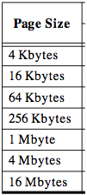
Page tables encode virtual address spaces
A virtual address space
is divided into blocks
of memory called pages
Virtual
Address Space
Physical
Address Space
frame
frame
A machine usually supports
pages of a few sizes
(MIPS R4000):
frame
frame
A valid page table entry codes physical memory “frame” address for the page
Computer Architecture Lecture 8

Slide 39
Page tables encode virtual address spaces
Page Table
Physical
Memory Space
A virtual address space
is divided into blocks
of memory called pages
frame
frame
frame
frame
A machine usually supports
pages of a few sizes
(MIPS R4000):
virtual address
OS manages the page table for each ASID
A page table is indexed by a
virtual address
A valid page table entry codes physical memory “frame” address for the page
Computer Architecture Lecture 8

Slide 40
Details of Page Table
Page Table
Physical
Memory Space
Virtual Address
frame
12
frame
V page no.
offset
frame
frame
Page Table
Page Table
Base Reg
V
Access
Rights
PA
index
into
page
table
virtual address
table located
in physical
memory
P page no.
offset
12
Physical Address
Page table maps virtual page numbers to physical frames (“PTE” = Page Table Entry)
Virtual memory => treat memory ≈ cache for disk
Computer Architecture Lecture 8

Slide 41
Virtual memory example
Assume the current process uses the page table below:
Which virtual pages are present in physical memory?
Assuming 1 KB pages and 16-bit addresses, what physical addresses would the virtual addresses below map to?
  0x041C
  0x08AD
  0x157B
Virtual page # | Valid bit | Reference bit | Dirty bit | Frame #
0 | 1 | 1 | 0 | 4
1 | 1 | 1 | 1 | 7
2 | 0 | 0 | 0 | --
3 | 1 | 0 | 0 | 2
4 | 0 | 0 | 0 | --
5 | 1 | 0 | 1 | 0
Computer Architecture Lecture 8

Slide 42
Virtual memory example soln.
Which virtual pages are present in physical memory?
  All those with valid PTEs: 0, 1, 3, 5
Assuming 1 KB pages and 16-bit addresses (both VA & PA), what PA, if any, would the VA below map to?
  1 KB pages → 10-bit page offset (unchanged in PA)
  Remaining bits: virtual page # → upper 6 bits
    Virtual page # chooses PTE; frame # used in PA
  0x041C = 0000 0100 0001 1100₂
    Upper 6 bits = 0000 01 = 1
    PTE 1 → frame # 7 = 000111
    PA = 0001 1100 0001 1100₂ = 0x1C1C
  0x08AD = 0000 1000 1010 1101₂
    Upper 6 bits = 0000 10 = 2
    PTE 2 is not valid → page fault
  0x157B = 0001 0101 0111 1011₂
    Upper 6 bits = 0001 01 = 5
    PTE 5 → frame # 0 = 000000
    PA = 0000 0001 0111 1011₂ = 0x017B
Computer Architecture Lecture 8

Slide 43
4 Questions for Virtual Memory (cont.)
Q3: Which page should be replaced on a page fault?
  Once again, LRU ideal but hard to track
  Virtual memory solution: reference bits
    Set bit every time page is referenced
    Clear all reference bits on regular interval
    Evict non-referenced page when necessary
Q4: What happens on a write?
  Slow disk → write-through makes no sense
  PTE contains dirty bit
Computer Architecture Lecture 8

Slide 44
Virtual memory performance
Address translation accesses memory to get PTE → every memory access twice as long
Solution: store recently used translations
  Translation lookaside buffer (TLB): a cache for page table entries
    “Tag” is the virtual page #
    TLB small → often fully associative
    TLB entry also contains valid bit (for that translation); reference & dirty bits (for the page itself!)
Computer Architecture Lecture 8

Slide 45
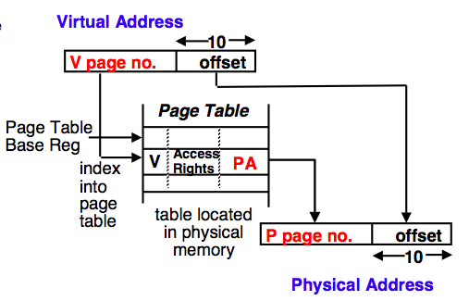
The TLB caches page table entries
Physical and virtual pages must be the same size!
TLB caches page table entries.
Physical
frame
address
virtual address
Base Reg
page
off
Page Table
2
0
1
3
V=0 pages either reside on disk or have not yet been allocated.
OS handles V=0
“Page fault”
physical address
TLB
frame
off
page
frame
2
2
Computer Architecture Lecture 8
5
0

Slide 46
Back to caches ...
Reduce misses → improve performance
Reasons for misses: “the three C’s”
  First reference to an address: Compulsory miss
    Increasing the block size
  Cache is too small to hold data: Capacity miss
    Increase the cache size
  Replaced from a busy line or set: Conflict miss
    Increase associativity
    Would have had hit in a fully associative cache
Computer Architecture Lecture 8

Slide 47
Advanced Cache Optimizations
Reducing hit time
Way prediction
Trace caches
Increasing cache bandwidth
Pipelined caches
Multibanked caches
Nonblocking caches
Reducing miss penalty
Critical word first
Reducing miss rate
Compiler optimizations
Reducing miss penalty or miss rate via parallelism
Hardware prefetching
Compiler prefetching
Computer Architecture Lecture 8

Slide 48
Fast Hit times via Way Prediction
How to combine fast hit time of Direct Mapped and have the lower conflict misses of 2-way SA cache?
Way prediction: keep extra bits in cache to predict the “way,” or block within the set, of next cache access.
  Multiplexor is set early to select desired block, only 1 tag comparison performed that clock cycle in parallel with reading the cache data
  Miss ⇒ 1st check other blocks for matches in next clock cycle
Accuracy ≈ 85%
Drawback: CPU pipeline is hard if hit takes 1 or 2 cycles
  Used for instruction caches vs. data caches
Hit Time
Way-Miss Hit Time
Miss Penalty
Computer Architecture Lecture 8

Slide 49
Fast Hit times via Trace Cache
Find more instruction level parallelism?
How avoid translation from x86 to microops?
Trace cache in Pentium 4 (only, possibly last, processor to use)
Dynamic traces of the executed instructions vs. static sequences of instructions as determined by layout in memory
  Built-in branch predictor
Cache the micro-ops vs. x86 instructions
  Decode/translate from x86 to micro-ops on trace cache miss
+ ⇒ better utilize long blocks (don’t exit in middle of block, don’t enter at label in middle of block)
⇒ complicated address mapping since addresses no longer aligned to power-of-2 multiples of word size
- ⇒ instructions may appear multiple times in multiple dynamic traces due to different branch outcomes
Computer Architecture Lecture 8

Slide 50
Increasing Cache Bandwidth by Pipelining
Pipeline cache access to maintain bandwidth, but higher latency
Instruction cache access pipeline stages:
1: Pentium
2: Pentium Pro through Pentium III
4: Pentium 4
⇒ greater penalty on mispredicted branches
⇒ more clock cycles between the issue of the load and the use of the data
Computer Architecture Lecture 8
Notes:
Answer is 3 stages between branch and new instruction fetch and 2 stages between load and use (even though if looked at red insertions that it would be 3 for load and 2 for branch)
Reasons:
1) Load: TC just does tag check, data available after DS; thus supply the data & forward it, restarting the pipeline on a data cache miss
2) EX phase does the address calculation even though just added one phase; presumed reason is that since want fast clockc cycle don’t want to sitck RF phase with reading regisers AND testing for zero, so just moved it back on phase

Slide 51
Increasing Cache Bandwidth:
Non-Blocking Caches
Non-blocking cache or lockup-free cache allow data cache to continue to supply cache hits during a miss
  requires F/E bits on registers or out-of-order execution
  requires multi-bank memories
“hit under miss” reduces the effective miss penalty by working during miss vs. ignoring CPU requests
“hit under multiple miss” or “miss under miss” may further lower the effective miss penalty by overlapping multiple misses
  Significantly increases the complexity of the cache controller as there can be multiple outstanding memory accesses
  Requires multiple memory banks (otherwise cannot support)
  Pentium Pro allows 4 outstanding memory misses
Computer Architecture Lecture 8

Slide 52
Increasing Bandwidth w/Multiple Banks
Rather than treat the cache as a single monolithic block, divide into independent banks that can support simultaneous accesses
  E.g.,T1 (“Niagara”) L2 has 4 banks
Banking works best when accesses naturally spread themselves across banks ⇒ mapping of addresses to banks affects behavior of memory system
Simple mapping that works well is “sequential interleaving”
  Spread block addresses sequentially across banks
  E,g, if there 4 banks, Bank 0 has all blocks whose address modulo 4 is 0; bank 1 has all blocks whose address modulo 4 is 1; …
Computer Architecture Lecture 8
Notes:
Answer is 3 stages between branch and new instruction fetch and 2 stages between load and use (even though if looked at red insertions that it would be 3 for load and 2 for branch)
Reasons:
1) Load: TC just does tag check, data available after DS; thus supply the data & forward it, restarting the pipeline on a data cache miss
2) EX phase does the address calculation even though just added one phase; presumed reason is that since want fast clockc cycle don’t want to sitck RF phase with reading regisers AND testing for zero, so just moved it back on phase

Slide 53
Reduce Miss Penalty:
Early Restart and Critical Word First
Don’t wait for full block before restarting CPU
Early restart—As soon as the requested word of the block arrives, send it to the CPU and let the CPU continue execution
  Spatial locality ⇒ tend to want next sequential word, so not clear size of benefit of just early restart
Critical Word First—Request the missed word first from memory and send it to the CPU as soon as it arrives; let the CPU continue execution while filling the rest of the words in the block
  Long blocks more popular today ⇒ Critical Word 1st Widely used
block
Computer Architecture Lecture 8

Slide 54
Reducing Misses by Compiler Optimizations
McFarling [1989] reduced caches misses by 75%
on 8KB direct mapped cache, 4 byte blocks in software
Instructions
  Reorder procedures in memory so as to reduce conflict misses
  Profiling to look at conflicts(using tools they developed)
Data
  Merging Arrays: improve spatial locality by single array of compound elements vs. 2 arrays
  Loop Interchange: change nesting of loops to access data in order stored in memory
  Loop Fusion: Combine 2 independent loops that have same looping and some variables overlap
  Blocking: Improve temporal locality by accessing “blocks” of data repeatedly vs. going down whole columns or rows
Computer Architecture Lecture 8

Slide 55
Merging Arrays Example
/* Before: 2 sequential arrays */
int val[SIZE];
int key[SIZE];
/* After: 1 array of stuctures */
struct merge {
int val;
int key;
};
struct merge merged_array[SIZE];
Reducing conflicts between val & key;
improve spatial locality
Computer Architecture Lecture 8

Slide 56
Loop Interchange Example
/* Before */
for (k = 0; k < 100; k = k+1)
for (j = 0; j < 100; j = j+1)
for (i = 0; i < 5000; i = i+1)
x[i][j] = 2 * x[i][j];
/* After */
for (k = 0; k < 100; k = k+1)
for (i = 0; i < 5000; i = i+1)
for (j = 0; j < 100; j = j+1)
x[i][j] = 2 * x[i][j];
Sequential accesses instead of striding through memory every 100 words; improved spatial locality
Computer Architecture Lecture 8

Slide 57
Loop Fusion Example
/* Before */
for (i = 0; i < N; i = i+1)
for (j = 0; j < N; j = j+1)
a[i][j] = 1/b[i][j] * c[i][j];
for (i = 0; i < N; i = i+1)
for (j = 0; j < N; j = j+1)
d[i][j] = a[i][j] + c[i][j];
/* After */
for (i = 0; i < N; i = i+1)
for (j = 0; j < N; j = j+1)
{ a[i][j] = 1/b[i][j] * c[i][j];
d[i][j] = a[i][j] + c[i][j];}
2 misses per access to a & c vs. one miss per access; improve spatial locality
Computer Architecture Lecture 8

Slide 58
Blocking Example
/* Before */
for (i = 0; i < N; i = i+1)
for (j = 0; j < N; j = j+1)
{r = 0;
for (k = 0; k < N; k = k+1){
r = r + y[i][k]*z[k][j];};
x[i][j] = r;
};
Two Inner Loops:
  Read all NxN elements of z[]
  Read N elements of 1 row of y[] repeatedly
  Write N elements of 1 row of x[]
Capacity Misses a function of N & Cache Size:
  2N³ + N² => (assuming no conflict; otherwise …)
Idea: compute on BxB submatrix that fits
Computer Architecture Lecture 8

Slide 59
Blocking Example
/* After */
for (jj = 0; jj < N; jj = jj+B)
for (kk = 0; kk < N; kk = kk+B)
for (i = 0; i < N; i = i+1)
for (j = jj; j < min(jj+B-1,N); j = j+1)
{r = 0;
for (k = kk; k < min(kk+B-1,N); k = k+1) {
r = r + y[i][k]*z[k][j];};
x[i][j] = x[i][j] + r;
};
B called Blocking Factor
Capacity Misses from 2N³ + N² to 2N³/B +N²
Conflict Misses Too?
Computer Architecture Lecture 8

Slide 60
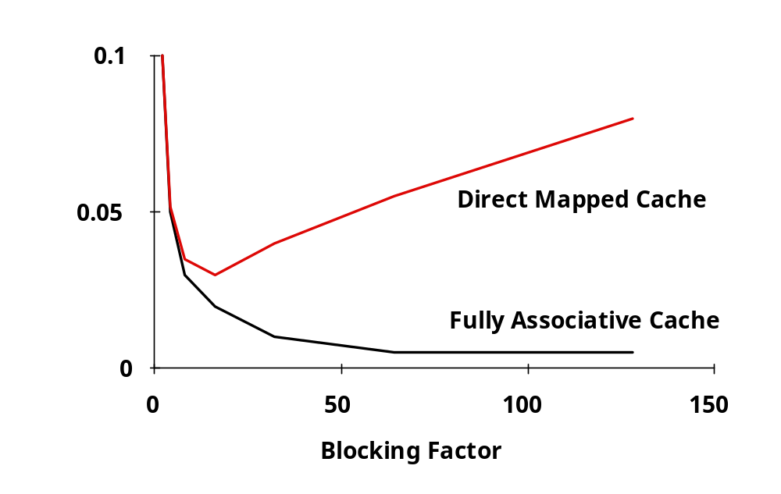
Reducing Conflict Misses by Blocking
Conflict misses in caches not FA vs. Blocking size
  Lam et al [1991] a blocking factor of 24 had a fifth the misses vs. 48 despite both fit in cache
Computer Architecture Lecture 8

Slide 61
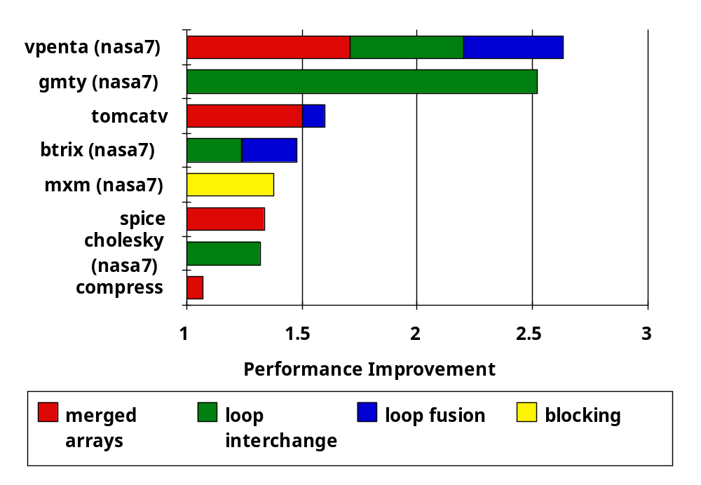
Summary of Compiler Optimizations to Reduce Cache Misses (by hand)
Computer Architecture Lecture 8

Slide 62
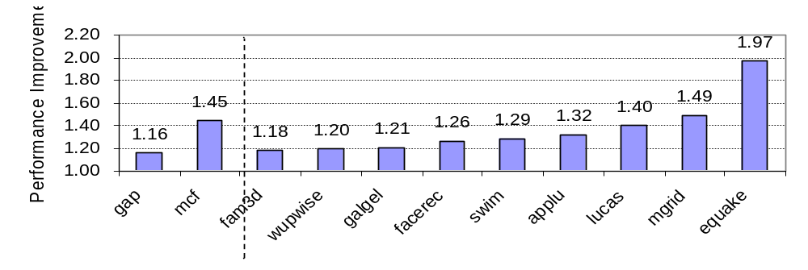
Reducing Misses by Hardware Prefetching of Instructions & Data
Prefetching relies on having extra memory bandwidth that can be used without penalty
Instruction Prefetching
  Typically, CPU fetches 2 blocks on a miss: the requested block and the next consecutive block.
  Requested block is placed in instruction cache when it returns, and prefetched block is placed into instruction stream buffer
Data Prefetching
  Pentium 4 can prefetch data into L2 cache from up to 8 streams from 8 different 4 KB pages
  Prefetching invoked if 2 successive L2 cache misses to a page,
  if distance between those cache blocks is < 256 bytes
Computer Architecture Lecture 8

Slide 63
Reducing Misses by
Software Prefetching Data
Data Prefetch
  Load data into register (HP PA-RISC loads)
  Cache Prefetch: load into cache
  (MIPS IV, PowerPC, SPARC v. 9)
  Special prefetching instructions cannot cause faults;
  a form of speculative execution
Issuing Prefetch Instructions takes time
  Is cost of prefetch issues < savings in reduced misses?
  Higher superscalar reduces difficulty of issue bandwidth
Computer Architecture Lecture 8

Slide 64
Final notes
Next time
  Storage
  Multiprocessors (primarily memory)
Reminders
  HW 7 due today
  HW 8 to be posted; due 11/13
  Poll re: final exam date (12/4 vs. 12/18)
    Link on discussion group, schedule page
    So far, 23/23 respondents are okay with change
    11 of you have yet to respond—please respond ASAP!
Computer Architecture Lecture 8

