Slide 1
16.482 / 16.561
Computer Architecture and Design
Instructor: Dr. Michael Geiger
Spring 2014
Lecture 10:
Storage
Multiprocessors

Slide 2
Lecture outline
Announcements/reminders
  HW 7 due today
  HW 8 due Monday 4/28 by 5:00 PM
    Extra credit assignment—replaces lowest grade for HW 1-7
  Final exam: Thursday 5/1
    Must complete course eval and bring to exam (will post online)
Review
  Virtual memory
  Cache optimizations
Today’s lecture
  Storage
  Multiprocessors
  Final Exam Preview
Computer Architecture Lecture 10

Slide 3
Reviewing optimizations
Way prediction
  Want benefits of
    Direct-mapped: fast hits
    Set-associative: fewer conflicts
  Predict which way within set holds data
Trace cache
  Intel-specific
  Track “traces” of decoded micro-ops
Multi-banked caches
  Cache physically split into pieces (“banks”)
  Data sequentially interleaved
    Spread accesses across banks
  Allows for cache pipelining, non-blocking caches
Computer Architecture Lecture 10

Slide 4
Reviewing optimizations
Critical word first / early restart
  Fetch desired word in cache block first on miss
  Restart processor as soon as desired word received
Merging write buffers
  Eliminate multiple copies of block in write buffer
Computer Architecture Lecture 10

Slide 5
Case for Storage
Shift in focus from computation to communication and storage of information
  E.g., Cray Research/Thinking Machines vs. Google/Yahoo
  “The Computing Revolution” (1960s to 1980s)
  ⇒ “The Information Age” (1990 to today)
Storage emphasizes reliability and scalability as well as cost-performance
Computer Architecture Lecture 10

Slide 6
Disk Size and Performance
Continued advance in capacity (60%/yr) and bandwidth (40%/yr)
Slow improvement in seek, rotation (8%/yr)
Time to read whole disk
Year Sequentially Randomly
(1 sector/seek)
1990 4 minutes 6 hours
2000 12 minutes 1 week(!)
2006 56 minutes 3 weeks (SCSI)
2006 171 minutes 7 weeks (SATA)
Computer Architecture Lecture 10
Notes:
Capacity: 80 GB * 2^5 = 2.5 TB
BW 30 MB/s * 1.4^5 = 160 MB/s
seek 6 / 1.1^5 = 4 ms
RPM 10000 => 20000? (3 to 1.5)
to read sequentially = 260 minutes or 4.4 hours!
To read randomly = 316 days or 1 year

Slide 7
Use Arrays of Small Disks?
Katz and Patterson asked in 1987:
  Can smaller disks be used to close gap in performance between disks and CPUs?
Conventional: 4 disk designs
3.5”
5.25”
10”
14”
Low End
High End
Disk Array: 1 disk design
3.5”
Computer Architecture Lecture 10

Slide 8
Array Reliability
Disk Arrays have potential for large data and I/O rates, high MB per cu. ft., high MB per KW, but what about reliability?
Reliability of N disks = Reliability of 1 Disk ÷ N
  50,000 Hours ÷ 70 disks = 700 hours
Disk system MTTF: Drops from 6 years to 1 month!
• Arrays (without redundancy) too unreliable to be useful!
Hot spares support reconstruction in parallel with
access: very high media availability can be achieved
Computer Architecture Lecture 10

Slide 9
Redundant Arrays of (Inexpensive) Disks
Files are "striped" across multiple disks
Redundancy yields high data availability
  Availability: service still provided to user, even if some components failed
Disks will still fail
Contents reconstructed from data redundantly stored in the array
  Capacity penalty to store redundant info
  Bandwidth penalty to update redundant info
Computer Architecture Lecture 10

Slide 10
RAID 1: Disk Mirroring/Shadowing
recovery
group
• Each disk is fully duplicated onto its “mirror”
Very high availability can be achieved
• Bandwidth sacrifice on write:
Logical write = two physical writes
  • Reads may be optimized
• Most expensive solution: 100% capacity overhead
(RAID 2 not interesting, so skip)
Computer Architecture Lecture 10

Slide 11
RAID 3: Parity Disk
10010011
11001101
10010011
. . .
P
logical record
1
0
1
0
0
0
1
1
1
1
0
0
1
1
0
1
1
0
1
0
0
0
1
1
1
1
0
0
1
1
0
1
Striped physical
records
P contains sum of
other disks per stripe
mod 2 (“parity”)
If disk fails, subtract
P from sum of other
disks to find missing information
Computer Architecture Lecture 10

Slide 12
RAID 3
Sum computed across recovery group to protect against hard disk failures, stored in P disk
Logically, a single high capacity, high transfer rate disk: good for large transfers
Wider arrays reduce capacity costs, but decreases availability
33% capacity cost for parity if 3 data disks and 1 parity disk
Computer Architecture Lecture 10

Slide 13
Inspiration for RAID 4
RAID 3 relies on parity disk to discover errors on Read
But every sector has an error detection field
To catch errors on read, rely on error detection field vs. the parity disk
Allows independent reads to different disks simultaneously
Computer Architecture Lecture 10

Slide 14

RAID 4: High I/O Rate Parity
Increasing
Logical
Disk
Address
D0
D1
D2
D3
P
Insides of 5 disks
D4
D5
D6
D7
P
D8
D9
D10
D11
P
Example:
small read D0 & D5,
large write D12-D15
D12
D13
D14
D15
P
Stripe
D16
D17
D18
D19
P
D20
D21
D22
D23
P
.
.
.
.
.
.
.
.
.
.
.
.
.
.
.
Disk Columns
Computer Architecture Lecture 10

Slide 15
Inspiration for RAID 5
RAID 4 works well for small reads
Small writes (write to one disk):
  Option 1: read other data disks, create new sum and write to Parity Disk
  Option 2: since P has old sum, compare old data to new data, add the difference to P
Small writes are limited by Parity Disk: Write to D0, D5 both also write to P disk
D0
D1
D2
D3
P
D4
D5
D6
D7
P
Computer Architecture Lecture 10

Slide 16
RAID 5: High I/O Rate Interleaved Parity
D0
D1
D2
D3
P
Increasing
Logical
Disk
Addresses
Independent writes
possible because of interleaved parity
RAID 6: Same as RAID 5, but with 2nd parity block per stripe
D4
D5
D6
P
D7
D8
D9
P
D10
D11
D12
P
D13
D14
D15
Example: write to D0, D5 uses disks 0, 1, 3, 4
P
D16
D17
D18
D19
D20
D21
D22
D23
P
.
.
.
.
.
.
.
.
.
.
.
.
.
.
.
Disk Columns
Computer Architecture Lecture 10

Slide 17
Flynn’s Taxonomy
M.J. Flynn, "Very High-Speed Computers",
Proc. of the IEEE, V 54, 1900-1909, Dec. 1966.
Single Instruction Single Data (SISD) (Uniprocessor) | Single Instruction Multiple Data SIMD (single PC: Vector, CM-2)
Multiple Instruction Single Data (MISD) (????) | Multiple Instruction Multiple Data MIMD (Clusters, SMP servers)
Flynn classified by data and control streams in 1966
SIMD ⇒ Data Level Parallelism
MIMD ⇒ Thread Level Parallelism
MIMD popular because
  Flexible: N pgms and 1 multithreaded pgm
  Cost-effective: same MPU in desktop & MIMD
Computer Architecture Lecture 10

Slide 18
Classifying Multiprocessors
Parallel Architecture = Computer Architecture + Communication Architecture
Classifying by memory:
  Centralized Memory (Symmetric) Multiprocessor
    Typically for smaller systems → bandwidth demands on both network and memory system
  Physically Distributed-Memory multiprocessor
    Scales better → bandwidth demands (mostly) for network
Classifying by communication:
  Message-Passing Multiprocessor: processors explicitly pass messages
  Shared Memory Multiprocessor: processors communicate through shared address space
    If using centralized memory, UMA (Uniform Memory Access time)
    If distributed memory, NUMA (Non Uniform Memory Access time)
Computer Architecture Lecture 10

Slide 19
Coherence and consistency
Issues with caching shared data
  Coherence: How are accesses from multiple processors to the same location viewed?
    P1 and P2 read A, then P1 writes A
    Must ensure P2 either gets up-to-date value or has copy invalidated
  Consistency: How are accesses from multiple processors to different locations viewed?
    Enforcing ordering—if P1 sees A written before B, all processors should see A written before B
    Will address later
Computer Architecture Lecture 10

Slide 20
Enforcing coherence
Preserve program order
  Processor should see value it writes to variable if no other processors write same variable
Coherent view of memory
  If P1 writes variable, and there is enough time between P1 write and P2 read, P2 should read the value written by P1
Write serialization
  Multiple writes to same location are seen in same order by all processors
Computer Architecture Lecture 10

Slide 21
Cache Coherence Protocols
Two types of protocol to track sharing status
  Directory based — One centralized structure holding all sharing information
  Snooping — Every cache that has a copy of data has a copy of its sharing state as well
Two different ways to handle writes in snooping protocols
  Write update—Broadcast value written for every write
  Write invalidate—Invalidate all other shared copies on a write
Computer Architecture Lecture 10

Slide 22
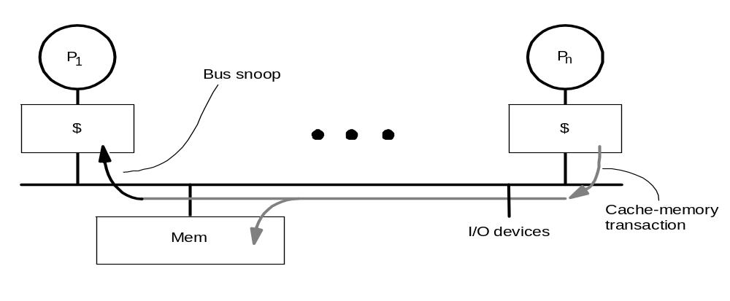
Snoopy Cache-Coherence Protocols
State
Address
Data
Cache Controller “snoops” all transactions on the shared medium (bus or switch)
  relevant transaction if for a block it contains
  take action to ensure coherence
    invalidate, update, or supply value
  depends on state of the block and the protocol
Either get exclusive access before write via write invalidate or update all copies on write (write update)
Computer Architecture Lecture 10

Slide 23
Example: Write-thru Invalidate
P
P
2
P
1
3
u
= ?
u
= ?
3
$
4
$
5
$
u
:5
u
:5
u
= 7
1
I/O devices
u
:5
2
u = 7
Memory
Must invalidate before step 3
Write update uses more broadcast medium BW
⇒ all recent MPUs use write invalidate
Computer Architecture Lecture 10

Slide 24
Architectural Building Blocks
What do we need to implement a cache coherence protocol?
  Cache block state transition diagram
    “States” encoded in valid/dirty bits
  Broadcast Medium Transactions (e.g., bus)
  Broadcast medium enforces serialization of read or write accesses ⇒ Write serialization
  Ability to find up-to-date copy of cache block
    Easy for write-through, harder for write-back
    Write-back can use snooping mechanism
      If processor has dirty copy of block, can respond
      May actually take longer to read data from cache than from memory—you have to work your way “up” the memory hierarchy!
Computer Architecture Lecture 10

Slide 25
Example Write Back Snoopy Protocol
Invalidation protocol, write-back cache
  Snoops every address on bus
  If it has a dirty copy of requested block, provides that block in response to the read request and aborts the memory access
Each memory block is in one state:
  Clean in all caches and up-to-date in memory (Shared)
  OR Dirty in exactly one cache (Exclusive)
  OR Not in any caches
Each cache block is in one state (track these):
  Shared : block can be read
  OR Modified : cache has only copy, its writeable, and dirty
  OR Invalid : block contains no data (in uniprocessor cache too)
Read misses: cause all caches to snoop bus
Writes to clean blocks are treated as misses
Computer Architecture Lecture 10

Slide 26
Write-Back State Machine - CPU
CPU Read hit, miss
State machine
for CPU requests
for each
cache block
4 cases per state
  Read hit
  Read miss
  Write hit
  Write miss
Shared
(read/only)
CPU Read
Invalid
Place read miss on bus
CPU Write
CPU Read miss
Place Write
Miss on bus
Write back
block
CPU Write
Place Write Miss on Bus
Cache Block
State
Modified
(read/write)
CPU read hit
CPU write hit
CPU Write Miss (?)
Write back cache block
Place write miss on bus
Computer Architecture Lecture 10
Notes:
Invalid:
read => shared
write => dirty
shared looks the same

Slide 27
Write-Back State Machine- Bus request
State machine
for bus requests
for each
cache block
  Write miss/read miss
Write miss
for this block
Shared
(read/only)
Invalid
Write miss
for this block
Write Back
Block; (abort
memory access)
Read miss
for this block
Write Back
Block; (abort
memory access)
Modified
(read/write)
Computer Architecture Lecture 10

Slide 28
Snooping protocol example
Assume we have the system shown on the next slide
  Each cache is direct-mapped, and each block contains two 32-bit words of memory—only the least significant byte of each word is shown.
  Addresses are written in hexadecimal. In this figure, the address tag shows the full address for simplicity.
  The coherence states are M (Modified—both exclusive and dirty), S (Shared), and I (Invalid). The system uses write-back caches and a write-invalidate protocol.
Computer Architecture Lecture 10

Slide 29
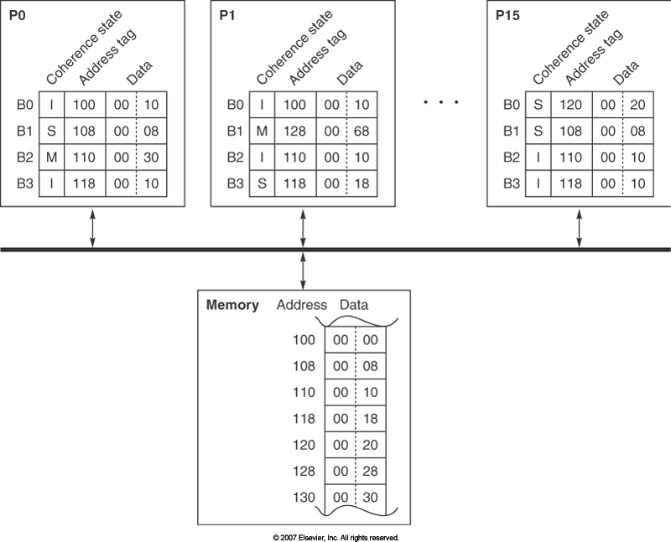
Snooping protocol example (cont.)
Computer Architecture Lecture 10

Slide 30
Snooping protocol example (cont.)
Each operation below is independently performed on the system using the initial state above. For each part, answer the following questions:
  What is the resulting state—coherence state, tags, and data—for the caches and memory after each given action?
    Show only the blocks that change, using the following format:
    P#.B#: (<state>, <tag>, <data>)
    If an access changes memory, list the state of the changed memory block using the format:
    M[<address>]: <data>
    Remember, a single access may affect multiple blocks, depending on their state.
  If the operation is a read, what value is returned?
P1: read 108
P0: write 108 ← 83
P1: write 108 ← 83
P15: read 118
P0: write 110 ← 52
P1: write 118 ← 99
P0: write 118 ← 99
Computer Architecture Lecture 10

Slide 31
Snooping protocol example solution
P1: read 108
  This block is in the shared state in two other caches, neither of which is affected. However, 108 maps to the same cache line as 128, a block which is in the modified state in P1’s cache, so that block must be written back to memory before 108 can be retrieved:
  P1.B1: (S, 108, 00 08)
  M[128]: 00 68
  The read returns 00.
P0: write 108 ← 83
  P0 and P15 hold this block in the shared state, so this write will invalidate P15’s copy and switch P0’s copy to modified:
  P0.B1: (M, 108, 83 08)
  P15.B1: (I, 108, 00 08)
P1: write 108 ← 83
  P1 is writing a block that both P0 and P15 have in the shared state—both of those copies must be invalidated. As in part (a), this access will evict 128 from P1’s cache, causing a write back and update of memory.
  P0.B1: (I, 108, 00 08)
  P1.B1: (M, 108, 83 08)
  P15.B1: (I, 108, 00 08)
  M[128]: 00 68
P15: read 118
  P15 reads a block not present in its cache; the block is in the shared state elsewhere.
  P15.B3: (S, 118, 00 18)
  The read returns 00.
Computer Architecture Lecture 10

Slide 32
Snooping protocol example soln (cont.)
P0: write 110 ← 52
  P0 writes a block it already holds in the modified state—no other caches are affected.
  P0.B2: (M, 110, 52 30)
P1: write 118 ← 99
  P1 holds this block in the shared state; no other caches have a copy, so the write only affects P1.
  P1.B3: (M, 118, 99 18)
P0: write 118 ← 99
  The only copy of this block is in P1. It must be invalidated, while P0 now has a modified copy.
  P0.B3: (M, 118, 99 18)
  P1.B3: (I, 118, 00 18)
Computer Architecture Lecture 10

Slide 33
Sharing misses
Cache performance is combination of
  Uniprocessor cache miss traffic
  Traffic caused by communication
    Results in invalidations and subsequent cache misses
4th C: coherence miss
  Joins Compulsory, Capacity, Conflict
  Two types of coherence misses, both related to sharing
    True sharing miss: word is written by one processor, thus invalidating block, and then accessed by a different processor
    False sharing miss: word is written by one processor, thus invalidating block, and then different word in that same block accessed by a different processor
  Increased sharing → increase in coherence misses
Computer Architecture Lecture 10

Slide 34
A Cache Coherent System Must:
Provide set of states, state transition diagram, and actions
Manage coherence protocol
  (0) Determine when to invoke coherence protocol
  (a) Find info about state of block in other caches to determine action
    whether need to communicate with other cached copies
  (b) Locate the other copies
  (c) Communicate with those copies (invalidate/update)
(0) is done the same way on all systems
  state of the line is maintained in the cache
  protocol is invoked if an “access fault” occurs on the line
Different approaches distinguished by (a) to (c)
Computer Architecture Lecture 10

Slide 35
Bus-based Coherence
All of (a), (b), (c) done through broadcast on bus
  faulting processor sends out a “search”
  others respond to the search probe and take necessary action
Could do it in scalable network too
  broadcast to all processors, and let them respond
Conceptually simple, but broadcast doesn’t scale with p
  on bus, bus bandwidth doesn’t scale
  on scalable network, every fault leads to at least p network transactions
Scalable coherence:
  can have same cache states and state transition diagram
  different mechanisms to manage protocol
Computer Architecture Lecture 10

Slide 36
Scalable Approach: Directories
Every memory block has associated directory information
  keeps track of copies of cached blocks and their states
  on a miss, find directory entry, look it up, and communicate only with the nodes that have copies if necessary
  in scalable networks, communication with directory and copies is through network transactions
Many alternatives for organizing directory information
Computer Architecture Lecture 10

Slide 37
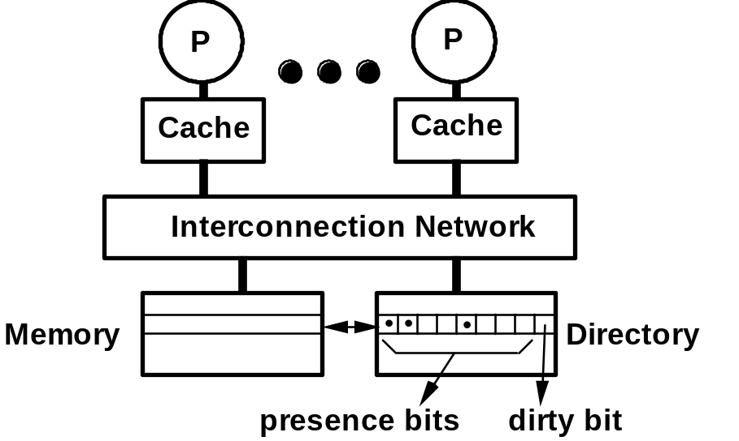
Basic Operation of Directory
• k processors.
• With each cache-block in memory:
k presence-bits, 1 dirty-bit
• With each cache-block in cache:
1 valid bit, and 1 dirty (owner) bit
• Read from main memory by processor i:
  • If dirty-bit OFF then { read from main memory; turn p[i] ON; }
  • if dirty-bit ON then { recall line from dirty proc (cache state to shared); update memory; turn dirty-bit OFF; turn p[i] ON; supply recalled data to i;}
• Write to main memory by processor i:
  • If dirty-bit OFF then { supply data to i; send invalidations to all caches that have the block; turn dirty-bit ON; turn p[i] ON; ... }
  • ...
Computer Architecture Lecture 10

Slide 38
Directory Protocol
Similar to Snoopy Protocol: Three states
  Shared: ≥ 1 processors have data, memory up-to-date
  Uncached: no processor has it; not valid in any cache
  Exclusive: 1 processor (owner) has data;
  memory out-of-date
In addition to cache state, must track which processors have data when in the shared state (usually bit vector, 1 if processor has copy)
Keep it simple(r):
  Writes to non-exclusive data
  => write miss
  Processor blocks until access completes
  Assume messages received
  and acted upon in order sent
Computer Architecture Lecture 10

Slide 39
Directory Protocol
No bus and don’t want to broadcast:
  Interconnect no longer single arbitration point
  All messages have explicit responses
Terms: typically 3 processors involved
  Local node where a request originates
  Home node where the memory location
  of an address resides
  Remote node has a copy of a cache
  block, whether exclusive or shared
Example messages on next slide:
P = processor number, A = address
Computer Architecture Lecture 10

Slide 40
Directory Protocol Messages (Fig 4.22)
Message type Source Destination Msg Content
Read miss Local cache Home directory P, A
  Processor P reads data at address A;
  make P a read sharer and request data
Write miss Local cache Home directory P, A
  Processor P has a write miss at address A;
  make P the exclusive owner and request data
Invalidate Home directory Remote caches A
  Invalidate a shared copy at address A
Fetch Home directory Remote cache A
  Fetch the block at address A and send it to its home directory;
  change the state of A in the remote cache to shared
Fetch/Invalidate Home directory Remote cache A
  Fetch the block at address A and send it to its home directory;
  invalidate the block in the cache
Data value reply Home directory Local cache Data
  Return a data value from the home memory (read miss response)
Data write back Remote cache Home directory A, Data
  Write back a data value for address A (invalidate response)
Computer Architecture Lecture 10

Slide 41
State Transition Diagram
For single cache block in directory-based system:
  States identical to snoopy case; transactions very similar.
  Transitions caused by read misses, write misses, invalidates, data fetch requests
  Generates read miss & write miss msg to home directory.
  Write misses that were broadcast on the bus for snooping => explicit invalidate & data fetch requests.
  Note: on a write, a cache block is bigger, so need to read the full cache block
Computer Architecture Lecture 10

Slide 42
State Transition Diagram for Directory
Similar states & structure as the transition diagram for an individual cache
2 actions: update of directory state & send messages to satisfy requests
Tracks all copies of memory block
Also indicates an action that updates the sharing set, Sharers, as well as sending a message
Computer Architecture Lecture 10

Slide 43
Directory State Machine
Read miss:
Sharers += {P};
send Data Value Reply
State machine
for Directory requests for each
memory block
Uncached state
if in memory
Read miss:
Sharers = {P}
send Data Value
Reply
Shared
(read only)
Uncached
Write Miss:
Sharers = {P};
send Data
Value Reply
msg
Write Miss:
send Invalidate
to Sharers;
then Sharers = {P};
send Data Value
Reply msg
Data Write Back:
Sharers = {}
(Write back block)
Write Miss:
Sharers = {P};
send Fetch/Invalidate;
send Data Value Reply
msg to remote cache
Read miss:
Sharers += {P};
send Fetch;
send Data Value Reply
msg to remote cache
(Write back block)
Exclusive
(read/write)
Computer Architecture Lecture 10
Notes:
Invalid:
read => shared
write => dirty
shared looks the same

Slide 44
Directory Protocol
Message sent to directory causes two actions:
  Update the directory
  More messages to satisfy request
Block is in Uncached state: the copy in memory is the current value; only possible requests for that block are:
  Read miss: requesting processor sent data from memory & requestor made only sharing node; state of block made Shared.
  Write miss: requesting processor is sent the value & becomes the Sharing node. The block is made Exclusive to indicate that the only valid copy is cached. Sharers indicates the identity of the owner.
Block is Shared => the memory value is up-to-date:
  Read miss: requesting processor is sent back the data from memory & requesting processor is added to the sharing set.
  Write miss: requesting processor is sent the value. All processors in the set Sharers are sent invalidate messages, & Sharers is set to identity of requesting processor. The state of the block is made Exclusive.
Computer Architecture Lecture 10

Slide 45
Directory Protocol (cont.)
Block is Exclusive: current value of the block is held in the cache of the processor identified by the set Sharers (the owner) => three possible directory requests:
  Read miss: owner processor sent data fetch message, causing state of block in owner’s cache to transition to Shared and causes owner to send data to directory, where it is written to memory & sent back to requesting processor.
  Identity of requesting processor is added to set Sharers, which still contains the identity of the processor that was the owner (since it still has a readable copy). State is shared.
  Data write-back: owner processor is replacing the block and hence must write it back, making memory copy up-to-date
  (the home directory essentially becomes the owner), the block is now Uncached, and the Sharer set is empty.
  Write miss: block has a new owner. A message is sent to old owner causing the cache to send the value of the block to the directory from which it is sent to the requesting processor, which becomes the new owner. Sharers is set to identity of new owner, and state of block is made Exclusive.
Computer Architecture Lecture 10

Slide 46
Directory protocol example
Assume
  Dual-processor system
  Write-invalidate directory coherence protocol
  Initial directory state:
Block # | P0 | P1 | Dirty
0 | 1 | 0 | 1
1 | 0 | 0 | 0
2 | 1 | 1 | 0
3 | 0 | 1 | 0
Computer Architecture Lecture 10

Slide 47
Directory protocol example (cont.)
What messages are sent between nodes and directory for each transactions to ensure
  Processor has the most up-to-date block copy
  Appropriate invalidations are made
  Directory holds the appropriate state
What is the final sharing state?
Assume answers are independent: B doesn’t depend on A, for example
P0: read block 1
P1: write block 2
P1: read block 0
P0: read block 3
Computer Architecture Lecture 10

Slide 48
Directory protocol example: solution
P0: read block 1
  Read to uncached block: must request data
  Messages
    ReadMiss(P0,1)
    DataValueReply(mem[1]) sent to P0
  Final state: shared, with P0 as only sharer
P1: write block 2
  Write to shared block: write miss sent out to invalidate other copy
  Messages
    WriteMiss(P1,2)
    Invalidate(2) sent to P0
    DataValueReply(mem[2]) sent to P1
      Indicates invalidation complete
  Final state: exclusive, with P1 as only sharer
Computer Architecture Lecture 10

Slide 49
Directory protocol example: soln (cont.)
P1: read block 0
  Read to exclusive block: must get most up-to-date value
  Messages
    ReadMiss(P1,0)
    Fetch(0) sent to P0
    DataWriteBack(0, mem[0]) sent from P0 to directory
    DataValueReply(mem[0] sent to P1
  Final state: shared, with P0 and P1 both sharing
P0: read block 3
  Read to shared block: just need up-to-date value
  Messages
    ReadMiss(P0,3)
    DataValueReply(mem[3]) sent to P0
  Final state: shared, with P0 and P1 both sharing
Computer Architecture Lecture 10

Slide 50
Final exam notes
Allowed to bring:
  Two 8.5” x 11” double-sided sheets of notes
  Calculator
No other notes or electronic devices
You can’t share anything—erasers, pencils, etc.
  I’ll bring extra erasers/pencils for those who may need them
Exam will last until 9:30
  Will be written for ~90 minutes ... in theory
Covers all lectures after Exam 1
  Material starts with multiple issue/multithreading
Question formats
  Problem solving
    Largely similar to homework problems, but shorter
  Some short answer
    Explain concepts in short paragraph
Computer Architecture Lecture 10

Slide 51
Review: TLP, multithreading
ILP (which is implicit) limited on realistic hardware for single thread of execution
Could look at explicit parallelism: Thread-Level Parallelism (TLP) or Data-Level Parallelism (DLP)
Focus on TLP and multithreading
  Coarse-grained: switch threads on a stall
  Fine-grained: switch threads every cycle
  Simultaneous: allow multiple threads to execute in same cycle
Computer Architecture Lecture 10

Slide 52
Review: Memory hierarchies
Want large, fast, low-cost memory; can’t have it all at once
Use multiple levels: cache (may have >1), main memory, disk
Discussed operation of hierarchy, focusing heavily on:
  Caching: principle of locality, addressing cache, “4 questions” (block placement, identification, replacement, write strategy)
  Virtual memory: advantages (translation, protection, sharing), page tables & address translation, page replacement, TLB
Computer Architecture Lecture 10

Slide 53
Review: cache optimizations
Way prediction
  Want benefits of
    Direct-mapped: fast hits
    Set-associative: fewer conflicts
  Predict which way within set holds data
Multi-banked caches
  Cache physically split into pieces (“banks”)
  Data sequentially interleaved
    Spread accesses across banks
  Allows for cache pipelining, non-blocking caches
Computer Architecture Lecture 10

Slide 54
Review: cache optimizations
Critical word first / early restart
  Fetch desired word in cache block first on miss
  Restart processor as soon as desired word received
Computer Architecture Lecture 10

Slide 55
Review: Storage
Disks → RAID
  Build redundancy (parity) into disk array because MTTFarray = MTTFdisk / # disks
  Files “striped” across disks along with parity
  Different levels of RAID offer improvements
    RAID 1: Mirroring
    RAID 3: Introduced parity disk
    RAID 4: Use per-sector error correction → allows small reads
    RAID 5: Interleaved parity → allows small writes
Computer Architecture Lecture 10

Slide 56
Review: Multiprocessors
Multiprocessor caches hold both private and shared data; must provide both:
  Migration: Data can be moved to local cache and used transparently
  Replication: Shared data can be used in multiple caches
Cache coherence
  Guarantee any read returns the most recently written value
  Coherent system
    Preserves program order
    Maintains coherent view of memory
    Serializes writes
      Write consistency: write completes when all processors can read it, and all writes across all processors are serialized
Computer Architecture Lecture 10

Slide 57
Review: Cache coherence protocols
Need to maintain coherence; two types of protocols for doing so
  Directory based: One (logically) centralized structure holds sharing information
    One entry per memory block
  Snooping: Each cache holding a copy of data has copy of its sharing information
    One entry per cache block
    Caches “snoop” bus and respond to relevant transactions
  You should have an understanding of both types of protocols
Two ways to handle writes
  Write invalidate: Ensure that cache has exclusive access to block before performing write
    All other copies are invalidated
  Write update (or write broadcast): Update all cached copies of a block whenever block is written
Computer Architecture Lecture 10

Slide 58
Review: More cache coherence
Should be familiar with coherence protocol state transition diagrams
  What happens on different CPU transactions? (Read/Write, Hit/Miss)
  For snooping protocol, what happens for relevant transactions sent over bus? (Read or write miss)
    In snooping protocol, all state transitions occur for cache block, since cache block tracks sharing info
  For directory protocol, what happens for each message sent to given processor or directory? (Read/Write Miss, Invalidate and/or Fetch, Data Reply)
    State transitions occur in cache blocks and directory entries (directory holds sharing info)
Additional cache misses: coherence misses
  True sharing misses: one processor writes to same location that’s later accessed by another processor
  False sharing misses: one processor writes to same block (but different location) later accessed by another processor
Computer Architecture Lecture 10

Slide 59
Final notes
Next time: Final Exam
Reminders
  HW 7 due today
  HW 8 due Monday 4/28 by 5:00 PM
    Extra credit assignment—replaces lowest grade for HW 1-7
  Final exam: Thursday 5/1
    Must complete course eval and bring to exam (will post online)
Computer Architecture Lecture 10

