Slide 1
16.482 / 16.561
Computer Architecture and Design
Instructor: Dr. Michael Geiger
Spring 2014
Lecture 4:
ILP and branch prediction

Slide 2
Lecture outline
Announcements/reminders
  HW 2 due today
  HW 3 to be posted; due 2/27
Review
  Basic datapath design
  Single-cycle datapath
  Pipelining
Today’s lecture
  Instruction level parallelism (intro)
  Dynamic branch prediction
Computer Architecture Lecture 4

Slide 3
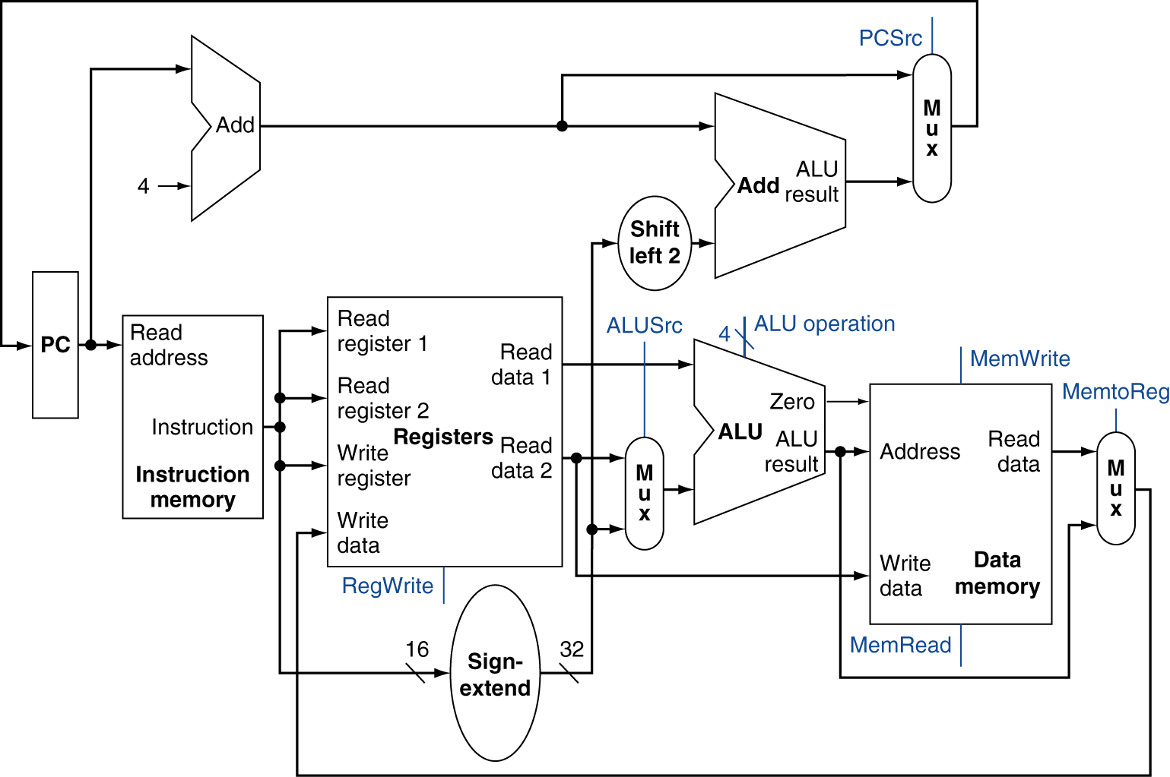
Review: Simple MIPS datapath
Chooses PC+4 or branch target
Chooses ALU output or memory output
Chooses register or sign-extended immediate
Computer Architecture Lecture 4

Slide 4
Review: Pipelining
Pipelining → low CPI and a short cycle
  Simultaneously execute multiple instructions
  Use multi-cycle “assembly line” approach
  Use staging registers between cycles to hold information
Hazards: situation that prevents instruction from executing during a particular cycle
  Structural hazards: hardware conflicts
  Data hazards: dependences cause instruction stalls; can resolve using:
    No-ops: compiler inserts stall cycles
    Forwarding: add hardware paths to ALU inputs
  Control hazards: must wait for branches
    Can move target, comparison into ID → only 1 cycle delay
Computer Architecture Lecture 4

Slide 5
Review: Pipeline diagram
 | Cycle 1 | 2 | 3 | 4 | 5 | 6 | 7 | 8
lw | IF | ID | EX | MEM | WB
add |  | IF | ID | EX | MEM | WB
beq |  |  | IF | ID | EX | MEM | WB
sw |  |  |  | IF | ID | EX | MEM | WB
Pipeline diagram shows execution of multiple instructions
  Instructions listed vertically
  Cycles shown horizontally
  Each instruction divided into stages
  Can see what instructions are in a particular stage at any cycle
Computer Architecture Lecture 4

Slide 6
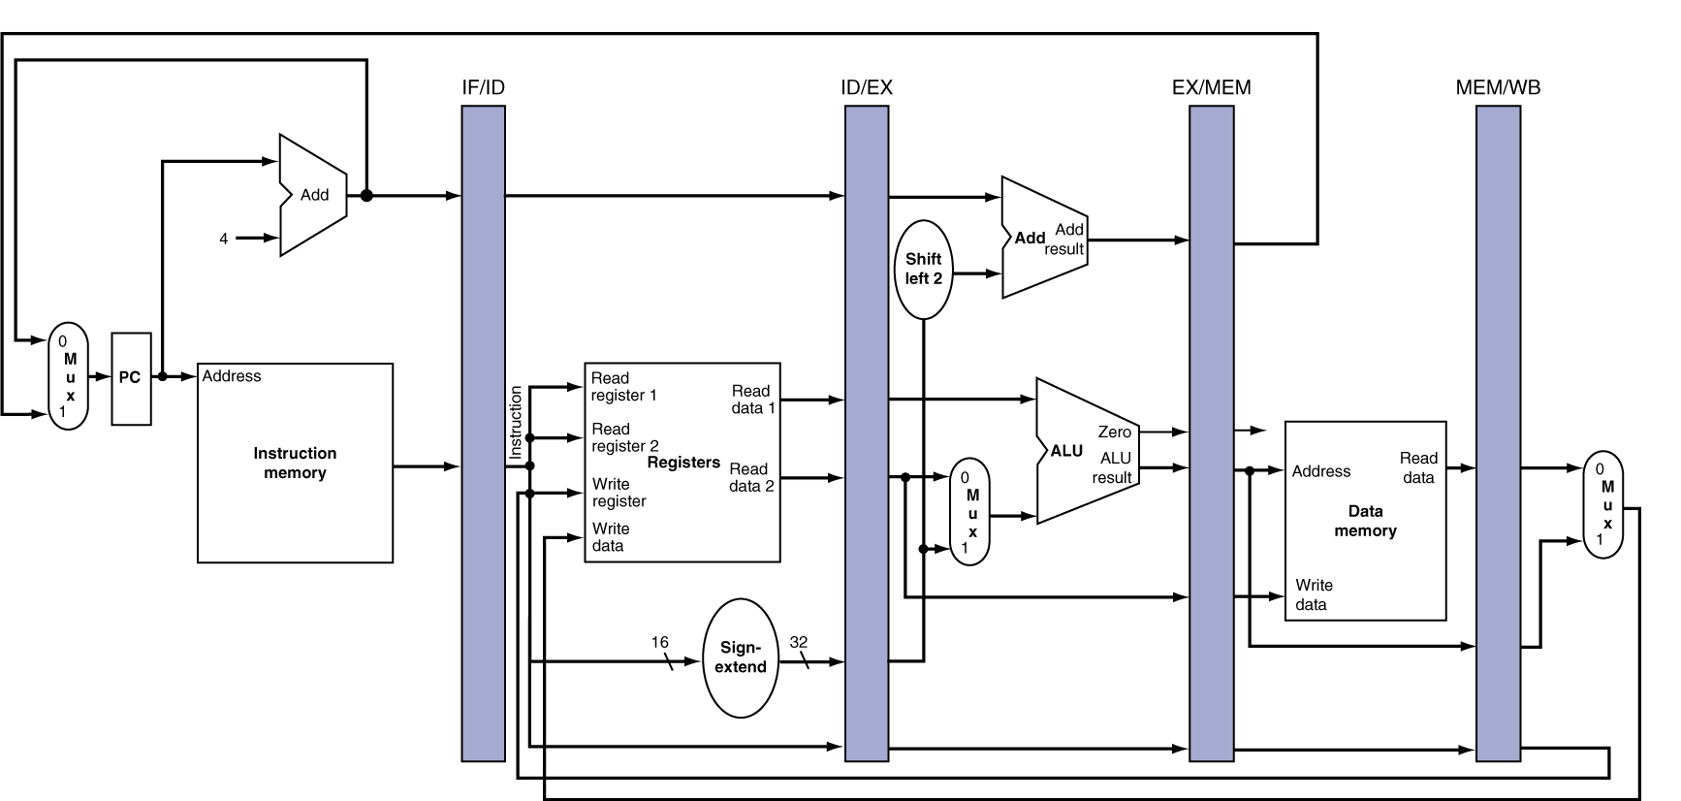
Review: Pipeline registers
Need registers between stages for info from previous cycles
Register must be able to hold all needed info for given stage
  For example, IF/ID must be 64 bits—32 bits for instruction, 32 bits for PC+4
May need to propagate info through multiple stages for later use
  For example, destination reg. number determined in ID, but not used until WB
Computer Architecture Lecture 4
Notes:
Morgan Kaufmann Publishers
Chapter 4 — The Processor

Slide 7
Branch Stall Impact
If CPI = 1, 30% branch,
Stall 3 cycles => new CPI = 1.9!
Two part solution:
  Determine branch taken or not sooner, AND
  Compute taken branch address earlier
MIPS branch tests if register = 0 or ≠ 0
MIPS Solution:
  Move Zero test to ID/RF stage
  Adder to calculate new PC in ID/RF stage
  1 clock cycle penalty for branch versus 3
Computer Architecture Lecture 4

Slide 8
Four Branch Hazard Alternatives
#1: Stall until branch direction is clear
#2: Predict Branch Not Taken
  Execute successor instructions in sequence
  “Squash” instructions in pipeline if branch actually taken
  Advantage of late pipeline state update
  47% MIPS branches not taken on average
  PC+4 already calculated, so use it to get next instruction
#3: Predict Branch Taken
  53% MIPS branches taken on average
  But haven’t calculated branch target address in MIPS
    MIPS still incurs 1 cycle branch penalty
    Other machines: branch target known before outcome
Computer Architecture Lecture 4

Slide 9
Four Branch Hazard Alternatives
#4: Delayed Branch
  Define branch to take place AFTER a following instruction
  branch instruction
  sequential successor₁
  sequential successor₂
  ........
  sequential successor_{n}
  branch target if taken
  1 slot delay allows proper decision and branch target address in 5 stage pipeline
  MIPS uses this
Branch delay of length n
Computer Architecture Lecture 4

Slide 10
Delayed Branch
Compiler effectiveness for single branch delay slot:
  Fills about 60% of branch delay slots
  About 80% of instructions executed in branch delay slots useful in computation
  About 50% (60% x 80%) of slots usefully filled
Downside: deeper pipelines/multiple issue → more branch delay
  Dynamic approaches now more common
    More expensive, but also more flexible
    Will revisit in discussion of ILP
Computer Architecture Lecture 4

Slide 11
Instruction Level Parallelism
Instruction-Level Parallelism (ILP): the ability to overlap instruction execution
2 approaches to exploit ILP & improve performance:
  Use hardware to dynamically find parallelism while running program
  Use software to find parallelism statically at compile-time
Computer Architecture Lecture 4

Slide 12
Finding ILP
Basic Block (BB) ILP is quite small
  BB: a code sequence with 1 entry and 1 exit point
  average dynamic branch frequency 15% to 25%
  => 4 to 7 instructions execute between branches
  Instructions in BB likely to depend on each other
Must exploit ILP across multiple BB
Simplest: loop-level parallelism
  Parallelism across iterations of a loop:
for (i=1; i<=1000; i=i+1)
x[i] = x[i] + y[i];
Computer Architecture Lecture 4

Slide 13
Loop-Level Parallelism
Exploit loop-level parallelism by “unrolling loop” either
dynamically via branch prediction or
static via loop unrolling by compiler
Determining instruction dependence is critical to Loop Level Parallelism
If 2 instructions are
  parallel, they can execute simultaneously in a pipeline of arbitrary depth without causing any stalls
  dependent, they are not parallel and must be executed in order, although they may often be partially overlapped
    A stall caused by a dependence is a hazard
Computer Architecture Lecture 4

Slide 14
Static solution to LLP: Loop unrolling
Loop iterations are often independent, e.g.
for (i=1000; i>0; i=i–1)
x[i] = x[i] + s;
Can create multiple copies of loop, then schedule them to avoid stalls
  Replicate loop body, renaming registers as you go
  Reorder appropriately to eliminate stalls
  Update entry/exit code
Unrolling goals
  Cover all stalls (without using too many registers)
  # old iterations should be divisible by # times unrolled
    Example: loop with 100 iterations can be unrolled 2, 4, 5 times; not 3
Computer Architecture Lecture 4

Slide 15
3 Limits to Loop Unrolling
Decrease in amount of overhead amortized with each extra unrolling
  Amdahl’s Law
Growth in code size
  For larger loops, concern it increases the instruction cache miss rate
Register pressure: potential shortfall in registers created by aggressive unrolling and scheduling
  If not be possible to allocate all live values to registers, may lose some or all of its advantage
Loop unrolling reduces branch impact on pipeline; another way is dynamic branch prediction
Computer Architecture Lecture 4

Slide 16
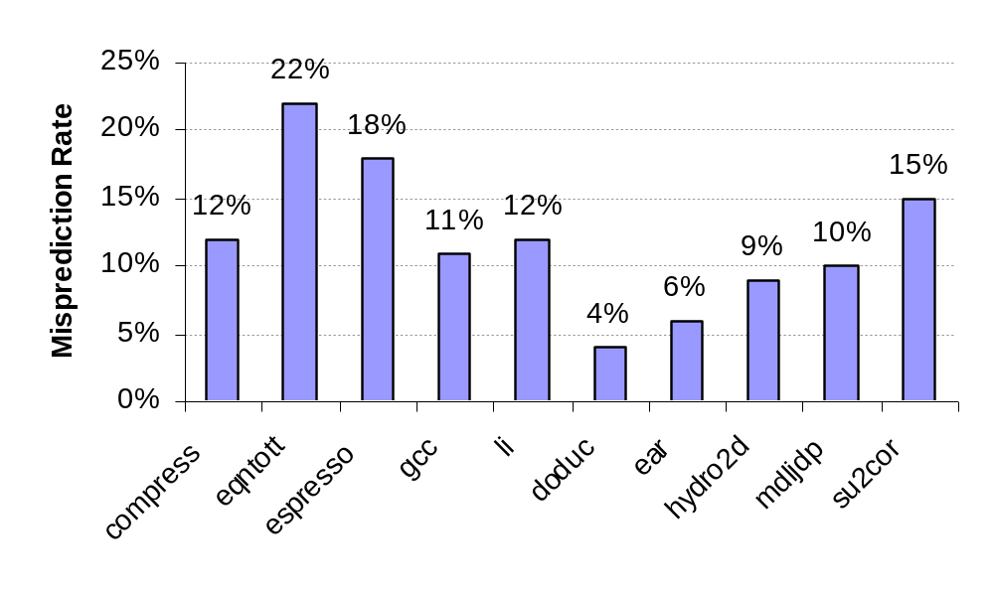
Static Branch Prediction
Earlier lecture showed scheduling code around delayed branch
To reorder code around branches, need to predict branch statically during compilation
Simplest scheme is to predict a branch as taken
  Average misprediction = untaken branch frequency = 34% SPEC
More accurate scheme predicts branches using profile information collected from earlier runs, and modify prediction based on last run:
Computer Architecture Lecture 4
Integer
Floating Point

Slide 17
Dynamic Branch Prediction
Why does prediction work?
  Underlying algorithm has regularities
  Data that is being operated on has regularities
  Instruction sequence has redundancies that are artifacts of way that humans/compilers think about problems
Is dynamic branch prediction better than static branch prediction?
  Seems to be
  There are a small number of important branches in programs which have dynamic behavior
Computer Architecture Lecture 4

Slide 18
Dynamic Branch Prediction
Performance = ƒ(accuracy, cost of misprediction)
Branch History Table: Lower bits of PC address index table of 1-bit values
  Says whether or not branch taken last time
  No address check
Problem: in a loop, 1-bit BHT will cause two mispredictions (avg is 9 iterations before exit):
  End of loop case, when it exits instead of looping as before
  First time through loop on next time through code, when it predicts exit instead of looping
Computer Architecture Lecture 4

Slide 19
Dynamic Branch Prediction
Solution: 2-bit scheme where change prediction only if get misprediction twice
Red: “stop” (branch not taken)
Green: “go” (branch taken)
Adds hysteresis to decision making process
T
NT
Predict Taken
11
10
Predict Taken
T
T
NT
NT
Predict Not
Taken
01
00
Predict Not
Taken
T
NT
Computer Architecture Lecture 4

Slide 20
BHT example 1
Simple loop with 1 branch, 4 iterations
BHT state initially 00
First iteration: predict NT, actually T
  Update BHT entry: 00 → 01
Second iteration: predict NT, actually T
  Update BHT entry: 01 → 11
Third iteration: predict T, actually T
  No change to BHT entry
Fourth iteration: predict T, actually NT
  Update BHT entry: 11 → 10
Computer Architecture Lecture 4

Slide 21
BHT example 1
Doesn’t seem to be very helpful
  4 instances of branch executed, 3 mispredictions
What if we return to the loop later?
  Initial BHT entry state is 10
  First iteration: predict T, actually T
    Update BHT entry to 11
  Second iteration: predict T, actually T
  Third iteration: predict T, actually T
  Fourth iteration: predict T, actually NT
    Update BHT entry
  → 4 instances, only 1 misprediction
Computer Architecture Lecture 4

Slide 22
BHT example 2
Given a nested loop:
Address
0 Loop1: ...
8 Loop2: ...
16 BNE R4, Loop2
20 ...
28 BEQ R7, Loop1
Assume 4-entry BHT
Questions:
  How many bits to index?
    And which ones?
  What’s initial prediction?
Say inner loop has 8 iterations, outer loop has 4
  How many mispredictions?
Line # | Prediction
0 | 00
1 | 00
2 | 00
3 | 00
Computer Architecture Lecture 4

Slide 23
BHT example 2 solution
4 = 2² entries in BHT → 2 bits to index
Use lowest order PC bits that actually change
  All instructions 32 bits → lowest 2 bits always 0
  Use next two bits
    For address 16 = 0…0001 0000₂, line 0 of BHT
    For address 28 = 0…0001 1100₂, line 3 of BHT
Computer Architecture Lecture 4

Slide 24
BHT example 2 solution (cont.)
First iteration of outer loop
  Reach inner loop for first time: BHT entry 0 = 00
    First iteration: predict NT, actually T
      Update BHT entry to 01
    Second iteration: predict NT, actually T
      Update BHT entry to 11
    Third iteration: predict T, actually T
      Can see that 4th-7th iterations will be exactly the same
    Eighth iteration: predict T, actually NT
      Update BHT entry to 10
  Reach branch at end of outer loop: BHT entry 3 = 00
    Predict NT, actually T
      Update BHT entry to 01
For this outer loop iteration
  5 correct predictions → Iterations 3-7 of inner loop
  4 mispredictions → Iterations 1, 2, & 8 of inner loop; iteration 1 of outer loop
Computer Architecture Lecture 4

Slide 25
BHT example 2 solution (cont.)
Second iteration of outer loop
  Reach inner loop: BHT entry 0 = 10
    First iteration: predict T, actually T
      Update BHT entry to 11
    2nd-7th iterations: predict T, actually T, no BHT entry transitions
    Eighth iteration: predict T, actually NT
      Update BHT entry to 10
  Reach branch at end of outer loop: BHT entry 3 = 01
    Predict NT, actually T
      Update BHT entry to 11
For this outer loop iteration
  7 correct predictions → Iterations 1-7 of inner loop
  2 mispredictions → Iteration 8 of inner loop; iteration 2 of outer loop
Computer Architecture Lecture 4

Slide 26
BHT example 2 solution (cont.)
Third iteration of outer loop
  Inner loop exactly the same
    Predict iterations 1-7 correctly, 8 incorrectly
  Correctly predict outer loop branch this time
    BHT entry 3 = 11, so predict T and branch actually T
  8 correct predictions, 1 misprediction
Fourth and final iteration of outer loop
  Inner loop again the same
  Outer loop branch mispredicted
    Predict T, branch actually NT
  7 correct predictions, 2 mispredictions
Overall
  5 + 7 + 8 + 7 = 27 correct predictions
  4 + 2 + 1 + 2 = 9 mispredictions
  Misprediction rate = 9 / (9 + 27) = 9 / 36 = 25%
Computer Architecture Lecture 4

Slide 27
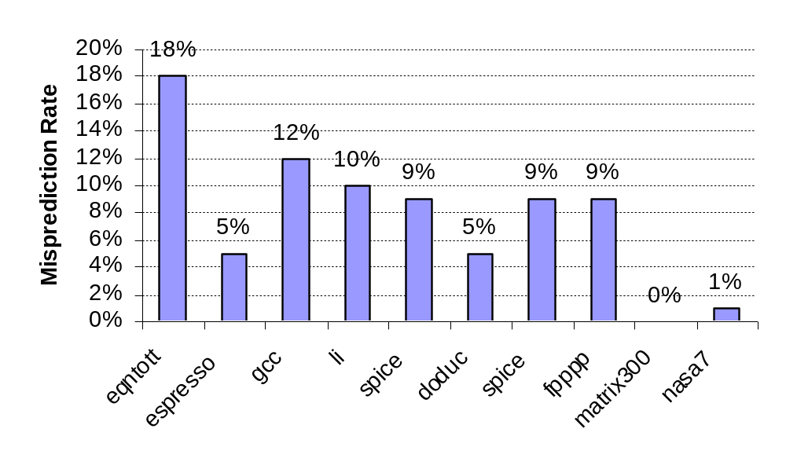
BHT Accuracy
Mispredict because either:
  Wrong guess for that branch
  Got branch history of wrong branch when index the table
4096 entry table:
Integer
Floating Point
Computer Architecture Lecture 4

Slide 28
Correlated Branch Prediction
Idea: record m most recently executed branches as taken or not taken, and use that pattern to select the proper n-bit branch history table
In general, (m,n) predictor means record last m branches to select between 2^{m} history tables, each with n-bit counters
  Thus, old 2-bit BHT is a (0,2) predictor
Global Branch History: m-bit shift register keeping T/NT status of last m branches.
Each entry in table has an n-bit predictor
  Choose entry same way you do in a basic BHT (low-order address bits)
Computer Architecture Lecture 4

Slide 29
Correlating Branches
(2,2) predictor
  – Behavior of recent branches selects between four predictions of next branch, updating just that prediction
Branch address
4
2-bits per branch predictor
Prediction
2-bit global branch history
Computer Architecture Lecture 4

Slide 30
Correlating example
Look at one entry of a simple (2,2) predictor
Assume
  The program has been running for some time
  Entry state is currently: (00, 10, 11, 01)
  Global history is currently: 01
    Last two branches were NT, T (T most recent)
Say we have a branch accessing this entry
  First 2 times, branch is taken
  Next 2 times, branch is not taken
  Final time, branch is taken
Computer Architecture Lecture 4

Slide 31
Correlating example (cont.)
First access
  Global history = 01 → entry[1] = 10
  Predict T, actually T
    Update entry[1] = 11
  Update global history = 11
Second access
  Global history = 11 → entry[3] = 01
  Predict NT, actually T
    Update entry[3] = 11
  Update global history = 11
    Looks the same, but you are shifting in a 1
Computer Architecture Lecture 4

Slide 32
Correlating example (cont.)
Third access
  Global history = 11 → entry[3] = 11
  Predict T, actually NT
    Update entry[3] = 10
  Update global history = 10
Fourth access
  Global history = 10 → entry[2] = 11
  Predict T, actually NT
    Update entry[2] = 10
  Update global history = 00
Fifth access
  Global history = 00 → entry[0] = 00
  Predict NT, actually T
    Update entry[0] = 01
  Update global history = 01
Computer Architecture Lecture 4

Slide 33
Accuracy of Different Schemes
20%
4096 Entries 2-bit BHT
Unlimited Entries 2-bit BHT
1024 Entries (2,2) BHT
18%
16%
14%
12%
11%
Frequency of Mispredictions
10%
8%
6%
6%
6%
6%
5%
5%
4%
4%
2%
1%
1%
0%
0%
nasa7
matrix300
tomcatv
doducd
spice
fpppp
gcc
expresso
eqntott
li
4,096 entries: 2-bits per entry
Unlimited entries: 2-bits/entry
1,024 entries (2,2)
Computer Architecture Lecture 4

Slide 34
Branch Target Buffers (BTB)
Branch prediction logic: relatively fast
Branch target calculation is slower
  Must actually decode instruction
  To remove stalls in speculative execution, need target more quickly
    Store previously calculated targets in branch target buffer
Send PC of branch to the BTB
  Check if matching address exists (tag check, like cache)
If match is found, corresponding Predicted PC is returned
If the branch was predicted taken, instruction fetch continues at the returned predicted PC
Computer Architecture Lecture 4

Slide 35
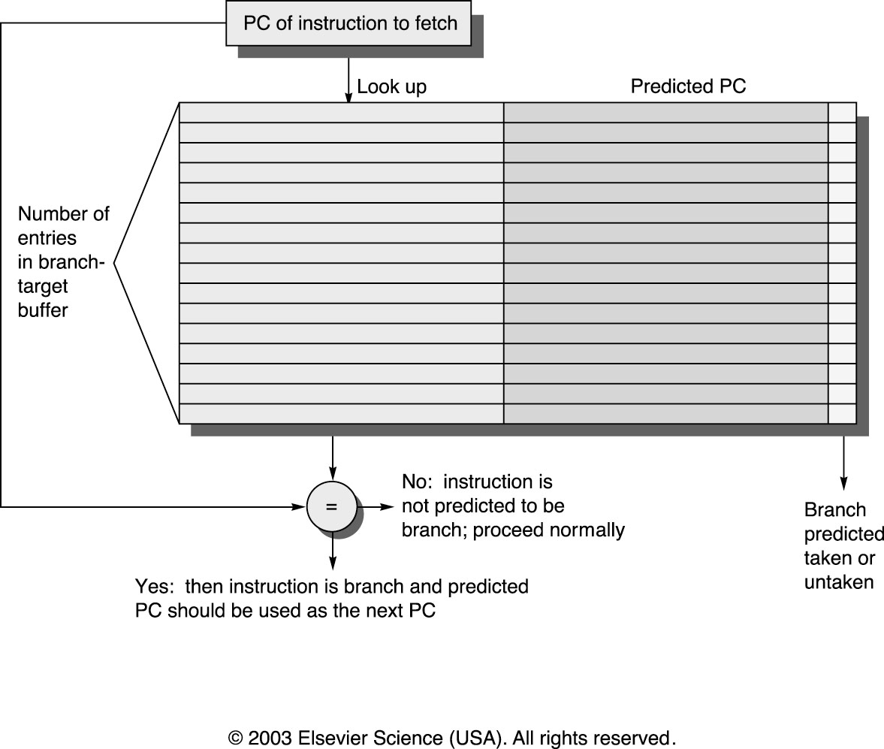
Branch Target Buffers
Computer Architecture Lecture 4

Slide 36
Final notes
Next time:
  Instruction scheduling issues
    Dynamic scheduling
    Multiple issue
Announcements/reminders
  HW 2 due today
  HW 3 to be posted; due 2/27
Computer Architecture Lecture 4

