Slide 1
16.482 / 16.561
Computer Architecture and Design
Instructor: Dr. Michael Geiger
Spring 2014
Lecture 6:
Speculation
Midterm exam preview

Slide 2
Lecture outline
Announcements/reminders
  HW 4 due today
  Midterm exam next week
Today’s lecture
  Speculation
  Midterm exam preview
Computer Architecture Lecture 8

Slide 3
Review: Dynamic scheduling
Dynamic scheduling - hardware rearranges the instruction execution to reduce stalls while maintaining data flow and exception behavior
  Key idea: Allow instructions behind stall to proceed
  Allow out-of-order execution and out-of-order completion
  We use Tomasulo’s Algorithm
  Decode stage now handles:
    Issue—check for structural hazards and assign instruction to functional unit (via reservation station)
      Check for register values
  Reservation stations implicitly perform register renaming
    Resolves potential WAW, WAR hazards
  Results broadcast over common data bus
Computer Architecture Lecture 8

Slide 4
Speculation to greater ILP
3 components of HW-based speculation:
Dynamic branch prediction
  Need BTB to get target in 1 cycle
Ability to speculate past branches
Dynamic scheduling
In Tomasulo’s algorithm, separate instruction completion from commit
  Once instruction is non-speculative, it can update registers/memory
  Reorder buffer tracks program order
    Head of ROB can commit when ready
    ROB supplies data between complete and commit
Computer Architecture Lecture 8

Slide 5
Reorder Buffer Entry
Each entry in the ROB contains four fields:
Instruction type
  a branch (has no destination result), a store (has a memory address destination), or a register operation (ALU operation or load, which has register destinations)
Destination
  Register number (for loads and ALU operations) or
  memory address (for stores)
  where the instruction result should be written
Value
  Value of instruction result until the instruction commits
Ready
  Indicates that instruction has completed execution, and the value is ready
Computer Architecture Lecture 8

Slide 6
Speculative Tomasulo’s Algorithm
Instruction fetch--get instruction from memory; place in Op Queue
Issue—get instruction from FP Op Queue
  If reservation station and reorder buffer slot free, issue instr & send operands & reorder buffer no. for destination (this stage sometimes called “dispatch”)
Execution—operate on operands (EX)
  When both operands ready then execute; if not ready, watch CDB for result; when both in reservation station, execute; checks RAW (sometimes called “issue”)
Memory access--if needed (MEM)
  NOTE: Stores update memory at commit, not MEM
Write result—finish execution (WB)
  Write on Common Data Bus to all awaiting FUs
  & reorder buffer; mark reservation station available.
Commit—update register with reorder result
  When instr. at head of reorder buffer & result present, update register with result (or store to memory) and remove instr from reorder buffer. Mispredicted branch flushes reorder buffer (sometimes called “graduation”)
Computer Architecture Lecture 8

Slide 7
Tomasulo’s With Reorder buffer:
Done?
FP Op
Queue
ROB7
ROB6
ROB5
ROB4
ROB3
ROB2
ROB1
Newest
Reorder Buffer
Oldest
F0
LD F0,10(R2)
N
Registers
To
Memory
Dest
Dest
from
Memory
Dest
Reservation
Stations
1 10+R2
FP adders
FP multipliers
Computer Architecture Lecture 8
Notes:
Resolve RAW memory conflict? (address in memory buffers)
Integer unit executes in parallel

Slide 8
Revisiting stores with speculation
With ROB, store buffers eliminated
Why?
  Can’t write memory until you know value is non-speculative
  Once address is calculated, store in “destination” field of ROB entry
  Need additional field in ROB for stores: equivalent to “Q” fields in reservation stations
    Indicates what instruction is writing value to be stored
Computer Architecture Lecture 8

Slide 9
Reorder buffer example
Given the following code:
  L.D F0, 0(R1)
  MUL.D F4, F0, F2
  S.D F4, 0(R1)
  DADDIU R1, R1, #-8
  BNE R1, R2, Loop
Walk through two iterations of the loop
Assume
  2 cycles for add, load
  1 cycle for address calculation
  6 cycles for multiply
  Forwarding via CDB
Computer Architecture Lecture 8

Slide 10
Reorder buffer example: key points
Execution stages
  Fetch & issue: always in order
  Execution & completion: may be out of order
  Commit: always in order
Hardware
  Reservation stations
    Occupied from IS to WB
  Reorder buffer
    Occupied from IS to C
    Used to
      Maintain program order for in-order commit
      Supply register values between WB and C
  Register result status
    Rename registers based on ROB entries
Computer Architecture Lecture 8

Slide 11
Memory hazards, exceptions
Reorder buffer helps limit memory hazards
  With additional logic for disambiguation (determine if addresses match)
  WAW / WAR automatically removed
  RAW maintained by
    Stalling loads if store with same address is in flight
    Ensuring that effective addresses are computed in order
Precise exceptions logical extension of ROB
  If instruction causes exception, flag in ROB
  Handle exception when instruction commits
Computer Architecture Lecture 8

Slide 12
Midterm exam notes
Allowed to bring:
  Two 8.5” x 11” double-sided sheets of notes
  Calculator
No other notes or electronic devices (phone, laptop, etc.)
Exam will last until 9:30
  Will be written for ~90 minutes
Covers all lectures through this week
  Material starts with MIPS instruction set
Question formats
  Problem solving
  Some short answer—may be asked to explain concepts
  Similar to homework, but shorter
Old exams are on website
  Note: not all material the same
  No performance assessment on this semester’s midterm
  Dynamic scheduling/speculation were on the final last semester
Computer Architecture Lecture 6

Slide 13
Review: MIPS addressing modes
MIPS implements several of the addressing modes discussed earlier
To address operands
  Immediate addressing
    Example: addi $t0, $t1, 150
  Register addressing
    Example: sub $t0, $t1, $t2
  Base addressing (base + displacement)
    Example: lw $t0, 16($t1)
To transfer control to a different instruction
  PC-relative addressing
    Used in conditional branches
  Pseudo-direct addressing
    Concatenates 26-bit address (from J-type instruction) shifted left by 2 bits with the 4 upper bits of the PC
Computer Architecture Lecture 2

Slide 14
Review: MIPS integer registers
Name | Register number | Usage
$zero | 0 | Constant value 0
$v0-$v1 | 2-3 | Values for results and expression evaluation
$a0-$a3 | 4-7 | Function arguments
$t0-$t7 | 8-15 | Temporary registers
$s0-$s7 | 16-23 | Callee save registers
$t8-$t9 | 24-25 | Temporary registers
$gp | 28 | Global pointer
$sp | 29 | Stack pointer
$fp | 30 | Frame pointer
$ra | 31 | Return address
List gives mnemonics used in assembly code
  Can also directly reference by number ($0, $1, etc.)
Conventions
  $s0-$s7 are preserved on a function call (callee save)
  Register 1 ($at) reserved for assembler
  Registers 26-27 ($k0-$k1) reserved for operating system
Computer Architecture Lecture 2

Slide 15
Review: MIPS data transfer instructions
For all cases, calculate effective address first
  MIPS doesn’t use segmented memory model like x86
  Flat memory model → EA = address being accessed
lb, lh, lw
  Get data from addressed memory location
  Sign extend if lb or lh, load into rt
lbu, lhu, lwu
  Get data from addressed memory location
  Zero extend if lb or lh, load into rt
sb, sh, sw
  Store data from rt (partial if sb or sh) into addressed location
Computer Architecture Lecture 2

Slide 16
Review: MIPS computational instructions
Arithmetic
  Signed: add, sub, mult, div
  Unsigned: addu, subu, multu, divu
  Immediate: addi, addiu
    Immediates are sign-extended
Logical
  and, or, nor, xor
  andi, ori, xori
    Immediates are zero-extended
Shift (logical and arithmetic)
  srl, sll – shift right (left) logical
    Shift the value in rs by shamt digits to right or left
    Fill empty positions with 0s
    Store the result in rd
  sra – shift right arithmetic
    Same as above, but sign-extend the high-order bits
  Can be used for multiply / divide by powers of 2
CIS 273: Lecture 3

Slide 17
Review: computational instructions (cont.)
Set less than
  Used to evaluate conditions
    Set rd to 1 if condition is met, set to 0 otherwise
  slt, sltu
    Condition is rs < rt
  slti, sltiu
    Condition is rs < immediate
    Immediate is sign-extended
Load upper immediate (lui)
  Shift immediate 16 bits left, append 16 zeros to right, put 32-bit result into rd
Computer Architecture Lecture 2

Slide 18
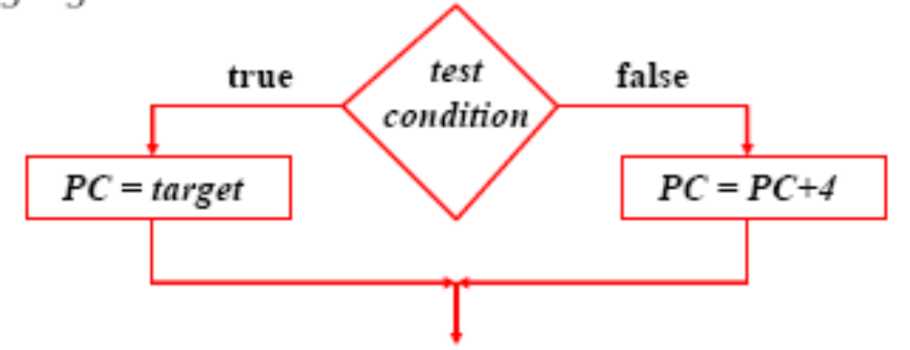
Review: MIPS control instructions
Branch instructions test a condition
  Equality or inequality of rs and rt
    beq, bne
    Often coupled with slt, sltu, slti, sltiu
  Value of rs relative to rt
    Pseudoinstructions: blt, bgt, ble, bge
Target address → add sign extended immediate to the PC
  Since all instructions are words, immediate is shifted left two bits before being sign extended
Computer Architecture Lecture 2

Slide 19
Review: MIPS control instructions (cont.)
Jump instructions unconditionally branch to the address formed by either
  Shifting left the 26-bit target two bits and combining it with the 4 high-order PC bits
    j
  The contents of register $rs
    jr
Branch-and-link and jump-and-link instructions also save the address of the next instruction into $ra
  jal
  Used for subroutine calls
  jr $ra used to return from a subroutine
Computer Architecture Lecture 2

Slide 20
Review: Binary multiplication
Generate shifted partial products and add them
Hardware can be condensed to two registers
  N-bit multiplicand
  2N-bit running product / multiplier
  At each step
    Check LSB of multiplier
    Add multiplicand/0 to left half of product/multiplier
    Shift product/multiplier right
Signed multiplication: Booth’s algorithm
  Add extra bit to left of all regs, right of prod./multiplier
  At each step
    Check two rightmost bits of prod./multiplier
    Add multiplicand, -multiplicand, or 0 to left half of prod./multiplier
    Shift product multiplier right
  Discard extra bits to get final product
CIS 273: Lecture 12

Slide 21
Review: IEEE Floating-Point Format
single: 8 bits
double: 11 bits
single: 23 bits
double: 52 bits
S
Exponent
Fraction
S: sign bit (0 ⇒ non-negative, 1 ⇒ negative)
Normalize significand: 1.0 ≤ |significand| < 2.0
  Significand is Fraction with the “1.” restored
Actual exponent = (encoded value) - bias
  Single: Bias = 127; Double: Bias = 1023
Encoded exponents 0 and 111 ... 111 reserved
FP addition: match exponents, add, then normalize result
FP multiplication: add exponents, multiply significands, normalize results
Computer Architecture Lecture 3
Notes:
Morgan Kaufmann Publishers
Chapter 3 — Arithmetic for Computers

Slide 22
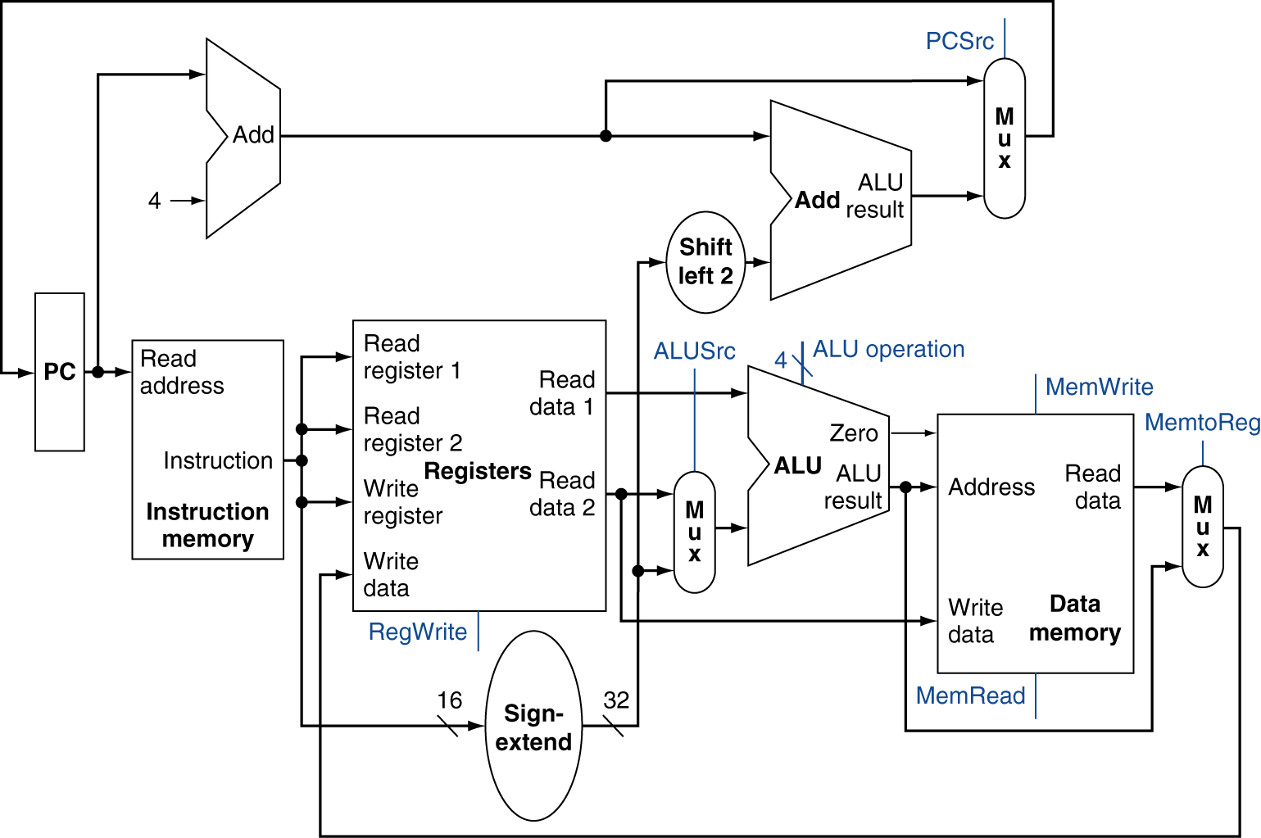
Review: Simple MIPS datapath
Chooses PC+4 or branch target
Chooses ALU output or memory output
Chooses register or sign-extended immediate
Computer Architecture Lecture 5

Slide 23
Review: Pipelining
Pipelining → low CPI and a short cycle
  Simultaneously execute multiple instructions
  Use multi-cycle “assembly line” approach
  Use staging registers between cycles to hold information
Hazards: situation that prevents instruction from executing during a particular cycle
  Structural hazards: hardware conflicts
  Data hazards: dependences cause instruction stalls; can resolve using:
    No-ops: compiler inserts stall cycles
    Forwarding: add hardware paths to ALU inputs
  Control hazards: must wait for branches
    Can move target, comparison into ID → only 1 cycle delay
Computer Architecture Lecture 6

Slide 24
Review: Pipeline diagram
 | Cycle 1 | 2 | 3 | 4 | 5 | 6 | 7 | 8
lw | IF | ID | EX | MEM | WB
add |  | IF | ID | EX | MEM | WB
beq |  |  | IF | ID | EX | MEM | WB
sw |  |  |  | IF | ID | EX | MEM | WB
Pipeline diagram shows execution of multiple instructions
  Instructions listed vertically
  Cycles shown horizontally
  Each instruction divided into stages
  Can see what instructions are in a particular stage at any cycle
Computer Architecture Lecture 6

Slide 25
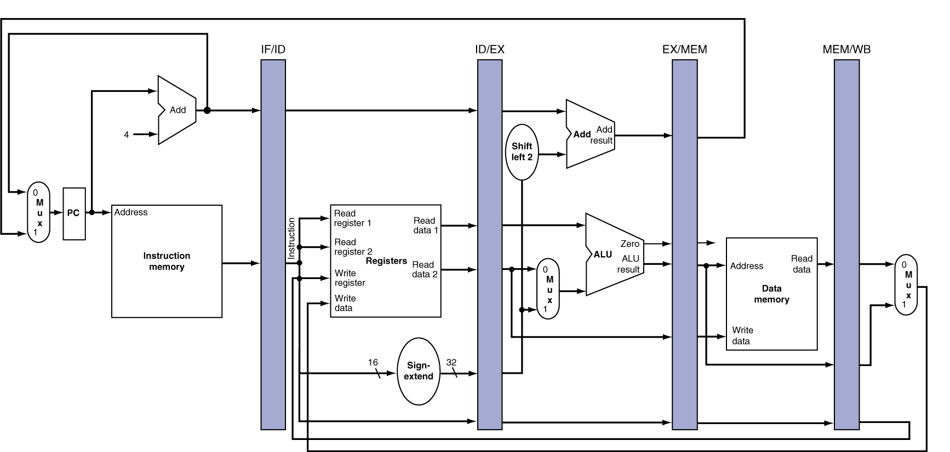
Review: Pipeline registers
Need registers between stages for info from previous cycles
Register must be able to hold all needed info for given stage
  For example, IF/ID must be 64 bits—32 bits for instruction, 32 bits for PC+4
May need to propagate info through multiple stages for later use
  For example, destination reg. number determined in ID, but not used until WB
Computer Architecture Lecture 6
Notes:
Morgan Kaufmann Publishers
Chapter 4 — The Processor

Slide 26
Review: Dynamic Branch Prediction
Want to avoid branch delays
Dynamic branch predictors: hardware to predict branch outcome (T/NT) in 1 cycle
  Use branch history to determine predictions
  Doesn’t calculate target
Branch history table: basic predictor
  Which line of table should we use?
    Use appropriate bits of PC to choose BHT entry
    # index bits = log₂(# BHT entries)
  What’s prediction?
  How does actual outcome affect next prediction?
M. Geiger CIS 570 Lec. 9

Slide 27
Review: BHT
Solution: 2-bit scheme where change prediction only if get misprediction twice
Red: “stop” (branch not taken)
Green: “go” (branch taken)
T
NT
Predict Taken
11
10
Predict Taken
T
T
NT
NT
Predict Not
Taken
01
00
Predict Not
Taken
T
NT
Computer Architecture Lecture 6

Slide 28
Review: Correlated predictors, BTB
Correlated branch predictors
  Track both individual branches and overall program behavior (global history)
    Makes some branches easier to predict
  To make a prediction
    Branch address chooses row
    Global history chooses column
    Once entry chosen, make prediction in same way as basic BHT (11/10 → predict T, 00/01→predict NT)
Branch target buffers
  Save previously calculated branch targets
  Use branch address to do fully associative search
M. Geiger CIS 570 Lec. 11

Slide 29
Review: Dynamic scheduling
Dynamic scheduling - hardware rearranges the instruction execution to reduce stalls while maintaining data flow and exception behavior
  Key idea: Allow instructions behind stall to proceed
  Allow out-of-order execution and out-of-order completion
  We use Tomasulo’s Algorithm
  Decode stage now handles:
    Issue—check for structural hazards and assign instruction to functional unit (via reservation station)
      Check for register values
  Reservation stations implicitly perform register renaming
    Resolves potential WAW, WAR hazards
  Results broadcast over common data bus
Computer Architecture Lecture 12

Slide 30
Review: Speculation
Hardware speculation, a technique with significant performance advantages, builds on dynamic scheduling
  Assume branch predictions are correct
    Speculate past control dependences
  Allow instructions to execute and complete out-of-order, but must commit in order
    Extra stage: when instructions commit, they update the register file or memory
    In-order commit also allows precise exceptions
    Reorder buffer maintains program order
      Also effectively replaces register file for in-flight instructions—instructions first check reorder buffer for operand values
Computer Architecture Lecture 12

Slide 31
Final notes
Next time
  Midterm exam
Reminders
  HW 4 due today
Computer Architecture Lecture 8

