Slide 1
16.482 / 16.561
Computer Architecture and Design
Instructor: Dr. Michael Geiger
Spring 2014
Lecture 7:
Multiple issue and multithreading
Memory hierarchies

Slide 2
Lecture outline
Announcements/reminders
  HW 5 to be posted; due 4/10
Today’s lecture
  Multiple issue and multithreading
  Memory hierarchy design
  Return midterm exams
Computer Architecture Lecture 7

Slide 3
Getting CPI below 1
CPI ≥ 1 if issue only 1 instruction every clock cycle
Multiple-issue processors come in 3 flavors:
  statically-scheduled superscalar processors,
  dynamically-scheduled superscalar processors, and
  VLIW (very long instruction word) processors
2 types of superscalar processors issue varying numbers of instructions per clock
  use in-order execution if they are statically scheduled, or
  out-of-order execution if they are dynamically scheduled
Computer Architecture Lecture 7

Slide 4
Performance beyond single thread ILP
There can be much higher natural parallelism in some applications
(e.g., Database or Scientific codes)
Explicit Thread Level Parallelism or Data Level Parallelism
Thread: process with own instructions and data
  thread may be a process part of a parallel program of multiple processes, or it may be an independent program
  Each thread has all the state (instructions, data, PC, register state, and so on) necessary to allow it to execute
Data Level Parallelism: Perform identical operations on data, and lots of data
Computer Architecture Lecture 7

Slide 5
Thread Level Parallelism (TLP)
ILP exploits implicit parallel operations within a loop or straight-line code segment
TLP explicitly represented by the use of multiple threads of execution that are inherently parallel
Goal: Use multiple instruction streams to improve
  Throughput of computers that run many programs
  Execution time of multi-threaded programs
TLP could be more cost-effective to exploit than ILP
Computer Architecture Lecture 7

Slide 6
New Approach: Mulithreaded Execution
Multithreading: multiple threads to share the functional units of 1 processor via overlapping
  processor must duplicate independent state of each thread e.g., a separate copy of register file, a separate PC, and for running independent programs, a separate page table
  memory shared through the virtual memory mechanisms, which already support multiple processes
  HW for fast thread switch; much faster than full process switch ≈ 100s to 1000s of clocks
When switch?
  Alternate instruction per thread (fine grain)
  When a thread is stalled, perhaps for a cache miss, another thread can be executed (coarse grain)
Computer Architecture Lecture 7

Slide 7
Fine-Grained Multithreading
Switch on each instruction
Usually done in a round-robin fashion, skipping any stalled threads
CPU must be able to switch threads every clock
Advantage: Hide both short/long stalls
Disadvantage: slows individual threads
Computer Architecture Lecture 7

Slide 8
Coarse-Grained Multithreading
Switches only on costly stalls, such as L2 cache misses
Advantages
  Relieves need to have very fast thread-switching
  Doesn’t slow down individual thread
Disadvantage: hard to overcome throughput losses on shorter stalls, due to pipeline start-up costs
  Since CPU issues instructions from 1 thread, when a stall occurs, the pipeline must be emptied or frozen
  New thread must fill pipeline before instructions can complete
Because of this start-up overhead, coarse-grained multithreading is better for reducing penalty of high cost stalls, where pipeline refill << stall time
Computer Architecture Lecture 7

Slide 9
Do both ILP and TLP?
TLP and ILP exploit two different kinds of parallel structure in a program
Could a processor oriented at ILP exploit TLP?
  Functional units are often idle in data path designed for ILP because of either stalls or dependences in the code
Could the TLP be used as a source of independent instructions that might keep the processor busy during stalls?
Could TLP be used to employ the functional units that would otherwise lie idle when insufficient ILP exists?
Computer Architecture Lecture 7

Slide 10
Simultaneous Multi-threading ...
One thread, 8 units
Two threads, 8 units
Cycle
M
M
FX
FX
FP
FP
BR
CC
Cycle
M
M
FX
FX
FP
FP
BR
CC
1
2
3
4
5
6
7
8
9
1
2
3
4
5
6
7
8
9
M = Load/Store, FX = Fixed Point, FP = Floating Point, BR = Branch, CC = Condition Codes
Computer Architecture Lecture 7

Slide 11
Simultaneous Multithreading (SMT)
Simultaneous multithreading (SMT): insight that dynamically scheduled processor already has many HW mechanisms to support multithreading
  Large set of virtual registers that can be used to hold the register sets of independent threads
  Register renaming provides unique register identifiers, so instructions from multiple threads can be mixed in datapath without confusing sources and destinations across threads
  Out-of-order completion allows the threads to execute out of order, and get better utilization of the HW
Just adding a per thread renaming table and keeping separate PCs
  Independent commitment can be supported by logically keeping a separate reorder buffer for each thread
Computer Architecture Lecture 7
Source: Microprocessor Report, December 6, 1999
“Compaq Chooses SMT for Alpha”

Slide 12
Multithreaded Categories
Simultaneous
Multithreading
Time (processor cycle)
Superscalar
Fine-Grained
Coarse-Grained
Multiprocessing
Thread 1
Thread 3
Thread 5
Thread 2
Thread 4
Idle slot
Computer Architecture Lecture 7

Slide 13
Design Challenges in SMT
Since SMT makes sense only with fine-grained implementation, impact of fine-grained scheduling on single thread performance?
  A preferred thread approach sacrifices neither throughput nor single-thread performance (?)
  Unfortunately, with a preferred thread, the processor is likely to sacrifice some throughput, when preferred thread stalls
Larger register file needed to hold multiple contexts
Not affecting clock cycle time, especially in
  Instruction issue - more candidate instructions need to be considered
  Instruction completion - choosing which instructions to commit may be challenging
Ensuring that cache and TLB conflicts generated by SMT do not degrade performance
Computer Architecture Lecture 7

Slide 14
Multithreading examples
Assume processor with following characteristics
  4 functional units
    2 ALU
    1 memory port (either load or store)
    1 branch
  In-order scheduling
Given 3 threads, show execution using
  Fine-grained multithreading
  Coarse-grained multithreading
    Assume any stall longer than 2 cycles causes switch
  Simultaneous multithreading
    Thread 1 is preferred, followed by Thread 2 & Thread 3
Assume any two instructions without stalls between them are independent
Computer Architecture Lecture 7

Slide 15
Motivating memory hierarchies
Why do we need out-of-order scheduling, TLP, etc?
  Data dependences cause stalls
  The longer it takes to satisfy a dependence, the longer the stall and the harder we have to work to find independent instructions to execute
Major source of stall cycles: memory accesses
Computer Architecture Lecture 7

Slide 16
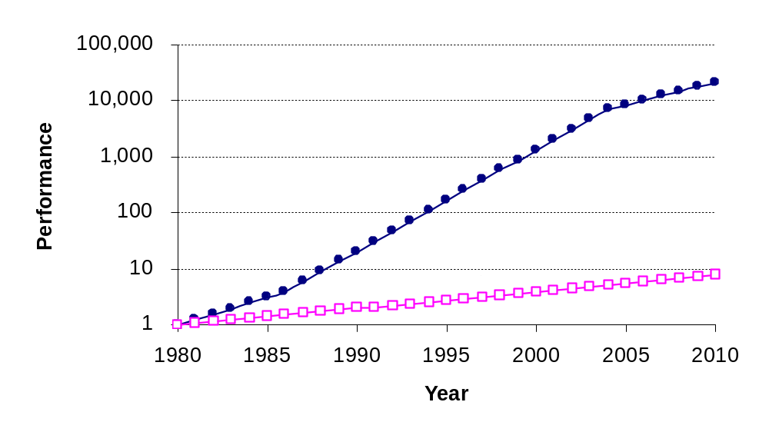
Why care about memory hierarchies?
Processor-Memory
Performance Gap
Growing
Major source of stall cycles: memory accesses
Computer Architecture Lecture 7
Notes:
Y-axis is performance
X-axis is time
Latency
Cliché:
Not e that x86 didn’t have cache on chip until 1989

Slide 17
Motivating memory hierarchies
What characteristics would we like memory to have?
  High capacity
  Low latency
  Low cost
Can’t satisfy these requirements with one memory technology
Solution: use a little bit of everything!
  Small SRAM array(s) → caches
    Small means fast and cheap
    Typically at least 2 levels (often 3) of cache on chip
  Larger DRAM array → main memory or RAM
    Hope you rarely have to use it
  Extremely large disk
    Costs are decreasing at a faster rate than we fill them
Computer Architecture Lecture 7

Slide 18
Memory hierarchy analogy
Looking for something to eat
  First step: check the refrigerator
    Find item → eat!
    Latency = 1 minute
  Second step: go to the store
    Find item → purchase it, take it home, eat!
    Latency = 20-30 minutes
  Third step: grow food
    Plant food, wait … wait some more … harvest, eat
    Latency = ~250,000 minutes (~6 months)
Computer Architecture Lecture 7

Slide 19
Terminology
Find data you want at a given level: hit
Data is not present at that level: miss
  In this case, check the next lower level
Hit rate: Fraction of accesses that hit at a given level
  (1 – hit rate) = miss rate
Another performance measure: average memory access time
AMAT = (hit time) + (miss rate) x (miss penalty)
Computer Architecture Lecture 7

Slide 20
Average memory access time
Given the following:
  Cache: 1 cycle access time
  Memory: 100 cycle access time
  Disk: 10,000 cycle access time
  What is the average memory access time if the cache hit rate is 90% and the memory hit rate is 80%?
Computer Architecture Lecture 7

Slide 21
AMAT example solution
Key point: miss penalty = AMAT_{next} _{level}
Therefore:
AMAT = (HT) + (MR)(MP)
= 1 + (0.1)(AMAT_{memory})
= 1 + (0.1)[100 + (0.2)(AMAT_{disk})]
= 1 + (0.1)[100 + (0.2)(10,000)]
= 1 + (0.1)[100 + 2000]
= 1 + (0.1)[2100]
= 1 + 210 = 211 cycles
Computer Architecture Lecture 7

Slide 22
Memory hierarchy operation
We’d like most accesses to use the cache
  Fastest level of the hierarchy
But, the cache is much smaller than the address space
Most caches have a hit rate > 80%
  How is that possible?
  Cache holds data most likely to be accessed
Computer Architecture Lecture 7

Slide 23
Principle of locality
Programs don’t access data randomly—they display locality in two forms
  Temporal locality: if you access a memory location (e.g., 1000), you are more likely to re-access that location than some random location
  Spatial locality: if you access a memory location (e.g., 1000), you are more likely to access a location near it (e.g., 1001) than some random location
Computer Architecture Lecture 7

Slide 24
Basic cache design
Each cache line consists of two main parts
  Tag: Upper bits of memory address
    Bits that uniquely identify a given block
    Check tag on each access to determine hit or miss
  Block: Actual data
    Block sizes can vary—typically 32 to 128 bytes
    Larger blocks exploit spatial locality
  Status bits
    Valid bit: Indicates if line holds valid data
    We’ll discuss dirty bit today; other bits in multiprocessors
Valid | Dirty | Tag | Block
1 | 0 | 0x1000 | 0x00 | 0x12 | 0x34 | 0x56
0 | 0 | 0x2234 | 0xAB | 0xCD | 0x87 | 0xA9
Computer Architecture Lecture 7

Slide 25
Cache organization
Cache consists of multiple tag/block pairs, called cache lines
  Can search lines in parallel (within reason)
  Each line also has a valid bit
  Write-back caches have a dirty bit
Note that block sizes can vary
  Most systems use between 32 and 128 bytes
  Larger blocks exploit spatial locality
  Larger block size → smaller tag size
Computer Architecture Lecture 7

Slide 26
4 Questions for Memory Hierarchy
Q1: Where can a block be placed in the upper level?
  (Block placement)
Q2: How is a block found if it is in the upper level?
  (Block identification)
Q3: Which block should be replaced on a miss?
  (Block replacement)
Q4: What happens on a write?
  (Write strategy)
Computer Architecture Lecture 7

Slide 27
Q1: Block placement (cont.)
Three alternatives
  Place block anywhere in cache: fully associative
    Impractical for anything but very small caches
  Place block in a single location: direct mapped
    Line # = (Block #) mod (# lines) = index field of address
    Block # = (Address) / (block size)
      In other words, all bits of address except offset
  Place block in a restricted set of locations: set associative
    n-way set associative cache has n lines per set
    Set # = (Block #) mod (# sets) = index field of address
Computer Architecture Lecture 7

Slide 28
Block placement example
Given:
  A cache with 16 lines numbered 0-15
  Main memory that holds 2048 blocks of the same size as each cache block
Determine which cache line(s) will be used for each of the memory blocks below, if the cache is (i) direct-mapped, or (ii) 4-way set associative
  Block 0
  Block 13
  Block 249
Computer Architecture Lecture 7

Slide 29
Solution
Cache line # = (block #) mod (# sets)
  “mod” = remainder of division (e.g., 5 mod 3 = 2)
  Direct-mapped cache: 1 line per “set”
    Block 0 → line (0 mod 16) = 0
    Block 13 → line (13 mod 16) = 12
    Block 249 → line (249 mod 16) = 9
      249 / 16 = 15 R9
  4-way SA cache: 4 lines per set → 4 total sets
    Block 0 → set (0 mod 4) = lines 0-3
    Block 12 → set (13 mod 4) = set 1 = lines 4-7
    Block 249 → set (249 mod 4) = set 1 = lines 4-7
Computer Architecture Lecture 7

Slide 30
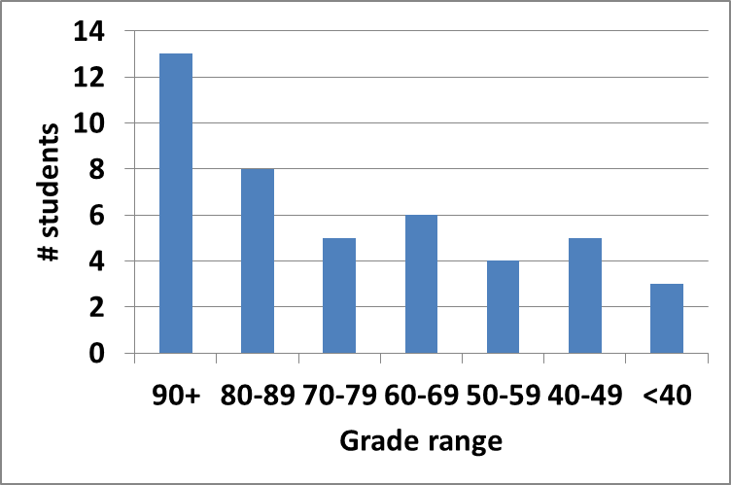
Exam stats & grade distribution
Average: 83.7
Median: 87
Std. deviation: 16.1
Max: 100 (x3)
Question-by-question averages:
  Q1: 10.7 / 12 (89%)
  Q2: 13.2 / 14 (94%)
  Q3: 15.9 / 18 (88%)
  Q4: 12.3 / 14 (88%)
  Q5: 17.3 / 20 (87%)
  Q6: 14.3 / 22 (65%)
Computer Architecture: Midterm exam stats

Slide 31
Final notes
Next time
  Finish memory hierarchy discussion
Reminders
  HW 5 to be posted; due 4/10
Computer Architecture Lecture 7

