Slide 1
16.482 / 16.561
Computer Architecture and Design
Instructor: Dr. Michael Geiger
Spring 2015
Lecture 7:
Multithreading
Midterm exam review

Slide 2
Lecture outline
Announcements/reminders
  HW 6 to be posted; due 3/26
  No class next week (Spring break)
  May have to reschedule final (traveling 4/30)
    Options:
      Second to last lecture (4/23)
      Finals week (5/7)
Today’s lecture
  Multiple issue and multithreading
  Return midterm exams
Computer Architecture Lecture 7

Slide 3
Getting CPI below 1
CPI ≥ 1 if issue only 1 instruction every clock cycle
Multiple-issue processors come in 3 flavors:
  statically-scheduled superscalar processors,
  dynamically-scheduled superscalar processors, and
  VLIW (very long instruction word) processors
2 types of superscalar processors issue varying numbers of instructions per clock
  use in-order execution if they are statically scheduled, or
  out-of-order execution if they are dynamically scheduled
Computer Architecture Lecture 7

Slide 4
Performance beyond single thread ILP
There can be much higher natural parallelism in some applications
(e.g., Database or Scientific codes)
Explicit Thread Level Parallelism or Data Level Parallelism
Thread: process with own instructions and data
  thread may be a process part of a parallel program of multiple processes, or it may be an independent program
  Each thread has all the state (instructions, data, PC, register state, and so on) necessary to allow it to execute
Data Level Parallelism: Perform identical operations on data, and lots of data
Computer Architecture Lecture 7

Slide 5
Thread Level Parallelism (TLP)
ILP exploits implicit parallel operations within a loop or straight-line code segment
TLP explicitly represented by the use of multiple threads of execution that are inherently parallel
Goal: Use multiple instruction streams to improve
  Throughput of computers that run many programs
  Execution time of multi-threaded programs
TLP could be more cost-effective to exploit than ILP
Computer Architecture Lecture 7

Slide 6
New Approach: Mulithreaded Execution
Multithreading: multiple threads to share the functional units of 1 processor via overlapping
  processor must duplicate independent state of each thread e.g., a separate copy of register file, a separate PC, and for running independent programs, a separate page table
  memory shared through the virtual memory mechanisms, which already support multiple processes
  HW for fast thread switch; much faster than full process switch ≈ 100s to 1000s of clocks
When switch?
  Alternate instruction per thread (fine grain)
  When a thread is stalled, perhaps for a cache miss, another thread can be executed (coarse grain)
Computer Architecture Lecture 7

Slide 7
Fine-Grained Multithreading
Switch on each instruction
Usually done in a round-robin fashion, skipping any stalled threads
CPU must be able to switch threads every clock
Advantage: Hide both short/long stalls
Disadvantage: slows individual threads
Computer Architecture Lecture 7

Slide 8
Coarse-Grained Multithreading
Switches only on costly stalls, such as L2 cache misses
Advantages
  Relieves need to have very fast thread-switching
  Doesn’t slow down individual thread
Disadvantage: hard to overcome throughput losses on shorter stalls, due to pipeline start-up costs
  Since CPU issues instructions from 1 thread, when a stall occurs, the pipeline must be emptied or frozen
  New thread must fill pipeline before instructions can complete
Because of this start-up overhead, coarse-grained multithreading is better for reducing penalty of high cost stalls, where pipeline refill << stall time
Computer Architecture Lecture 7

Slide 9
Do both ILP and TLP?
TLP and ILP exploit two different kinds of parallel structure in a program
Could a processor oriented at ILP exploit TLP?
  Functional units are often idle in data path designed for ILP because of either stalls or dependences in the code
Could the TLP be used as a source of independent instructions that might keep the processor busy during stalls?
Could TLP be used to employ the functional units that would otherwise lie idle when insufficient ILP exists?
Computer Architecture Lecture 7

Slide 10
Simultaneous Multi-threading ...
One thread, 8 units
Two threads, 8 units
Cycle
M
M
FX
FX
FP
FP
BR
CC
Cycle
M
M
FX
FX
FP
FP
BR
CC
1
2
3
4
5
6
7
8
9
1
2
3
4
5
6
7
8
9
M = Load/Store, FX = Fixed Point, FP = Floating Point, BR = Branch, CC = Condition Codes
Computer Architecture Lecture 7

Slide 11
Simultaneous Multithreading (SMT)
Simultaneous multithreading (SMT): insight that dynamically scheduled processor already has many HW mechanisms to support multithreading
  Large set of virtual registers that can be used to hold the register sets of independent threads
  Register renaming provides unique register identifiers, so instructions from multiple threads can be mixed in datapath without confusing sources and destinations across threads
  Out-of-order completion allows the threads to execute out of order, and get better utilization of the HW
Just adding a per thread renaming table and keeping separate PCs
  Independent commitment can be supported by logically keeping a separate reorder buffer for each thread
Computer Architecture Lecture 7
Source: Microprocessor Report, December 6, 1999
“Compaq Chooses SMT for Alpha”

Slide 12
Multithreaded Categories
Simultaneous
Multithreading
Time (processor cycle)
Superscalar
Fine-Grained
Coarse-Grained
Multiprocessing
Thread 1
Thread 3
Thread 5
Thread 2
Thread 4
Idle slot
Computer Architecture Lecture 7

Slide 13
Design Challenges in SMT
Since SMT makes sense only with fine-grained implementation, impact of fine-grained scheduling on single thread performance?
  A preferred thread approach sacrifices neither throughput nor single-thread performance (?)
  Unfortunately, with a preferred thread, the processor is likely to sacrifice some throughput, when preferred thread stalls
Larger register file needed to hold multiple contexts
Not affecting clock cycle time, especially in
  Instruction issue - more candidate instructions need to be considered
  Instruction completion - choosing which instructions to commit may be challenging
Ensuring that cache and TLB conflicts generated by SMT do not degrade performance
Computer Architecture Lecture 7

Slide 14
Multithreading examples
Assume processor with following characteristics
  4 functional units
    2 ALU
    1 memory port (either load or store)
    1 branch
  In-order scheduling
Given 3 threads, show execution using
  Fine-grained multithreading
  Coarse-grained multithreading
    Assume any stall longer than 2 cycles causes switch
  Simultaneous multithreading
    Thread 1 is preferred, followed by Thread 2 & Thread 3
Assume any two instructions without stalls between them are independent
Computer Architecture Lecture 7

Slide 15
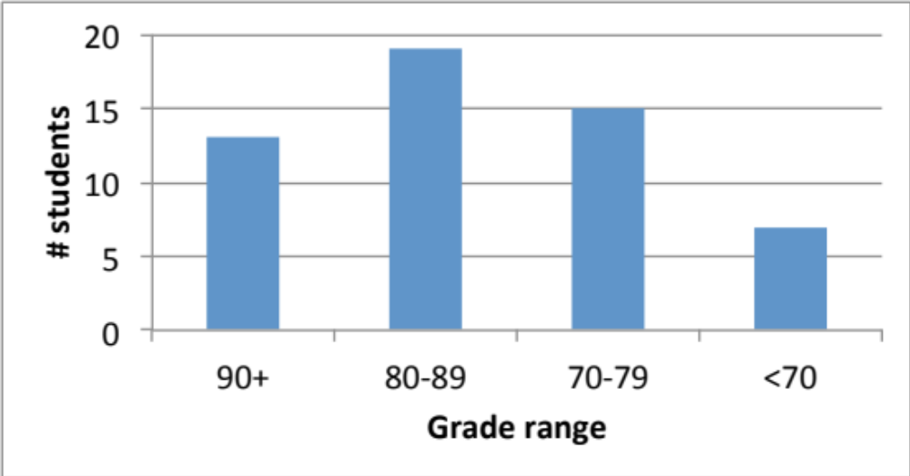
Exam stats & grade distribution
Average: 80.1
  16.482: 77.3
  16.561: 81.2
Median: 84.75
Std. deviation: 13.8
Max: 98
Question-by-question averages:
  Q1: 6.9 / 8 (86%)
  Q2: 13.5 / 16 (85%)
  Q3: 18.4 / 20 (92%)
  Q4: 12.7 / 16 (80%)
  Q5: 16.9 / 21 (80%)
  Q6: 11.6 / 19 (61%)
ECE Application Programming: Lecture 14

Slide 16
Final notes
Next time
  Memory hierarchies (Thursday, 3/26)
Reminders
  HW 6 to be posted; due 3/26
  No class next week (Spring break)
  May have to reschedule final (traveling 4/30)
    Options:
      Second to last lecture (4/21)
      Finals week (5/7)
Computer Architecture Lecture 7

