Slide 1
EECE.3170
Microprocessor Systems Design I
Instructors: Dr. Lin Li & Dr. Michael Geiger
Fall 2019
Lecture 37:
Exam 3 Preview

Slide 2
Lecture outline
Announcements/reminders
  “Extra credit” HW: only count top 5 HW grades
    Lowest score = extra credit
  Exam 3: Wednesday, 12/18, 6:30-9:30 PM
    Will need to complete course eval prior to exam
    Eval online; hard copies also available in class today or from your instructor’s office
    Room assignments
      Ball 314: Students in Sec. 202 (Dr. Geiger) with last names starting with A-P
      Ball 326: All students in Sec. 201 (Dr. Li) + students in Sec. 202 with last names starting with R-Z
Today’s lecture: Exam 3 Preview
Microprocessors I: Lecture 37

Slide 3
Exam 3 notes
Allowed
  One 8.5” x 11” double-sided sheet of notes
  Calculator
No other notes, electronic devices (phone, laptop, etc.)
Instruction list available online
Exam will last three hours
  Will be written for ~1 hour, but can use whole period
Covers PIC programming material (Lec. 25-36)
  When studying old exams, look at old Exam 2 & 3
Format similar to previous exams
  Multiple choice questions
  Code sequences to evaluate
  Code sequences to be written
Microprocessors I: Lecture 37

Slide 4
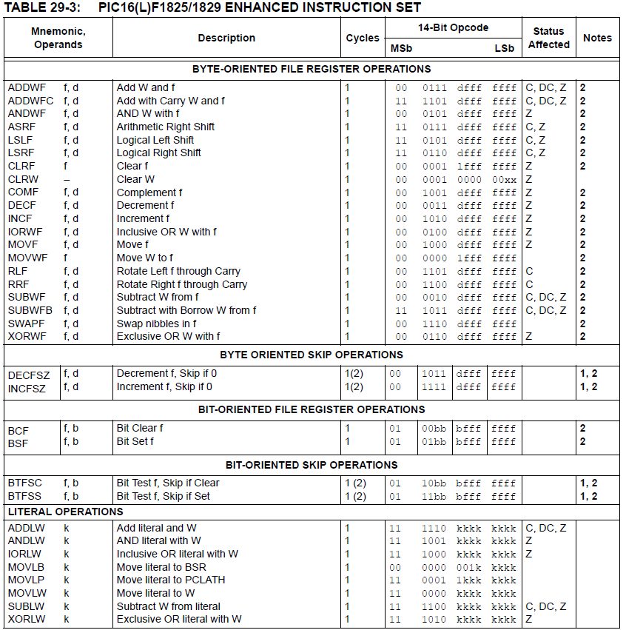
Microprocessors I: Lecture 37

Slide 5
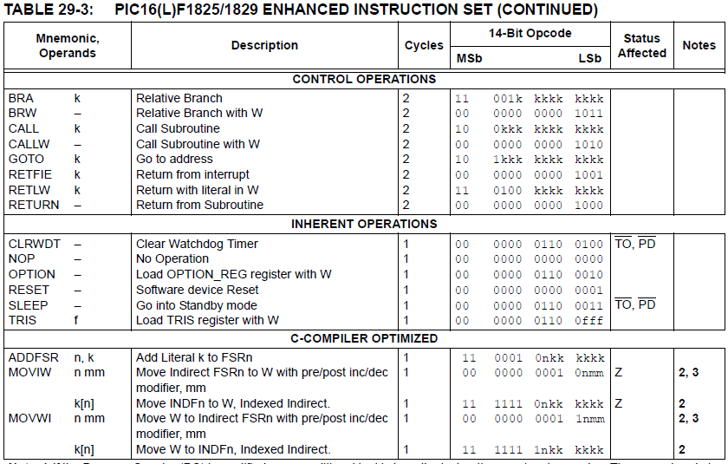
Microprocessors I: Lecture 37

Slide 6
Review: PIC instructions (cont.)
Clearing register: clrw/clrf
Moving values: movlw/movwf/movf
Swap nibbles: swapf
Single bit manipulation: bsf/bcf
Unary operations: incf/decf/comf
Arithmetic: addlw/addwf/addwfc/
sublw/subwf/subwfb
Microprocessors I: Lecture 37

Slide 7
Review: PIC instructions (cont.)
Logical operations
  andlw/andwf
  iorlw/iorwf
  xorlw/xorwf
Rotates/shifts
  rrf/lsrf/asrf
  rlf/lslf
Jumps/calls/return
  goto/bra
  call
  return/retlw/retfie
Conditional execution
  Test bit and skip next instruction if clear/set: btfsc/btfss
  Increment/decrement register and skip next instruction if zero: incfsz/decfsz
Example use: combined with goto to create conditional jump
Microprocessors I: Lecture 37

Slide 8
Review: complex operations
Multiple registers
  Data must be transferred through working register
Conditional jumps
  Usually btfsc/btfss instruction + goto
  Equality/inequality—use subtract in place of CMP
  If you subtract X – Y:
    X > Y → Z = 0, C = 1
    X == Y → Z = 1, C = 1
    X < Y → Z = 0, C = 0
    X <= Y → Z == C
    X != Y → Z = 0
    X >= Y → C = 1
Shift/rotate
  Manipulate carry before operation (or appropriate bit after)
  Use loop for multi-bit shift/rotate
Microprocessors I: Lecture 37

Slide 9
Review: Multi-byte data
Logical operations can be done byte-by-byte
Arithmetic and shift/rotate operations require you to account for data flow between bytes
  Carry/borrow in arithmetic
    Addition: if carry from lower byte, increment one of the upper bytes (addwfc)
    Subtraction: if borrow from lower byte, decrement one of the upper bytes (subwfb)
  Bit shifted between bytes in shift/rotate
    Performing instructions in correct order ensures bit transferred correctly through C bit
    All instructions after first one must be rrf/rlf
    Rotate/shift left: start with LSB
    Rotate/shift right: start with MSB
Microprocessors I: Lecture 37

Slide 10
Review: PICkit example programs
Be comfortable with the following:
  Working with I/O ports
    Configuring as inputs (1)/outputs (0) using TRISx
    Writing using LATx
    Reading using PORTx
  Delay
    Instruction count-based
    Timer-based
  Interrupts
    General setups
    Specific ones we covered (timer, negative edge)
Microprocessors I: Lecture 37

Slide 11
Final notes
Next time:
  Exam 3
Reminders:
  “Extra credit” HW: only count top 5 HW grades
    Lowest score = extra credit
  Exam 3: Wednesday, 12/18, 6:30-9:30 PM
    Will need to complete course eval prior to exam
    Eval online; hard copies also available in class today or from your instructor’s office
    Room assignments
      Ball 314: Students in Sec. 202 (Dr. Geiger) with last names starting with A-P
      Ball 326: All students in Sec. 201 (Dr. Li) + students in Sec. 202 with last names starting with R-Z
Microprocessors I: Lecture 37

