Slide 1
EECE.4810/EECE.5730 Operating Systems
Instructor:
Dr. Michael Geiger
Spring 2018
Lecture 9:
Synchronization (continued)

Slide 2
Lecture outline
Announcements/reminders
Program 2 to be posted; due 3/19
3/19 = Monday after Spring Break
Start the program early!
No Thursday office hours this week
If normal office hours don’t work, please make an appointment for another day
Today’s lecture
Program 2 intro
More on synchronization
Monitors
Semaphores
Deadlock

Slide 3
Program 2: MT producer-consumer
Extend producer-consumer problem to incorporate synchronization
Multithreaded, not multiprocess
Increasing degrees of complexity
1 producer followed by 1 consumer
MT adaptation of IPC example
Concurrent multithreaded solutions
1 producer, 1 consumer
1 producer, N consumers
M producers, N consumers

Slide 4
Program 2: MT producer-consumer
Use Pthread library for implementation
Locks: pthread_mutex_t type
Must initialize/destroy lock at start/end
Functions
pthread_mutex_lock(&lock)
pthread_mutex_unlock(&lock)
Condition variables: pthread_cond_t type
Must initialize/destroy CV at start/end
Functions
pthread_cond_wait(&CV, &lock)
pthread_cond_signal(&CV)
pthread_cond_broadcast(&CV)
Implement bounded buffer monitor
Shared data + synchronization primitives

Slide 5
Synchronization types
Mutual exclusion
Ensures only one thread in critical section
“Not at the same time”
lock/unlock
Condition variables
Used when one thread must wait for another to do something
“Before/after”
dequeue() must wait for enqueue() if empty

Slide 6
Monitors
Combine two types of synchronization
Lock for mutual exclusion
Condition variables for ordering constraints
Monitor = shared data + 1+ locks + CVs associated with lock
In OOP, “shared objects”

Slide 7
Programming with monitors
List shared data needed for problem
Assign locks to each group of shared data
Enforces mutual exclusion
Assign condition variables for every condition thread holding lock may have to wait on
Before/after conditions: while (!condition) wait
Call signal() or broadcast() when thread changes something another thread might be waiting for
Need queue of threads associated with every lock, condition variable
Implicitly handled in common thread libraries

Slide 8
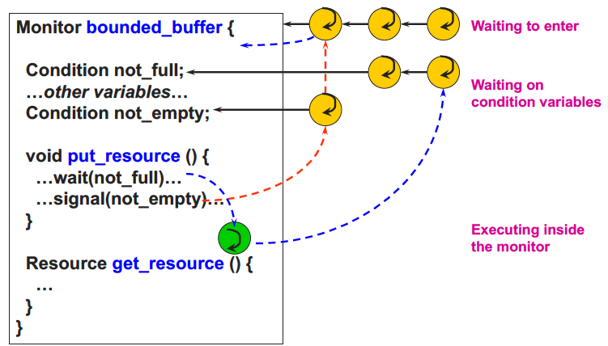
Monitor queues

Slide 9
Typical monitor programming
lock
while (!condition) {
wait
}
do work
signal other thread(s) about work
unlock

Slide 10
Semaphores
Generalized lock/unlock
Definition
Integer initialized to user-specific value
Supports two atomic operations
down(): wait for semaphore value to become positive, then atomically decrement by 1
Sometimes called wait(); originally P()
To avoid busy waiting, semaphore can maintain list of waiters
Process calls block() once added to list
up(): increment semaphore value
Sometimes called signal(); originally V()
If maintaining list, remove process from list and wake up
wakeup() call signals blocked process

Slide 11
Using semaphores
Semaphore types
Counting semaphore: Range of values unrestricted
Binary semaphore: values == 0 or 1 (same as lock)
Can implement both mutual exclusion and ordering
Mutual exclusion
Initialize semaphore to 1
down();
critical section
up();
Ordering
Typically initialize to 0
Say thread A must wait for thread B
Thread A Thread B
down(); complete task
continue work up();

Slide 12
Semaphore example
Servers often designed to limit max # number of connections
Accept up to N connections
Other requests wait if max # has been reached
How can semaphores be used to limit the number of simultaneous connections?

Slide 13
Example solution
Single semaphore initialized to max #
Each connection request: call down()
Any request > max # will block
Each released connection: call up()
Semaphore increments
One blocked request allowed to proceed

Slide 14
Producer-consumer with semaphores
Need three semaphores
mutex: ensures mutual exclusion around code manipulating buffer
full: counts number of full slots in buffer
Initialized to 0
empty: counts number of empty slots in buffer
Initialized to maximum value

Slide 15
Producer-consumer with semaphores (2)
Producer
add Coke
Consumer
take coke

Slide 16
Producer-consumer with semaphores (3)
Producer
down(empty)
down(mutex)
add Coke
up(mutex)
up(full)
Consumer
down(full)
down(mutex)
take Coke
up(mutex)
up(empty)

Slide 17
Readers-Writers Problem
A data set is shared among a number of concurrent processes
Readers – only read the data set; they do not perform any updates
Writers – can both read and write
Problem – allow multiple readers to read at the same time
Only one single writer can access the shared data at the same time
Shared Data
Data set
Semaphore rw_mutex initialized to 1
Semaphore mutex initialized to 1
Integer read_count initialized to 0

Slide 18
Readers-Writers Problem (Cont.)
The structure of a writer process
do { down(rw_mutex);
... /* writing is performed */
...
up(rw_mutex);
} while (true);

Slide 19
Readers-Writers Problem (Cont.)
The structure of a reader process
do { down(mutex); read_count++; if (read_count == 1)
down(rw_mutex);
up(mutex);
... /* reading is performed */
...
down(mutex); read count--; if (read_count == 0)
up(rw_mutex);
up(mutex);
} while (true);

Slide 20
Readers-Writers Problem notes
mutex used to restrict access to read_count variable
rw_mutex uses:
Ensure only one writer active at a time
Decremented by 1st reader to enter critical section
Prevents writer from overwriting data as it’s read
Incremented by last reader to exit critical section
Allows writer to update data again
If writer is writing and n readers waiting
1 reader waiting on rw_mutex
n-1 readers waiting on mutex

Slide 21
Comparing monitors/semaphores
Semaphores provide 1 mechanism for both mutual exclusion and ordering, while monitors use separate mechanisms for each
Elegant mechanism
Can be difficult to use
Monitor lock = binary semaphore (init to 1)
lock() = down()
unlock() = up()

Slide 22
Comparing CVs/semaphores
Condition variable
while (cond) {wait();}
Conditional code in user program
User writes customized condition → more flexible
User provides shared var and protects with lock
No memory of past signals
Semaphore
down()
Conditional code in semaphore definition
Condition specified by semaphore definition
Semaphore provides shared var (int) and thread-safe ops (down, up)
Remembers past up calls

Slide 23
Final notes
Next time
Deadlock
Reminders:
Program 2 to be posted; due 3/19
3/19 = Monday after Spring Break
Start the program early!
No Thursday office hours this week
If normal office hours don’t work, please make an appointment for another day

Slide 24
Acknowledgements
These slides are adapted from the following sources:
Silberschatz, Galvin, & Gagne, Operating Systems Concepts, 9th edition
Chen & Madhyastha, EECS 482 lecture notes, University of Michigan, Fall 2016
Pthread example programs obtained from: https://computing.llnl.gov/tutorials/pthreads/

